Slide 1
Chapter 4
Object-Oriented Programming
with C#

Slide 2
Objectives
Understanding the C# Class type
How to do encapsulation
How to do inheritance
Polymorphism with C#

Slide 3
Content
Reviewing the pillars of OOP
The C# Class type
C#’s Encapsulation services
C#’s Inheritance and Polymorphism support

Slide 4
Reviewing the pillars of OOP
Encapsulation: How does this language hide an object's internal implementation?
Inheritance: How does this language promote code reuse?
Polymorphism: How does this language let you treat related objects in a similar way?

Slide 5
Reviewing the pillars of OOP
Member variables and methods
Constructors and Destructors
Method overloading
“Is a kind of” and “Has-a” relationships
Base class and Derived class

Slide 6
The C# class type
A class is a custom user-defined type (UDT) that is composed of field data and functions
Can define any number of constructors
Support destructor
Can define a C# type across multi file *.cs files
this keyword

Slide 7
The C# class type
Public interface
  Refers to the set of members that are directly accessible from an object variable via the dot operator
  Is any item declared in a class using the public keyword
  May be populated by: methods, properties and constant/read-only fields

Slide 8
C#’s Encapsulation services
The concept of encapsulation revolves around the notion that an object’s field data should not be directly accessible from the public interface
Two main techniques:
  Define a pair of traditional accessor and mutator methods
  Define a named property

Slide 9
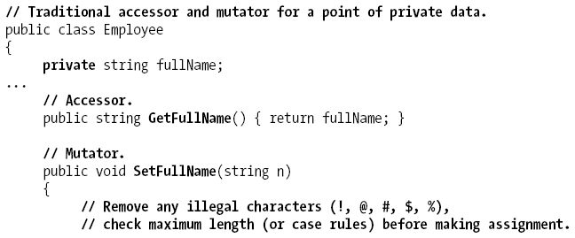

C#’s Encapsulation services
Enforcing Encapsulation Using Traditional Accessors and Mutators

Slide 10
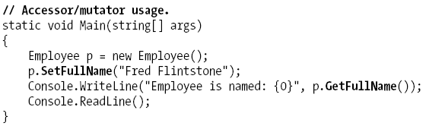
C#’s Encapsulation services
Enforcing Encapsulation Using Traditional Accessors and Mutators

Slide 11
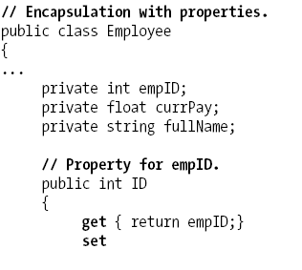
C#’s Encapsulation services
Another Form of Encapsulation: Class Properties

Slide 12
C#’s Encapsulation services
Read-only properties are properties without a corresponding set block
Write-only properties are properties without a corresponding get block
Static properties are properties that are accessed at the class level, not from an instance of that class

Slide 13
C#’s Inheritance and Polymorphic support
Override methods
  Is an instance method declaration includes an override modifier
Overridden base method
  Is a method overridden by an override declaration
  Is a virtual, abstract, or override method
Override method and overridden base method
  Have the same return type
  Have the same declared accessibility

Slide 14
C#’s Inheritance and Polymorphic support
base keyword
  Used to access the members of a base class from within a derived class
  Used to call constructors of a base class while creating an instance of a derived class
  Using the keyword base in a static method will result in an error.

Slide 15
C#’s Inheritance and Polymorphic support
override keyword
  Used to modify a method
  An override method provides a new implementation of the base method. The base method should be declared as virtual
  Accessibility level of a base method cannot be changed by a method overriding it
  Keyword new, static, virtual cannot be used along with override modifier
  (Read more at page 162, Main book)

Slide 16
C#’s Inheritance and Polymorphic support
virtual keyword
  Is used in the definition of a method to support polymorphism
  Used to modify method declaration in a class
  Child classes are free to implement their own versions of virtual method using override keyword
  Virtual modifier cannot used with modifiers like static and override
  (Read more at page 162, Main book)

Slide 17
C#’s Inheritance and Polymorphic support
new keyword
  Used as an operator or as a modifier
  new modifier is used to explicitly hide a member that is inherited from the base class
  It is an error to use both new and override on the same method
  (Read more at page 169, Main book)

Slide 18
C#’s Inheritance and Polymorphic support
Sealing a class
  A class is sealed when no class should be allowed to inherit from that class
  Keyword sealed is used to seal a class
  (Read more at page 158, Main book)

Slide 19
Q & A

