Slide 1
REMS -------- Real Estate Management System
Group 6
- Fakunle Mayowa Samuel

Slide 2
REMS - Real Estate Management System
REMS helps its user manage any real estate property.
Real estate management is the operation, control, and oversight of real estate as used in its most broad terms. Management indicates a need to be cared for, monitored and accountability given for its useful life and condition. This is much akin to the role of management in any business.
Real estate management is also the management of personal property, equipment, tooling and physical capital assets that are acquired and used to build, repair and maintain end item deliverables. Property management involves the processes, systems and manpower required to manage the life cycle of all acquired property as defined above including acquisition, control, accountability, responsibility, maintenance, utilization and disposition.

Slide 3
REMS - Real Estate Manager
Log In
Add new property
Search Property
Edit property details
Add new property owner
Search Property owner
Edit property owner details
Add new tenant
Search tenant
Edit tenant details
Check personal details
Edit personal details

Slide 4
REMS – Property Owner / Landlord
Log In
Search Property
Edit property details
Check personal details
Edit personal details

Slide 5
REMS - Real Estate Tenant
Log In
Check personal details
Edit personal details
Search New Property to rent

Slide 6
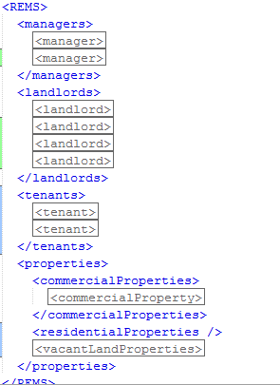

Slide 7
Properties
Properties haves
Address
Price
Description
Status (Sold,Lease,Available..)
Landlord
Vacant Land | Residential | Commercial
Size | No of Rooms | Building
 | Living Area | Type
 | Type

Slide 8
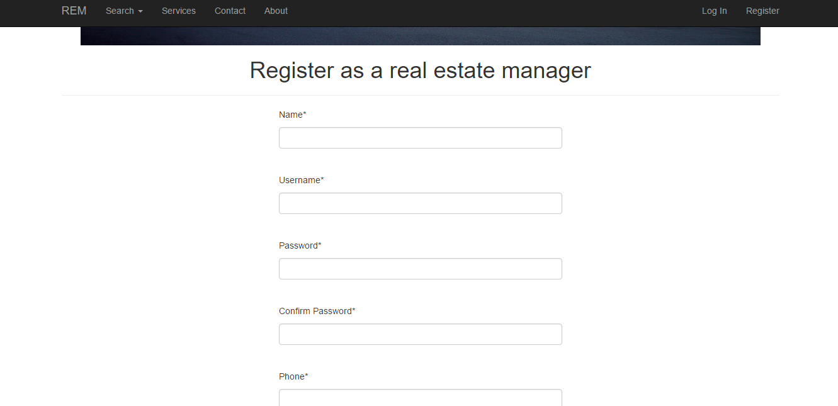
Register

Slide 9
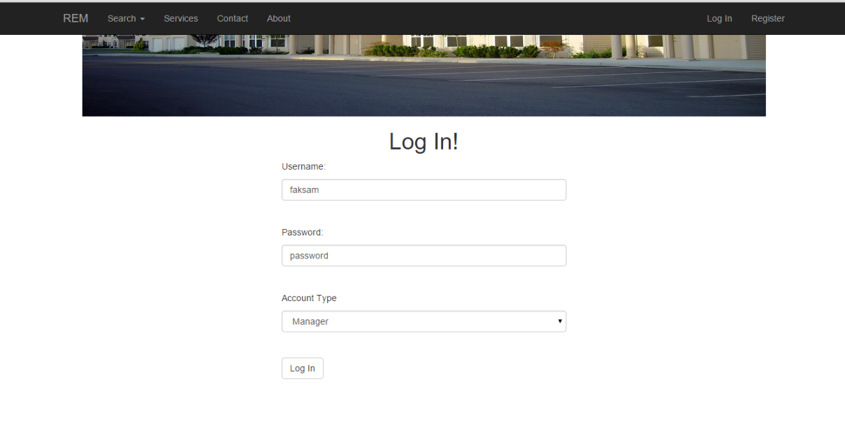
Log In

Slide 10
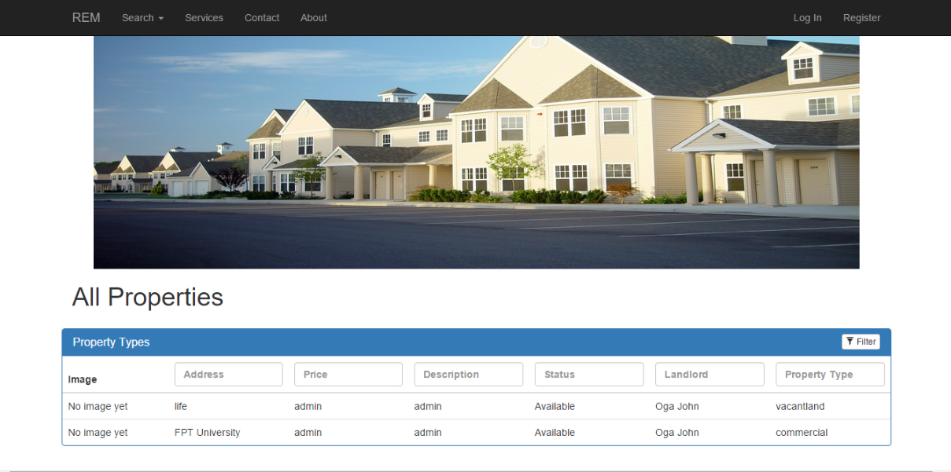
Search Page

Slide 11
