Slide 1

Indie Spotify
The ADA-Unibo Lab project presentation about Spotify and music trends
A.Y 2023-2024

Slide 2
The Research
In our research we’re discovering trends and features of modern popular music via the data of Spotify.
Our primary focus is exploring the difference in indie and popular music.

Slide 3
The Research Questions
Taking a look at the dataset some questions sparked:
What is popularity, how does it relate to followers?
What is the definition of indie?
How genres distribute?
How do labels work?

Slide 4
The Dataset
The dataset we decided to use lives on Kaggle
Created by Tony Gordon Jr. using the Spotify API
49 columns in the general dataset
5 files in total (~450MB)
CSV format

Slide 5
The approach
The approach we used involved simple but powerful data analysis tool.
Colab for code sharing and live cooperation
Pandas for exploration and analysis
Numpy for linear algebra tasks
Matplotlib to visualize
Last but not least the KISS philosophy (Keep It Simple Stupid)

Slide 6
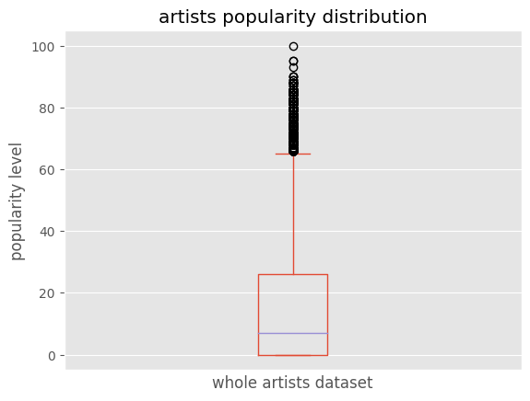
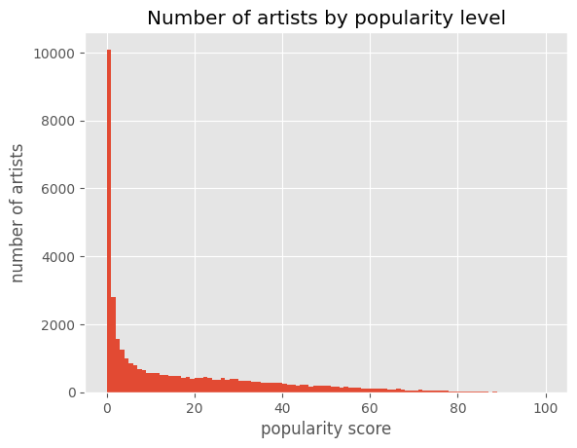
The skewed artist popularity
These two graphs show how skewed and submerged the lowest levels of popularity are in the dataset

Slide 7
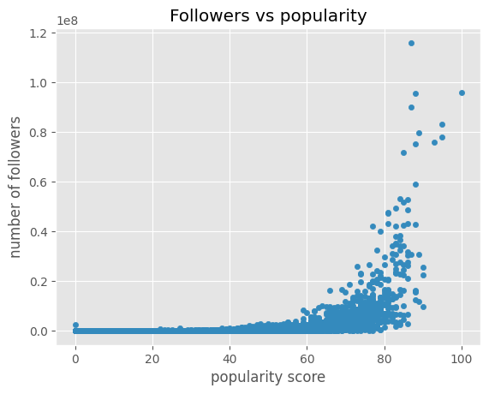
Popularity is current trend, Followers are something else
Hypothesis: Popularity and followers are not the same. Popularity measures current trends relating to time.
From the graph we can infer that:
Popularity and Followers are somehow correlated but different
The highest number of followers does not correspond to the highest popularity
Followers are an absolute measure, therefore Popularity must be somehow time related (current trending artists)

Slide 8
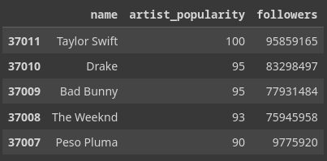
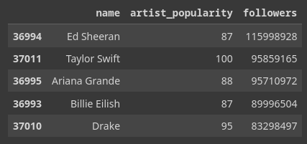
Popularity is current trend, Followers are something else
Being Taylor Swift the most popular at the time and date of this dataset (2023) we can say with a certain degree of certainty that our hypothesis is correct.

Slide 9
What do we mean by “indie” anyway?
In the scope of this project we investigate and treat as indie the submerged and ignored part of the Spotify data.
We decided that the right approach was not selecting those artists that have the “indie” word stand-alone or associated to another genre in the genre columns. (In order to avoid indie artists of the past that are popular and well known today).
Our approach was to select the 1000 least followed ones, avoiding the artists with 0 followers that are not very representative in our opinion.

Slide 10
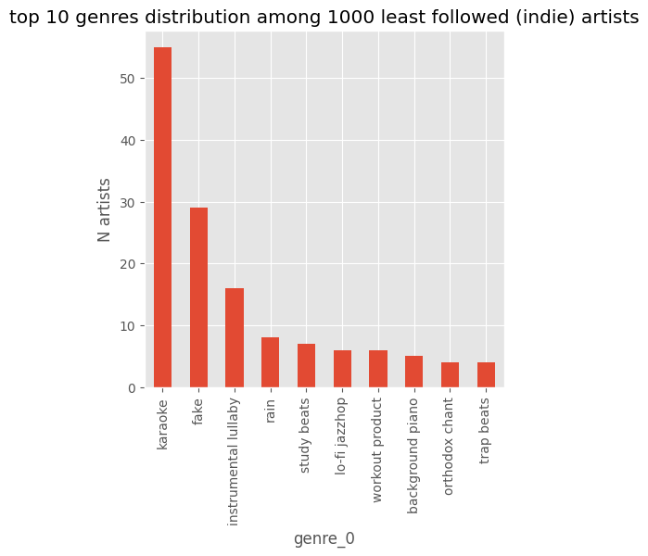
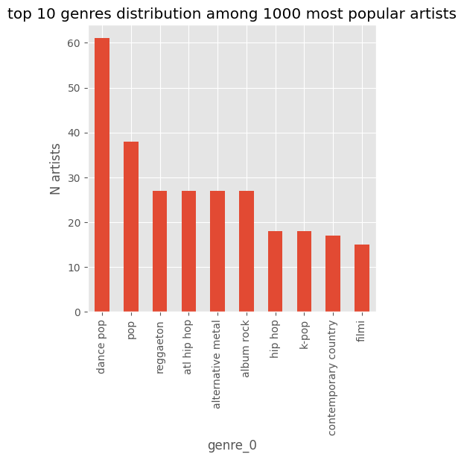
Indie and Popular artists have different taste
Our hypothesis on genre distribution was correct, different popularity leads to different leading genres. Popular ones have few surprises in store, while indie ones were quite unexpected.

Slide 11
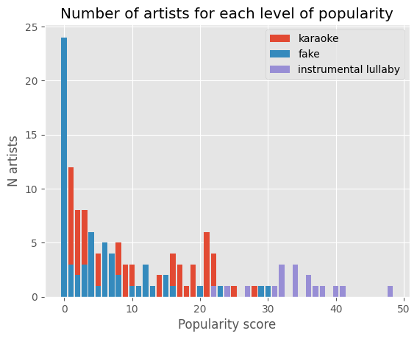
Genre popularity evolves in strange ways
In this graph we sampled different peculiar genres from the top 10 indie genres seen in the previous chart.
Popularity for these genres is varied and present different curves:
Fake is a placeholder genre for covers, unidentified reproduction of existing music and it makes sense to have high number of “artists” in the 0 tier.
Karaoke is distributed in a more uniform way to then disappear at almost 30 popularity
Instrumental lullaby is a very niche but consistently popular genre that starts at 20 and finishes with an artist at almost 50 popularity

Slide 12
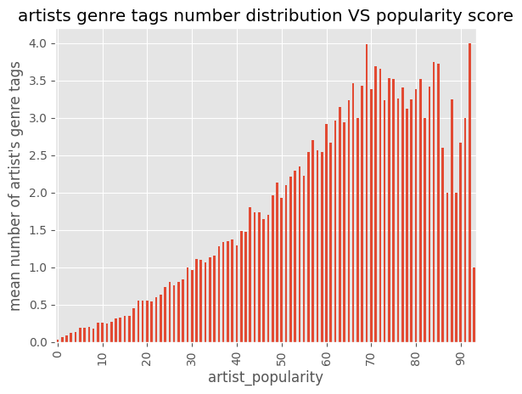
Indie music has many genres, indie artists don’t.
11.06% of total genres are also present among most popular artists (top 1000)
22.51% of total genres are also present among indie artists (least 1000)
This graph seems to collide with the percentages showed above, but they’re not actually. It just explains that indie and emerging artists have more variety when they pick a genre, but having a smaller production they tend to have fewer genres for each one of them.

Slide 13
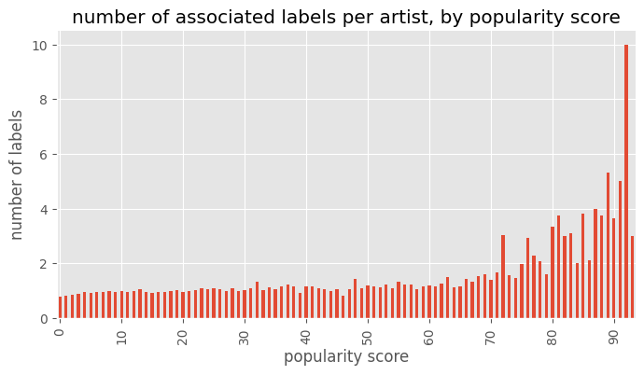
Popular artists have few labels to choose from.
For the most part of the popularity range, the distribution grows apparently linearly
For very popular artists the distribution starts growing explosively
This goes to show that major artists tend to get much more attention from the labels

Slide 14
Conclusions and take away of the Project
This study allows us to understand some key features of music trends and how they are stored and treated by the main music provider today.
Submerged parts of the dataset represent and allow us to peak into different genres and interests from higher popularity tiers.
Spotify is easy-access for new artists but it’s not that easy to become popular.
Labels follow a different pattern in Spotify from the one we can expect.
Indie and popular music are different in their genre distribution
Indie music is more creative with genres but one indie artist is usually less so than one popular artist
Labels treat indie and average segment equally, and treat the most popular artists differently

Slide 15
Thank you for your attention!
Francesco Alaimo - Nikolai Gorbachev

