Slide 1

PHISHING ATTACKS
& How to Protect Yourself
How to spot the hook before you take the bait, and what to do if you already have.
A PRACTICAL GUIDE TO STAYING SAFE ONLINE
FALAK SHAIKH

Slide 2



What Is Phishing?
Phishing is basically a con game that plays out over email, text message, or a phone call. The attacker pretends to be someone you already trust: your bank, your employer, even a delivery courier. The goal is simple, get you to hand over a password, click on something you shouldn’t, or send money before you’ve had time to really think it through.
Disguise
The attacker poses as a trusted brand, colleague, or institution.
Urgency
You’re pushed to act fast, before there’s time to check anything.
The name comes from "fishing." Attackers cast bait across the internet and simply wait for someone to bite.
Bait
A link, attachment, or request built to grab your data the second you engage.
FALAK SHAIKH
02

Slide 3
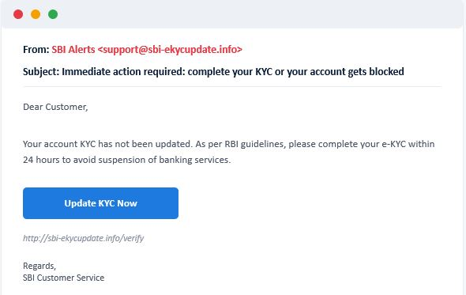
What Does a Phishing Attempt Look Like?
A typical example, annotated. The details rarely look as fake as they actually are.
Unofficial domain
A genuine bank uses its real, registered domain, not a lookalike like this one.
Manufactured urgency
The 24-hour deadline exists purely to stop you from thinking it over.
Generic greeting
Your bank already has your name on file and would normally use it.
Update KYC Now
Suspicious link
Hovering shows a web address that has nothing to do with the bank.
FALAK SHAIKH
03

Slide 4






KNOW THE VARIANTS
Six Faces of the Same Trick
Email Phishing
Spear Phishing
Whaling
Mass emails sent out to thousands of addresses at once, hoping a small share of people bite.
A targeted message aimed at one specific person, built using details found about them online.
Spear phishing pointed squarely at executives or other high-value targets in an organization.
Smishing
Vishing
Clone / Pharming
Phishing delivered through an SMS text, usually carrying a shortened, disguised link.
A phone call from someone posing as your bank, the tax department, or similar authority.
A copied website, or a redirected page, that quietly records whatever you type into it.
FALAK SHAIKH
04

Slide 5






Why Attackers Do This
Steal login credentials
Direct financial theft
Get into your accounts and impersonate you elsewhere.
Drain a bank account or push through fraudulent purchases.
Identity theft
Install malware or ransomware
Use your personal details to open loans or accounts in your name.
Gain deeper access to a device, or lock it and demand a ransom.
Corporate espionage
Sell harvested data
Get hold of business data, client lists, or trade secrets.
Pass the details along to other criminals on the dark web.
FALAK SHAIKH
05

Slide 6




Red Flags to Watch For
Recognizing the attempt itself, before you ever click.
A sender address that looks close, but isn’t quite right
Urgent or threatening language demanding instant action
A generic "Dear Customer" instead of your actual name
A link that doesn’t match the real company once you hover over it
An attachment you never asked for or expected to receive
Spelling mistakes or sentences that just read a bit oddly
FALAK SHAIKH
06

Slide 7
Have You Already Been Caught Out?
1
Password reset emails that you never actually requested
2
Transactions on a bank or card statement that you don’t recognize
3
Contacts telling you they got a strange message that looked like it came from you
4
A device that’s suddenly slower, or pop-ups that weren’t there before
5
Alerts about a sign-in from a device or location you don’t recognize
6
Getting locked out of an account you use every day
FALAK SHAIKH
07

Slide 8





If You Think You’ve Been Phished, Act Fast
The first hour matters the most, so work through these steps in order.
1
2
3
4
5
6
Stay calm & disconnect
Change passwords now
Turn on 2FA
Call your bank
Scan your device
Report the incident
If malware might be involved, take the device off Wi-Fi.
Update the affected account and anywhere you reused it.
Add two-factor authentication if it isn’t active already.
Do this straightaway if money or card details were involved.
Run a full antivirus or anti-malware check.
Tell your IT team, your bank, or the cybercrime authority.
FALAK SHAIKH
08

Slide 9


Reach Out. You’re Not Alone in This.
Who to contact if you suspect a phishing attack, for readers in India.
1930
cybercrime.gov.in
National Cyber Crime Helpline
National Cyber Crime Reporting Portal
Toll-free, available 24x7, for financial fraud and cybercrime
File a complaint online, any time of day
112
1800-11-4949
National Police Emergency Number
CERT-In Incident Helpdesk
For urgent, in-progress emergencies
India’s national cybersecurity response team
Outside India? Look up your own country’s cybercrime or CERT authority. Most run something similar: a 24x7 hotline plus an online portal.
FALAK SHAIKH
09

Slide 10




PERSONAL HABITS
Build These Habits Now
Pause & verify
Hover before you click
Never share OTPs or PINs
Confirm the sender through a separate, known channel before acting on anything.
Check where a link actually leads before you follow it.
No genuine bank or company will ever ask you for these over phone or email.
Use unique passwords
Turn on two-factor authentication
Keep everything updated
A different, strong password for every account you hold.
Switch it on wherever it’s offered, especially for email and banking.
Update your apps, browser, and operating system as they prompt you.
FALAK SHAIKH
10

Slide 11





TECHNICAL SAFEGUARDS
Let Technology Back You Up
Spam & phishing filters
Antivirus / anti-malware
Browser protection
Turn them on in your email client and let them do the sorting.
Run a reputable security tool and keep it updated.
Use a browser that warns you about phishing and malware sites.
VPN on public Wi-Fi
Regular backups
Stay informed
Encrypt your connection on networks you don’t control.
Keep copies of important data in case ransomware ever hits.
Revisit the basics now and then. Attackers keep changing tactics.
FALAK SHAIKH
11

Slide 12

Quick Quiz — Test Yourself
Part 1 of 2. No peeking at the earlier slides!
1. A bank email urges you to "verify your account within 1 hour or lose access." What should you do first?
A. Click the link in the email right away | B. Reply to the email with your password | C. Go directly to the bank’s official app or website | D. Ignore it without checking anything
2. Which of these is a common phishing red flag?
A. A personalized greeting with your correct name | B. A generic "Dear Customer" greeting | C. An email sent during normal business hours | D. A message with no links at all
3. "Smishing" refers to phishing carried out through:
A. Phone calls | B. SMS text messages | C. Physical mail | D. Fax machines
FALAK SHAIKH
12

Slide 13

Quick Quiz — Part 2
Two more questions, then check your answers below.
4. You realize you’ve just entered your password on a fake site. Your very first move?
A. Wait and see if anything happens | B. Change that password immediately | C. Restart your computer | D. Post about it on social media
5. Which number connects you to India’s national cyber crime helpline?
A. 100 | B. 1930 | C. 108 | D. 1099
Answer Key: 1-C 2-B 3-B 4-B 5-B
FALAK SHAIKH
13

Slide 14
Thank You
Stay alert, stay a little skeptical, and think twice before you click.
Questions & Discussion
FALAK SHAIKH

