Slide 1


22CAC09
FULL STACK DEVELOPMENT
UNIT-I
BOOTSTRAP

Slide 2
Introduction of Bootstrap
Powerful, extensible, and feature-packed frontend toolkit.
Bootstrap is the most commonly used framework for Front-End Development.
Bootstrap providing several pre defined libraries for css and java script.
Current version of Bootstrap is: 5.2.x
https://getbootstrap.com/
https://www.w3schools.com/howto/

Slide 3
Bootstrap 4 VS Bootstrap 5
BASIS OF | BOOTSTRAP 4 | BOOTSTRAP 5
Grid System | It has 5 tier (xs, sm, md, lg, xl). | It has 6 tier (xs, sm, md, lg, xl, xxl).
Color | It has limited colors. | Extra colors added with the looks, A card improved color palette.
Jquery | It has jquery and all related plugins. | Jquery is removed and switched to vanilla JS with some working plugins
Internet Explorer | Bootstrap 4 supports both IE 10 and 11. | Bootstrap 5 doesn’t support IE 10 and 11.
Form elements | Radio buttons, checkboxes have different look in different OS and browsers. | The look of form elements will not change, on different OS or browser.
Bootstrap Icons | Bootstrap 4 doesn’t have its own SVG icons, we have to use font-awesome for icons. | Bootstrap 5 have its own SVG icons
Jumbotron | It supports. | It doesn’t support jumbotron.

Slide 4
Connectivity of Bootstrap in page
We can connect Bootstrap with HTML by using the following 2 ways.
By using CDN
Locally
CDN [ Content Delivery Network ]
Add the following in the <head> part of our html
<link href="https://cdn.jsdelivr.net/npm/bootstrap@5.1.3/dist/css/bootstrap.min.css" rel="stylesheet" >

Slide 5
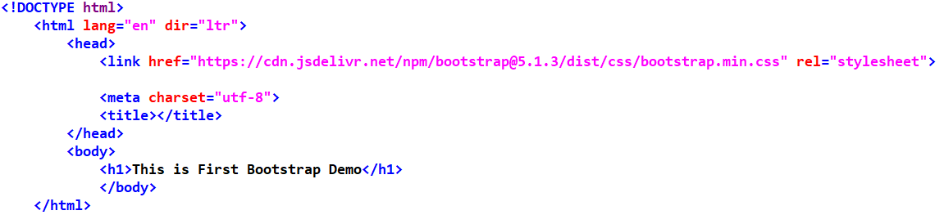
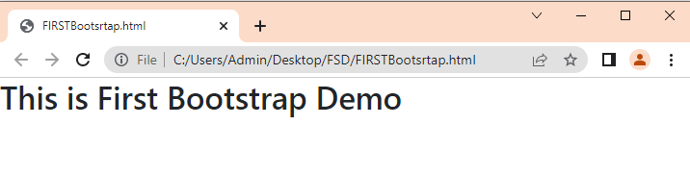
Content Delivery Network

Slide 6
Use Bootstrap Locally
Download bootstrap.css file from the link getbootstrap.com .
zip file contains bootstrap.css file.
copy this file in our application folder and add the following link in html.
<link rel="stylesheet" href=“bootstrap.css">

Slide 7
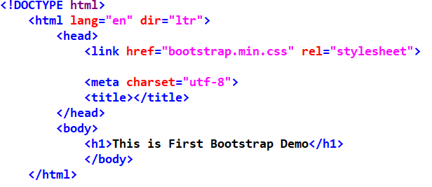
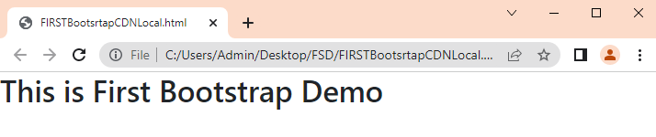
Use Bootstrap Locally

Slide 8
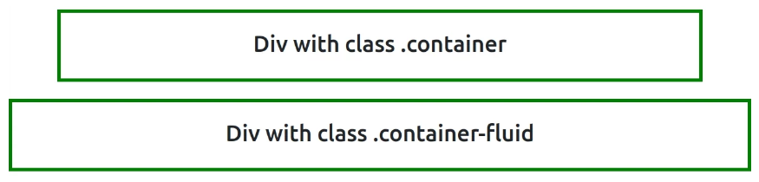
Container and Container-fluid
In bootstrap, the container is used to set the content’s margin.
.container
The .container class provides a responsive fixed width container.
.container-fluid
The .container-fluid class provides a full-width container which spans the entire width of the viewport.

Slide 9
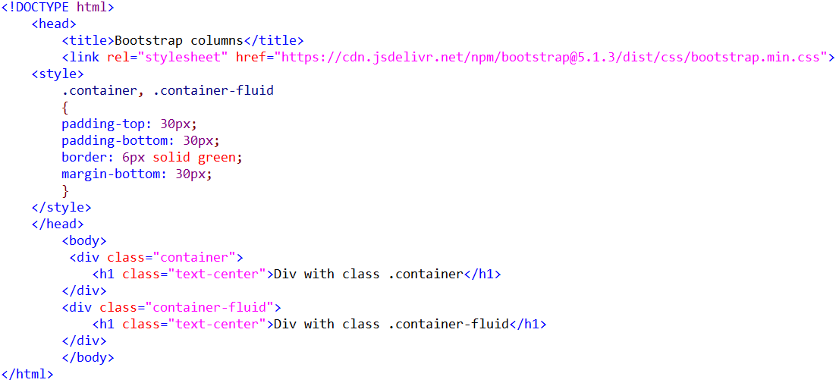
Container and Container-fluid

Slide 10
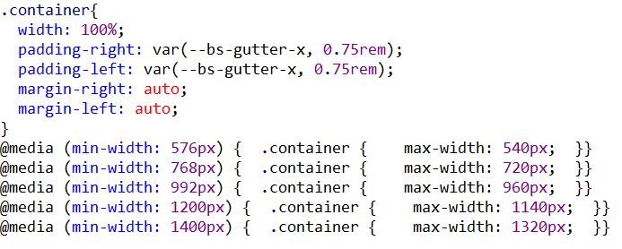
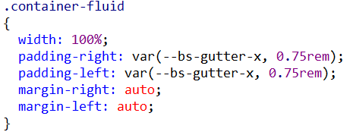
Container and Container-fluid

Slide 11
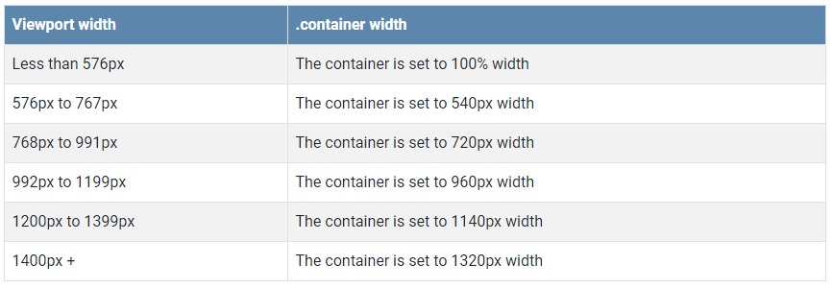
Container and Container-fluid

Slide 12
Bootstrap Component - Button
Most of the styles in Bootstrap are implemented as class styles.
We can use these classes directly in our web application to improve look and feel.
Commonly Used Classes :
1) Container Class
2) Button Related Classes
3) Jumbotron Classes

Slide 13

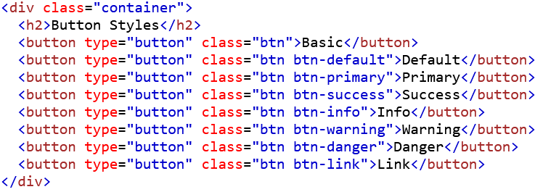
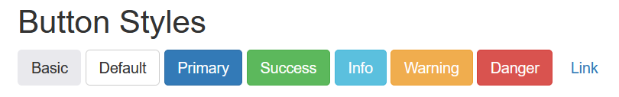
Bootstrap Component - Button
Container Class:
To center our elements we should use container class.

Slide 14
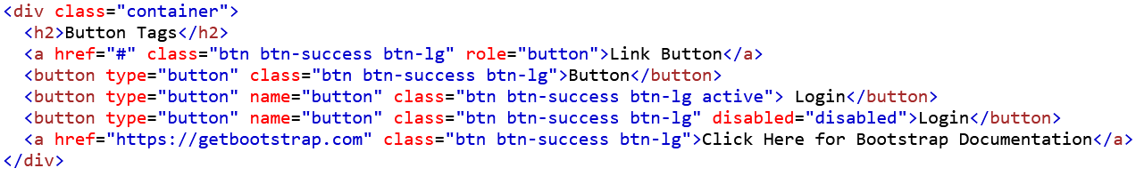
Bootstrap Component - Button
The button classes can be used on an <a>, <button>, or <input> element:
Notes:
# IS USED AS NO REFERNCE LINK IS PROVIDED

Slide 15
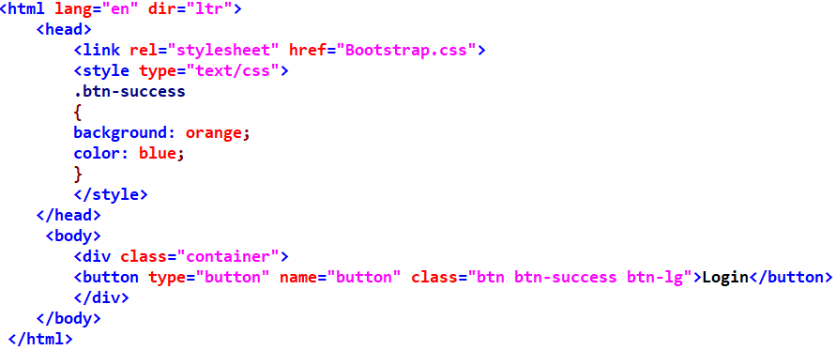
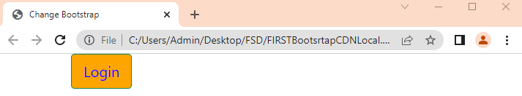
How to Change Default Styles of Bootstrap

Slide 16
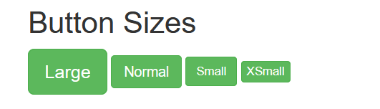
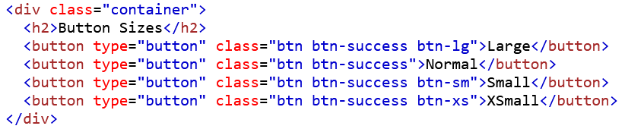
Bootstrap Component - Button
Bootstrap provides four button sizes.
classes that define the different sizes are:
.btn-lg
.btn-sm
.btn-xs

Slide 17

Bootstrap Component - Button
Button Groups
Bootstrap allows you to group a series of buttons together (on a single line) in a button group.
Use a <div> element with class .btn-group to create a button group
<div class="btn-group btn-group-vertical btn-group-lg btn-group-justified btn-success">

Slide 18
Bootstrap Component- Jumbotron
A jumbotron indicates a big box for calling extra attention to some special content or information.
A jumbotron is displayed as a grey box with rounded corners. It also enlarges the font sizes of the text inside it.
Inside a jumbotron you can put nearly any valid HTML, including other Bootstrap elements/classes.

Slide 19
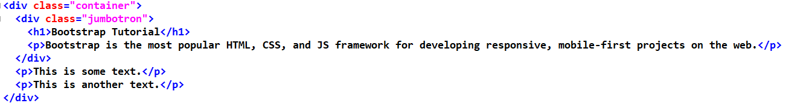
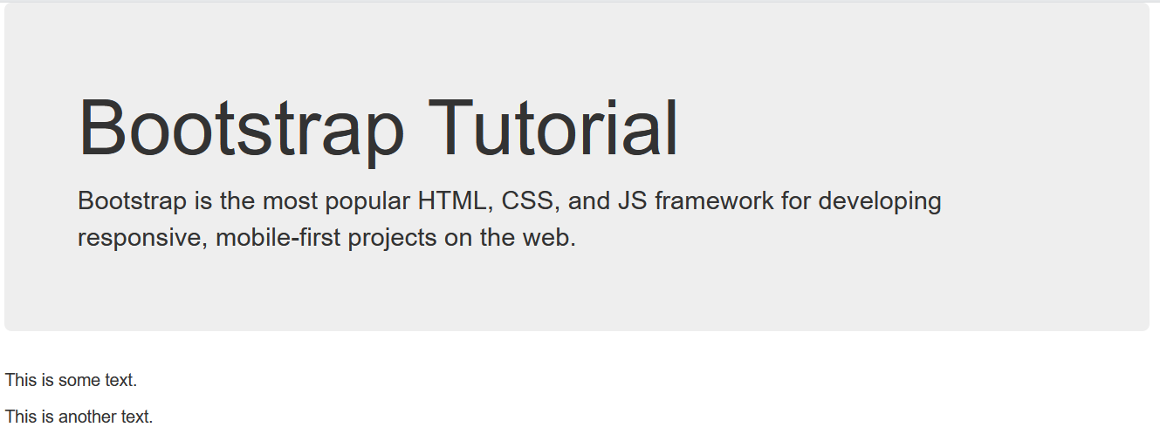
Bootstrap Component- Jumbotron

Slide 20
Bootstrap Component- Grid
Bootstrap’s grid system uses a series of containers, rows, and columns to layout and align content.
Bootstrap's grid system is built with flexbox and allows up to 12 columns across the page.
If you do not want to use all 12 columns individually, you can group the columns together to create wider columns.
https://chrome.google.com/webstore/detail/bootstrap-grid-overlay/mnlklmelflkheijccafopdohgclfefcg

Slide 21
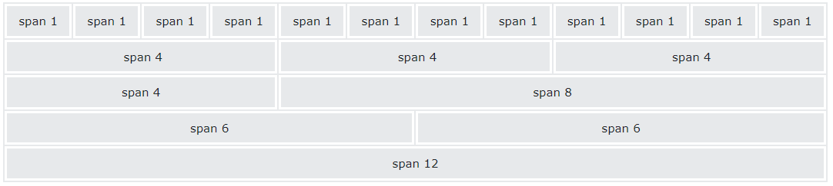
Bootstrap Component- Grid
Why we need Grid?
To display our application layout properly on multiple devices of multiple screen sizes like desktop, laptop, tab, mobile etc, we should go for grid system.

Slide 22
Bootstrap Component- Grid
Bootstrap 5 grid system has six classes
.col- (extra small devices - screen width less than 576px)
.col-sm- (small devices - screen width equal to or greater than 576px)
.col-md- (medium devices - screen width equal to or greater than 768px)
.col-lg- (large devices - screen width equal to or greater than 992px)
.col-xl- (xlarge devices - screen width equal to or greater than 1200px)
.col-xxl- (xxlarge devices - screen width equal to or greater than 1400px)

Slide 23
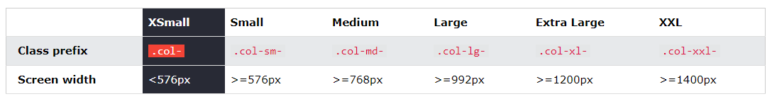
Bootstrap Component- Grid
How to implement Grid?
We can implement grid by using 2 classes
1. row class: to define row
<div class="row">
2. Within the row we can define columns by using the following class
col-screenSize-noOfColumns

Slide 24
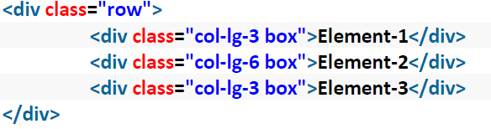
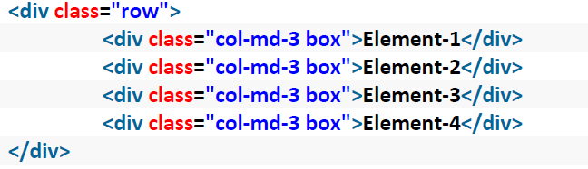
Bootstrap Component- Grid
CASE 1:
?
CASE 2:
?

Slide 25
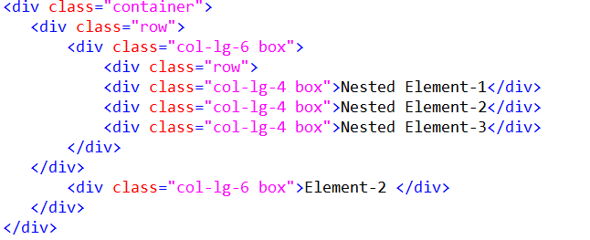
Bootstrap Component- Grid
Nested Grid: Grid inside Grid

Slide 26
Bootstrap Component- Table
A basic Bootstrap 5 table has a light padding and horizontal dividers.
The .table class adds basic styling to a table.
The .table-striped class adds zebra-stripes to a table.
The .table-bordered class adds borders on all sides of the table and cells.
The .table-hover class adds a hover effect on table rows.
The .table-dark class adds a black background to the table.
The .table-dark and .table-striped to create a dark, striped table.
The .table-borderless class removes borders from the table.

Slide 27
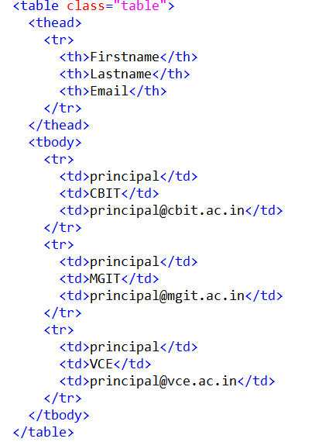
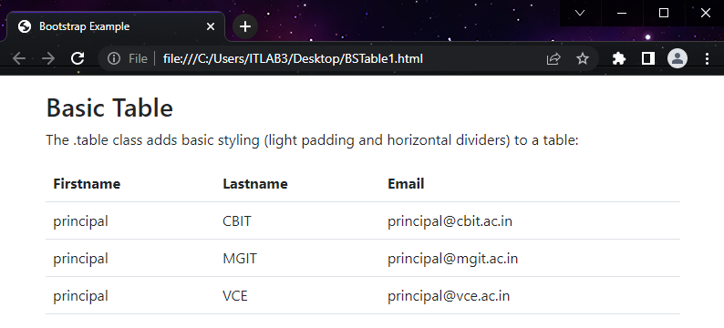
Bootstrap Component- Table

Slide 28
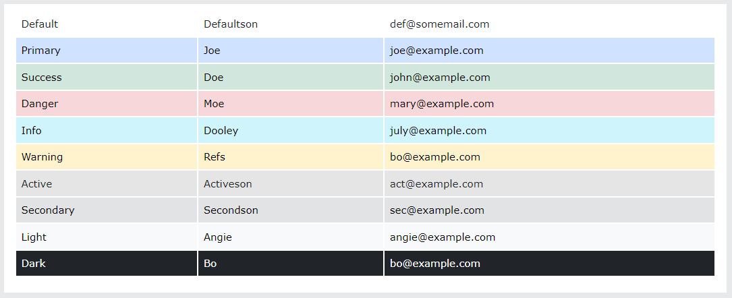
Bootstrap Component- Table
Contextual classes can be used to color the whole table (<table>), the table rows (<tr>) or table cells (<td>).

Slide 29
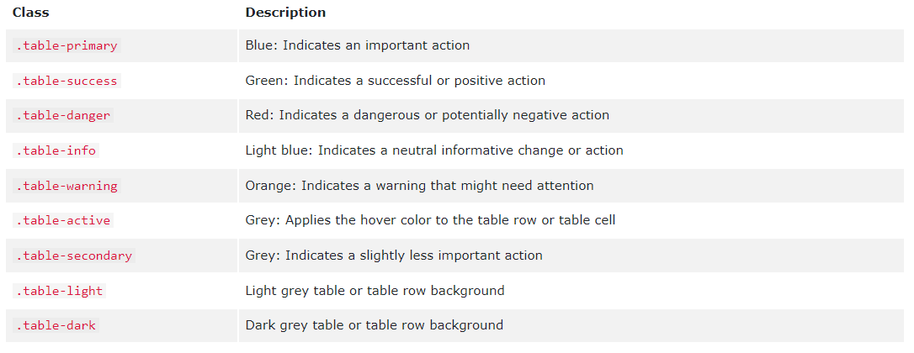
Bootstrap Component- Table

Slide 30
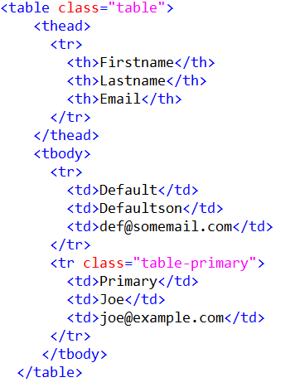
Bootstrap Component- Table

Slide 31
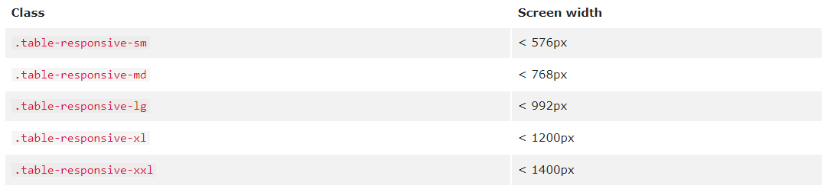
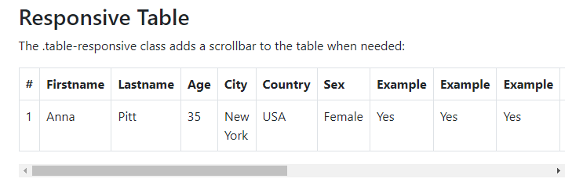
Bootstrap Component- Table
Responsive Tables
The .table-responsive class adds a scrollbar to the table.

Slide 32
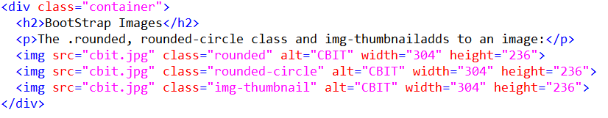
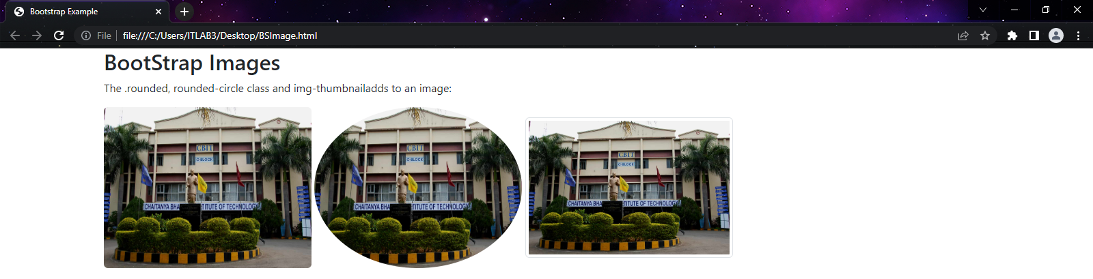
Bootstrap Component- Image

Slide 33
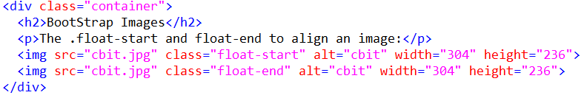
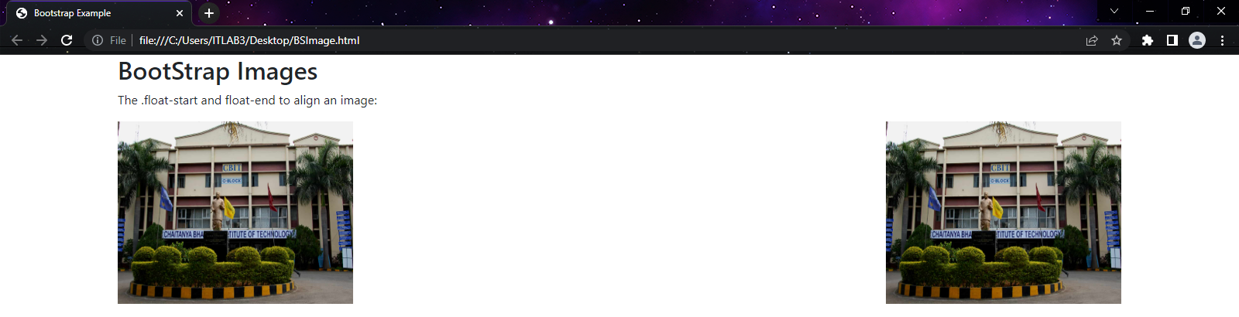
Bootstrap Component- Image
Aligning Images
Float an image to the left with the .float-start class or to the right with .float-end.

Slide 34
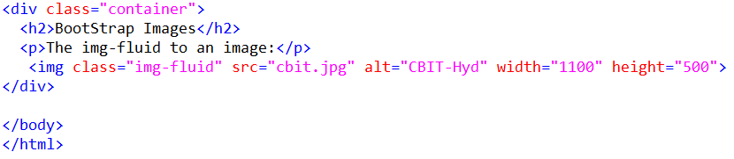
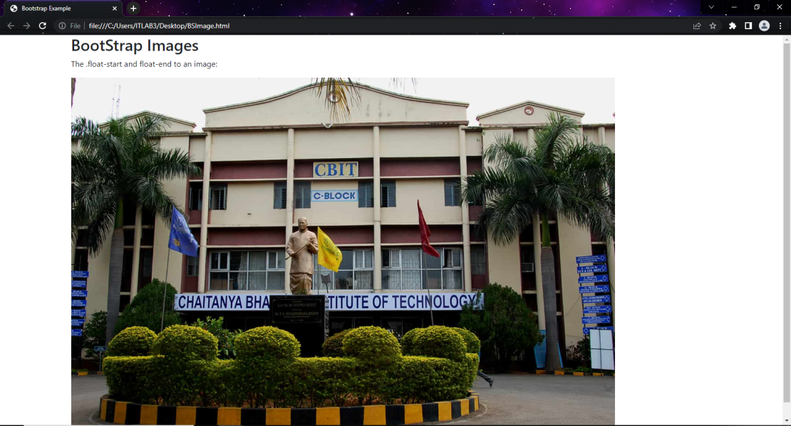
Bootstrap Component- Image
Images come in all sizes. Responsive Images automatically adjust to fit the size of the screen.

Slide 35
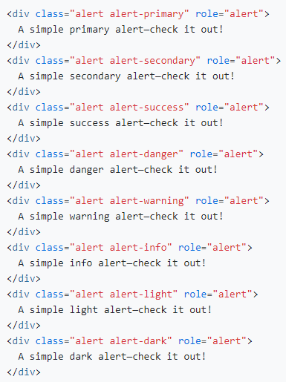
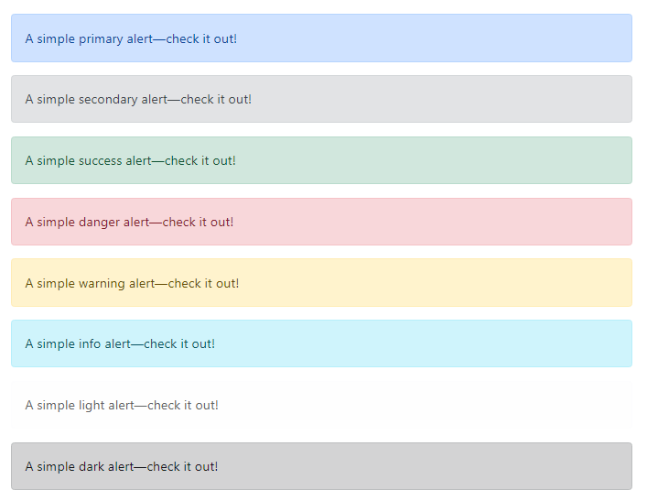
Bootstrap Component- Alert
Bootstrap 5 provides an easy way to create predefined alert messages.
Example .alert-success

Slide 36
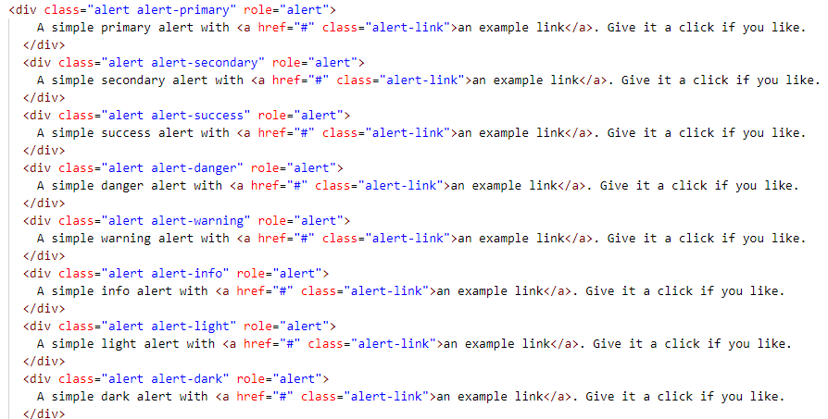
Bootstrap Component- Alert
Link color
Use the .alert-link utility class to quickly provide matching colored links within any alert.

Slide 37
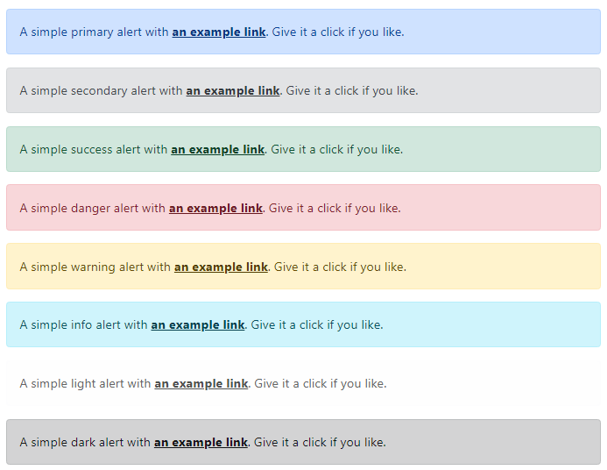
Bootstrap Component- Alert

Slide 38
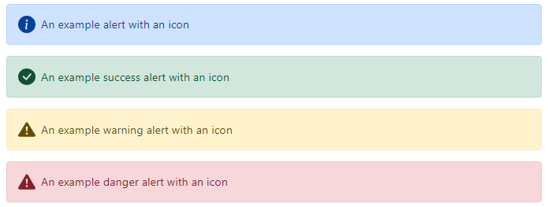
Bootstrap Component- Alert
Icons
Similarly, you can use Bootstrap Icons to create alerts with icons. Depending on your icons and content, you may want to add more utilities or custom styles.

Slide 39
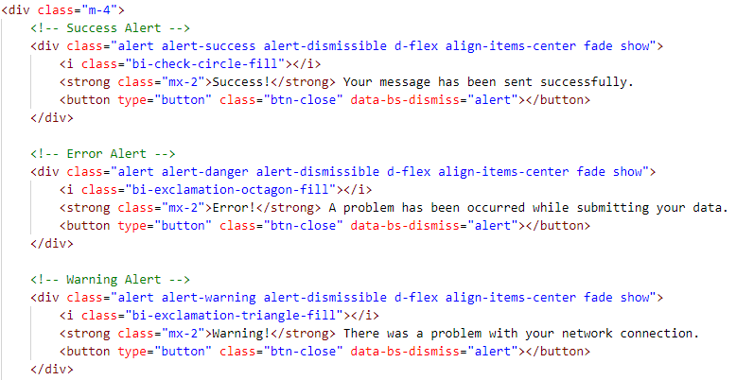
Bootstrap Component- Alert

Slide 40

Bootstrap Component- Progress Bar
A progress bar can be used to show how far a user is in a process.
.progress class to create a default progress bar.
.progress-bar to indicate the progress so far.

Slide 41


Bootstrap Component- Progress Bar
Progress Bar Height

Slide 42

Bootstrap Component- Progress Bar
Progress Bar Labels

Slide 43
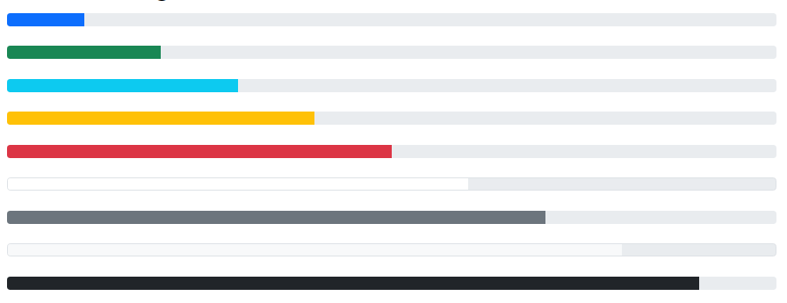
Bootstrap Component- Progress Bar
Colored Progress Bars
By default, the progress bar is blue (primary).

Slide 44
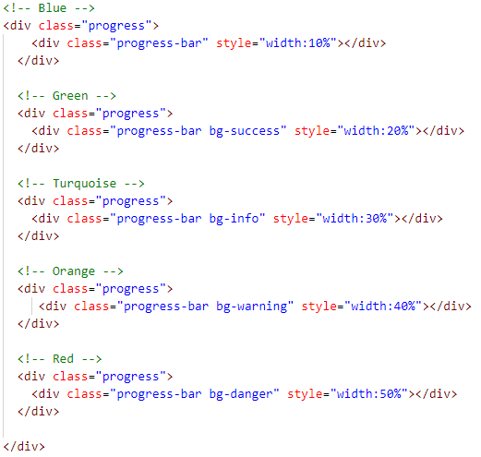
Bootstrap Component- Progress Bar

Slide 45


Bootstrap Component- Progress Bar
Striped Progress Bars
Use the .progress-bar-striped class to add stripes to the progress bars.

Slide 46
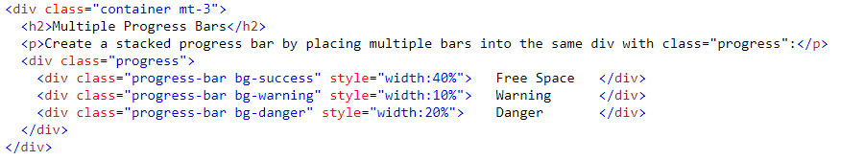
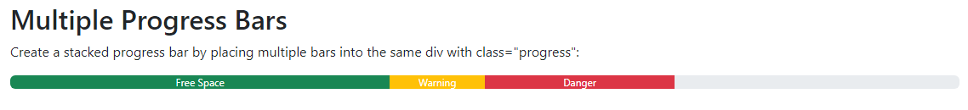
Bootstrap Component- Progress Bar
Animated Progress Bar
Multiple Progress Bars

Slide 47
Bootstrap Component- Spacing
Where property is one of:
m - for classes that set margin
p - for classes that set padding
Where sides is one of:
t - for classes that set margin-top or padding-top
b - for classes that set margin-bottom or padding-bottom
x - for classes that set both *-left and *-right
y - for classes that set both *-top and *-bottom

Slide 48
Bootstrap Component- Navbar
A navigation bar is a navigation header that is placed at the top of the page.
Navbars require a wrapping .navbar with .navbar-expand{-sm|-md|-lg|-xl|-xxl} for responsive collapsing and color scheme classes.
Navbars and their contents are fluid by default. Change the container to limit their horizontal width in different ways.
Navbars are responsive by default, but you can easily modify them to change that.

Slide 49
Bootstrap Component- Navbar
To add links inside the navbar, use either an <ul> element (or a <div>) with class="navbar-nav". Then add <li> elements with a .nav-item class followed by an <a> element with a .nav-link class.

Slide 50
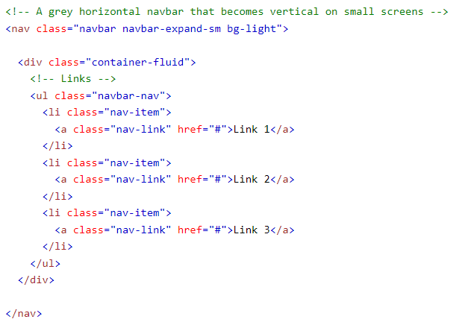
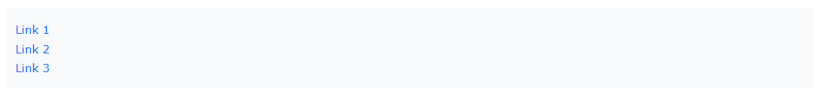
Bootstrap Component- Navbar
Remove the .navbar-expand-* class to create a navigation bar that will always be vertical.

Slide 51
Bootstrap Component- Navbar
Centered Navbar
Add the .justify-content-center class to center the navigation bar.
Colored Navbar
Use any of the .bg-color classes to change the background color of the navbar. (.bg-primary, .bg-success, .bg-info, .bg-warning etc)

Slide 52
Bootstrap Component- Navbar
Brand / Logo
The .navbar-brand class is used to highlight the brand/logo/project name of your page.
When using the .navbar-brand class with images, Bootstrap 5 will automatically style the image to fit the navbar vertically.

Slide 53
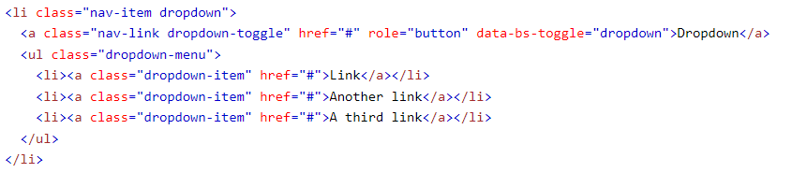
Bootstrap Component- Navbar
Navbar With Dropdown

Slide 54

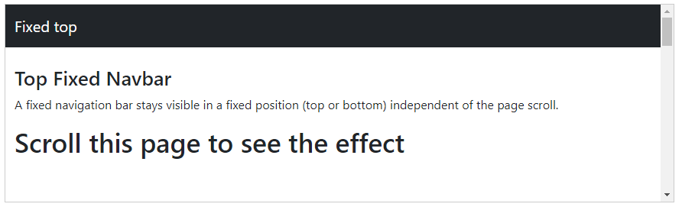
Bootstrap Component- Navbar
Fixed Navigation Bar
The navigation bar can also be fixed at the top or at the bottom of the page.
The .fixed-top class makes the navigation bar fixed at the top.
Use the .fixed-bottom class to make the navbar stay at the bottom of the page.

Slide 55



Bootstrap Component- Navbar/Tabs/Pills
Nav
Tab
Pill

Slide 56


Bootstrap Component- Navbar/Tabs/Pills
If you want to create a horizontal menu of the list , add the .list-inline class to <ul>.

Slide 57

Bootstrap Component- Navbar/Tabs/Pills
Tabs
Tabs are created with <ul class="nav nav-tabs">.
Note: Also mark the current page with <li class="active">.

Slide 58


Bootstrap Component- Navbar/Tabs/Pills
Tabs With Dropdown Menu

Slide 59


Bootstrap Component- Navbar/Tabs/Pills
Pills
Pills are created with <ul class="nav nav-pills">. Also mark the current page with <li class="active">.

Slide 60


Bootstrap Component- Navbar/Tabs/Pills
Vertical Pills
Pills can also be displayed vertically. Just add the .nav-stacked class.

Slide 61

Bootstrap Component- Modal
Use Bootstrap’s JavaScript modal plugin to add dialogs to your site for lightboxes, user notifications, or completely custom content.

Slide 62


Bootstrap Component- Modal

Slide 63


Bootstrap Component- Modal
Add animation
Use the .fade class to add a fading effect when opening and closing the modal.
Modal Size
Add the size class to the <div> element with class .modal-dialog.
.modal-sm class for small modals.
.modal-lg class for large modals
.modal-xl for extra large modals

Slide 64
Bootstrap Component- Modal
Full Screen Modals
If you want the modal to span the whole width and height of the page, use the .modal-fullscreen class
Responsive Full Screen Modals- .modal-fullscreen-*-*
Class | Description
.modal-fullscreen-sm-down | Fullscreen below 576px
.modal-fullscreen-md-down | Fullscreen below 768px
.modal-fullscreen-lg-down | Fullscreen below 992px
.modal-fullscreen-xl-down | Fullscreen below 1200px
.modal-fullscreen-xxl-down | Fullscreen below 1400px

Slide 65
Bootstrap Component- Form
Bootstrap provides several classes for forms.
1) form-group: Removed and Replaced by the Grid System in BS5
It is responsible to maintain proper space between elements so that elements will be arranged properly.
2) form-control:
This class is responsible to make width as 100% for elements <input>, <textarea>, and <select>. It is also responsible for border styling.

Slide 66

Bootstrap Component- Form

Slide 67
Bootstrap Component- Form Validation
The .was-validated or .needs-validation to the <form> element, depending on whether you want to provide validation feedback before or after submitting the form.
The input fields will have a green (valid) or red (invalid) border to indicate what's missing in the form.
You can also add a .valid-feedback or .invalid-feedback message to tell the user explicitly what's missing, or needs to be done before submitting the form.

Slide 68

Bootstrap Component- Form Validation

