Slide 1
ZABEJ
Informal sport creates
sustainable communities

Slide 2
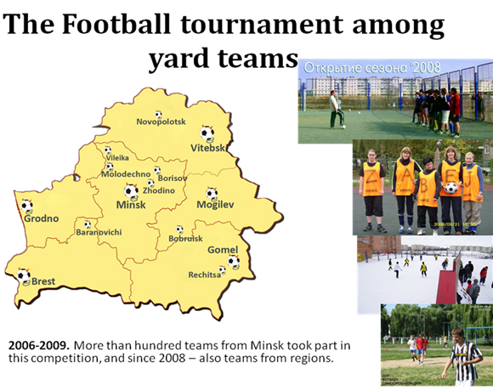

Slide 3


Slide 4
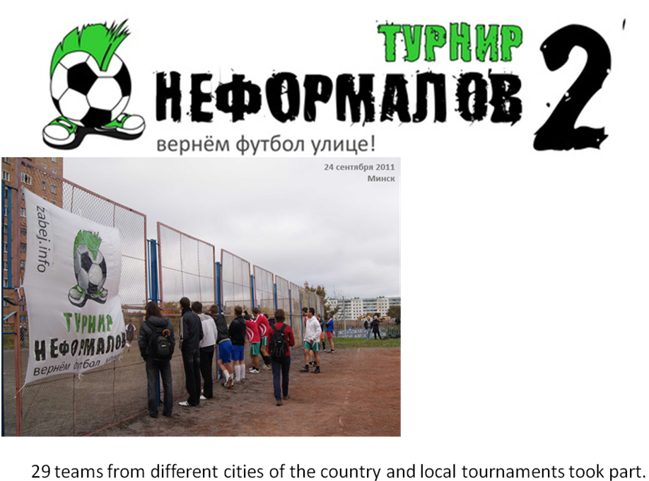

Slide 5

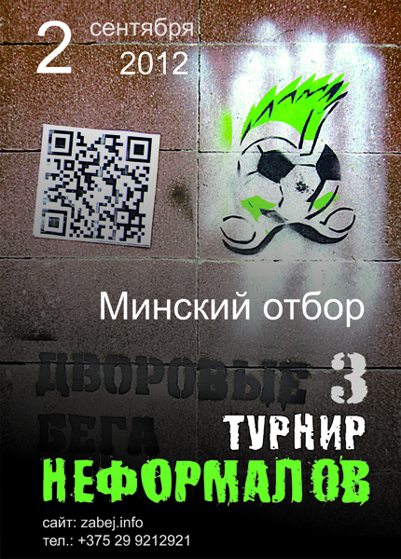
Today we continue topic civil activity in our sports events on Belarus and continue to prepare to the yard football festival where more than 40 different are going to take part (2th, 15th of September).

Slide 6
Our contacts:
zabej.info
zzabej@gmail.com
+375 29 1274267
The Zabej is waiting for you!

