Slide 1

Voting-App DevOps Project
Name- Sonit Gupta
Mentor- Balamurugan C

Slide 2
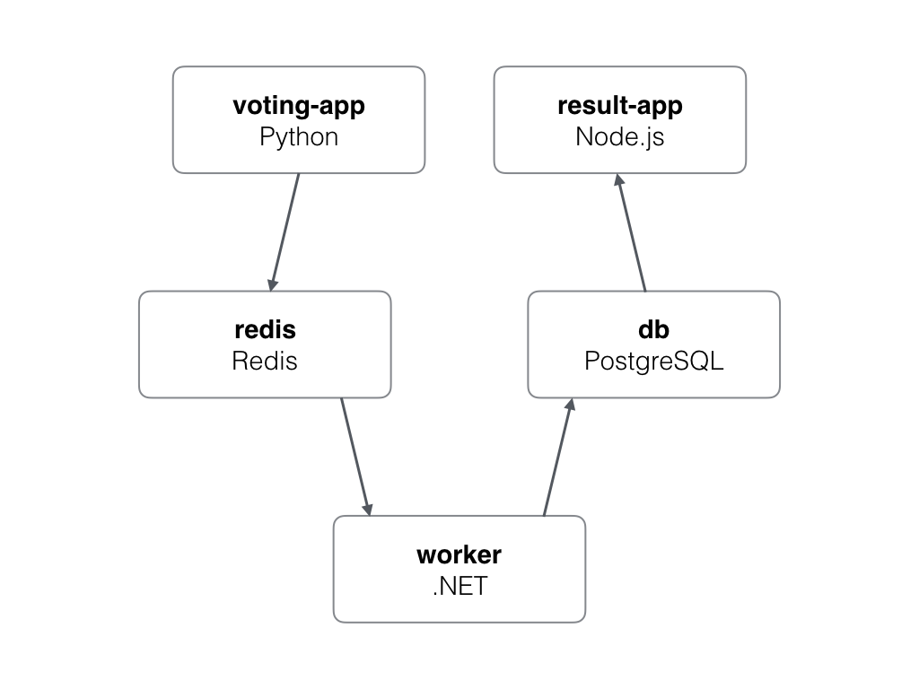
Overview of Project:
A simple voting app that has its backend built in Python and frontend being a node Js. It uses Redis as backend database and Postgres as frontend.
A worker node is used to connect both the databases and help them facilitate communication.

Slide 3
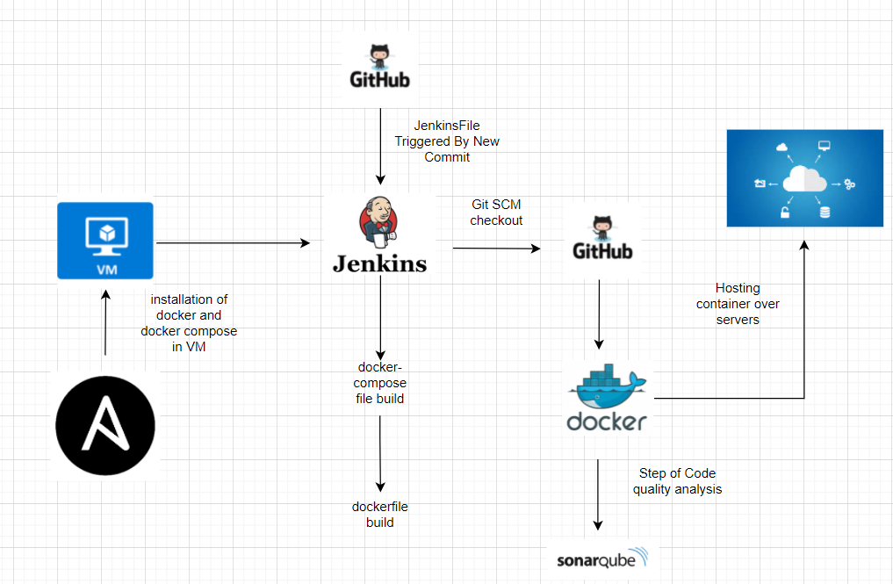
Architecture

Slide 4
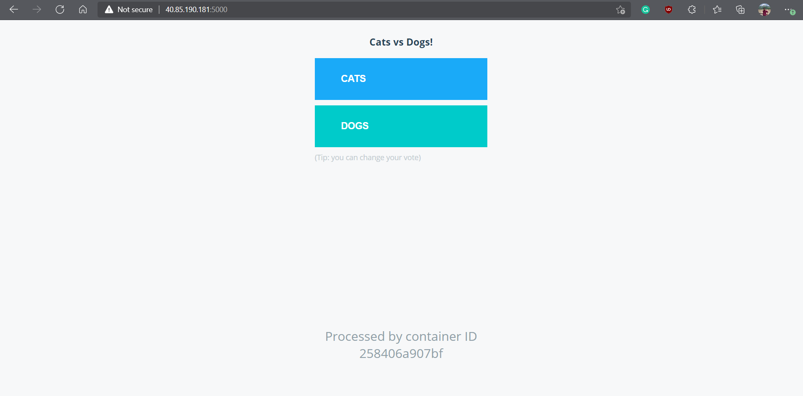
Results:

Slide 5
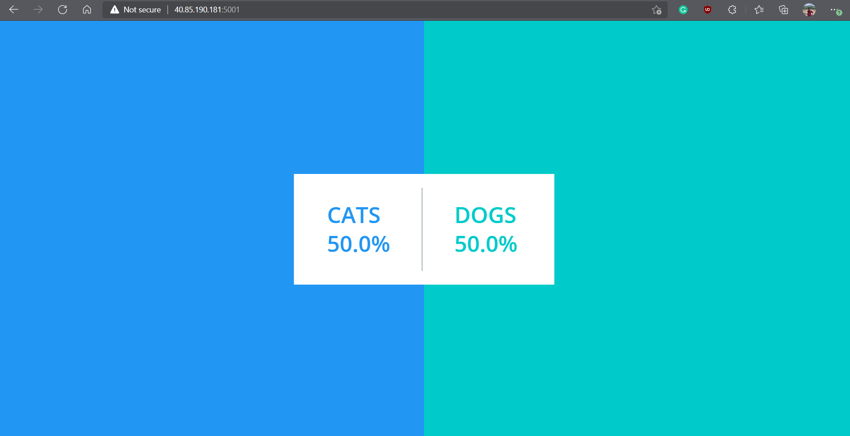

Slide 6
