Slide 1


K8 Namespace
Notes:
<number>

Slide 2
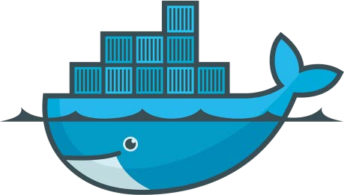
Lightweight, open, secure platform Simplify building, shipping, running apps
What Is Docker?
Runs natively on Linux or Windows Server
Runs on Windows or Mac Development machines (with a virtual machine)
Relies on "images" and "containers"
Notes:
<number>

