Slide 1


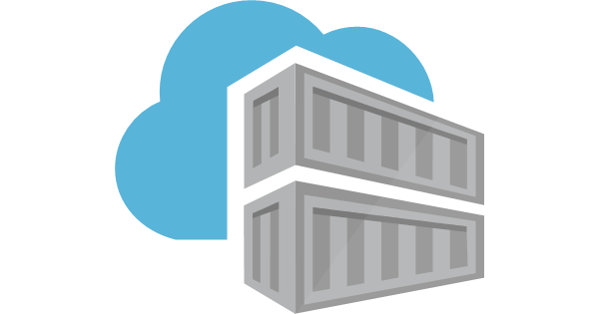
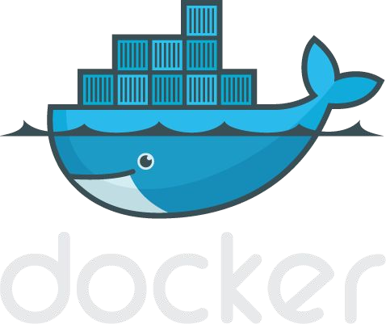
Introduction to Docker
Notes:
<number>

Slide 2
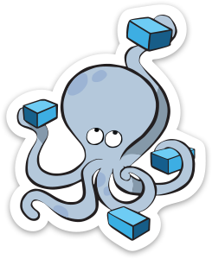
Agenda
Section 1:
What is Docker
What is Docker Not
Basic Docker Commands Dockerfiles
Section 3:
Networking
Section 2:
Anatomy of a Docker image Docker volumes
Section 4:
Docker compose / stacks
Demo
Notes:
<number>

Slide 3
Section 1: What is Docker
Basic Docker Commands Dockerfiles
Notes:
<number>

Slide 4
What is docker
Docker is an open platform for developing, shipping, and running applications
Docker enables you to separate your applications from your infrastructure so you can deliver software quickly
With Docker, you can manage your infrastructure in the same ways you manage your applications
Docker provides the ability to package and run an application in a loosely isolated environment called a container
The isolation and security allows you to run many containers simultaneously on a given host.
Containers are lightweight and contain everything needed to run the application, so you do not need to rely on what is currently installed on the host.
You can easily share containers while you work, and be sure that everyone you share with gets the same container that works in the same way.
Notes:
<number>

Slide 5
Docker provides tooling and a platform to manage the lifecycle of your containers:
Develop your application and its supporting components using containers.
The container becomes the unit for distributing and testing your application.
When you’re ready, deploy your application into your production environment, as a container or an orchestrated service.
This works the same whether your production environment is a local data center, a cloud provider, or a hybrid of the two.

Slide 6
What can I use Docker for?
Fast, consistent delivery of your applications
Containers are great for continuous integration and continuous delivery (CI/CD) workflows
Responsive deployment and scaling
Docker’s portability and lightweight nature also make it easy to dynamically manage workloads, scaling up or tearing down applications and services as business needs dictate, in near real time.
Running more workloads on the same hardware
Docker is lightweight and fast. It provides a viable, cost-effective alternative to hypervisor-based virtual machines, so you can use more of your compute capacity to achieve your business goals

Slide 7
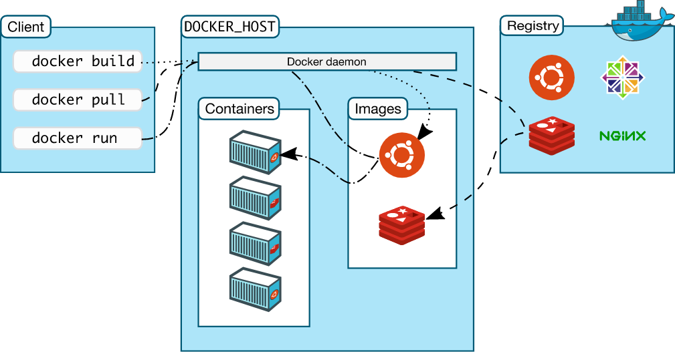
Docker architecture

Slide 8
The Docker daemon
The Docker daemon (dockerd) listens for Docker API requests and manages Docker objects such as images, containers, networks, and volumes. A daemon can also communicate with other daemons to manage Docker services.
The Docker client
The Docker client (docker) is the primary way that many Docker users interact with Docker. When you use commands such as docker run, the client sends these commands to dockerd, which carries them out. The docker command uses the Docker API. The Docker client can communicate with more than one daemon.
Docker Desktop
Docker Desktop is an easy-to-install application for your Mac or Windows environment that enables you to build and share containerized applications and microservices. Docker Desktop includes the Docker daemon (dockerd), the Docker client (docker), Docker Compose, Docker Content Trust, Kubernetes, and Credential Helper. For more information, see Docker Desktop.
Docker registries
A Docker registry stores Docker images. Docker Hub is a public registry that anyone can use, and Docker is configured to look for images on Docker Hub by default. You can even run your own private registry.
When you use the docker pull or docker run commands, the required images are pulled from your configured registry. When you use the docker push command, your image is pushed to your configured registry.

Slide 9




Some Docker vocabulary
Docker Image
The basis of a Docker container. Represents a full application
Docker Container
The standard unit in which the application service resides and executes
Docker Engine
Creates, ships and runs Docker containers deployable on a physical or virtual, host locally, in a datacenter or cloud service provider
Registry Service (Docker Hub(Public) or Docker Trusted Registry(Private))
Cloud or server based storage and distribution service for your images
<number>
Notes:
<number>

Slide 10
Docker objects
When you use Docker, you are creating and using images, containers, networks, volumes, plugins, and other objects. This section is a brief overview of some of those objects.
Images
An image is a read-only template with instructions for creating a Docker container. Often, an image is based on another image, with some additional customization. For example, you may build an image which is based on the ubuntu image, but installs the Apache web server and your application, as well as the configuration details needed to make your application run.
Containers
A container is a runnable instance of an image. You can create, start, stop, move, or delete a container using the Docker API or CLI. You can connect a container to one or more networks, attach storage to it, or even create a new image based on its current state.

Slide 11
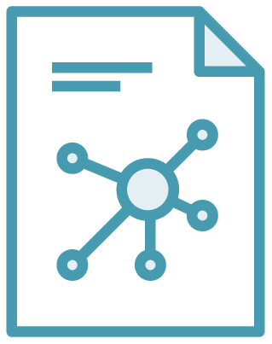
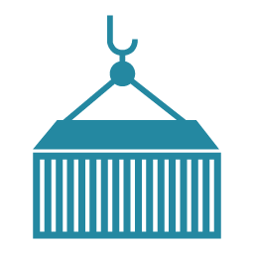
The Role of Images and Containers
Docker Image
Docker Container
Example: Ubuntu with Node.js and Application Code
Created by using an image. Runs your application.
Notes:
<number>

Slide 12
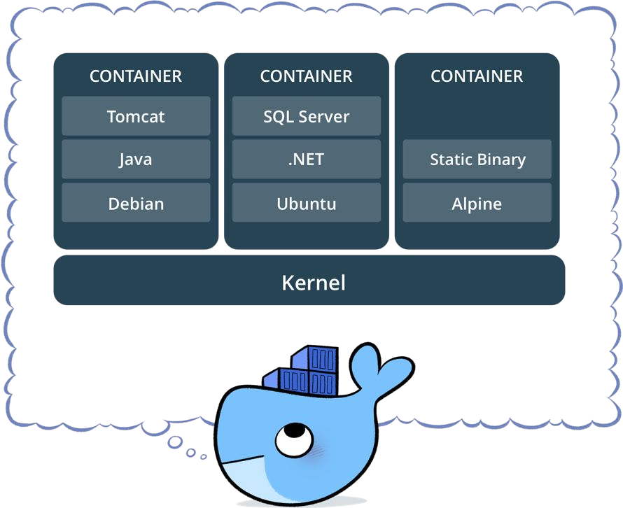
What is a container?
Standardized packaging for software and dependencies
Isolate apps from each other
Share the same OS kernel
Works for all major Linux distributions
Containers native to Windows Server 2016
Notes:
<number>

Slide 13


Docker containers are NOT VMs
Easy connection to make
Fundamentally different architectures
Fundamentally different benefits
VM
VM with Container
<number>
Notes:
<number>

Slide 14
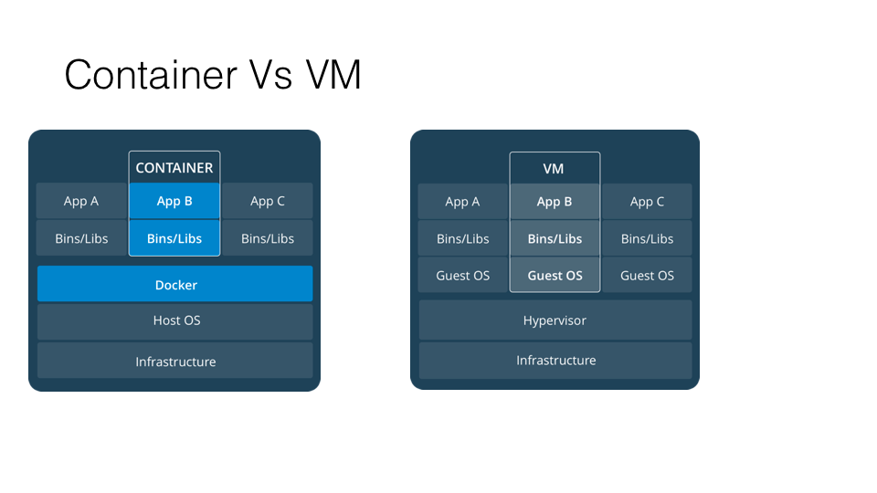
Container And VM

Slide 15
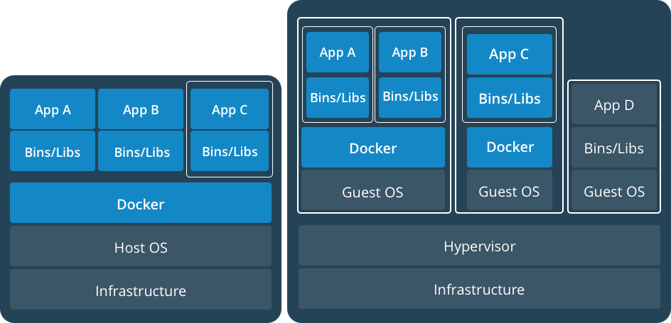
Docker Containers Versus Virtual Machines
App 1
App 2
Bins/Libs
Bins/Libs
Guest OS
Guest OS
App 1
App 2
Bins/Libs
Bins/Libs
Hypervisor
Docker Engine
Host Operating System
Host Operating System
Virtual Machines
Docker Containers
Notes:
<number>

Slide 16
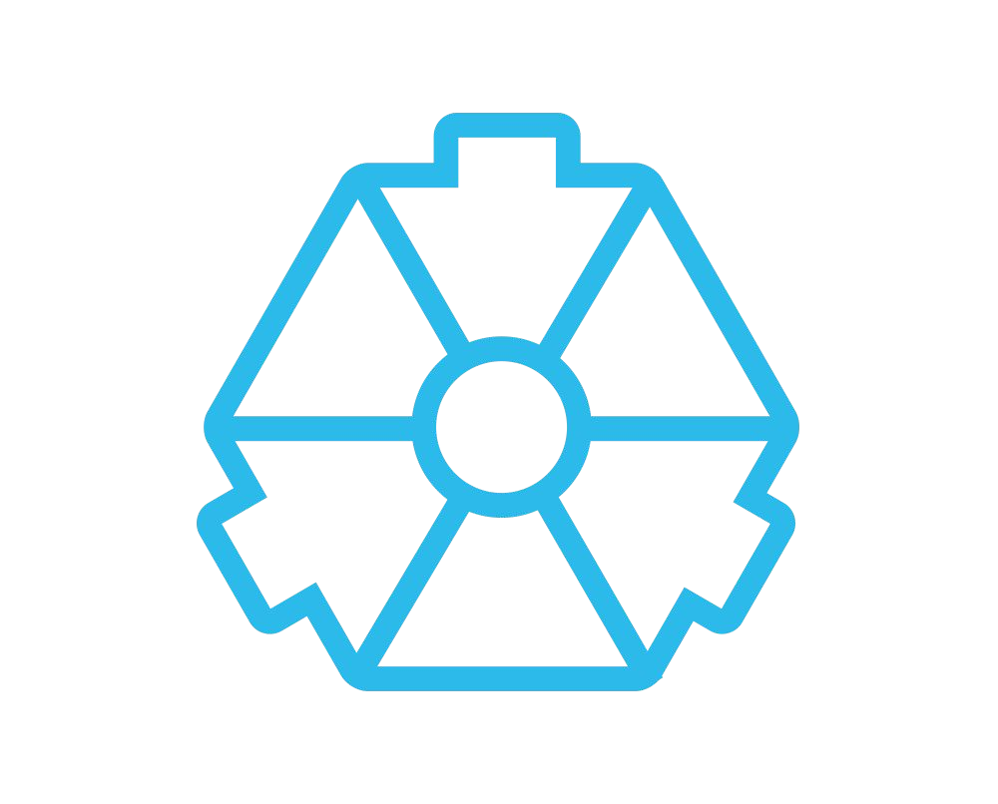
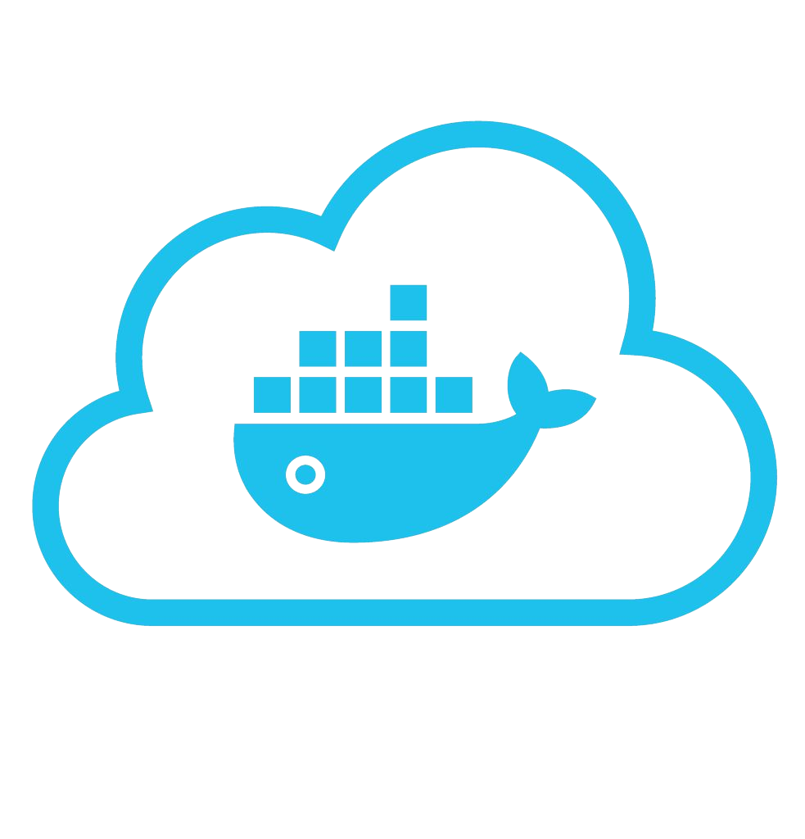
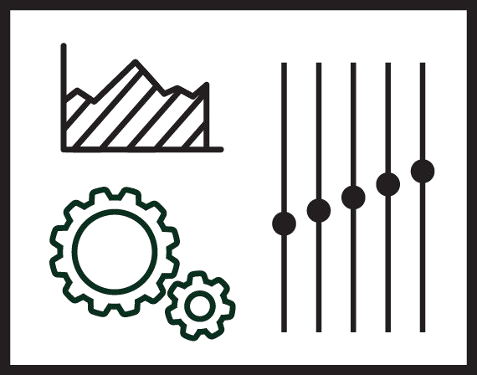





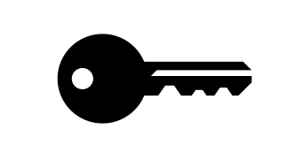



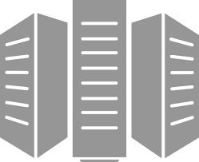



Using Docker: Build, Ship, Run Workflow
Developers IT Operations
BUILD
Development Environments
SHIP
Create & Store Images
RUN
Deploy, Manage, Scale
<number>
Notes:
<number>

Slide 17
The underlying technology
Docker is written in the Go programming language and takes advantage of several features of the Linux kernel to deliver its functionality.
Docker uses a technology called namespaces to provide the isolated workspace called the container.
When you run a container, Docker creates a set of namespaces for that container.
These namespaces provide a layer of isolation.
Each aspect of a container runs in a separate namespace and its access is limited to that namespace.

Slide 18
Installing Docker
Installing docker on Windows:
https://docs.docker.com/docker-for-windows/install/

Slide 19
Installing docker on ubuntu
https://tecadmin.net/install-docker-on-ubuntu/
https://docs.docker.com/install/linux/docker-ce/ubuntu/

Slide 20
Installing docker on mac
https://docs.docker.com/docker-for-mac/install/

Slide 21
Container
https://www.docker.com/resources/what-container
A container is a standard unit of software that packages up code and all its dependencies so the application runs quickly and reliably from one computing environment to another.

Slide 22
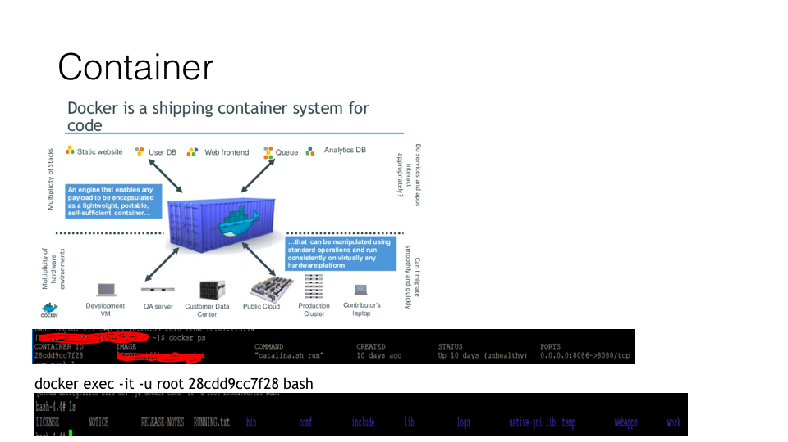

Slide 23
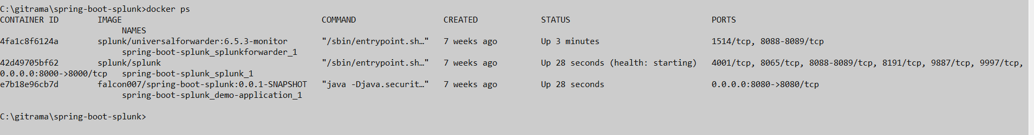
A Docker container image is a lightweight, standalone, executable package of software that includes everything needed to run an application: code, runtime, system tools, system libraries and settings

Slide 24
Docker Image
A Docker image is a file, comprised of multiple layers, used to execute code in a Docker container. An imageis essentially built from the instructions for a complete and executable version of an application, which relies on the host OS kernel.

Slide 25
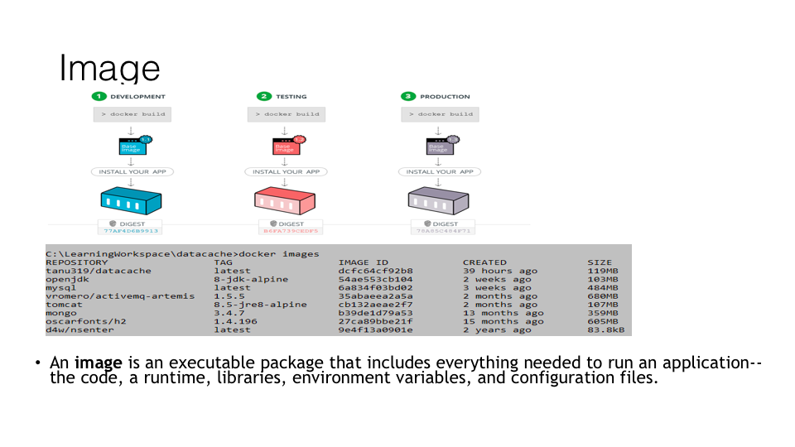
Image

Slide 26
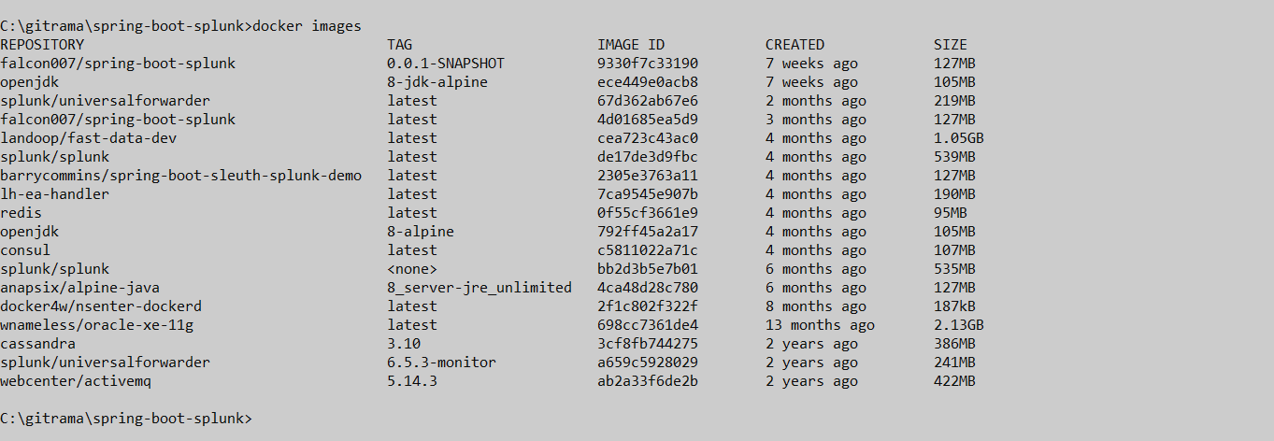
Docker images

Slide 27
Docker Commands Lab
Notes:
<number>

Slide 28
Basic Docker Commands
1)Pull docker images
$ docker image pull hello-world:latest
2)List docker image
$ docker image ls
3)Start container or Run Container
$ docker run --name hello hello-world:latest
4) List all running Container
$ docker ps
5) Stop container
$ docker stop hello(or <container id>)
Notes:
<number>

Slide 29
6)Remove docker container
$ docker rm hello (or <container id>)
7)Remove docker image
$ docker rmi hello-world(or <image id>)
8)Build docker image
$ docker build –t hello-world:2.0 .
9)Push docker image to repository
$ docker image push hello:2.0
10) List docker images
$ docker images
11) docker -help

Slide 30
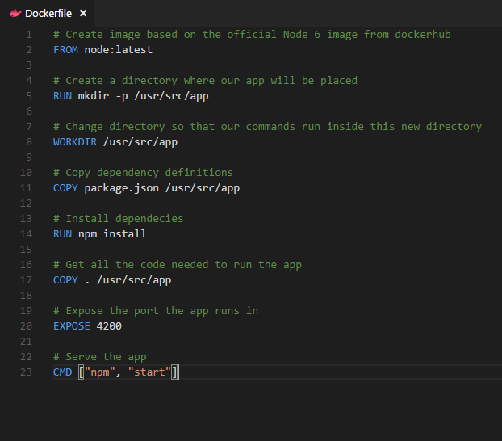
Dockerfile – Linux Example
Instructions on how to build a Docker image
Looks very similar to “native” commands
Important to optimize your Dockerfile
14
Notes:
<number>

Slide 31
Section 2:
Anatomy of a Docker Container Docker Volumes
Volume Use Cases
Notes:
<number>

Slide 32
Let’s Go Back to Our Dockerfile
<number>

Slide 33
Each Dockerfile Command Creates a Layer
…
EXPOSE
COPY
WORKDIR
RUN
FROM
Kernel
<number>
Notes:
<number>

Slide 34
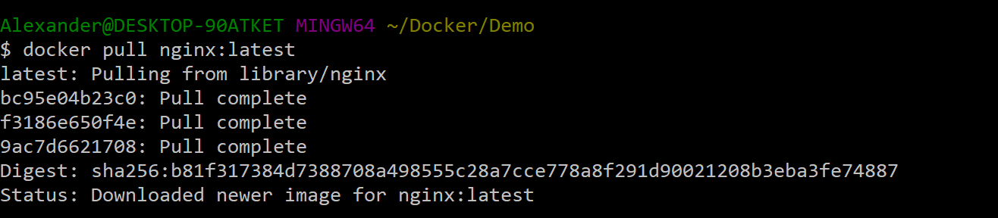
Docker Image Pull: Pulls Layers
<number>
Notes:
<number>

Slide 35
Docker Volumes
Volumes mount a directory on the host into the container at a specific location
Can be used to share (and persist) data between containers
Directory persists after the container is deleted
Unless you explicitly delete it
Can be created in a Dockerfile or via CLI
<number>
Notes:
<number>

Slide 36
Why Use Volumes
Mount local source code into a running container
docker container run -v $(pwd):/usr/src/app/ myapp
Improve performance
− As directory structures get complicated traversing the tree can slow system performance
Data persistence
<number>
Notes:
<number>

Slide 37

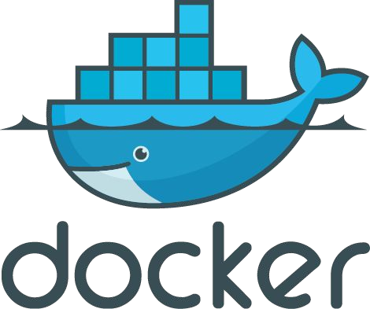
Section 3: Networking

Slide 38
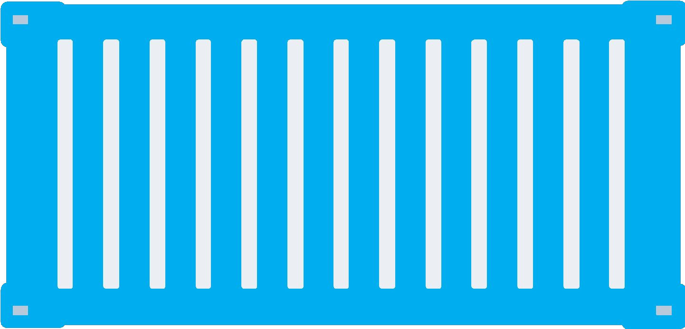
What is Docker Bridge Networking
Docker host
Docker host
Cntnr 1
Cntnr 2
Cntnr 3
Cntnr 4
Cntnr 5
Cntnr 6
Cntnr 7
bridgenet1
bridgenet2
bridgenet3
docker network create -d bridge --name bridgenet1
<number>

Slide 39


Docker Bridge Networking and Port Mapping
Docker host 1
Host port
Container port
Cntnr1
10.0.0.8
:80
$ docker container run -p 8080:80 ...
Bridge
172.14.3.55
:8080
L2/L3 physical network
<number>

Slide 40
Section 4: Docker Compose
Notes:
<number>

Slide 41




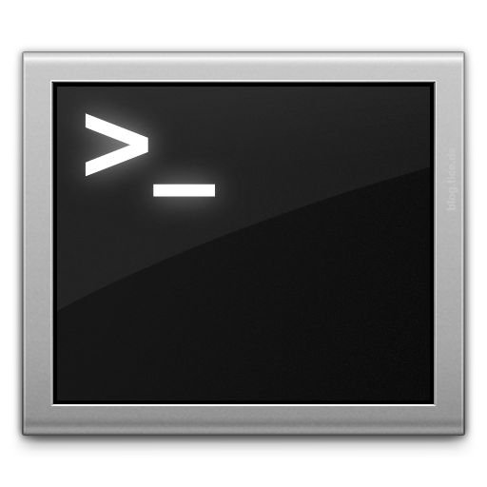







Docker Compose: Multi Container Applications
Build and run one container at a time
Manually connect containers together
Must be careful with dependencies and start up order
Define multi container app in compose.yml file
Single command to deploy entire app
Handles container dependencies
Works with Docker Swarm, Networking, Volumes, Universal Control Plane
49
Notes:
<number>

Slide 42

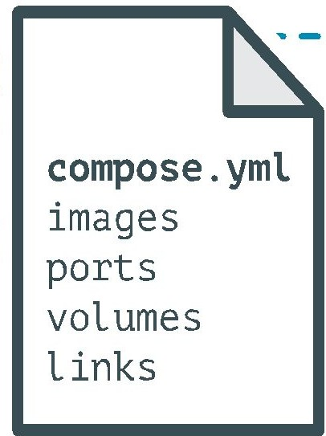
Docker Compose: Multi Container Applications
version: '2' # specify docker-compose version
# Define the services/containers to be run
services:
angular: # name of the first service
build: client # specify the directory of the Dockerfile
ports:
- "4200:4200" # specify port forewarding
express: #name of the second service
build: api # specify the directory of the Dockerfile
ports:
- "3977:3977" #specify ports forewarding
database: # name of the third service
image: mongo # specify image to build container from
ports:
- "27017:27017" # specify port forewarding
Notes:
<number>

Slide 43
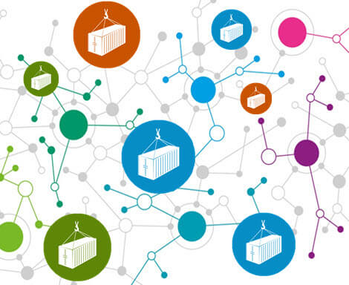
Docker Compose: Scale Container Applications
Notes:
<number>

Slide 44



Demo
Angular
Node.js/Express
Mongo DB
Notes:
<number>

Slide 45
Notes:
<number>

