Slide 1
Spring Boot Basics
"An Introduction to Rapid Application Development with Spring Boot"
Presenter Name: Rama Shanker
Date: 28/01/2025

Slide 2
Agenda
What is Spring Boot?
Features of Spring Boot
Spring Boot vs. Spring Framework
Core Components
How to Create a Spring Boot Application
Demo (Optional)
Q&A

Slide 3
What is Spring Boot?
A framework for building stand-alone, production-ready Spring applications.
Simplifies Spring Framework setup with embedded servers, default configurations, and reduced boilerplate.
Suitable for Microservices architecture.

Slide 4
Features of Spring Boot
Auto-Configuration: Automatically configures Spring Beans based on application needs.
Embedded Server: Comes with embedded Tomcat, Jetty, or Undertow.
Opinionated Defaults: Provides sensible defaults to get started quickly.
Production-Ready: Includes monitoring and health checks via Actuator.
Microservice Support: Ideal for creating lightweight, distributed services.

Slide 5
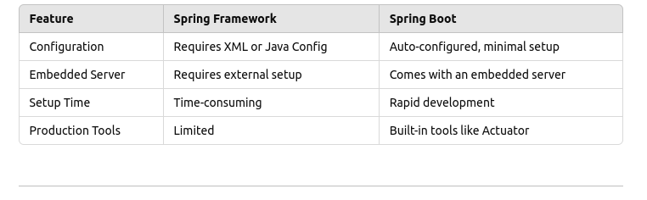
Spring Boot vs. Spring Framework

Slide 6
Core Components of Spring Boot
Starter Dependencies: Simplifies Maven/Gradle dependencies (e.g., spring-boot-starter-web).
Spring Boot CLI: Command-line tool for running Spring Boot applications.
Embedded Servers: Run applications without external server dependencies.
Spring Boot Actuator: Monitor and manage applications in production.
Spring Boot Initializer: Web-based tool to generate Spring Boot projects (https://start.spring.io)

Slide 7
Spring Boot Architecture
Spring Boot Application Layer:
Spring Boot Starter: Predefined dependencies for simplifying configuration (e.g., spring-boot-starter-web, spring-boot-starter-data-jpa).
Spring Boot CLI: Optional tool for running Groovy scripts and rapid development.
Controller Layer:
Handles HTTP requests and defines RESTful endpoints.
Controllers use annotations like @RestController, @RequestMapping, and @GetMapping.
Service Layer:
Contains the business logic of the application.
Uses @Service annotation.
Repository/Data Access Layer:
Interacts with the database using JPA, Hibernate, or other data persistence APIs.
Uses @Repository annotation.
Includes Spring Data JPA and CRUD Repository abstractions.

Slide 8
Model Layer:
Contains entity classes that represent the applicationâ€™s data structure.
Annotations like @Entity, @Table, and @Id are used for mapping.
Configuration Layer:
Auto-configuration provided by Spring Boot to reduce boilerplate code.
Includes application.properties or application.yml for external configurations.
Embedded Server:
Default servers like Tomcat, Jetty, or Undertow for running the application.
Dependency Injection (DI) Container:
Manages beans and their lifecycle.
Uses @Component, @Bean, @Autowired, and other annotations for dependency injection.
Spring Boot Actuator:
Provides production-ready features like health checks, metrics, and monitoring.
Spring Security (Optional):
Handles authentication, authorization, and security.

Slide 9
How to Create a Spring Boot Application
Using Spring Initializr
Go to https://start.spring.io.
Choose dependencies (e.g., Web, JPA, H2).
Generate and download the project.
Code Example:
@RestController
public class HelloController {
@GetMapping("/hello")
public String sayHello() {
return "Hello, Spring Boot!";
}
}
Run the Application:
Use mvn spring-boot:run or run the main() method.

Slide 10
Demo
Build a simple "Hello World" Spring Boot application.
Add a REST endpoint and run the application.
Summary
Spring Boot simplifies application development with less configuration.
Key features include auto-configuration, embedded servers, and production-ready tools.
Perfect for microservices architecture.

