Slide 3
Java Multithreading
Presented by Rama Shanker
[Date]: 24/01/2025

Slide 4
What is Multithreading?
Definition:
The ability to execute multiple threads (smallest units of a process) concurrently.
Why Multithreading?
Better utilization of CPU resources.
Parallel execution for faster performance.
Allows responsiveness in applications (e.g., GUI).

Slide 5
Threads in Java
Thread: Lightweight process.
Java Support:
java.lang.Thread class.
Java.lang.Runnable interface.
Main Thread: Every Java application starts with a single thread - the main thread.

Slide 6
Creating Threads
Two Ways to Create Threads:
Extend the Thread class.
Implement the Runnable interface.

Slide 7
Extending the Thread Class
Code Example:
Key Methods:
start(): Starts the thread.
run(): Contains the logic for the thread.
public class MyThread extends Thread {
public void run() {
System.out.println("Thread is running...");
}
public static void main(String[] args) {
MyThread thread = new MyThread();
thread.start(); // Starts the thread
}
}

Slide 8
Implementing the Runnable Interface
Code Example:
public class MyRunnable implements Runnable {
public void run() {
System.out.println("Thread is running...");
}
public static void main(String[] args) {
Thread thread = new Thread(new MyRunnable());
thread.start(); // Starts the thread
}
}
Why Use Runnable?
Better for cases where a class needs to extend another class.

Slide 9
Thread Lifecycle
States of a Thread:
New: Thread is created but not started.
Runnable: Ready to run but waiting for CPU time.
Running: Thread is executing.
Blocked/Waiting: Thread is waiting for resources.
Terminated: Thread has completed execution.

Slide 10
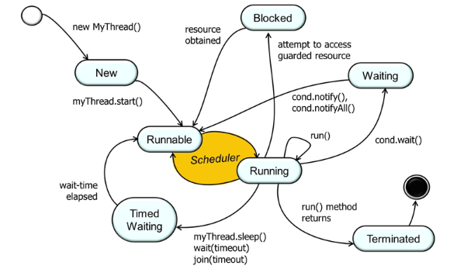
Diagram

Slide 11
Thread Synchronization
Why Synchronize?
To prevent race conditions when multiple threads access shared resources.
Synchronized Keyword:
Locks the resource so only one thread can access it at a time.
public class Counter {
private int count = 0;
public synchronized void increment() {
count++;
}
public int getCount() {
return count;
}
}

Slide 12
Inter-Thread Communication
Purpose: Allows threads to communicate and coordinate their actions.
Methods:
wait(): Causes the current thread to wait until another thread invokes notify().
notify(): Wakes up a single waiting thread.
notifyAll(): Wakes up all waiting threads.
synchronized(obj) {
obj.wait(); // Wait for notification
obj.notify(); // Notify one thread
}

Slide 13
Thread Pools
Definition: A group of pre-instantiated threads available for use.
Advantages:
Efficient thread management.
Prevents overhead of thread creation/destruction.

Slide 14
Example with Executor Service:
import java.util.concurrent.ExecutorService;
import java.util.concurrent.Executors;
public class ThreadPoolExample {
public static void main(String[] args) {
ExecutorService executor = Executors.newFixedThreadPool(3);
for (int i = 0; i < 5; i++) {
executor.execute(() -> {
System.out.println("Thread " + Thread.currentThread().getName() + " is running");
});
}
executor.shutdown();
}
}

Slide 15
Multithreading Challenges
Race Conditions:
Occurs when multiple threads modify shared resources concurrently.
Deadlocks:
Occurs when two threads are waiting on each other to release locks.
Starvation:
A thread is unable to execute because other threads consume all resources.

Slide 16
Best Practices for Multithreading
Minimize use of shared resources.
Use thread-safe collections (e.g., ConcurrentHashMap).
Use thread pools for managing multiple threads.
Avoid deadlocks by acquiring locks in a consistent order.

Slide 17
Summary
Multithreading allows parallel execution and efficient CPU utilization.
Use synchronization and thread pools for better thread management.
Handle challenges like race conditions and deadlocks carefully.

