Slide 1
Title: Introduction to Java Basics and Data Types
Subtitle: A Comprehensive Guide for Beginners
Name: Rama Shanker
Date: 21/01/2025

Slide 2
What is Java?
Definition
Java is a high-level, object-oriented programming language.
Designed for platform independence: "Write Once, Run Anywhere."
Key Features
Simple and easy to learn.
Secure and robust.
Portable and platform-independent.
Multi-threaded and dynamic.

Slide 3
Why Learn Java?
Applications of Java
Android app development.
Web applications.
Enterprise software.
Embedded systems.
Benefits
Strong community support.
Extensive libraries and frameworks.
High demand in the industry.

Slide 4
Java Development Environment
Components
JDK (Java Development Kit): Contains tools for development.
JRE (Java Runtime Environment): Enables execution of Java programs.
JVM (Java Virtual Machine): Converts bytecode to machine code.
Setup Steps
Download and install JDK.
Set the PATH environment variable.
Use an IDE like IntelliJ IDEA, Eclipse, or NetBeans.

Slide 5
Basic Syntax of Java
Example Program
public class HelloWorld {
int a=10;
int b=20
char =’a’
public static void main(String[] args) {
System.out.println("Hello, World!");
}
}
HelloWorld hello= new HelloWorld();
Explanation
public class HelloWorld: Declares a class.
public static void main(String[] args): Entry point of the program.
System.out.println: Prints output to the console.
010110

Slide 6
Java Data Types
Categories of Data Types
Primitive Data Types:
Basic building blocks.
Examples: int, float, char, boolean.
Non-Primitive Data Types:
Objects and arrays.
Examples: Strings, Arrays, Classes.

Slide 7
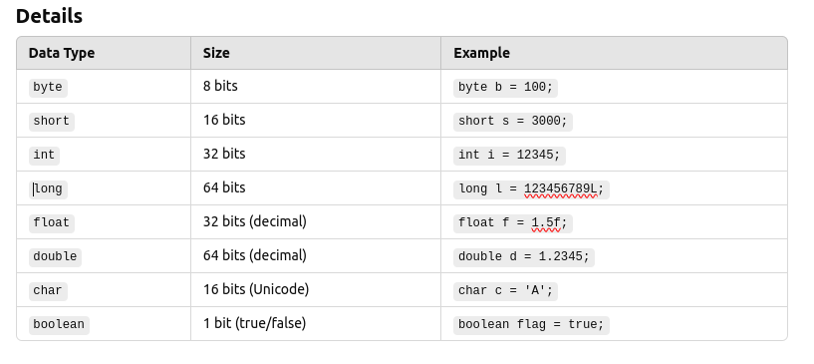
Primitive Data Types

Slide 8
Non-Primitive Data Types
Examples
String: A sequence of characters.
String name = "Java";
Array: Collection of elements of the same type.
int[] numbers = {1, 2, 3, 4, 5};
Class and Objects: Custom types created by the user.
class Car {
String brand;
int speed;
int wheels=4
String VIN
}
Car myCar= new Car()

Slide 9
Data Type Conversion
Automatic (Widening)
Converts smaller types to larger types.
Example:
int num = 10;
double d = num; // int to double
Explicit (Narrowing)
Converts larger types to smaller types.
Example:
double d = 10.5;
int num = (int) d; // double to int

Slide 10
Summary
Java Basics:
Platform-independent and widely used.
Clear syntax and powerful features.
Data Types:
Primitive and Non-Primitive.
Integral, floating-point, character, and boolean.
Practice Tips:
Write and debug simple programs.
Explore data types in depth.

