Slide 1

Installation
Rama Shanker

Slide 2



Slide 3
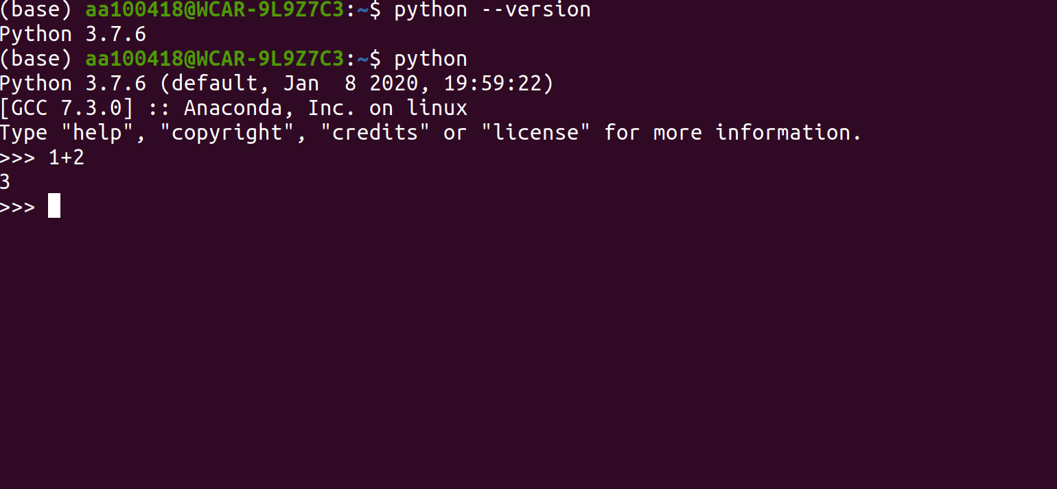
https://www.python.org/downloads/
https://docs.python-guide.org/starting/install3/linux/

Slide 4
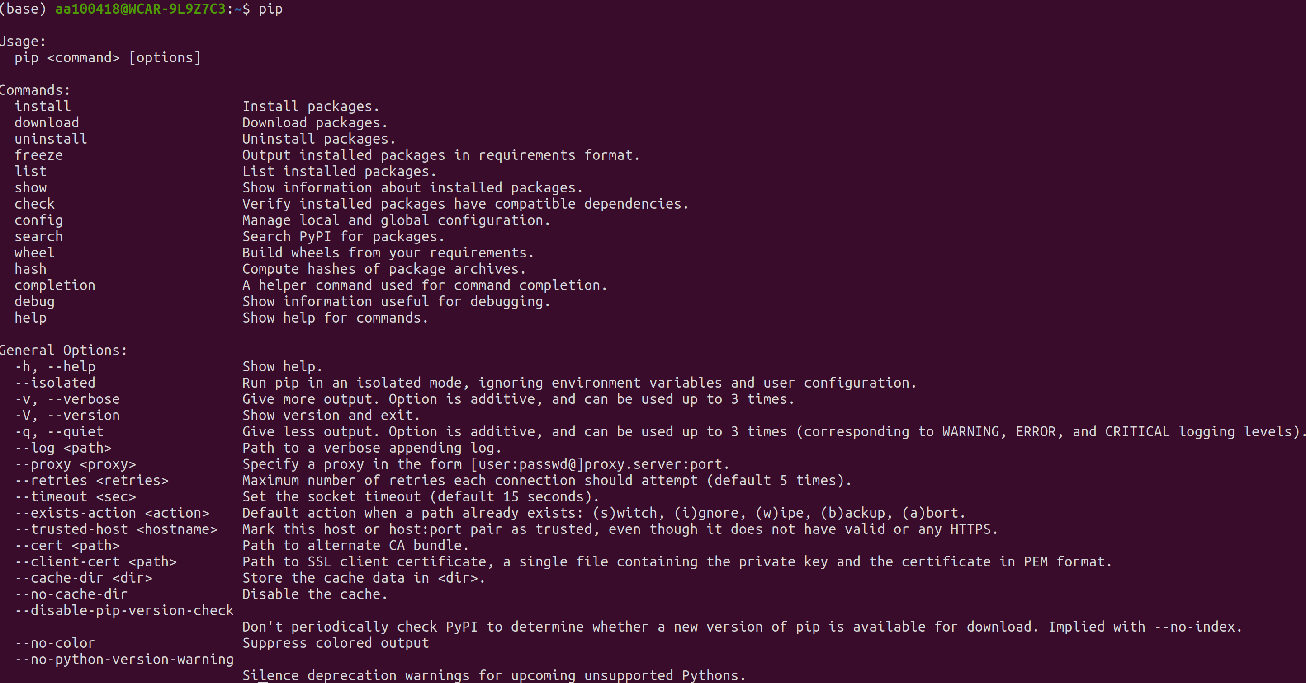
Set Up PIP

Slide 5


Slide 6
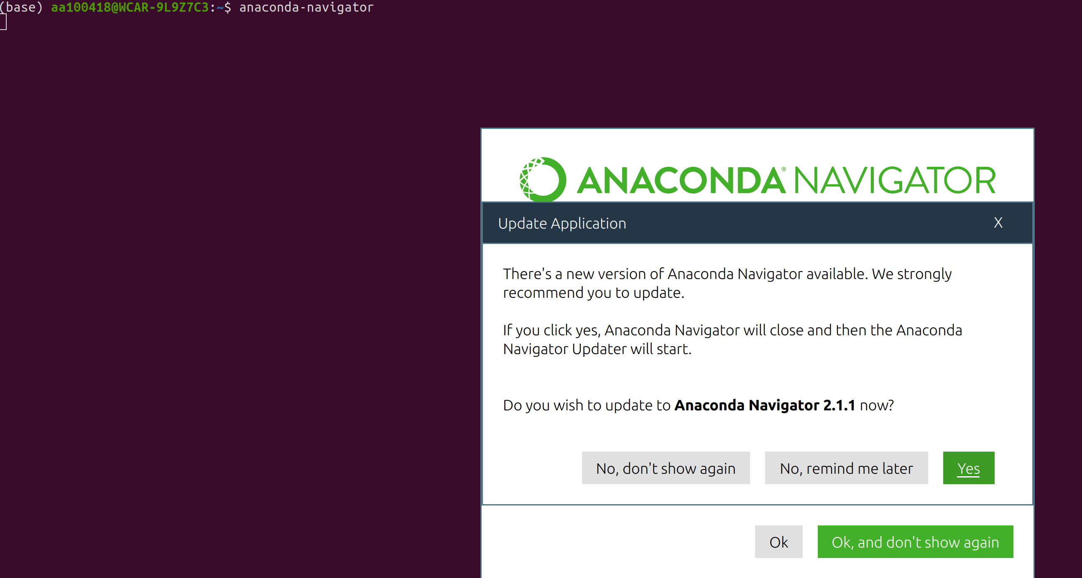
https://docs.conda.io/projects/conda/en/latest/user-guide/install/index.html

Slide 7
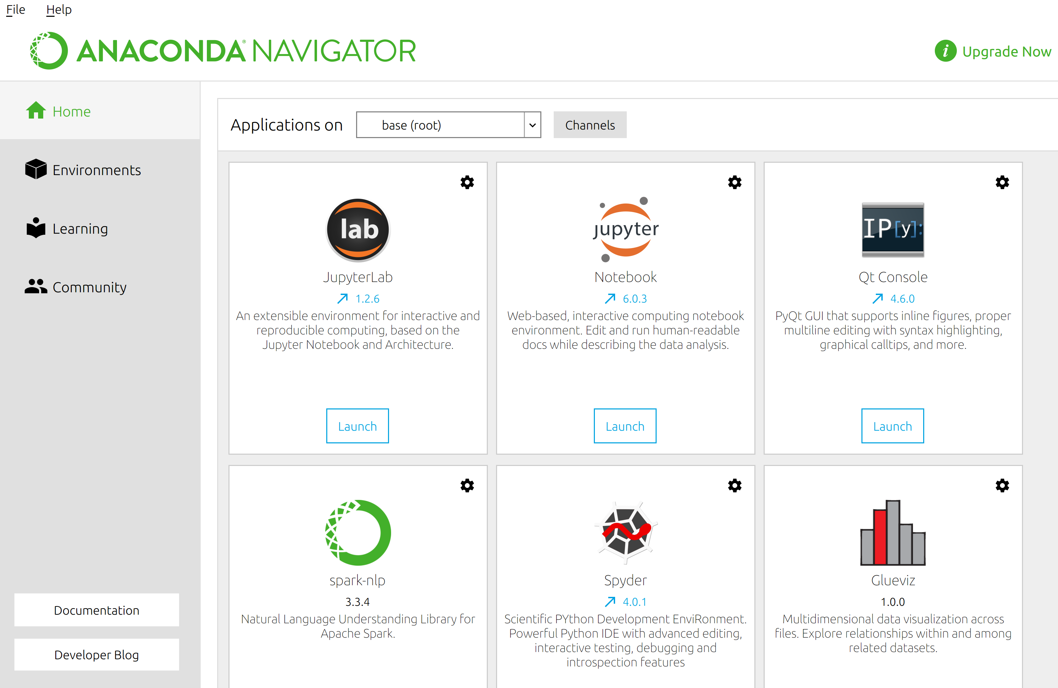

Slide 8


Slide 9
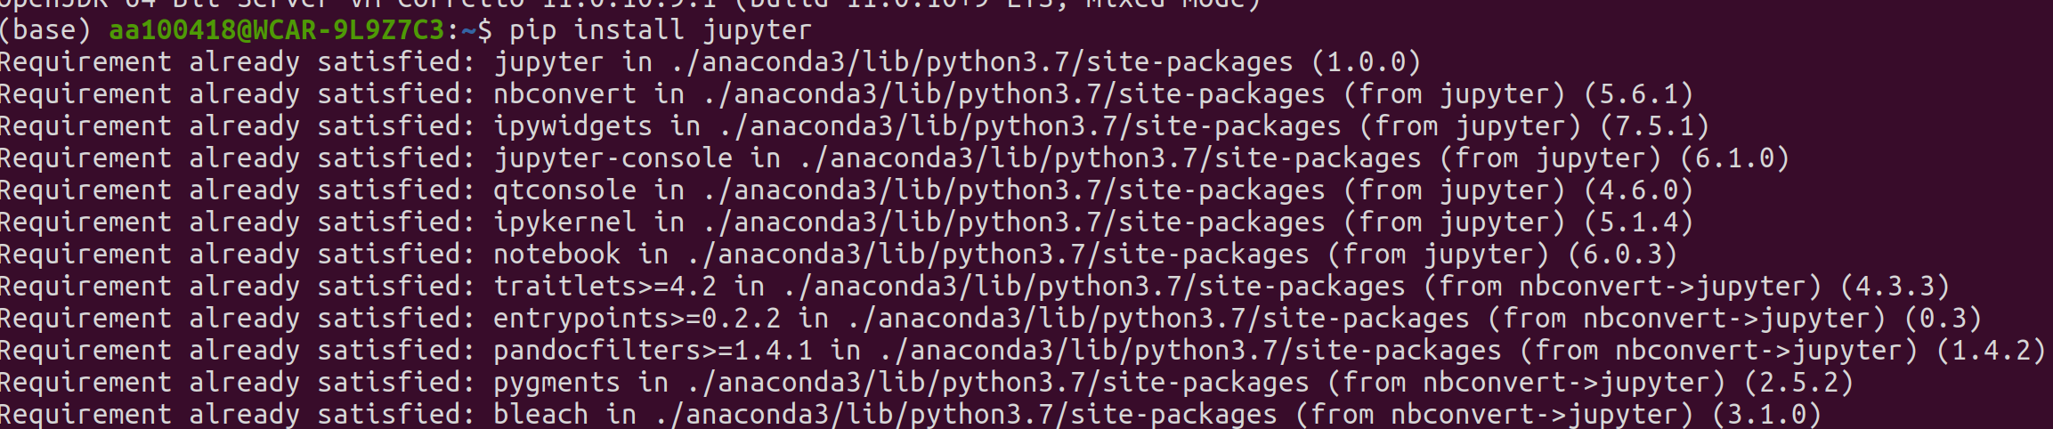
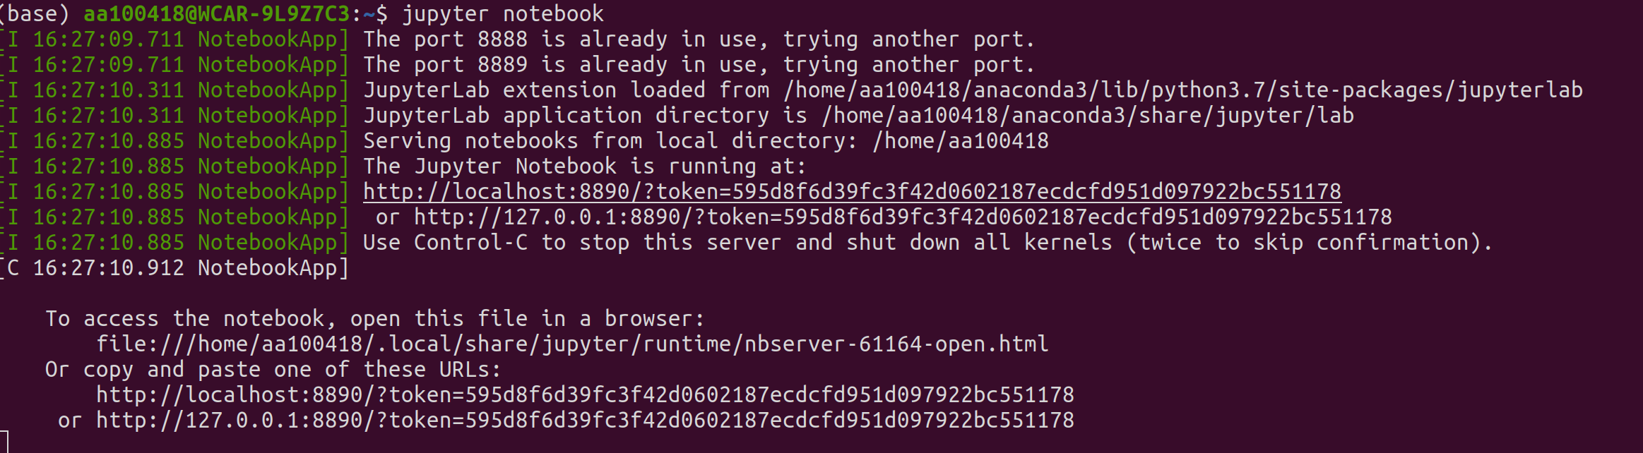
pip install jupyter
jupyter notebook

Slide 10
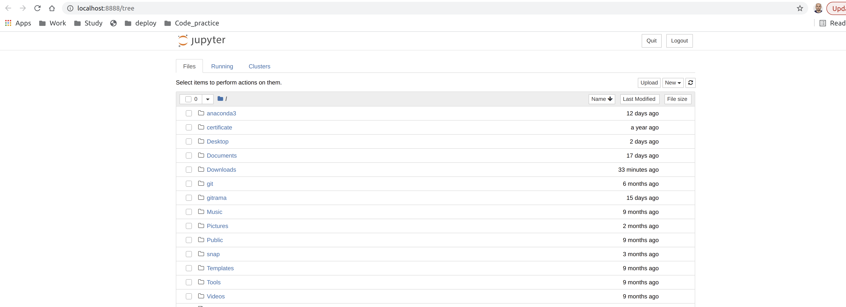
https://jupyter.org/install
http://localhost:8889/tree

Slide 11


Slide 12
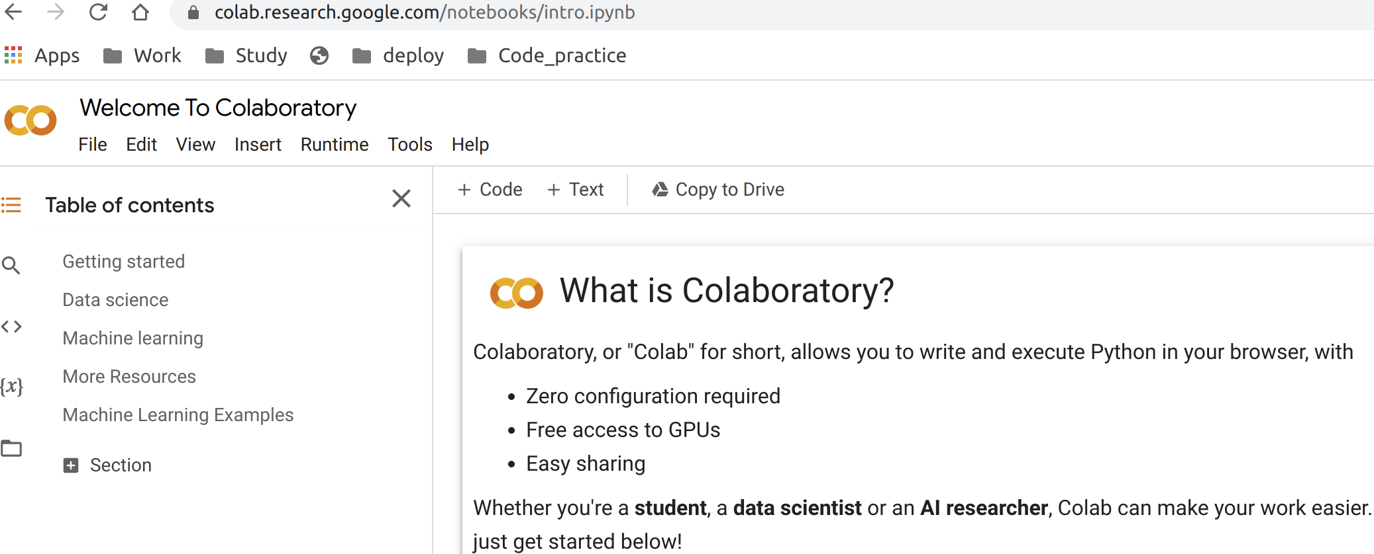
https://colab.research.google.com/notebooks/intro.ipynb

Slide 13


Slide 14
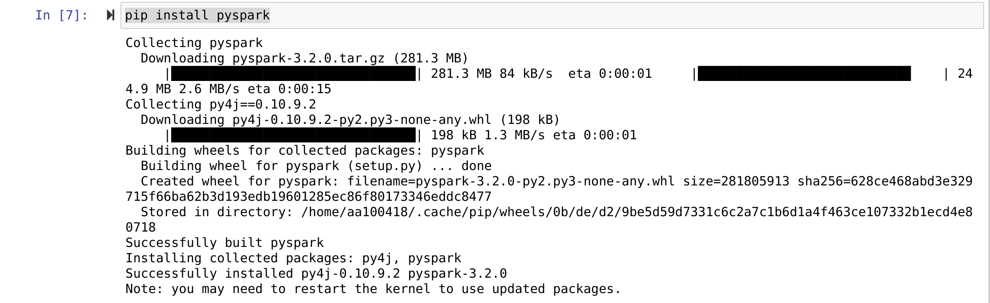
pip install pyspark

Slide 15
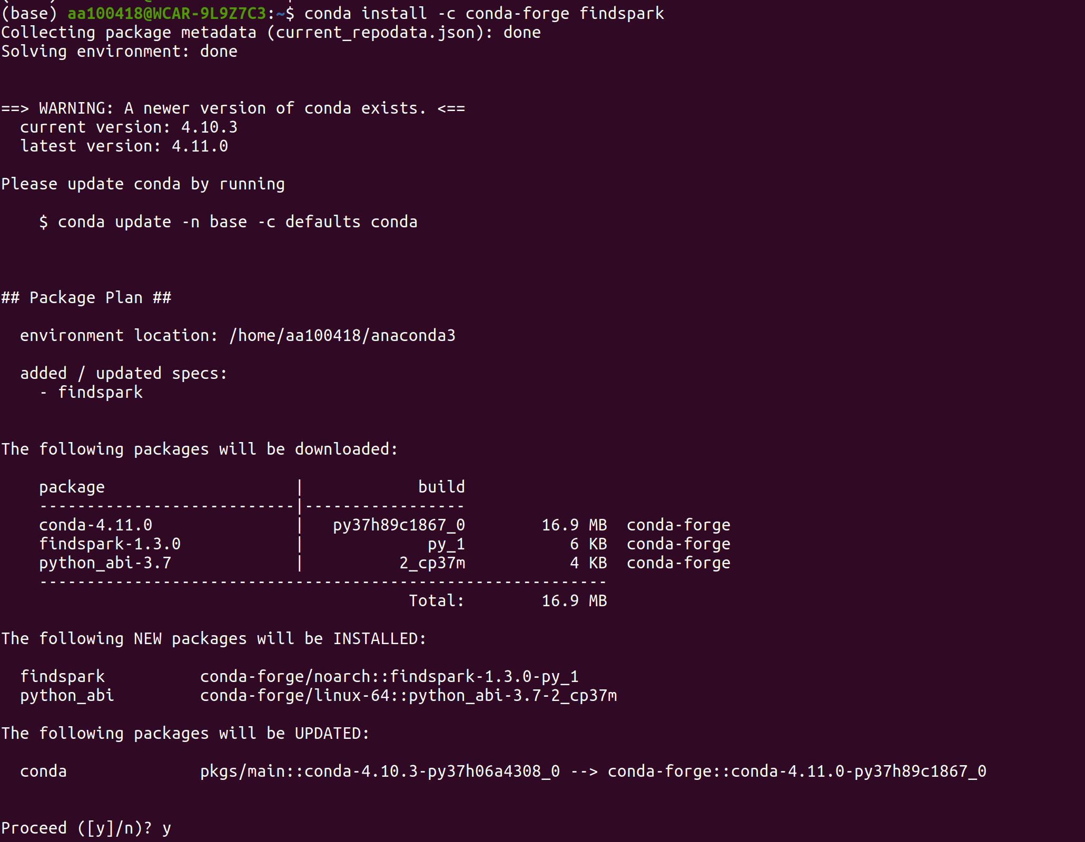

Slide 16
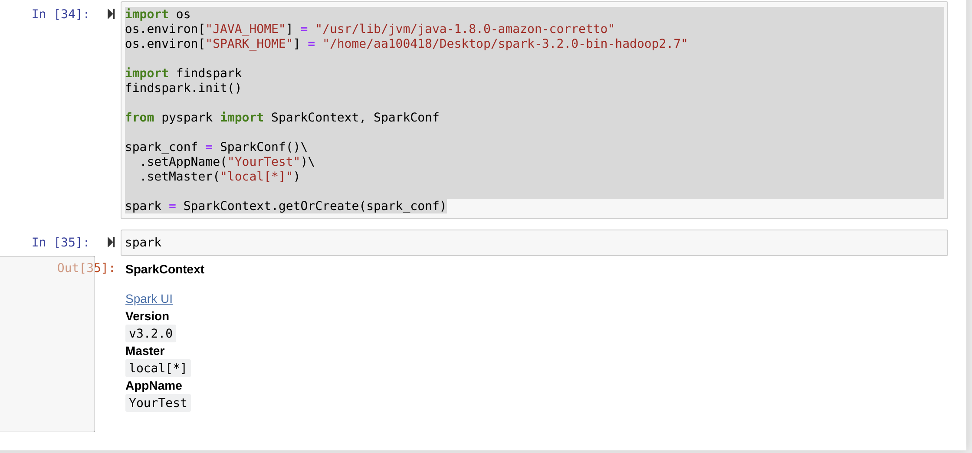
import os
os.environ["JAVA_HOME"] = "/usr/lib/jvm/java-1.8.0-amazon-corretto"
os.environ["SPARK_HOME"] = "/home/aa100418/Desktop/spark-3.2.0-bin-hadoop2.7"
import findspark
findspark.init()
from pyspark import SparkContext, SparkConf
spark_conf = SparkConf()\
.setAppName("YourTest")\
.setMaster("local[*]")
spark = SparkContext.getOrCreate(spark_conf)

Slide 17
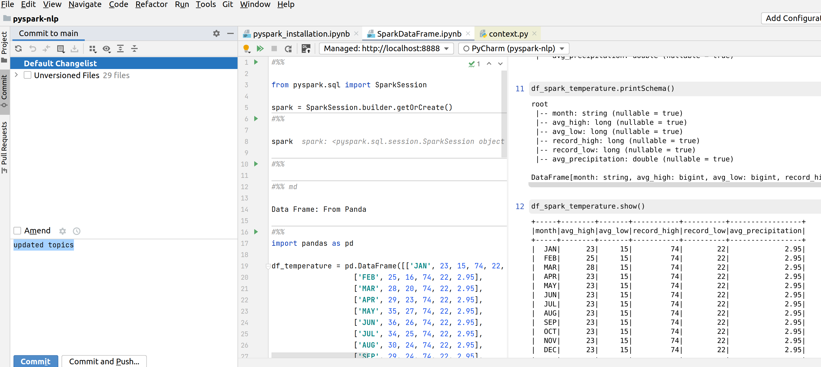
Pycharm:Set proper(conda) python interpreter before start

Slide 18
!apt-get update -qq > /dev/null
!apt-get install openjdk-8-jdk-headless -qq > /dev/null
!wget -q https://downloads.apache.org/spark/spark-3.2.0/spark-3.2.0-bin-hadoop2.7.tgz
!tar xf spark-3.2.0-bin-hadoop2.7.tgz
!pip install -q findspark
import os
os.environ["JAVA_HOME"] = "/usr/lib/jvm/java-8-openjdk-amd64"
os.environ["SPARK_HOME"] = "/content/spark-3.2.0-bin-hadoop2.7"
import findspark
findspark.init()
from pyspark import SparkContext, SparkConf
spark_conf = SparkConf()\
.setAppName("SparkTest")\
.setMaster("local[*]")
spark = SparkContext.getOrCreate(spark_conf)

Slide 19
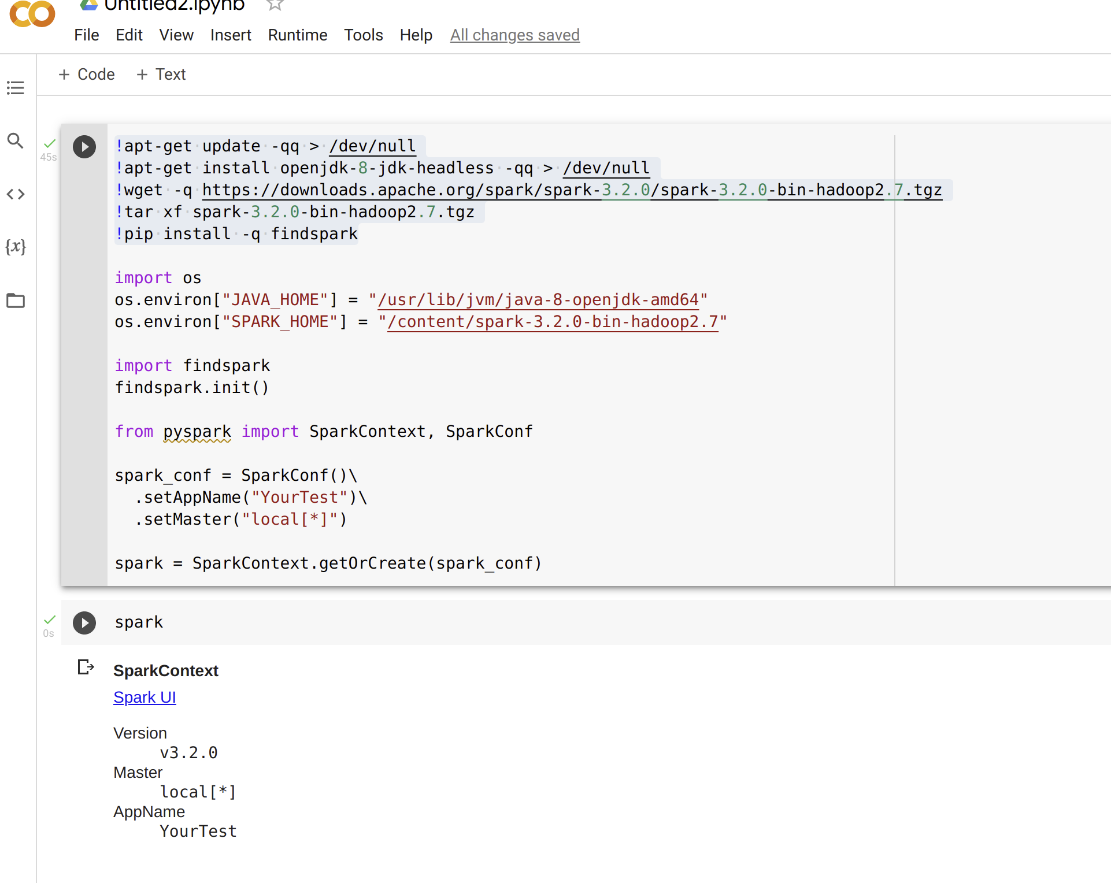

Slide 21
THANKS !

