Slide 1

Decision Tree Model
Rama Shanker

Slide 2
DecisionTree Model With Case study

Slide 3
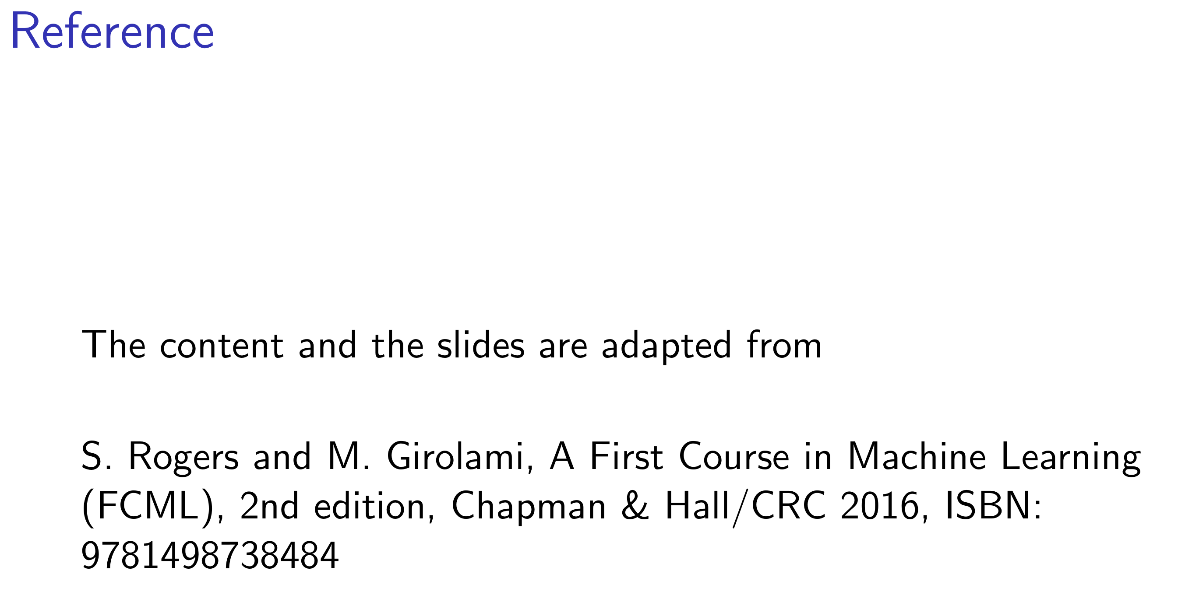

Slide 4
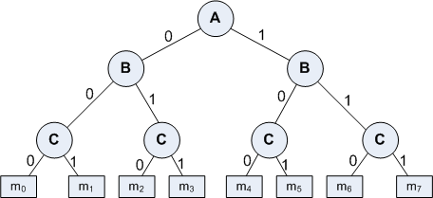
Basic Concept
A Decision Tree is an important data structure known to solve many computational problems
Example 9.1: Binary Decision Tree
<number>

Slide 5
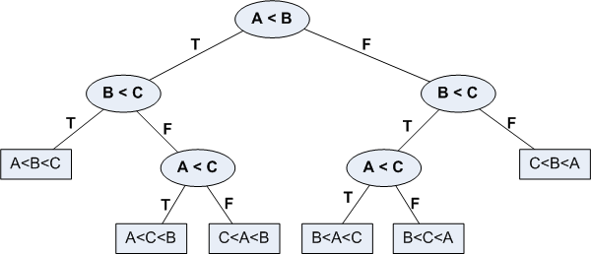
Basic Concept
In Example 9.1, we have considered a decision tree where values of any attribute if binary only. Decision tree is also possible where attributes are of continuous data type
Example 9.2: Decision Tree with numeric data
<number>

Slide 6
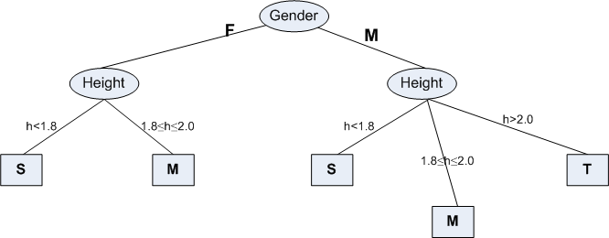
Some Characteristics
Decision tree may be n-ary, n ≥ 2.
There is a special node called root node.
All nodes drawn with circle (ellipse) are called internal nodes.
All nodes drawn with rectangle boxes are called terminal nodes or leaf nodes.
Edges of a node represent the outcome for a value of the node.
In a path, a node with same label is never repeated.
Decision tree is not unique, as different ordering of internal nodes can give different decision tree.
<number>

Slide 7
Decision Tree and Classification Task
Decision tree helps us to classify data.
Internal nodes are some attribute
Edges are the values of attributes
External nodes are the outcome of classification
Such a classification is, in fact, made by posing questions starting from the root node to each terminal node.
<number>

Slide 8
Decision Tree and Classification Task
Example 9.3 : Vertebrate Classification
What are the class label of Dragon and Shark?
Name | Body Temperature | Skin Cover | Gives Birth | Aquatic Creature | Aerial Creature | Has Legs | Hibernates | Class
Human | Warm | hair | yes | no | no | yes | no | Mammal
Python | Cold | scales | no | no | no | no | yes | Reptile
Salmon | Cold | scales | no | yes | no | no | no | Fish
Whale | Warm | hair | yes | yes | no | no | no | Mammal
Frog | Cold | none | no | semi | no | yes | yes | Amphibian
Komodo | Cold | scales | no | no | no | yes | no | Reptile
Bat | Warm | hair | yes | no | yes | yes | yes | Mammal
Pigeon | Warm | feathers | no | no | yes | yes | no | Bird
Cat | Warm | fur | yes | no | no | yes | no | Mammal
Leopard | Cold | scales | yes | yes | no | no | no | Fish
Turtle | Cold | scales | no | semi | no | yes | no | Reptile
Penguin | Warm | feathers | no | semi | no | yes | no | Bird
Porcupine | Warm | quills | yes | no | no | yes | yes | Mammal
Eel | Cold | scales | no | yes | no | no | no | Fish
Salamander | Cold | none | no | semi | no | yes | yes | Amphibian
<number>

Slide 9
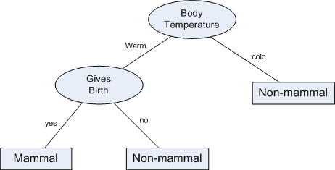
Decision Tree and Classification Task
Example 9.3 : Vertebrate Classification
Suppose, a new species is discovered as follows.
Decision Tree that can be inducted based on the data (in Example 9.3) is as follows.
Name | Body Temperature | Skin Cover | Gives Birth | Aquatic Creature | Aerial Creature | Has Legs | Hibernates | Class
Gila Monster | cold | scale | no | no | no | yes | yes | ?
<number>

Slide 10
THANKS !

