Slide 1

Logistic Regression Model
Rama Shanker

Slide 2
Gradient Boosting Model With Case study

Slide 3
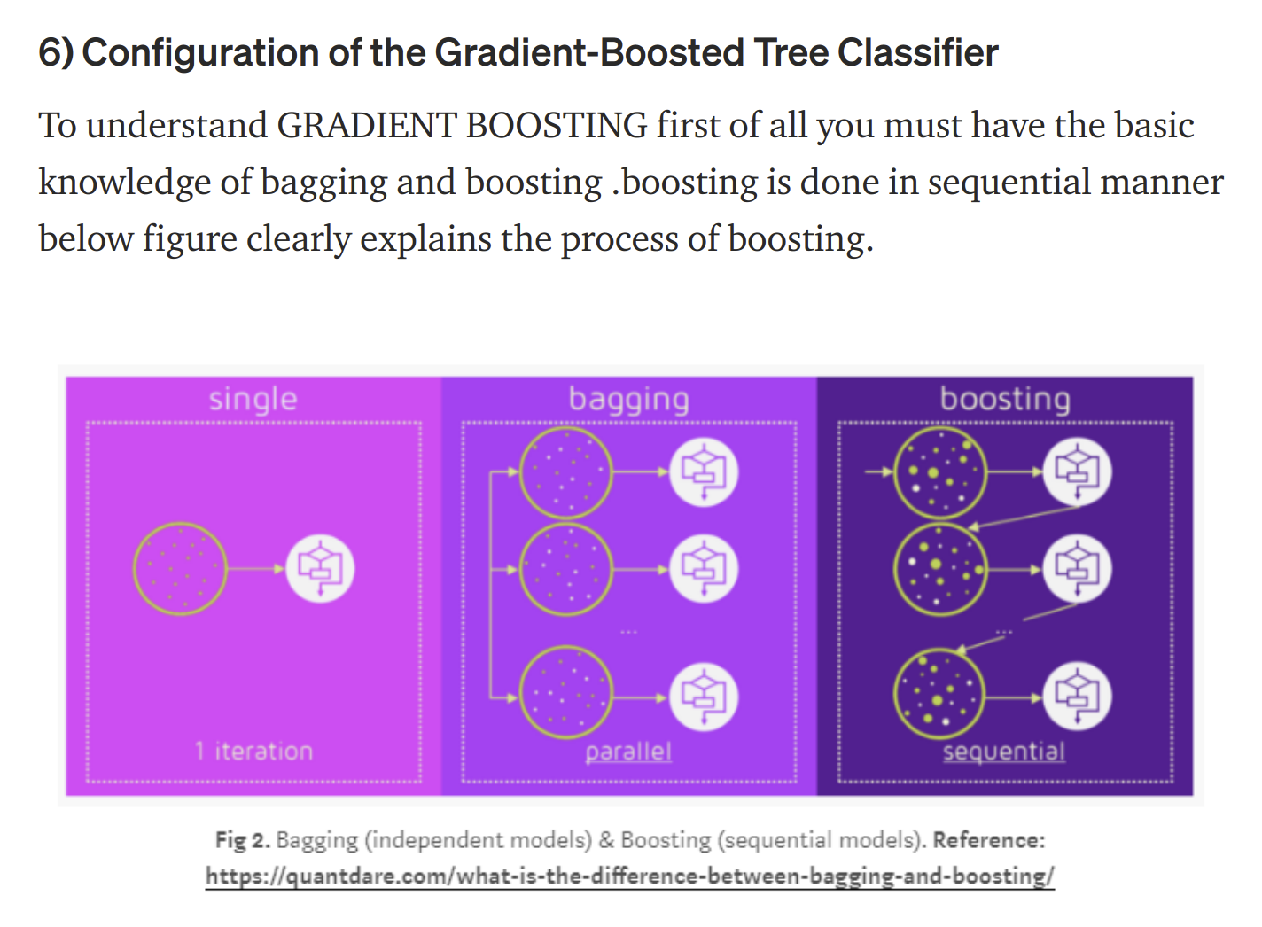

Slide 4
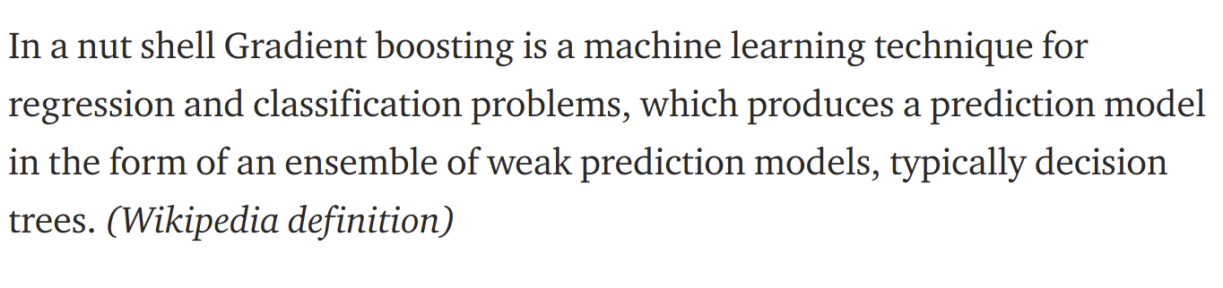

Slide 5
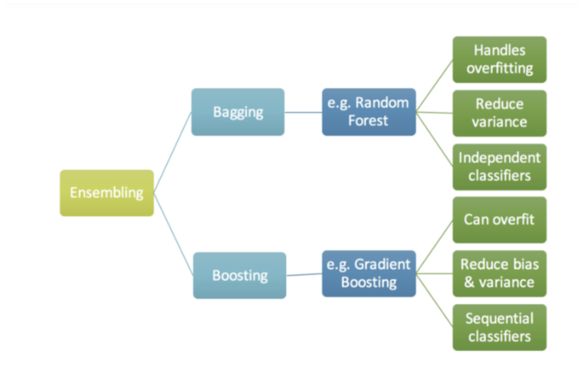

Slide 6
THANKS !

