Slide 1

Pyspark Reading DataSet
Rama Shanker

Slide 2

Pyspark

Slide 3

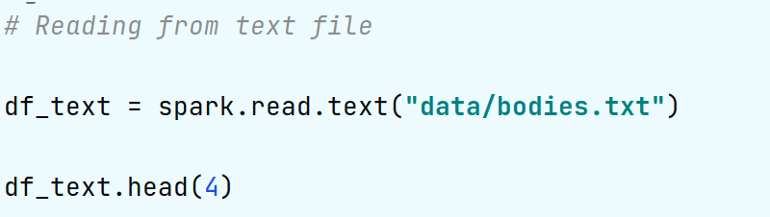
Reading from text file

Slide 4
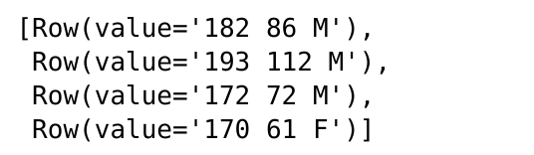

Slide 5
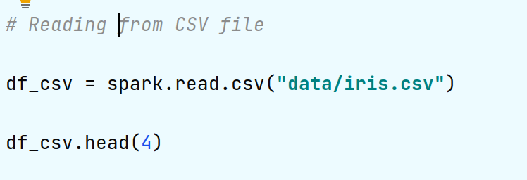

Slide 7
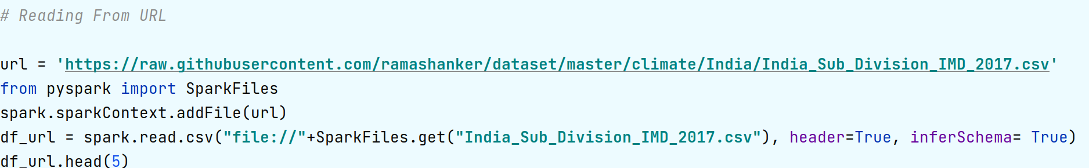

Slide 8
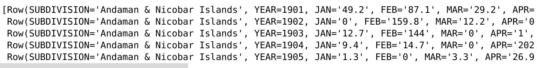

Slide 9

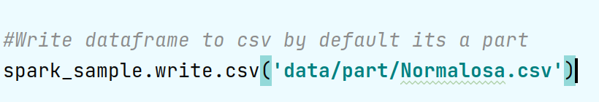
Writing to file (its always write as a part)

Slide 10
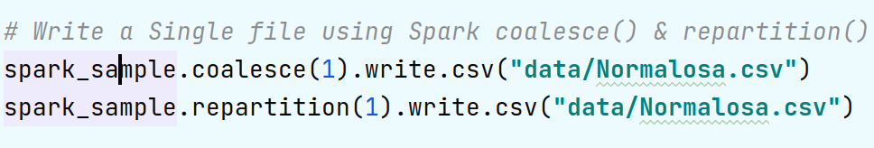

Slide 11
THANKS !

