Slide 1

Pyspark Reading DataSet
Rama Shanker

Slide 2

Pyspark

Slide 3

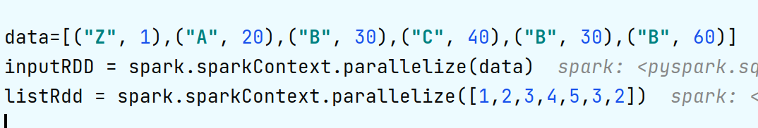
Pyspark Actions

Slide 4

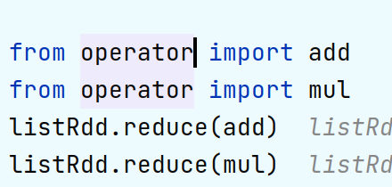
reduce Aggregate the elements of the data set using a function func (which takes two arguments and returns one). The function should be commutative and associative so that it can be computed correctly in parallel.

Slide 5
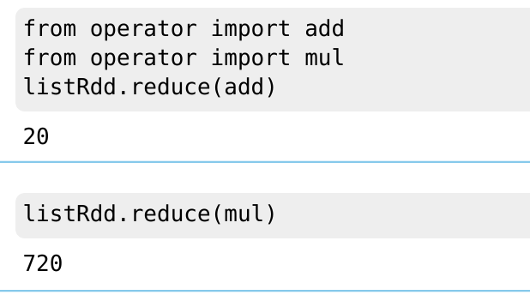

Slide 6

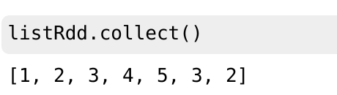
# Collect #Return all the elements of the dataset as an array at the driver program. #This is usually useful after a filter or other operation that returns a sufficiently small subset of the data.

Slide 7
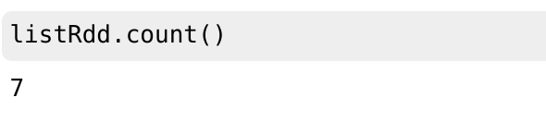
count:Return the number of elements in the dataset.

Slide 8
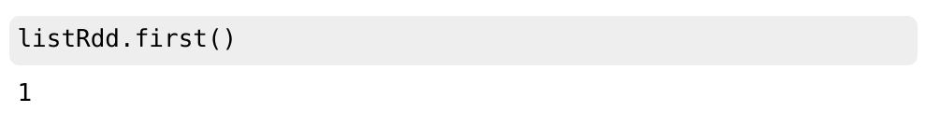
first: Return the first element of the data set (similar to take(1)).

Slide 9
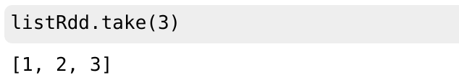
take(n):Return an array with the first n elements of the dataset.

Slide 10
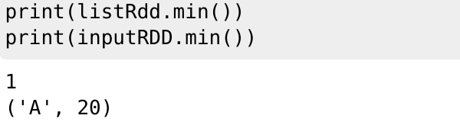

Slide 11
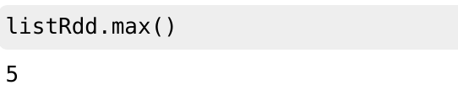

Slide 12
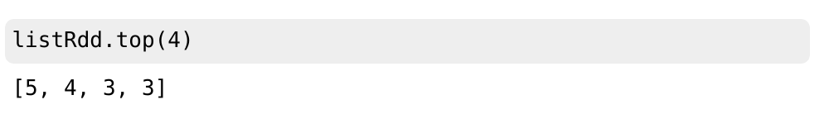
# top #top() – Return top n elements from the dataset.

Slide 13
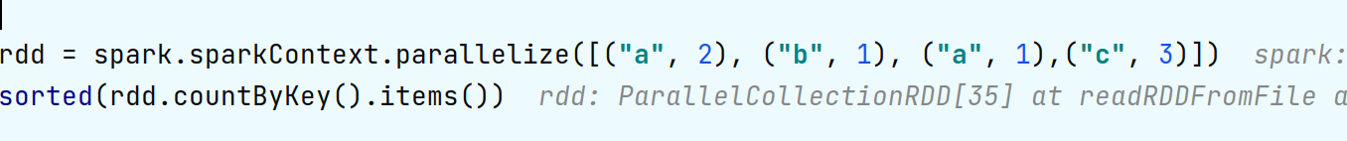
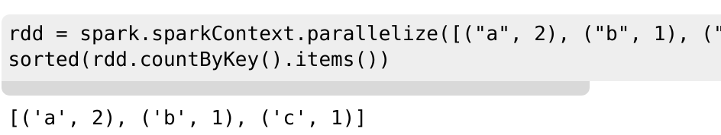

Slide 14
THANKS !

