Slide 1

Pyspark Transformation
Rama Shanker

Slide 2

Transformation

Slide 3




Slide 4




Slide 5




Slide 6




Slide 7


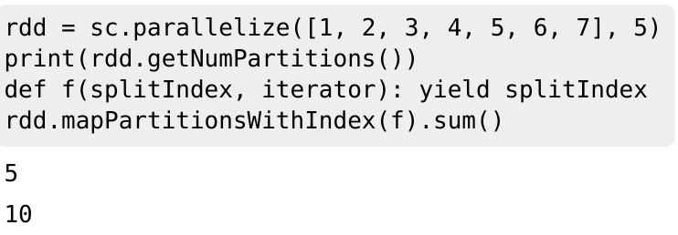

Slide 8



Notes ----- This is not guaranteed to provide exactly the fraction specified of the total count of the given :class:`DataFrame`.

Slide 9




Slide 10



Slide 11



Slide 12


# groupByKey([numPartitions]) When called on a dataset of (K, V) pairs, returns a dataset of (K, Iterable<V>) pairs. Note: If you are grouping in order to perform an aggregation (such as a sum or average) over each key,
using reduceByKey or aggregateByKey will yield much better performance. Note: By default, the level of parallelism in the output depends on the number of partitions of the parent RDD.
You can pass an optional numPartitions argument to set a different number of tasks.

Slide 13




Slide 14




Slide 15




Slide 16




Slide 17
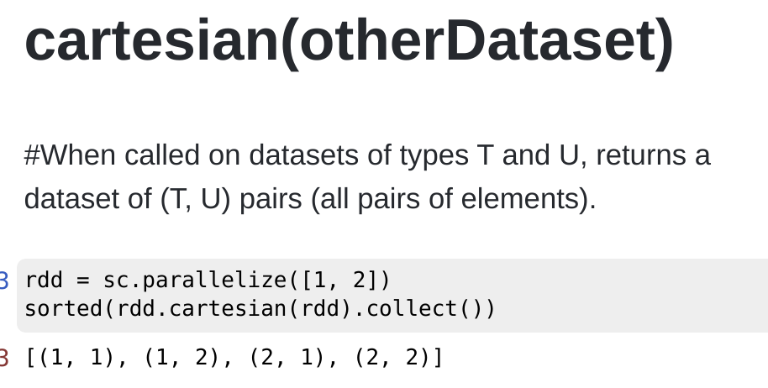

Slide 18
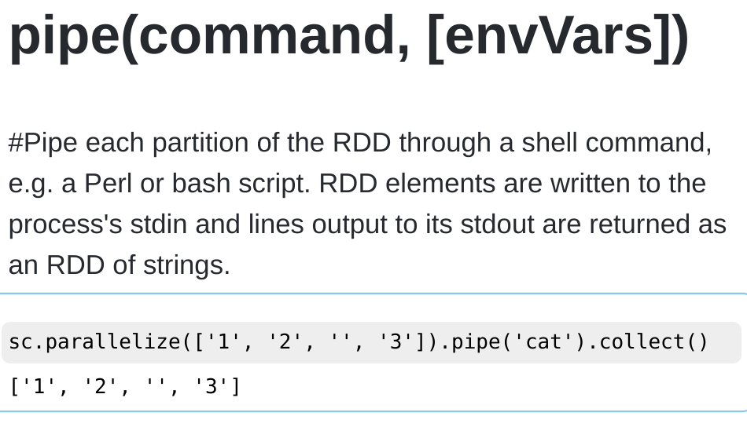

Slide 19
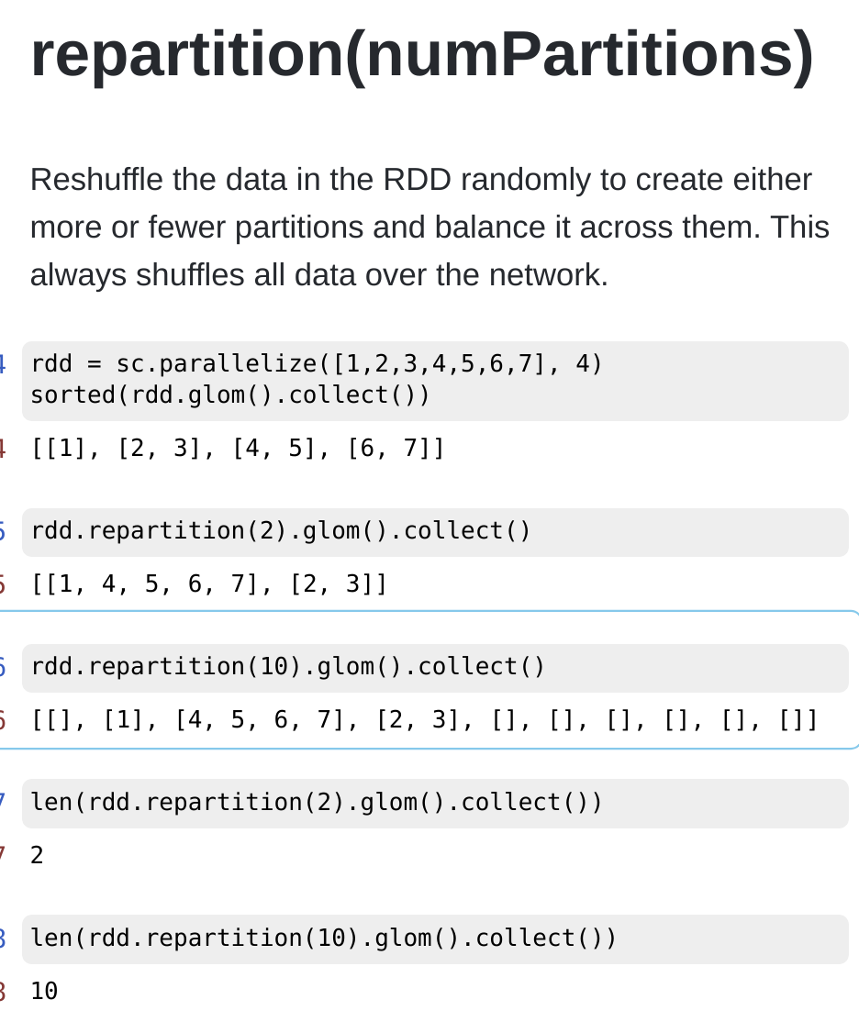

Slide 20
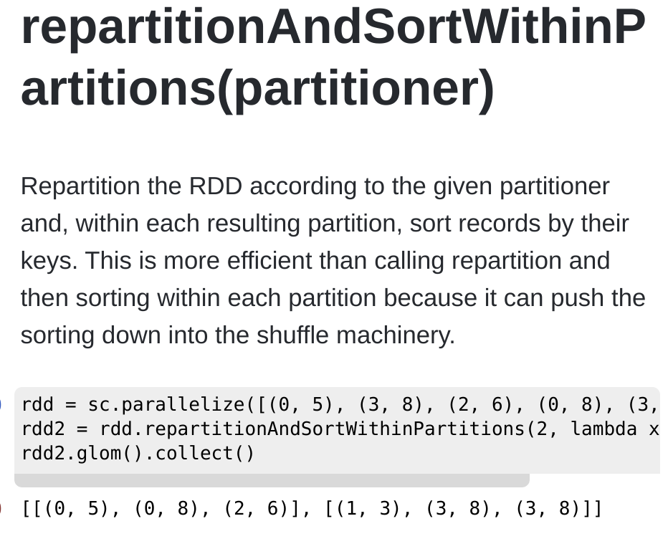

Slide 21
THANKS !

