Slide 1
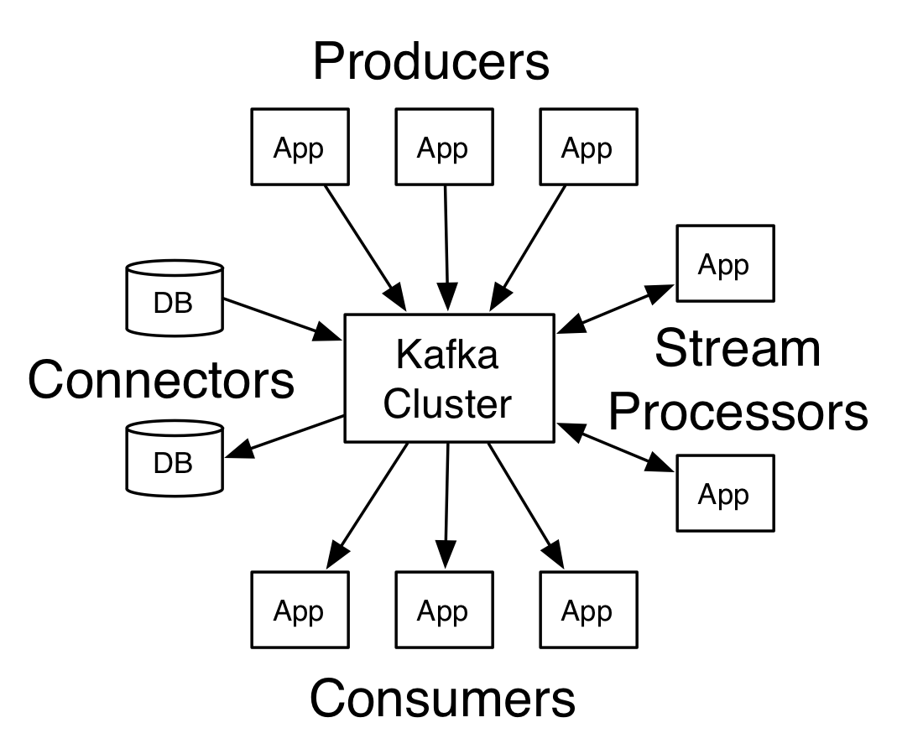
Kafka

Slide 2
Environment
Kafka is run as a cluster on one or more servers that can span multiple datacenters.
The Kafka cluster stores streams of records in categories called topics.
Each record consists of a key, a value, and a timestamp.
Kafka has four core APIs:
The Producer API allows an application to publish a stream of records to one or more Kafka topics.
The Consumer API allows an application to subscribe to one or more topics and process the stream of records produced to them.
The Streams API allows an application to act as a stream processor, consuming an input stream from one or more topics and producing an output stream to one or more output topics, effectively transforming the input streams to output streams.
The Connector API allows building and running reusable producers or consumers that connect Kafka topics to existing applications or data systems. For example, a connector to a relational database might capture every change to a table.

Slide 3
Uses
Uses of kafka
Kafka is generally used for two broad classes of applications:
Building real-time streaming data pipelines that reliably get data between systems or applications
Building real-time streaming applications that transform or react to the streams of data

Slide 4
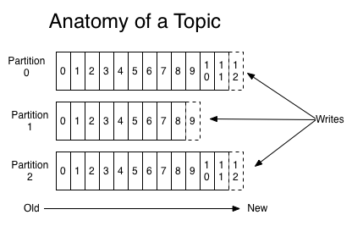
Topic and partition
For each topic, the Kafka cluster maintains a partitioned log that looks like this:
Kafka topics are divided into a number of partitions. Partitions allow you to parallelize a topic by splitting the data in a particular topic across multiple brokers — each partition can be placed on a separate machine to allow for multiple consumers to read from a topic in parallel.

Slide 5
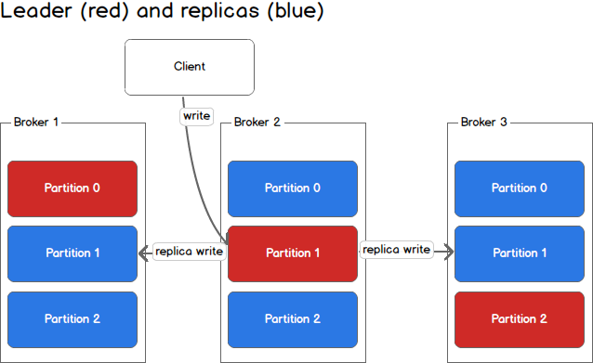
Producer Write
Handle replica write

Slide 6
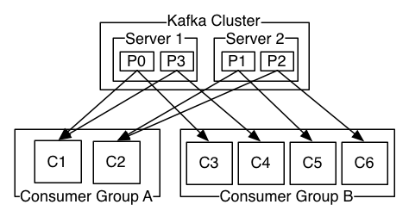
Partition and Cosumer Group
One topic—two server-- four partition—two group—six consumer
Kafka only provides a total order over records within a partition, not between different partitions in a topic
All guarantees are off if you are reading from the same partition using two consumers or writing to the same partition using two producers.

