Slide 1

Springboot With Asynchronous Communication

Slide 2




Slide 3
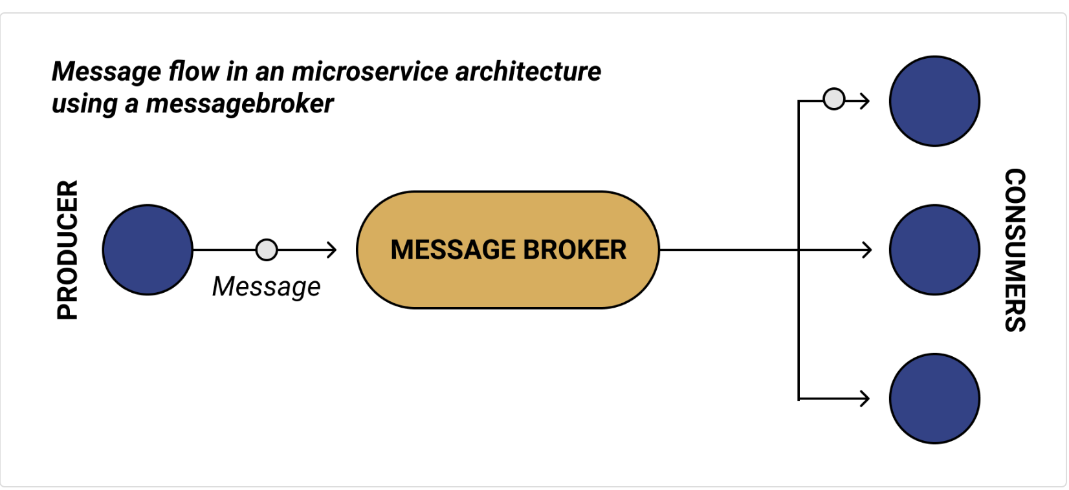
Architectural style

Slide 4

Apache ActiveMQ is an open source message broker written in Java together with a full Java Message Service (JMS) client.
There's another broker under the ActiveMQ umbrella code-named Artemis. It is based on the HornetQ code-base which was donated[4] from the JBoss community to the Apache ActiveMQ community in 2015. Artemis is the "next generation" broker from ActiveMQ and will ultimately become the next major version of ActiveMQ.[5]

Slide 5
Code Deep Dive
Notes:
1

Slide 6
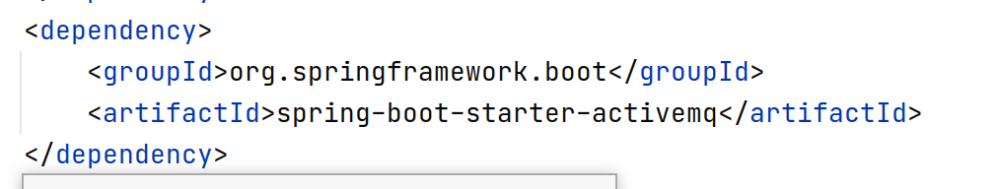
Producer-consumer

Slide 7
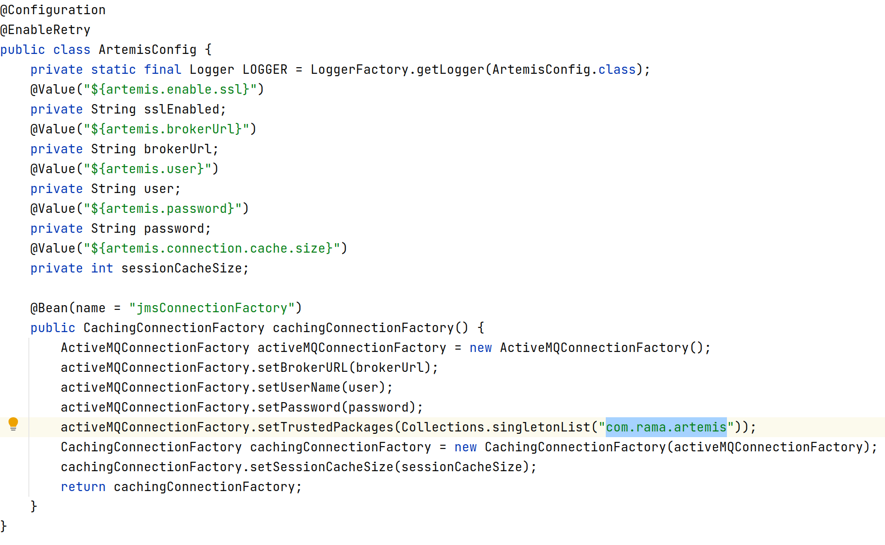

Slide 8
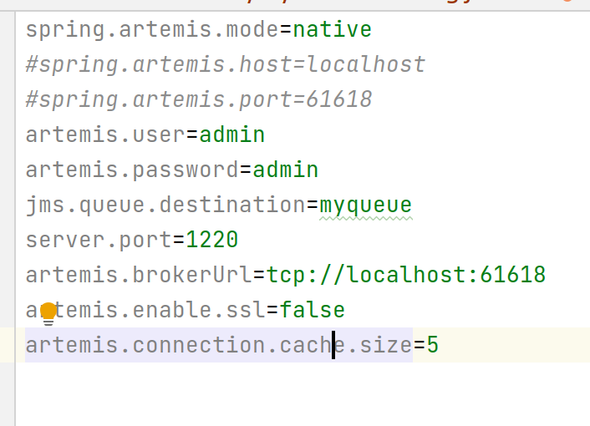

Slide 9
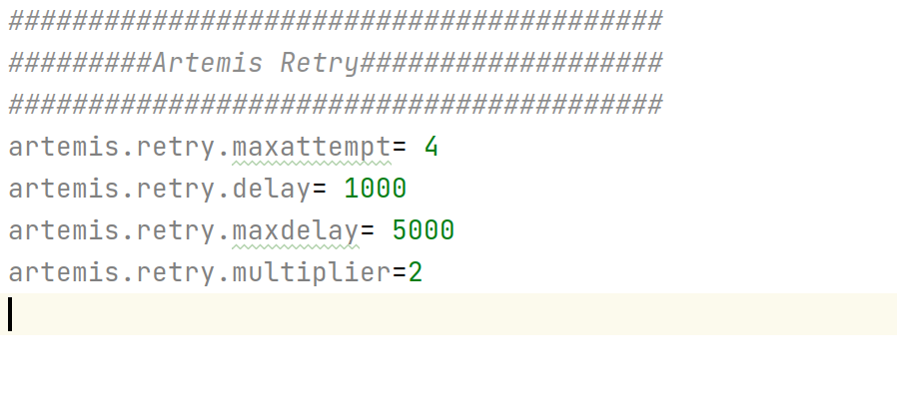
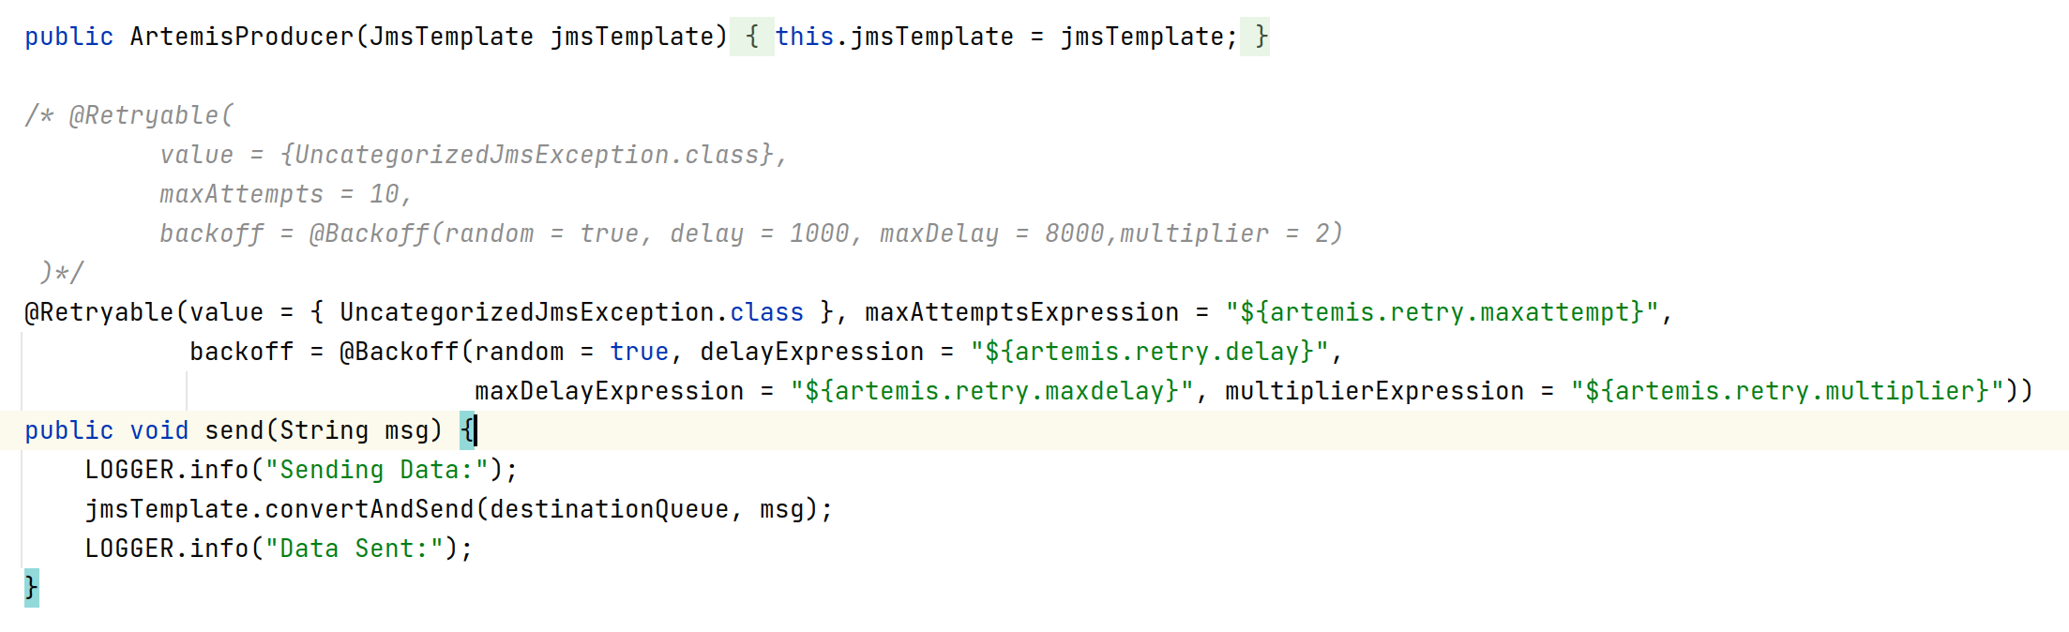
Retry Producer Important!

Slide 10
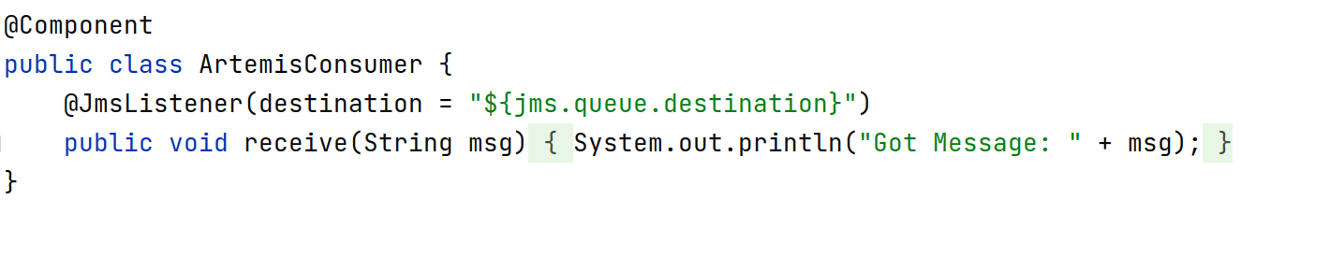
Consumer

Slide 11
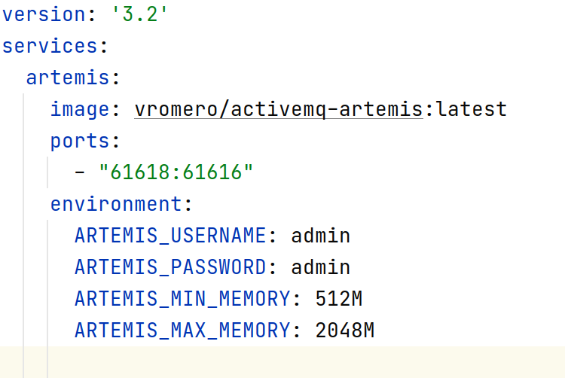
Start Artemis in docker:

Slide 12
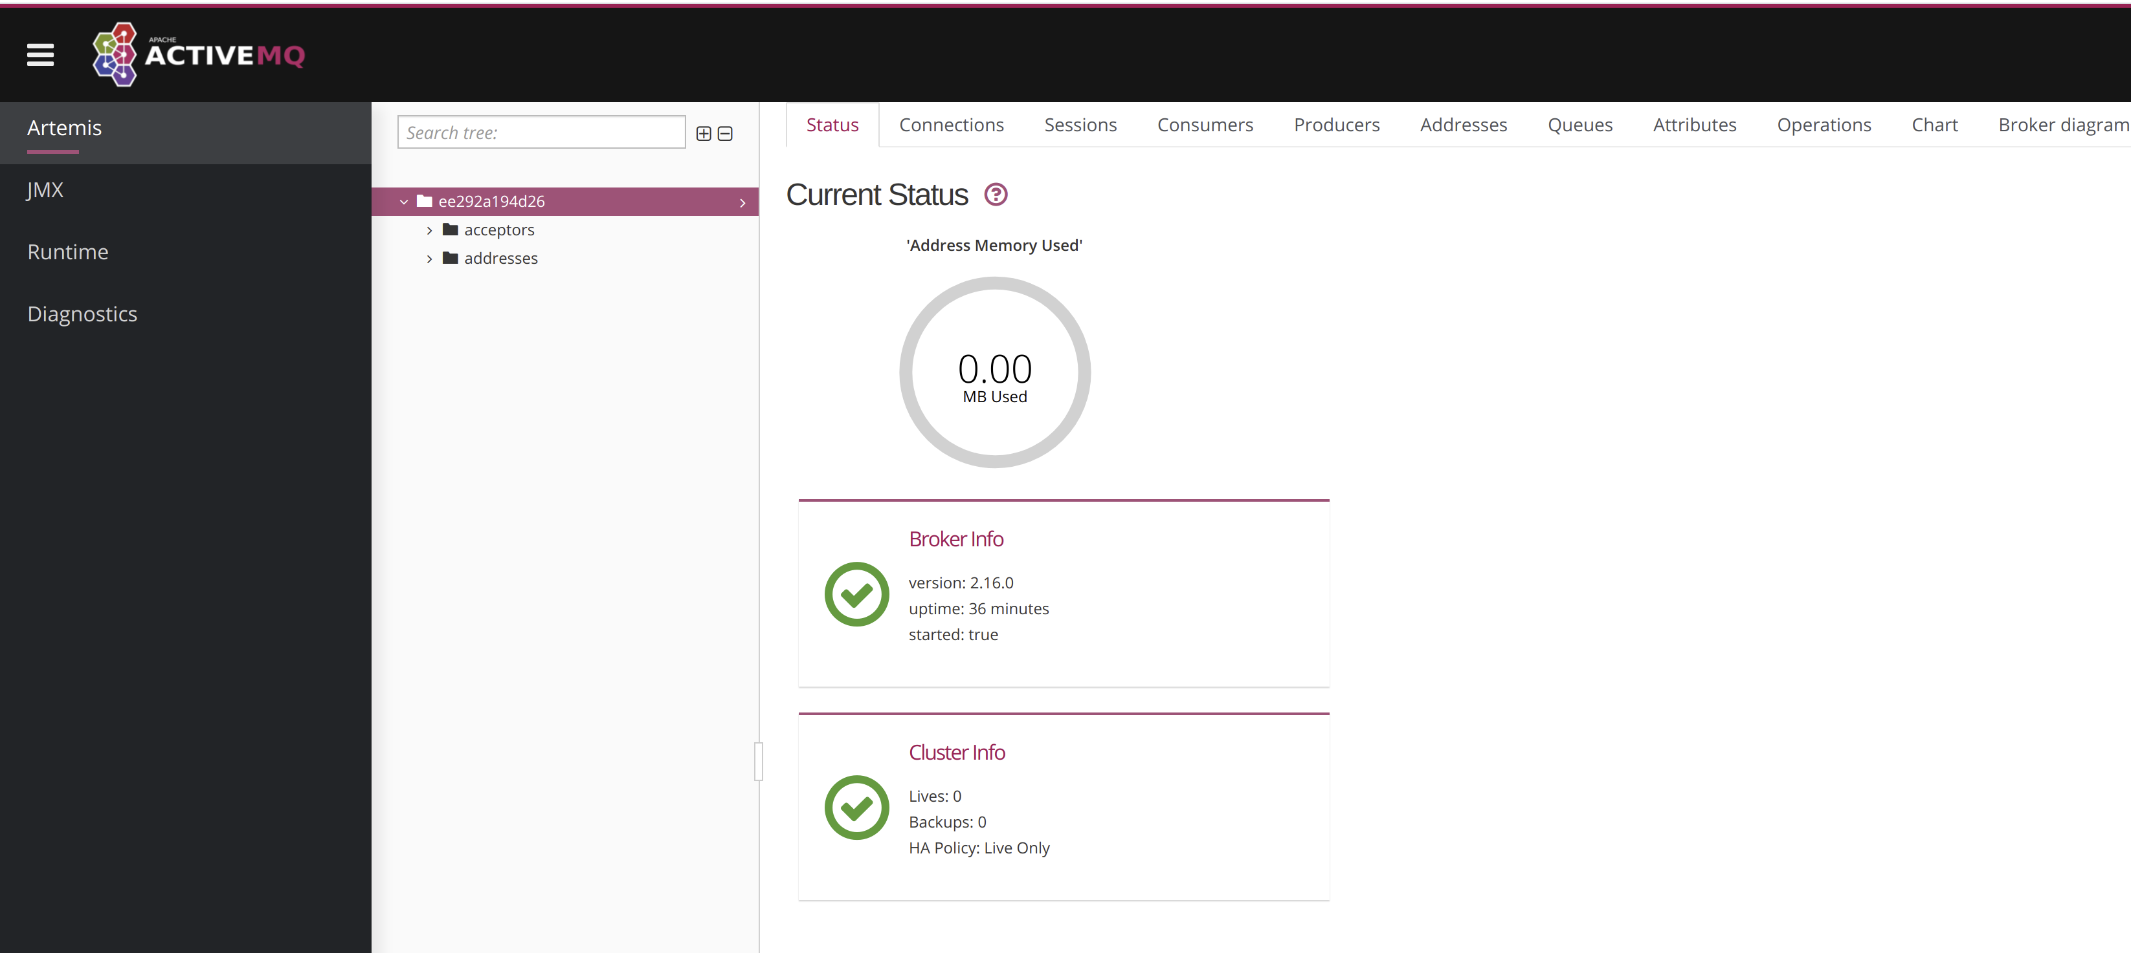

Slide 13
Lab4:Create Your first artemis project

Slide 14
Create a springboot project which sends the message artemis with retry mechanism(Try message with request body both format json, xml)
Input:
Auto message communication :
Message: to,from,content,correlationid(uuid)
Operation:
Send message
Receive message
Run and test through curl and postman

Slide 15

RabbitMQ is an open-source message-broker software (sometimes called message-oriented middleware) that originally implemented the Advanced Message Queuing Protocol (AMQP) and has since been extended with a plug-in architecture to support Streaming Text Oriented Messaging Protocol (STOMP), MQ Telemetry Transport (MQTT), and other protocols.

Slide 16
Code Deep Dive
Notes:
1

Slide 17
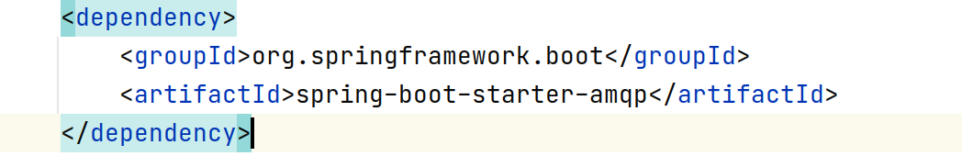
Producer-consumer

Slide 18
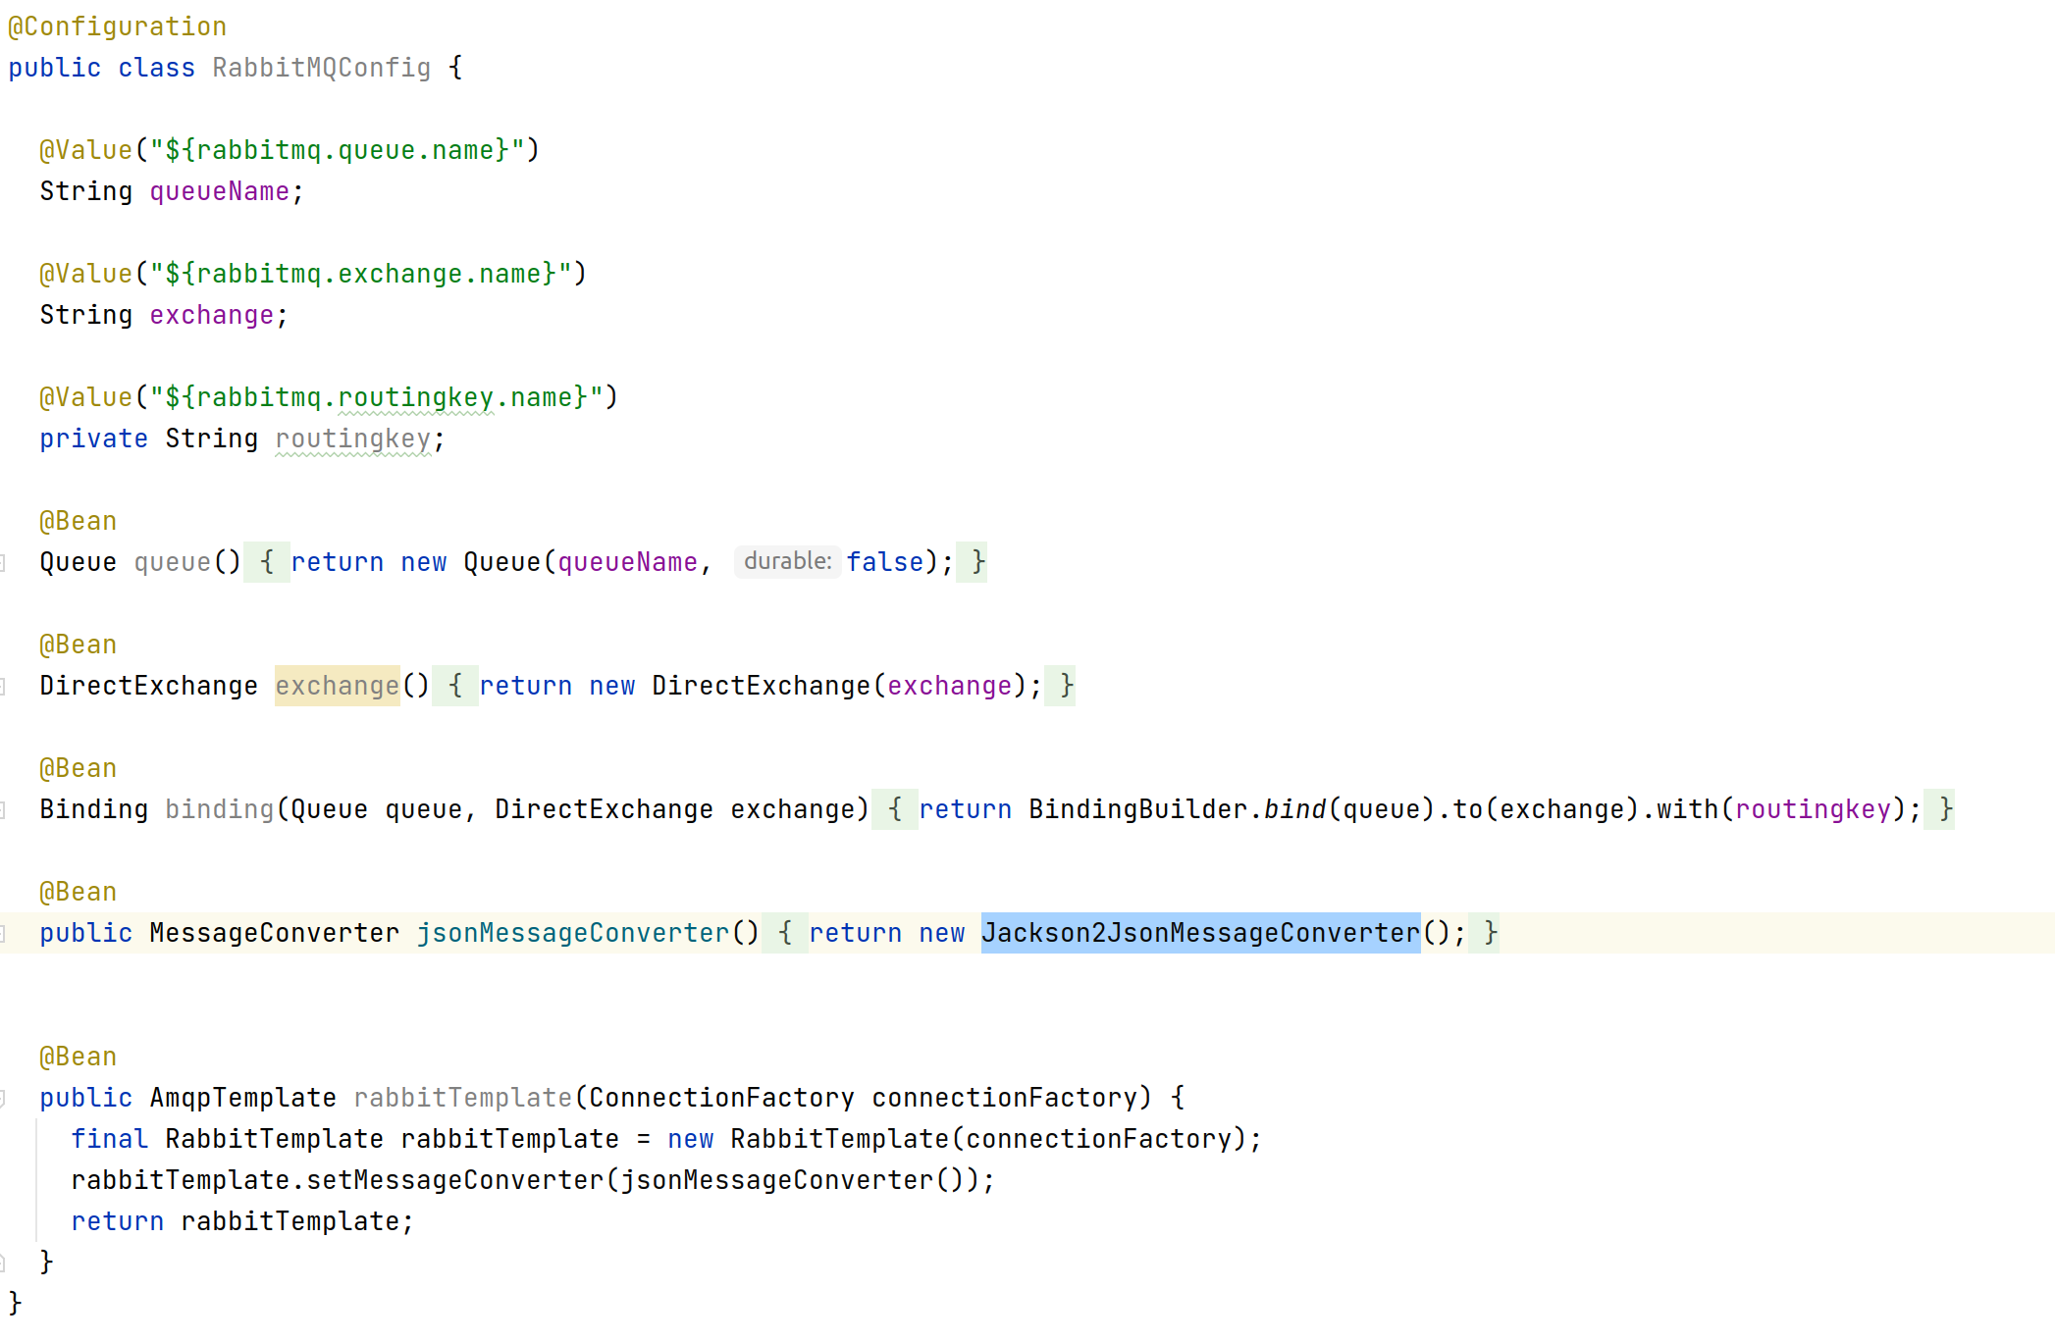
Producer

Slide 19
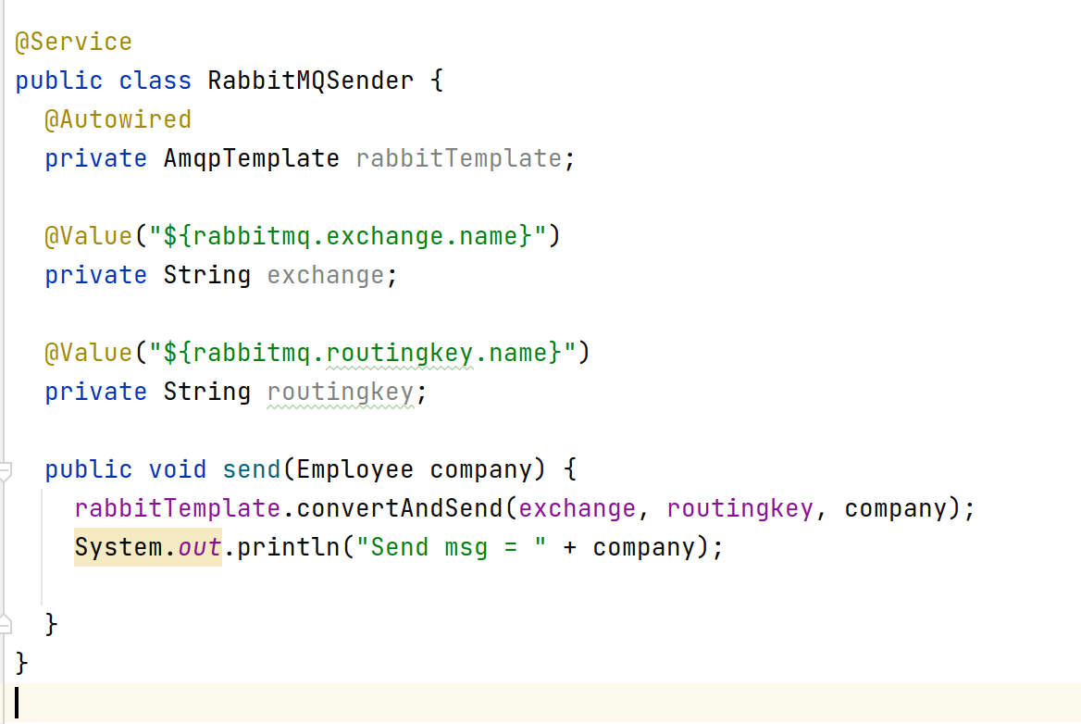

Slide 20
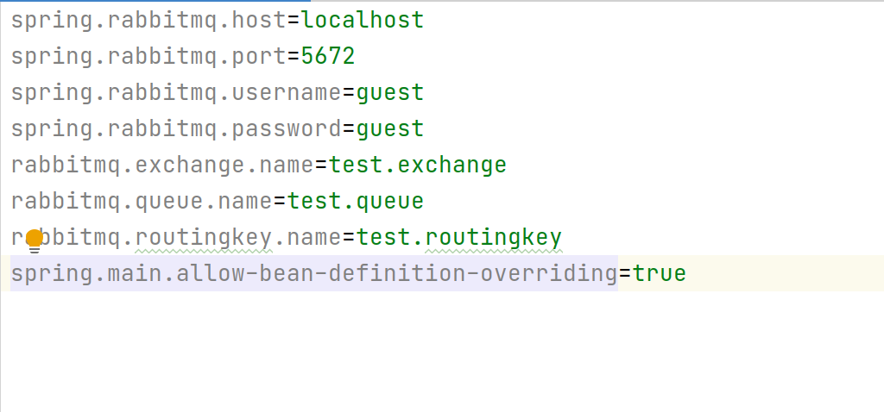

Slide 21
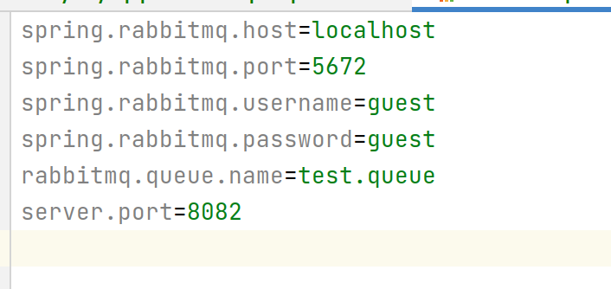
Consumer

Slide 22
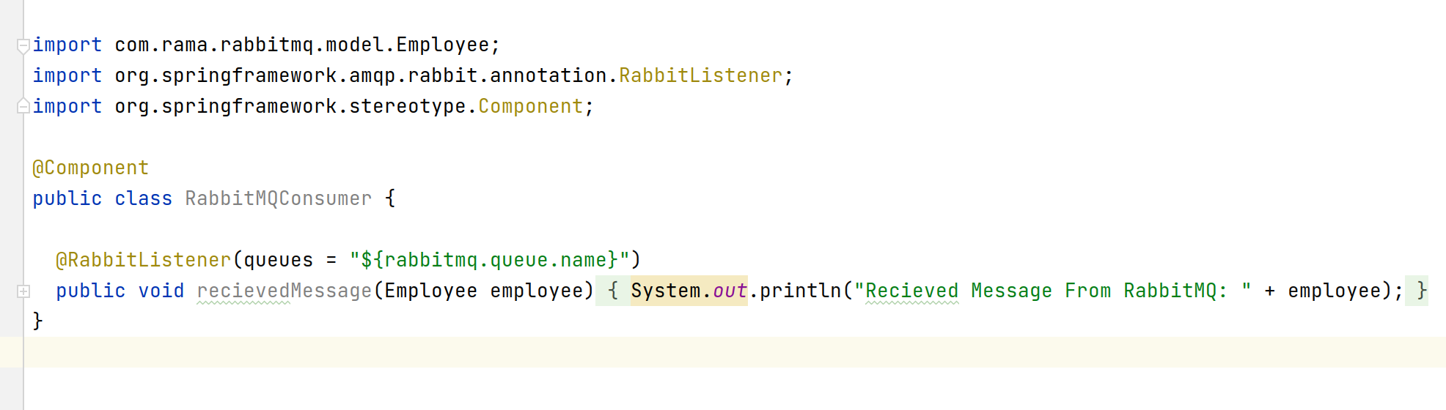

Slide 23
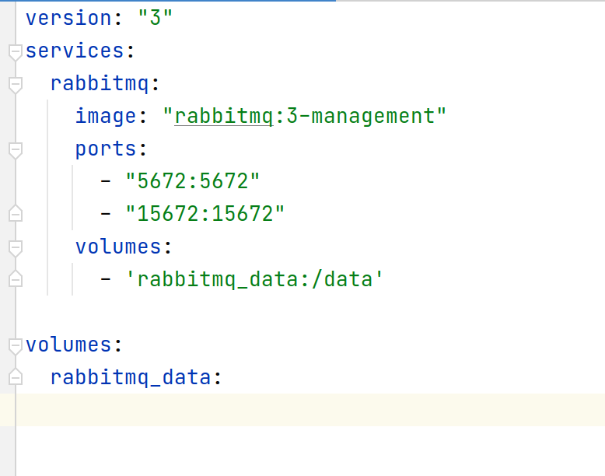

Slide 24
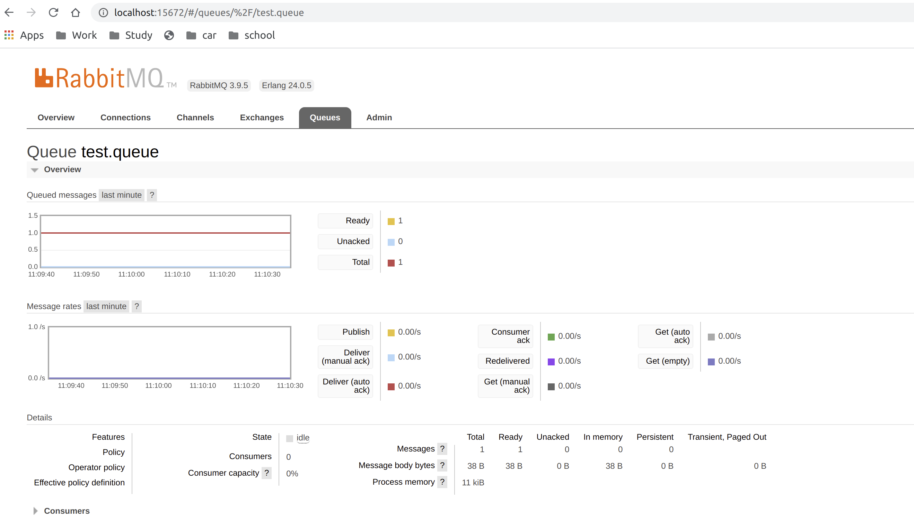

Slide 25
Lab4:Create Your first Rabbit project

Slide 26
Create a springboot project which sends the message rabbitmq with retry mechanism(Try message with request body both format json, xml)
Input:
Auto message communication :
Message: to,from,content,correlationid(uuid)
Operation:
Send message
Receive message
Run and test through curl and postman

Slide 27
THANKS !

