Slide 1
Zuul

Slide 2
Definition
Zuul is an edge service that proxies requests to multiple backing services. It provides a unified “front door” to your system, which allows a browser, mobile app, or other user interface to consume services from multiple hosts without managing cross-origin resource sharing (CORS) and authentication for each one

Slide 3
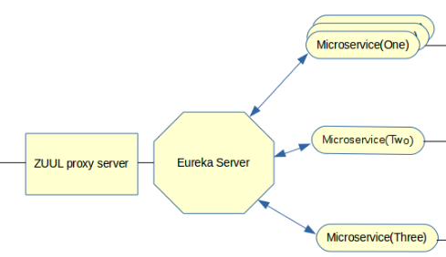

Slide 4
Server
<dependency> <groupId>org.springframework.cloud</groupId> <artifactId>spring-cloud-starter-netflix-zuul</artifactId> </dependency>
@SpringBootApplication @EnableZuulProxy public class ZuulApplication { public static void main(String[] args) { SpringApplication.run(ZuulApplication.class, args); } }
zuul: host: connect-timeout-millis: 10000 socket-timeout-millis: 60000 eureka: client: serviceUrl: defaultZone: http://localhost:8761/eureka/ server: port: 8050

Slide 5
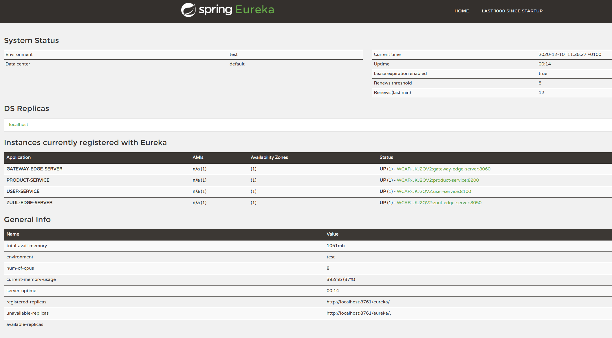

Slide 6
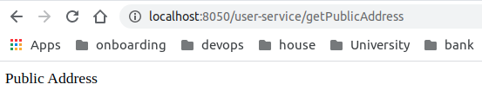
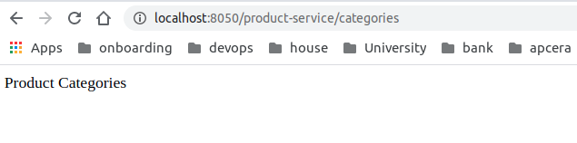
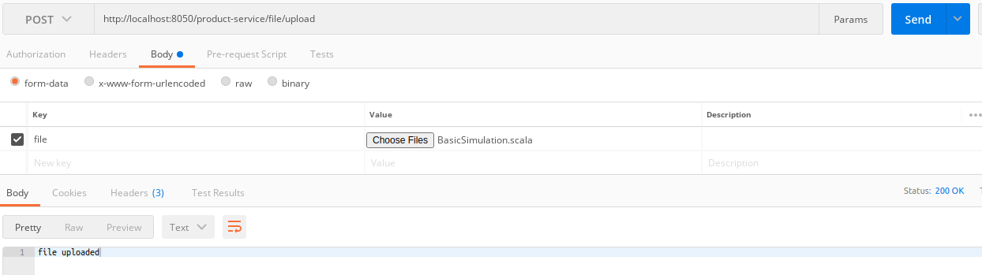

Slide 7
Gateway

