Slide 1
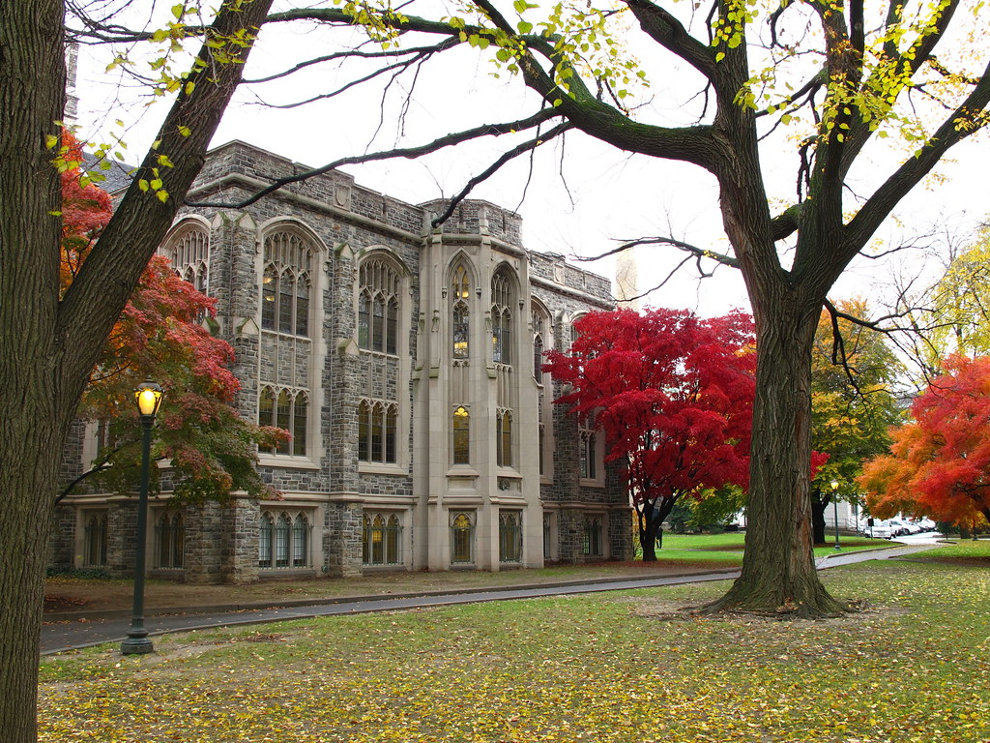
Campus-Pulse
- Pranav Napolean
- Jeevan
- Trinadh
- Satwik
- Rakesh​
Pitch

Slide 2
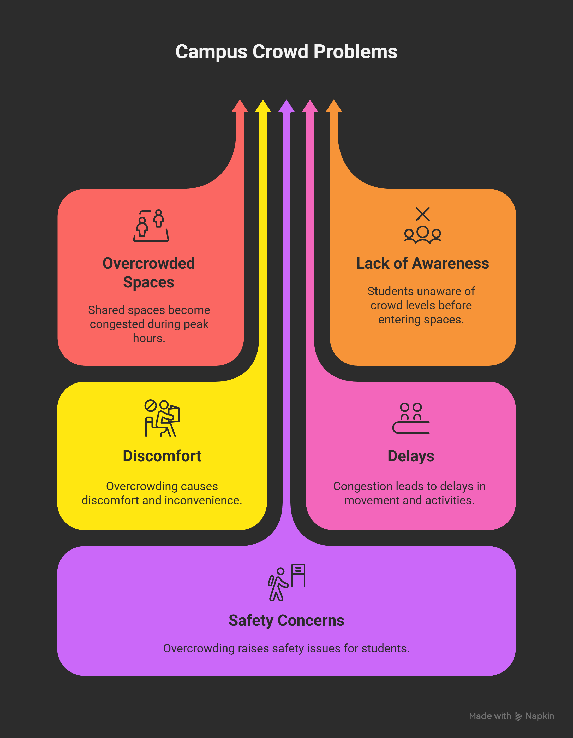
Problem statement
College campuses have multiple shared spaces such as corridors, canteens, libraries, and common areas. During peak hours, these spaces often become overcrowded. Students usually enter such areas without prior awareness of crowd levels, leading to discomfort, delays, and safety concerns.
About

Slide 3
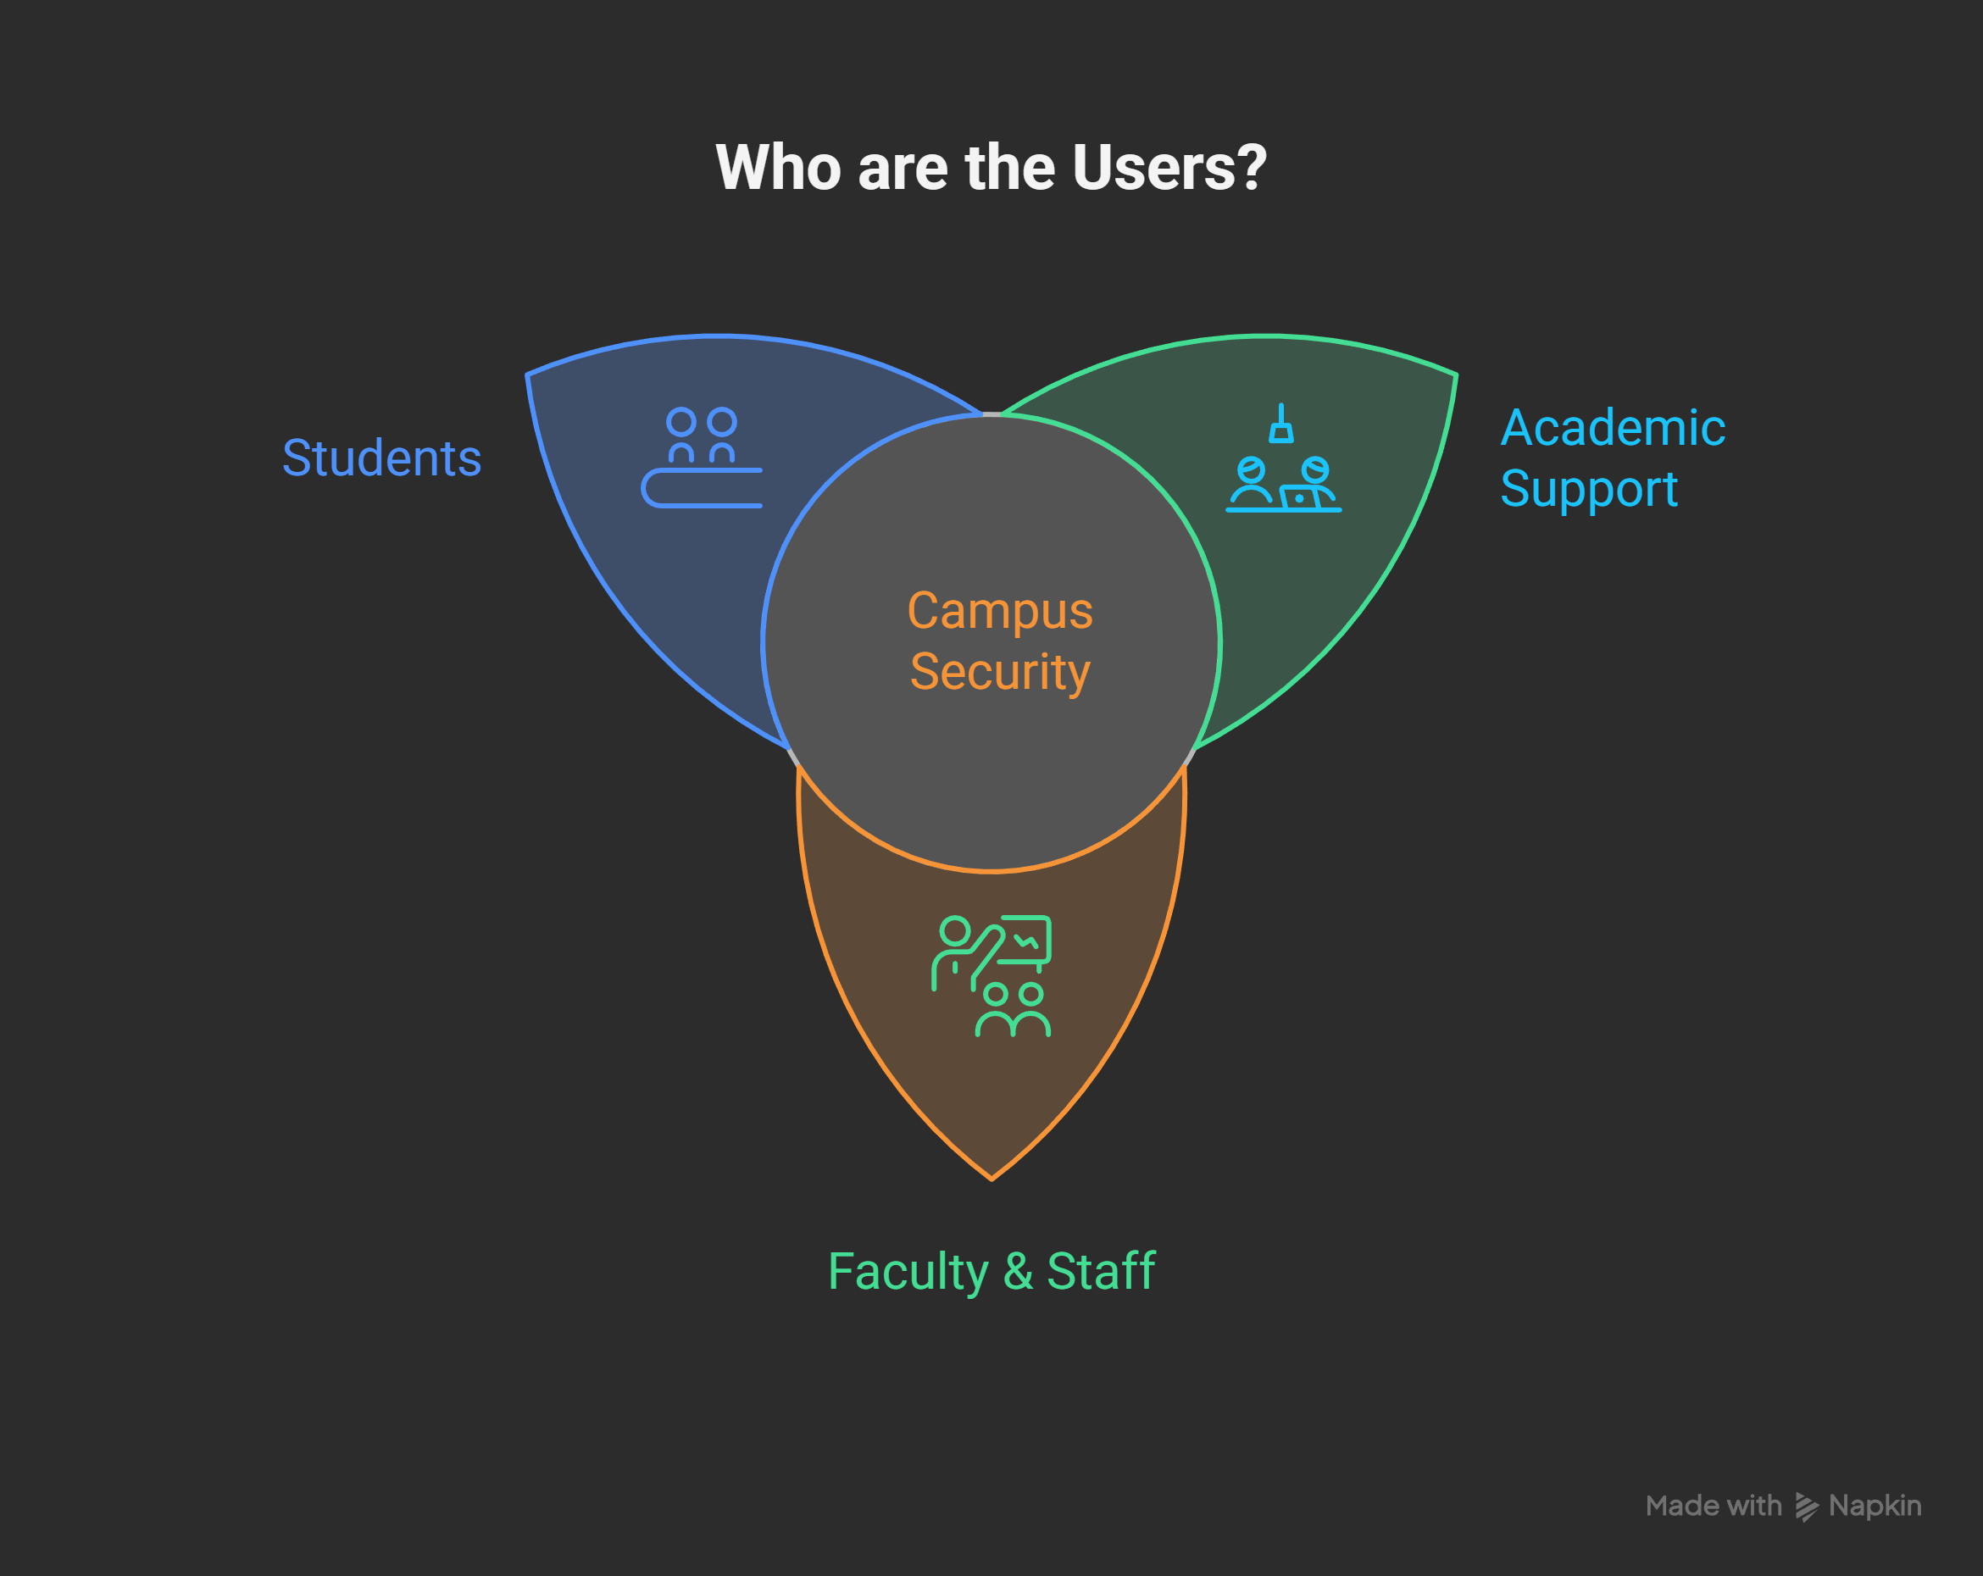
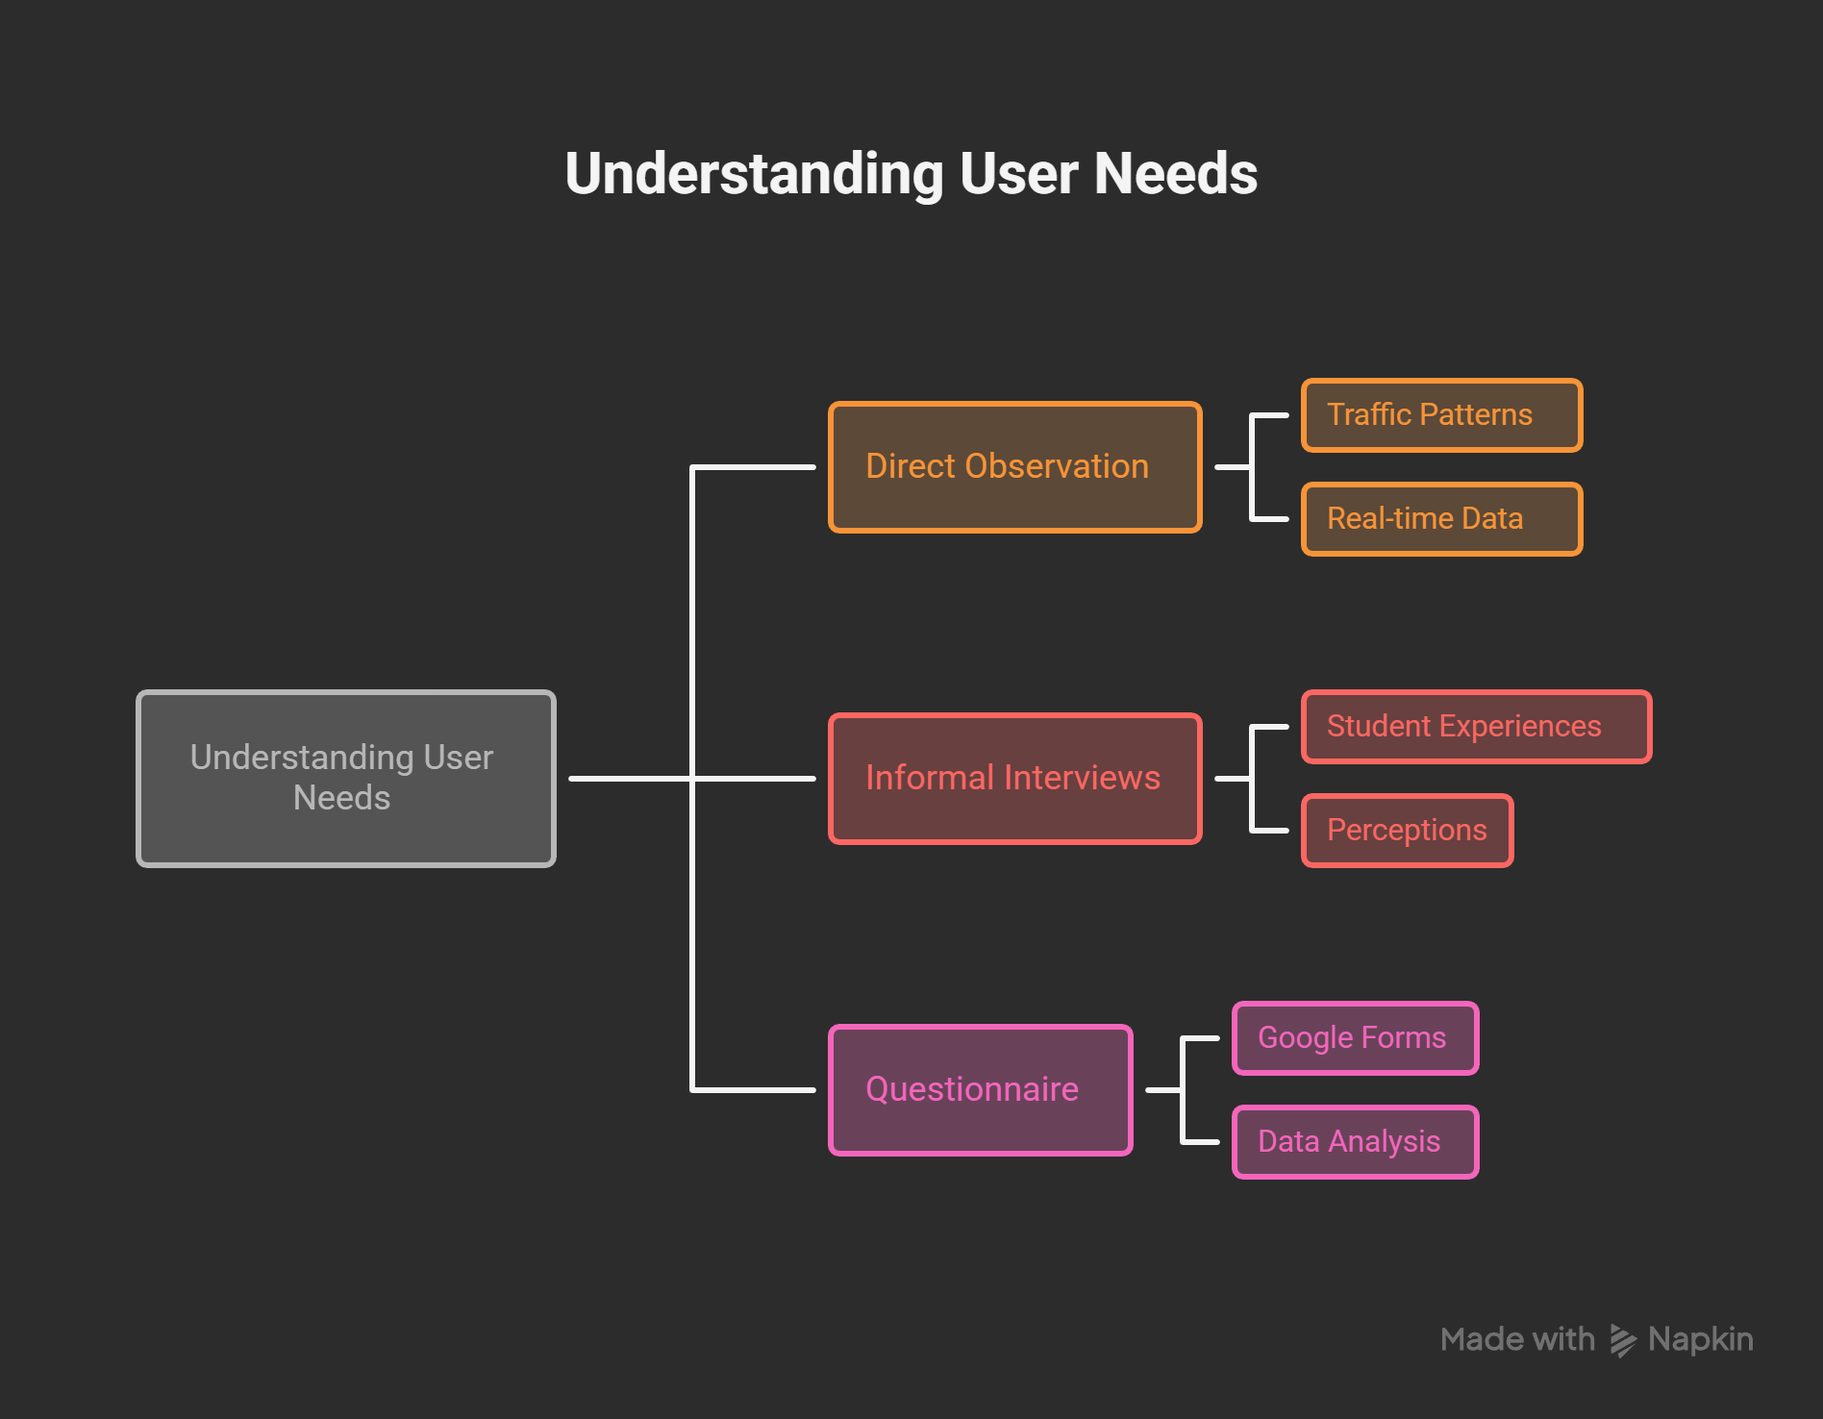
Users

Slide 4
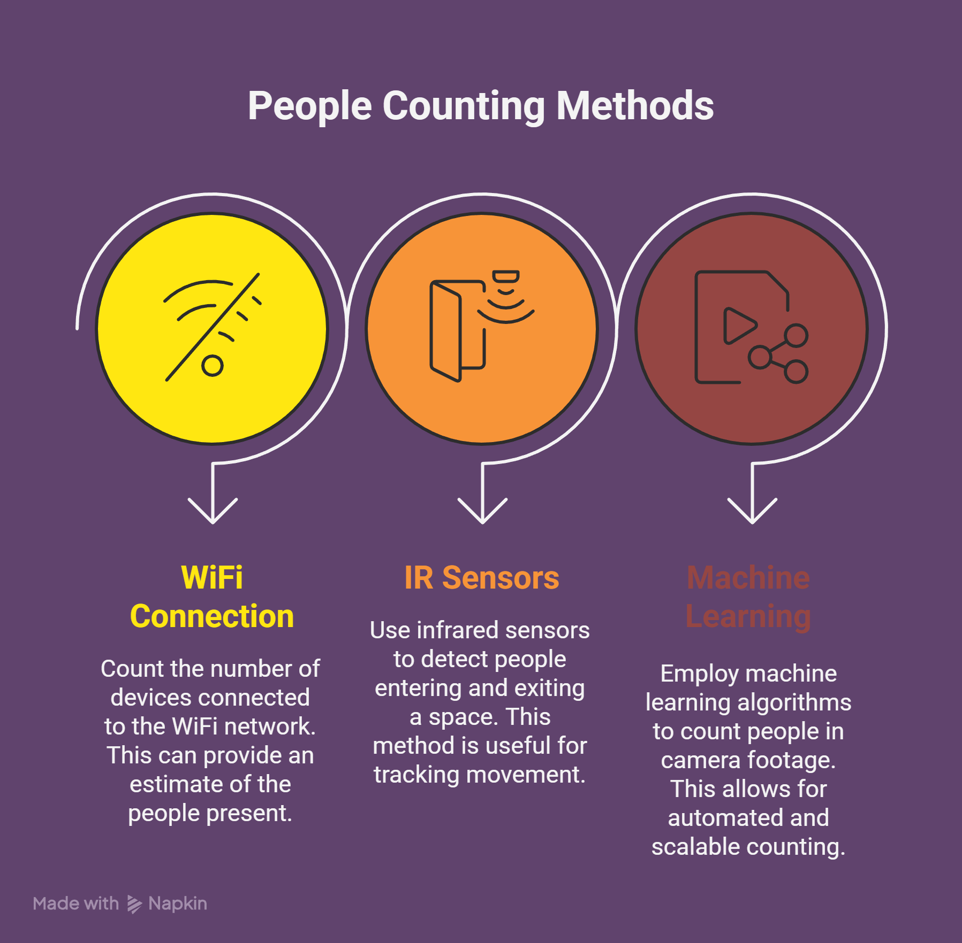
Technical Aspects
1. Wifi Count
2. IR sensors
3. Machine learning + camera
Unique

Slide 5
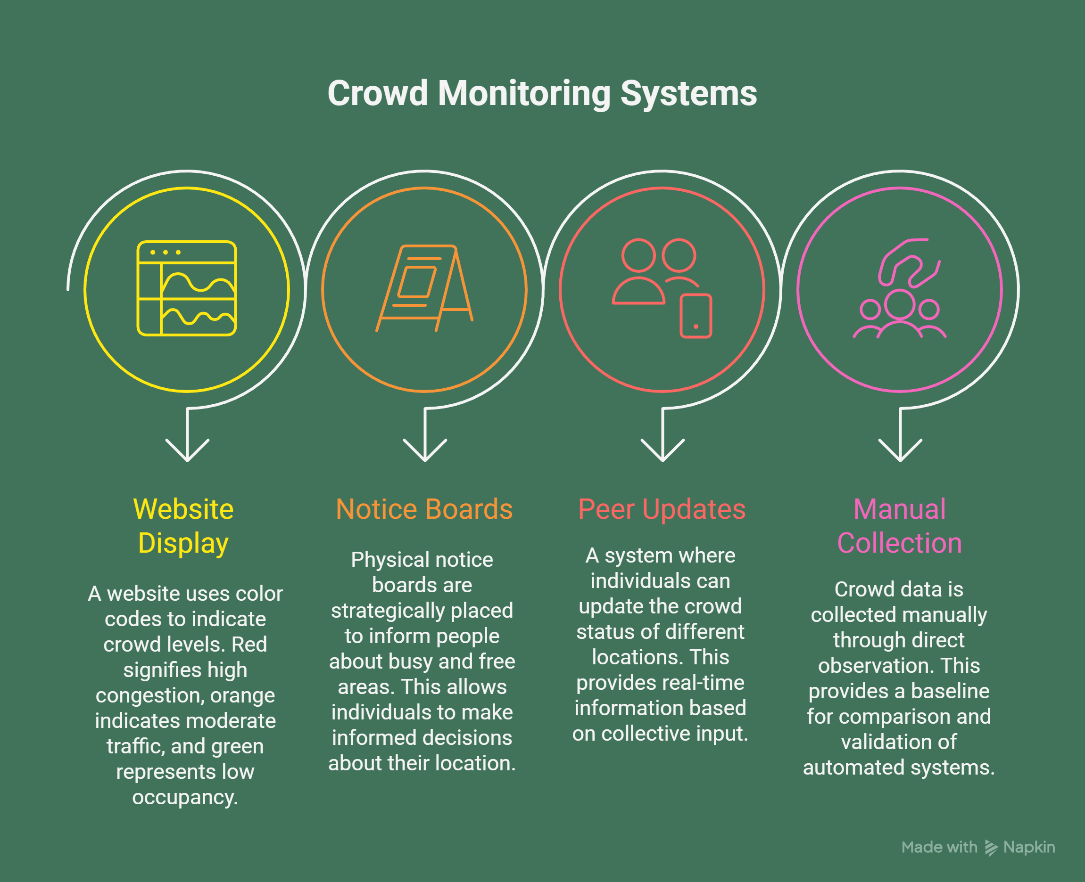
Prototype(Ideate)
1. Website
2. Notice board
3. Peer Updated
4. Manual Observation
Feedback loop
Business
1. Validate users
2. Surveys
3. Iterate the Prototype

Slide 6
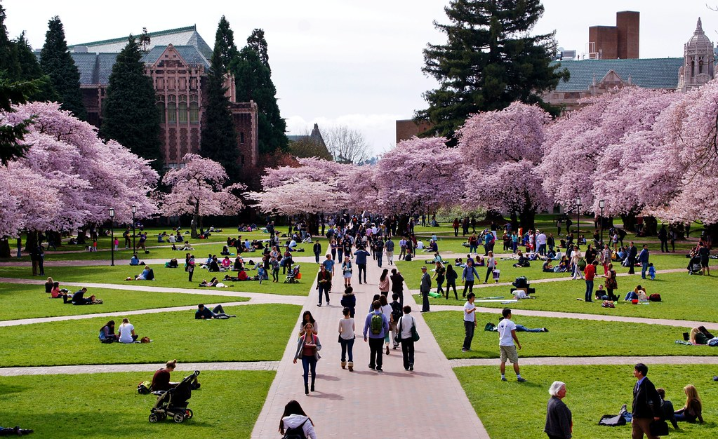
Any questions?

