Slide 1
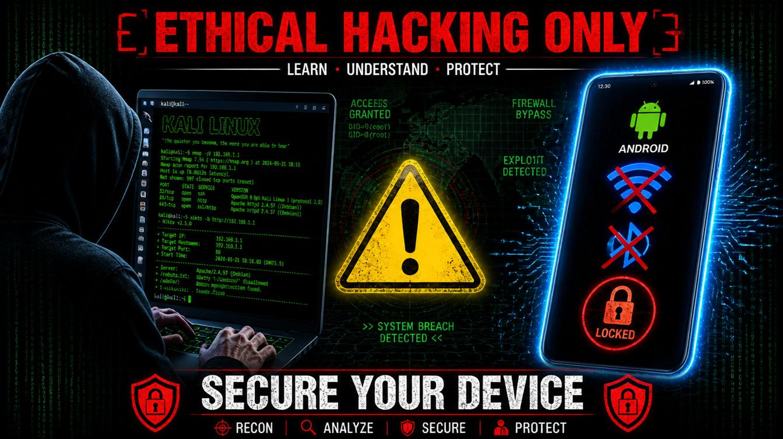
v7.2.3
RECONPRO
The Most Dangerous Open-Source Recon Tool on the Planet
pip install reconpro
$
14 modules · 33 commands · 6 integrations · 7 compliance frameworks · Cross-platform
Notes:
Every single minute of every single day, another company gets breached. The attackers are fast, automated, and relentless — they share toolkits on the dark web, they chain zero-days with supply chain exploits, and they dwell inside networks for months before anyone notices. Meanwhile, defenders are drowning. They're juggling ten different tools, none of which talk to each other, running manual checklists that were outdated the day they were written, and drowning in alert fatigue from SIEM systems that cry wolf thousands of times a day. That's why we built ReconPro — a free, open-source weapon for the good guys. It's on PyPI right now. Anyone — a solo consultant, a blue team lead, a CISO — can install it with a single command and start hunting threats in under thirty seconds. No SaaS, no subscription, no vendor lock-in. Just pure, uncompromising reconnaissance power.

Slide 2
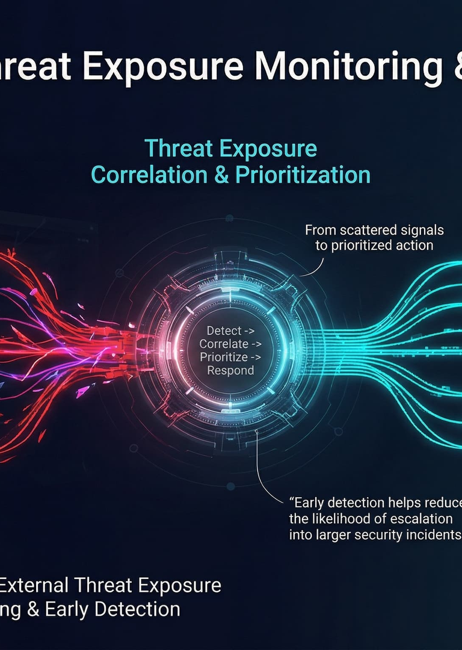

THE THREAT IS EVOLVING.
YOUR TOOLS AREN'T.
The average time to detect a breach is 207 days. Attackers use APTs, zero-days, and supply chain attacks while defenders juggle 10+ disconnected tools, manual checklists, and alert fatigue. No single platform unifies recon, vulnerability scanning, threat hunting, and compliance — until now.
207
days avg. detection time
10+
disconnected tools per team
$4.45M
avg. breach cost
Notes:
Let me paint the picture for you. IBM's Cost of a Data Breach report found that the average organization takes two hundred and seven days just to detect that they've been compromised. That's seven months of an attacker living inside your network, exfiltrating data, establishing persistence, moving laterally. Meanwhile, on the defensive side, security teams are overwhelmed. A typical SOC analyst is juggling ten or more disconnected tools — one for recon, one for vuln scanning, one for threat intel, one for compliance reporting. None of these tools talk to each other. Alert fatigue is real and dangerous: studies show that SOC teams ignore or dismiss up to thirty percent of alerts because they simply can't keep up. The financial impact is staggering — the average breach now costs four point four five million dollars. The problem isn't a lack of effort. The problem is that defenders are fighting a modern war with fragmented, legacy tools. ReconPro was built to fix that.

Slide 3
ONE TOOL. ZERO COMPROMISE.
ReconPro is a free, open-source security reconnaissance platform with 14 integrated scan modules, 6 enterprise integrations, 7 compliance frameworks, and 33 CLI commands — all in a single pip install. No SaaS. No subscription. No limits.
14 Modules
Cross-Platform
100% Free & Open Source
$
pip install reconpro && reconpro scan --target your-domain.com
Notes:
So what's the answer? ReconPro. One tool that replaces ten or more of those disconnected point solutions you're currently juggling. It's completely free — MIT licensed, open source, no SaaS, no subscription, no trial period that expires, no feature gating. You get all fourteen scan modules, all six enterprise integrations, all seven compliance frameworks, and all thirty-three CLI commands from day one. The entire platform installs with a single pip command and runs on Windows, Linux, and macOS without any compiled dependencies. No vendor lock-in, no proprietary agents, no data leaving your network. We built this because we were tired of watching defenders fight with one hand tied behind their back. ReconPro levels the playing field. One command to install, one command to scan, and you're hunting threats in thirty seconds. That's the promise, and it delivers.

Slide 4
01
CHAPTER 01
THE SCAN ENGINE
Three flagship modules. Zero mercy for threats.
Notes:
Now we're going to dive deep into the core of ReconPro — the Scan Engine. This is where the heavy lifting happens. Over the next few slides, we're going to walk through three flagship modules that set ReconPro apart from every other open-source security tool out there. First, GORGON ULTRA — a fifteen-stage threat analysis engine that produces something called the Fear Index. Second, OBLIVION — a twenty-stage deep vulnerability scanner with its own DREAD scoring system and a severity level that goes above critical. And third, PEGASUS HUNTER — a module specifically designed to detect the world's most sophisticated spyware, including indicators from Pegasus and other nation-state malware. These three modules represent the cutting edge of what's possible in open-source security tooling. Let's start with GORGON.

Slide 5
GORGON ULTRA
15-STAGE THREAT ANALYSIS
GORGON ULTRA is ReconPro's flagship threat assessment engine. It runs 15 sequential analysis stages:
FEAR INDEX LEVELS
SUBTLE
NOTABLE
fingerprint → tech detect → port scan → TLS audit →
DNS recon → SSL check → cookie analysis → header audit →
info leak → vuln probe → XSS test → SQLi test →
RCE test → config audit → final synthesis
ALARMING
DEVASTATING
OMNIPOTENT
Each stage feeds into the Fear Index — a unified threat score.
The Fear Index quantifies your threat level on a scale from subtle to omnipotent. No other open-source tool does this.
Notes:
GORGON ULTRA is the crown jewel of the Scan Engine. It runs fifteen sequential analysis stages against a target — and I want to stress that word sequential, because each stage's output feeds into the next. It starts with basic fingerprinting and technology detection, moves through port scanning and TLS auditing, then dives into DNS reconnaissance, SSL verification, cookie and header analysis. After that, it probes for information leaks and known vulnerabilities, runs active XSS, SQL injection, and remote code execution tests, and finishes with a configuration audit. All fifteen stages converge into what we call the Fear Index. The Fear Index takes all of those disparate findings and synthesizes them into a single threat score with five levels: Subtle, Notable, Alarming, Devastating, and Omnipotent. No other open-source tool provides this kind of unified threat quantification. You can look at one number and instantly understand how badly a target is exposed. That's the power of GORGON.

Slide 6
OBLIVION
20-STAGE DEEP VULNERABILITY SCANNER
OBLIVION is the deep vulnerability scanner that goes where standard tools fear to tread. 20 analysis stages including SQL injection probing, XSS hunting, SSRF chain exploitation, path traversal detection, and more.
✦
Wisdom Verdict
AI-powered summary of your security posture. OBLIVION synthesizes all twenty stages into a plain-English verdict — no more interpreting raw scanner output.
Every finding is scored on the DREAD scale.
Info
Low
Medium
❄
Mirror Fracture
High
Attack surface decomposition showing how vulnerabilities chain together. See the kill chain, not just isolated findings.
Critical
TRANSCENDENT
▲ unique to OBLIVION
Notes:
OBLIVION is ReconPro's deep vulnerability scanner, and it's a beast. While GORGON focuses on threat assessment and synthesis, OBLIVION goes deep — twenty analysis stages that include SQL injection probing, cross-site scripting hunting, server-side request forgery chain exploitation, path traversal detection, and much more. Every single finding is scored on the DREAD scale: Info, Low, Medium, High, Critical. But here's what makes OBLIVION unique — it introduces a sixth severity level called TRANSCENDENT. This is a level above critical, reserved for vulnerabilities that aren't just severe in isolation but that chain together to create existential threats. Only OBLIVION uses this level. Beyond scoring, OBLIVION has two features you won't find anywhere else. Wisdom Verdict is an AI-powered summary that takes all twenty stages of output and gives you a plain-English assessment of the target's security posture. Mirror Fracture decomposes the attack surface and shows you exactly how individual vulnerabilities chain together into a complete kill chain. These two features alone justify the entire platform.

Slide 7


PEGASUS HUNTER
ADVANCED SPYWARE DETECTION
PEGASUS HUNTER detects the world's most sophisticated spyware and APT indicators. It scans for 135 known C2 domains used by Pegasus, Hermit Worm, and similar nation-state malware. It checks 11 SMS attack patterns, 19 suspicious process signatures, and 9 filesystem path indicators.
135
11
C2 DOMAINS
SMS PATTERNS
19
9
PROCESS SIGNATURES
PATH INDICATORS
✦
THREAT INTELLIGENCE DATABASE
⚠
PEGASUS HUNTER is not a toy. These indicators track real threats used against journalists and activists.
Notes:
PEGASUS HUNTER is our third flagship module, and it tackles a problem most open-source tools completely ignore: nation-state spyware detection. We've compiled a curated threat intelligence database of 135 known command-and-control domains associated with Pegasus, Hermit Worm, and other sophisticated surveillance malware used by governments worldwide. The module checks 11 SMS-based attack delivery patterns, 19 suspicious process signatures that indicate compromise, and 9 filesystem path indicators where these tools typically store their payloads. This isn't theoretical — these are real threat indicators used in documented attacks against journalists, activists, and political figures. If you're a security researcher, a defender, or someone working in digital rights, this module gives you the ability to scan infrastructure and endpoints for traces of the world's most dangerous spyware, all from a single CLI command.

Slide 8
02
CHAPTER 02
THE ECOSYSTEM
Modules, integrations, and compliance — all wired together.
Notes:
We've covered the three flagship scan engines — GORGON ULTRA, OBLIVION, and PEGASUS HUNTER. Now let's zoom out and look at the full ReconPro ecosystem. This isn't just three tools duct-taped together. It's a comprehensive platform with 14 integrated scan modules, 6 enterprise integrations that plug into your existing workflow, and 7 compliance frameworks that automatically map every finding to the right controls. Everything is designed to work together — you run one scan, and you get threat assessment, vulnerability data, compliance mappings, and automated alerts all at once. Let's walk through the full module catalog first.

Slide 9
14 SCAN MODULES. ONE UNIFIED PLATFORM.
⌕
recon
〜
vibesec
⚿
auth
Reconnaissance engine
Vibe security analysis
Authentication auditing
⌘
chain
✦
bot
✦
gorgon
Attack chain mapping
Botnet detection — Cobalt Strike, Metasploit, Emotet, TrickBot, QakBot, SolarWinds, Log4Shell
GORGON ULTRA threat engine
⛨
oblivion
✦
pegasus
OBLIVION deep scanner
PEGASUS spyware hunter
✦
nhi
▢
host
✦
dev
✚
doctor
Network host intelligence
Host system audit
Developer security tools
System diagnostics
☁
cloud_recon
♟
team
Cloud infrastructure recon
Team management
Notes:
Here's the full module catalog. 14 modules, all wired into the same platform. Let me walk you through the categories. First, the core: recon is the foundational reconnaissance engine that everything else builds on. Then you have the three flagship modules we've already covered — gorgon for threat assessment, oblivion for deep vulnerability scanning, and pegasus for spyware detection. These are the heavy hitters, and they're highlighted in green on this grid. The bot module is particularly interesting — it specifically detects infrastructure associated with major threat groups like Cobalt Strike, Metasploit, Emotet, TrickBot, QakBot, SolarWinds, and Log4Shell exploitation. Then there's cloud_recon which targets AWS, Azure, and GCP infrastructure. The team module lets you manage your security crew, assign roles, and share findings. Every module can run standalone or combined in a single scan command — that's the power of a unified platform.

Slide 10
6 ENTERPRISE INTEGRATIONS. ZERO CONFIG HEADACHES.
▤
Jira
◌
Slack
✦
GitHub
Auto-create tickets from findings
Real-time alerts to channels
Push security reports to repos
REST API
Webhook
REST API
▦
Splunk
◔
PagerDuty
✦
Z.AI
Forward findings to SIEM
Trigger incident escalation
SSE streaming with AI analysis
HEC / REST
Events API
Server-Sent Events
All integrations use standard protocols. No proprietary agents needed.
Notes:
ReconPro doesn't ask you to rip out your existing security stack. It plugs into the tools your team already uses. We support six enterprise integrations out of the box. Jira integration automatically creates tickets from scan findings — every critical vulnerability becomes a tracked issue with full context. Slack sends real-time alerts to your security channels as scans complete, so your team knows immediately when something lands. GitHub integration pushes security reports directly into your repositories, perfect for dev teams who want findings in their pull request workflow. Splunk forwards all findings to your SIEM via HEC or REST, so your SOC analysts can correlate ReconPro data with everything else. PagerDuty triggers incident escalation for critical findings, making sure the right people get paged. And Z.AI uses Server-Sent Events for real-time AI-powered analysis of your scan results as they stream in. The key point: every integration uses standard, well-documented protocols. There's no proprietary agent to install, no reverse proxy to configure. You just point and go.

Slide 11
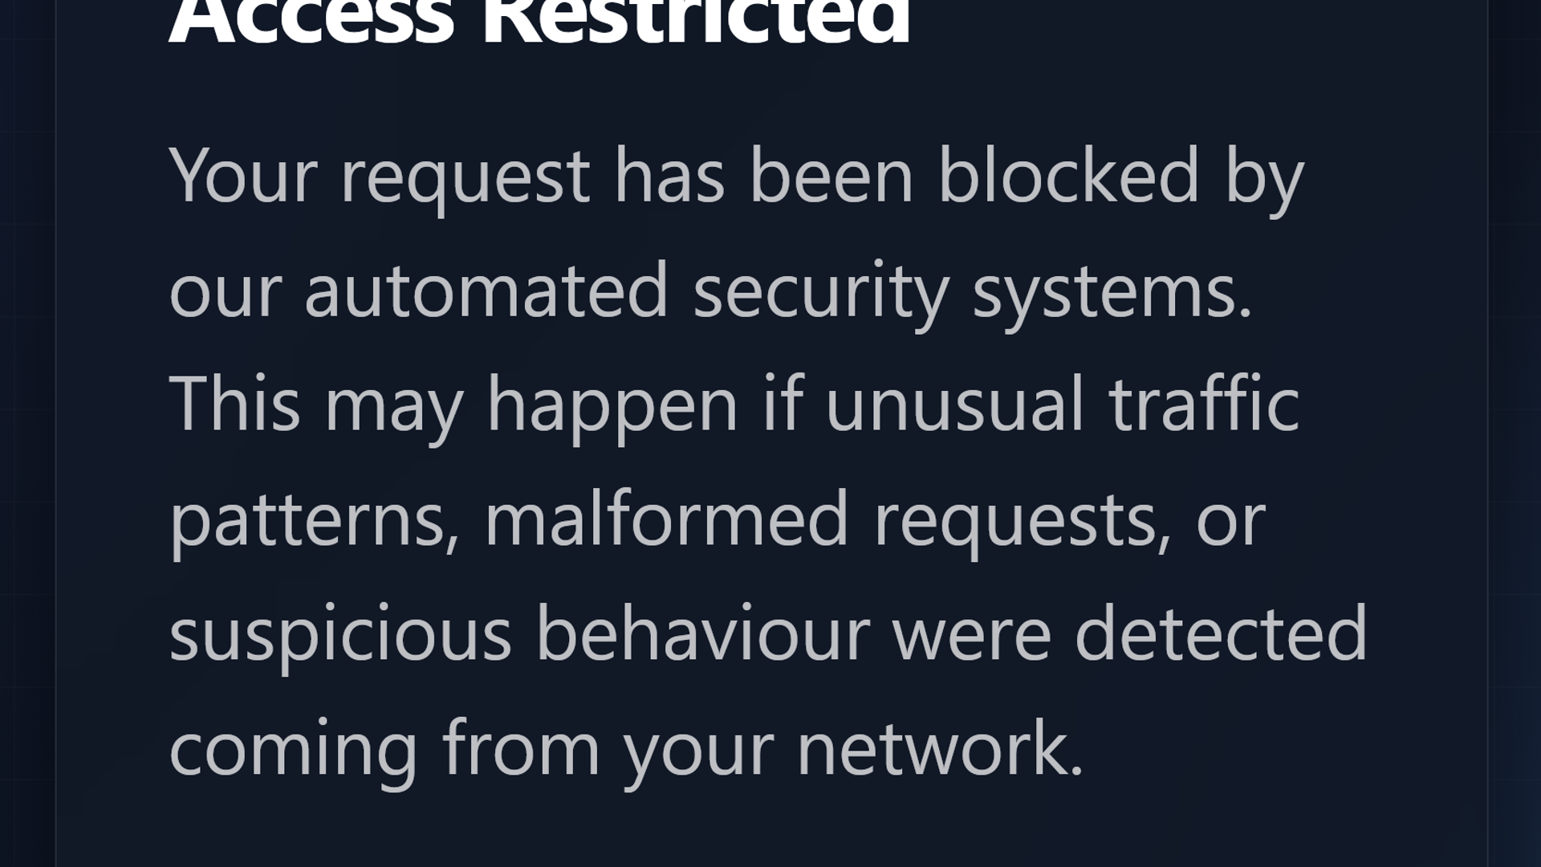
7 COMPLIANCE FRAMEWORKS. MAPPED AUTOMATICALLY.
SOC2
ISO 27001
PCI-DSS
HIPAA
⛨
▤
Information Security Management
▭
✚
Trust Service Criteria
Payment Card Data Security
Health Information Privacy
⚖
GDPR
⛨
CIS Controls
🏛
NIST CSF
Data Protection Regulation
Center for Internet Security
Cybersecurity Framework
ReconPro's ComplianceMapper automatically maps every finding to relevant framework controls. Run a scan, get a compliance report. No manual cross-referencing.
Notes:
Compliance is where most security teams lose hundreds of hours. You run a vulnerability scan, you get a list of findings, and then someone has to manually cross-reference every single finding against your compliance frameworks — SOC2, ISO 27001, PCI-DSS, HIPAA, GDPR, CIS Controls, NIST CSF. It's a nightmare of spreadsheets and tribal knowledge. ReconPro eliminates that entirely. Our ComplianceMapper engine automatically maps every finding from every module to the relevant controls across all seven frameworks. You run a single scan, and you get a compliance-ready report that tells you exactly which controls are satisfied and which have gaps. SOC2 covers Trust Service Criteria. ISO 27001 covers Information Security Management. PCI-DSS handles Payment Card Data Security. HIPAA covers Health Information Privacy. GDPR handles Data Protection Regulation. CIS Controls maps to the Center for Internet Security baseline. And NIST CSF covers the Cybersecurity Framework. No more manual cross-referencing. No more audit prep marathons. The tool does the mapping for you.

Slide 12
03
CHAPTER 03
THE PLATFORM
33 commands. 3 operating systems. Zero friction.
Notes:
Now let's talk about the platform itself — how ReconPro actually works under the hood and how you get started. We've covered the ecosystem: 14 modules, 6 integrations, 7 compliance frameworks. But none of that matters if the tool is hard to use. So in this section, I'll show you the CLI interface — 33 commands that give you complete control over every module, every integration, and every report format. I'll also cover our cross-platform story: ReconPro is pure Python, tested on Windows 10 and 11, Ubuntu and Debian, and macOS. One pip install, one codebase, every platform. And finally, I'll walk you through the install process — literally 30 seconds from zero to your first scan. The platform philosophy is simple: power without complexity.

Slide 13
33 COMMANDS. INFINITE POWER.
reconpro — bash
CORE
TEAM
$ reconpro scan --target example.com
$ reconpro team add @hacker --role lead
$ reconpro scan --modules gorgon,oblivion
$ reconpro team list
$ reconpro report --format json
INTEGRATIONS
MODULES
$ reconpro integrations slack --channel #alerts
$ reconpro gorgon --target example.com
$ reconpro oblivion --url https://example.com
UTILITIES
$ reconpro pegasus --full-scan
$ reconpro doctor --check-all
$ reconpro export --format pdf
Every command has --help. Every module can run standalone or combined.
Notes:
This is the heart of ReconPro — the CLI. Thirty-three commands give you complete control over every module, every integration, and every workflow. The design philosophy is simple: if you can type it, ReconPro can do it. Core commands handle scanning and reporting. Module commands let you invoke GORGON, OBLIVION, or PEGASUS directly. Team commands manage your crew. Integration commands plug into Slack, Jira, Splunk, and more. And utility commands like doctor and export keep your environment healthy. Every single command supports --help, so you're never lost. And every module can run independently or chained together in a single scan. This isn't a GUI with a CLI bolted on — the CLI is the product.

Slide 14
WORKS EVERYWHERE. PERIOD.
▢
✦
▢
Windows
Linux
macOS
pip install reconpro
pip install reconpro
pip install reconpro
✓
Pure Python (zero compiled dependencies)
✓
py3-none-any wheel (universal)
✓
Tested on Windows 10/11, Ubuntu/Debian, macOS
One codebase. Every platform. No compatibility hacks.
Notes:
Cross-platform is a promise most security tools make and very few keep. ReconPro actually delivers. The entire codebase is pure Python — no C extensions, no compiled binaries, nothing that breaks when you switch operating systems. We ship a py3-none-any wheel, which is the most universal package format possible. Early on we hit a nasty bug where os.uname() crashed on Windows — we ripped it out and replaced it with a cross-platform abstraction. Same code, same commands, same output on Windows 10 and 11, Ubuntu, Debian, and macOS. Whether you're a red teamer on Kali or a defender on a corporate Windows laptop, the experience is identical. One codebase. Every platform. No hacks.

Slide 15
START HUNTING IN 30 SECONDS.
$ pip install reconpro
SCAN A TARGET
RUN GORGON ULTRA
⌕
✦
reconpro scan --target your-domain.com
reconpro gorgon --target your-domain.com
$
✦
⊘
Free Forever
Open Source
Zero Dependencies
No SaaS, no subscription, MIT license
Community driven, transparent code
Pure Python, no compiled libs
Notes:
Let me walk you through getting started — because it really does take thirty seconds. Open your terminal, type pip install reconpro, and you're done. That single command pulls down everything: GORGON, OBLIVION, PEGASUS, all 14 modules, all 33 commands. No API keys to configure, no database to set up, no daemon to run. Once installed, you can immediately run a full scan with reconpro scan --target and your domain, or jump straight into GORGON ULTRA with reconpro gorgon. Three things make this possible. First, ReconPro is free forever — MIT licensed, no SaaS tier, no premium upsell. Second, it's fully open source — every line of code is auditable on GitHub. Third, it has zero compiled dependencies — pure Python means it installs cleanly on any system. Go install it and start hunting.

Slide 16
RECONPRO
The future of recon is open. The future is now.
pip install reconpro
✦
GitHub: github.com/vibesec/reconpro
↓
PyPI: pypi.org/project/reconpro
BUILT BY DEFENDERS. FOR DEFENDERS. ALWAYS FREE.
Notes:
And that's ReconPro. One command to install, one command to scan, and you've got the most powerful open-source reconnaissance platform on the planet. Fourteen integrated modules, six enterprise integrations, seven compliance frameworks, and thirty-three CLI commands, all wrapped in a pure Python package that runs on Windows, Linux, and macOS. Head over to GitHub, star the repo, read the code, and start contributing. Whether you're a red teamer, a blue teamer, a bug bounty hunter, or a security engineer at a startup, ReconPro was built for you. It's free, it's open source, and it's not going anywhere. Stay dangerous, stay secure. Go install it right now — pip install reconpro — and join the hunt.

