Slide 1


Department of Artificial Intelligence and Deep Learning
Intelligence fraud detection: Leveraging Deep Learning For Credit Card Transactions
Mrs.Renuka Devi S M.E(Asst. Prof)
Faleel Mohsin 221801010
Kawshik 221801025

Slide 2
Problem Statement and Motivation
A credit card company is aiming to resolve credit card fraud anomalies by analyzing transaction patterns and customer behavior to minizine a potential credential fraud in the system.
The motivation of this problem statement is to minimize financial losses, gaining customers trust and upholding the brand reputation.

Slide 3
Objectives
The primary goal of this project is to reduce customers financial losses by analyzing the transaction process and customer behaviour to detect fradulent activities within the system.

Slide 4
Abstract
This project aims to enhance credit card fraud detection capabilities by analyzing real-time and past transaction patterns and customer behavior. By leveraging advanced data analytics and machine learning techniques, the system will identify and minimize potential fraudulent activities. The project will focus on developing adaptive models that can detect anomalies in real-time, reduce false positives, and improve the overall security of the credit card system. This approach will ensure a more robust and efficient fraud detection system, ultimately safeguarding customers and reducing financial losses.

Slide 5
Introduction and Overview of the Project
Introduction:
Credit card is a widely used payment method for online and offline transactions. However, the mass evolution of credit cards paved the way for different fraudulent actions.
Overview:
The aim of this project is to create a robust system for real-time identification of fraudulent credit card transactions. Using advanced data analysis and machine learning, the system will analyze transaction data and customer behavior to detect anomalies fraud patterns

Slide 6
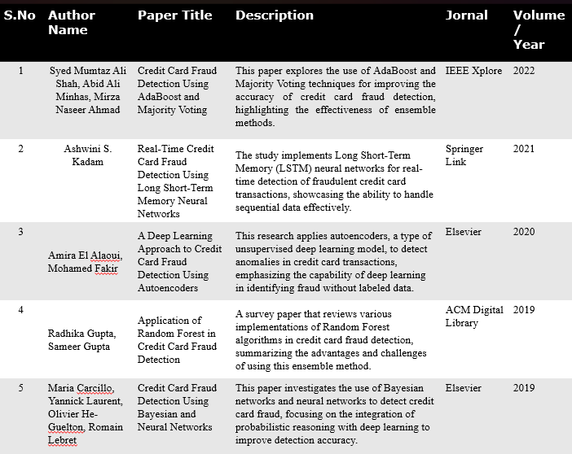
Literature Survey

Slide 7
Existing System
Rule-Based Systems
Rule-based systems rely on predefined rules and thresholds to detect fraudulent transactions.
Machine Learning Techniques
Supervised Learning : Models are trained on historical labeled data (fraudulent and non-fraudulent transactions).
Unsupervised Learning : Models identify patterns and anomalies without labeled data.

Slide 8
Drawback of Existing System
Rule-Based Systems
Rule-based systems are inflexible and need manual updates to handle new fraud patterns. They become complex and slow as rules increase, require high maintenance, and often miss sophisticated fraud.
Machine Learning
ML models rely on large amounts of high-quality, labeled data and require significant manual effort for feature engineering. They can suffer from overfitting or underfitting and are often difficult to interpret.

Slide 9
Proposed System
System Integration: Combines Neural OED and XGBoost for credit card fraud detection.
Feature Engineering: Neural OED is used to identify significant features from transaction data.
Classifier Training: XGBoost is trained using the optimized features.
Model Optimization: Hyperparameters of XGBoost are fine-tuned and validated with cross-validation.
Real-Time Deployment: The system is deployed for real-time fraud detection.6. Continuous Monitoring: The system is monitored and updated based on new data and feedback.

Slide 10
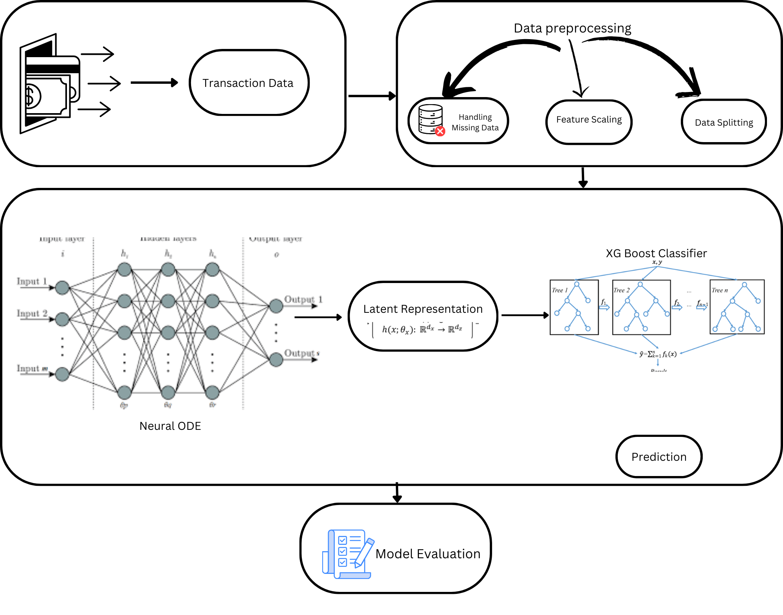
System Architecture

Slide 11
List of modules
Module 1: Data Pre-processing Module.
Module 2: Data balancing Module
Module 2: Implementing neural Module
Module 3: Implementation of XGBoost
Module 4: Evaluation Module
Module 5: Fraud Detection Module.

Slide 12
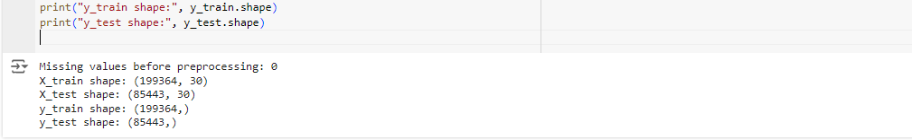
Data Pre-Processing Module
Handling Missing Data: Rows with missing values are dropped to ensure a clean dataset for accurate analysis.
Feature Scaling: Features are standardized using StandardScaler, ensuring consistent scaling across all features.
Data Splitting: The dataset is split into training and testing sets, maintaining class distribution with stratified sampling.
Output:

Slide 13
Data Pre-Processing Module:
Data Flow Diagram:

Slide 14

Data Balancing Module
Synthetic Oversampling: SMOTE generates synthetic samples for the minority class (fraud) by interpolating between existing data points, rather than simply duplicating them.
Maintains Class Distribution: It ensures that both the majority and minority classes have equal representation in the training set, addressing the issue of class imbalance.
Focused on Training Data: SMOTE is applied only to the training set, preventing information leakage into the testing set while ensuring the model is trained on balanced data.
Output:

Slide 15

Data Balancing Module
Data Flow Diagram:

Slide 16
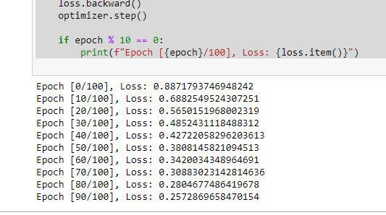
Implementation of Neural ODE Module:
Optimization: The model uses the Adam optimizer, which adjusts the weights to reduce prediction errors (using binary cross-entropy loss) during training, helping the model improve its fraud detection.
Learning Through ODE: Gradients (how much to adjust weights) are computed through the ODE block, allowing the model to learn how features evolve over time and capture complex relationships in the data.
Iterative Training: The model processes the training data multiple times (epochs), gradually refining its ability to classify fraudulent and non-fraudulent transactions with each pass.
Output:

Slide 17
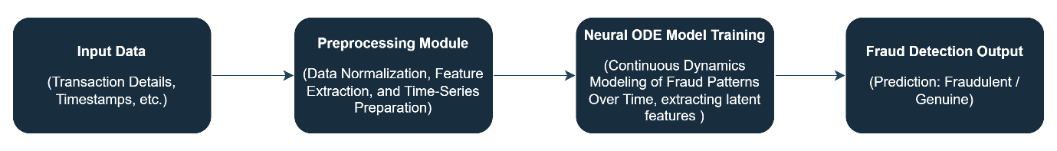
Implementation of Neural ODE Module:
Data Flow Diagram:

Slide 18

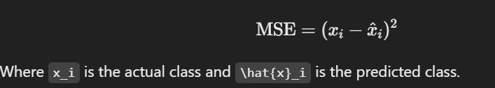
Formulas:
Ordinary Differential Equation (ODE):
The dynamics of the system are modeled using the equation:
Here, x(t) is the state, 𝑓is a neural network representing the rate of change, and 𝜃are the parameters of this network.
Training Objective:
The model is trained by minimizing the loss function, which measures the difference between observed and predicted values:

Slide 19
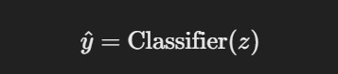
Formula:
Common choices for Loss datainclude mean squared error (MSE) or binary cross-entropy for classification tasks.
Classifier Integration:
After obtaining the latent representation 𝑧, you can feed it into a classifier (e.g., XGBoost) to classify transactions as fraudulent or not:
The classifier provides predictions based on the latent representation derived from the ODE.

Slide 20
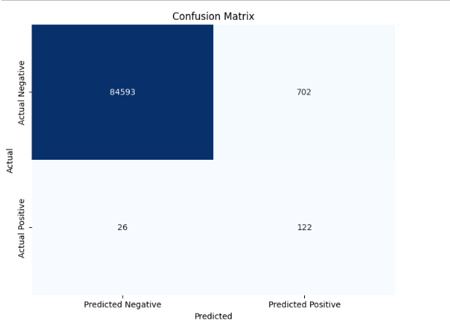
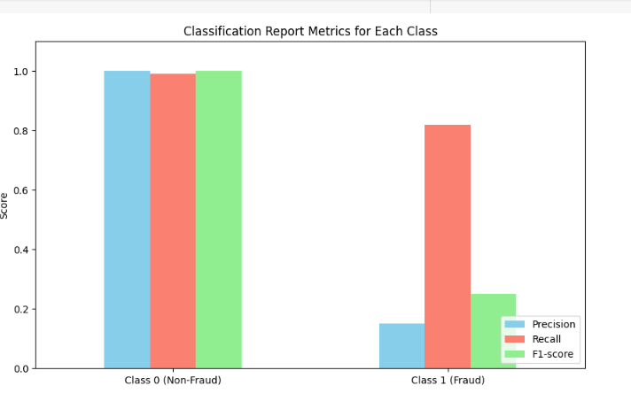
Output:
Untuned XGBoost classifier using latent representation from NOED
Precision, Recall and F1 Score Metrics Evaluation

Slide 21
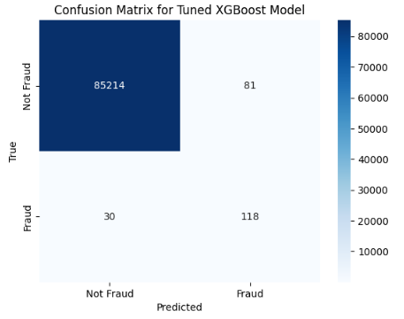
Output:

Slide 22
Conclusion:
In conclusion, we implemented two advanced models, Neural ODE and XGBoost, to tackle credit card fraud detection. To address the significant class imbalance in the dataset, we applied SMOTE for synthetic oversampling, ensuring an even representation of fraud and non-fraud cases in the training set. This preprocessing step allowed both models to better capture the subtle patterns of fraudulent transactions. By combining dynamic feature learning with Neural ODE and the powerful gradient-boosting capabilities of XGBoost, we aimed to create a robust, effective solution for identifying fraud with improved accuracy.

Slide 23
References
Srivastava, A., Kundu, A., Sural, S., & Majumdar, A. K. (2008). Credit Card Fraud Detection Using Hidden Markov Model. IEEE Transactions on Dependable and Secure Computing, 5(1), 37-48.
Bhattacharyya, S., Jha, S., Tharakunnel, K., & Westland, J. C. (2011). Data mining for credit card fraud: A comparative study. Decision Support Systems, 50(3), 602-613.
Phua, C., Lee, V., Smith, K., & Gayler, R. (2010). A comprehensive survey of data mining-based fraud detection research. Artificial Intelligence Review, 34(1), 1-14.

Slide 24
Thank You

