Slide 1
Embedded Systems Design
Inter-Integrated Circuit (I2C) Bus

Slide 2
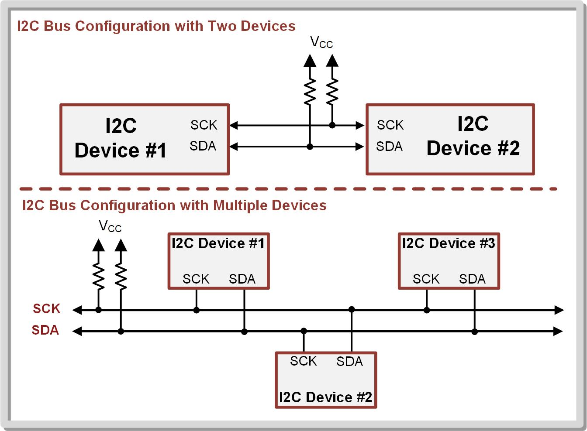
Ch. 14: Serial Communication in C
14.3.1 The I2C Protocol
The Inter-Integrated Circuit (I2C) standard is a serial interface implement with a two-wire link that can support multiple masters and multiple slaves.
14.3 Inter-Integrated Circuit (I2C) Bus

Slide 3
Ch. 14: Serial Communication in C
14.3.1 The I2C Protocol
The Inter-Integrated Circuit (I2C) standard is a serial interface implement with a two-wire link that can support multiple masters and multiple slaves.
Providing a clock allows higher data rates over UART.
14.3 Inter-Integrated Circuit (I2C) Bus

Slide 4
Ch. 14: Serial Communication in C
14.3.1 The I2C Protocol
The Inter-Integrated Circuit (I2C) standard is a serial interface implement with a two-wire link that can support multiple masters and multiple slaves.
Providing a clock allows higher data rates over UART.
The two-wire interface allows devices to be added without increasing the number of lines like on SPI.
14.3 Inter-Integrated Circuit (I2C) Bus

Slide 5
Ch. 14: Serial Communication in C
14.3.1 The I2C Protocol
An I2C bus contains a clock line (SCK) and data line (SDA).
14.3 Inter-Integrated Circuit (I2C) Bus

Slide 6
Ch. 14: Serial Communication in C
14.3.1 The I2C Protocol
An I2C link is always half-duplex, meaning that all devices share the data line with only one device transmitting at any given time.
14.3 Inter-Integrated Circuit (I2C) Bus

Slide 7
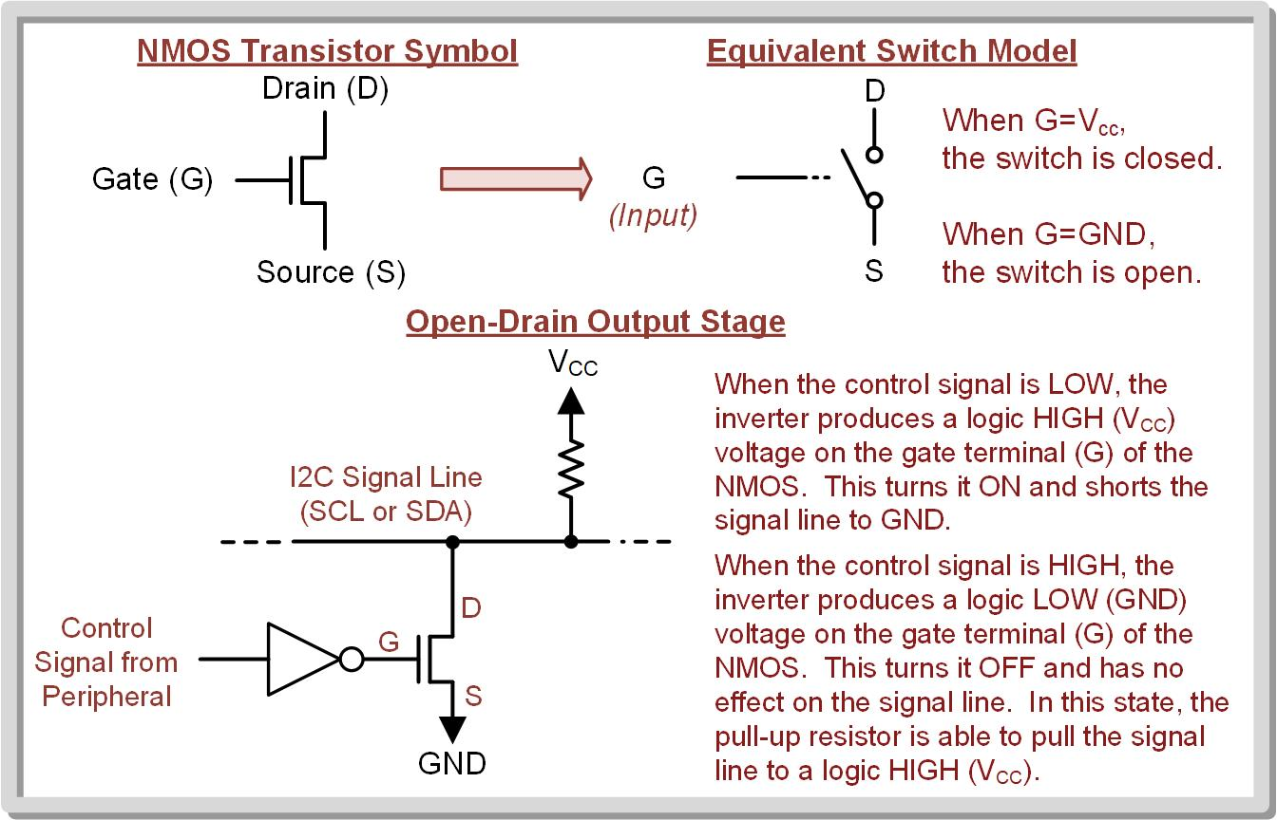
Ch. 14: Serial Communication in C
14.3.1 The I2C Protocol
Open-drain output stage – supports multiple drivers on the same signal line using NMOS transistor.
14.3 Inter-Integrated Circuit (I2C) Bus

Slide 8
Ch. 14: Serial Communication in C
14.3.1 The I2C Protocol
NMOS Transistor Operation
14.3 Inter-Integrated Circuit (I2C) Bus

Slide 9
Ch. 14: Serial Communication in C
14.3.1 The I2C Protocol
NMOS Transistor Operation
The NMOS switch will turn ON and close when its gate voltage is at V_{CC}.
14.3 Inter-Integrated Circuit (I2C) Bus

Slide 10
Ch. 14: Serial Communication in C
14.3.1 The I2C Protocol
NMOS Transistor Operation
The NMOS switch will turn ON and close when its gate voltage is at V_{CC}.
When the NMOS is ON, a conduction path is formed between its other two terminals, which effectively closes the switch.
14.3 Inter-Integrated Circuit (I2C) Bus

Slide 11
Ch. 14: Serial Communication in C
14.3.1 The I2C Protocol
NMOS Transistor Operation
The NMOS switch will turn ON and close when its gate voltage is at V_{CC}.
When the NMOS is ON, a conduction path is formed between its other two terminals, which effectively closes the switch.
The NMOS will switch OFF when the gate voltage is at GND.
14.3 Inter-Integrated Circuit (I2C) Bus

Slide 12
Ch. 14: Serial Communication in C
14.3.1 The I2C Protocol
NMOS Transistor Operation
The NMOS switch will turn ON and close when its gate voltage is at V_{CC}.
When the NMOS is ON, a conduction path is formed between its other two terminals, which effectively closes the switch.
The NMOS will switch OFF when the gate voltage is at GND.
When the NMOS is OFF, there is no conduction path between the source and drain, which effectively opens the switch.
14.3 Inter-Integrated Circuit (I2C) Bus

Slide 13
Ch. 14: Serial Communication in C
14.3.1 The I2C Protocol
Consider the Open-Drain Output Stage:
14.3 Inter-Integrated Circuit (I2C) Bus

Slide 14
Ch. 14: Serial Communication in C
14.3.1 The I2C Protocol
Consider the Open-Drain Output Stage:
If we turn on the NMOS by driving a HIGH (1) to its gate, it will pull the I2C line to GND, or LOW (0).
LOW (0)
HIGH (1)
ON
14.3 Inter-Integrated Circuit (I2C) Bus

Slide 15
Ch. 14: Serial Communication in C
14.3.1 The I2C Protocol
Consider the Open-Drain Output Stage:
If we turn off the NMOS by driving a LOW (0) to its gate, the line is left floating, which is an unknown logic level.
???
LOW (0)
OFF
14.3 Inter-Integrated Circuit (I2C) Bus

Slide 16
Ch. 14: Serial Communication in C
14.3.1 The I2C Protocol
Consider the Open-Drain Output Stage:
If we turn off the NMOS by driving a LOW (0) to its gate, the line is left floating, which is an unknown logic level.
If a pull-up resistor it placed on the line, it will pull the resistor to a HIGH (1) when the NMOS is off.
HIGH (1)
LOW (0)
OFF
14.3 Inter-Integrated Circuit (I2C) Bus

Slide 17
Ch. 14: Serial Communication in C
14.3.1 The I2C Protocol
Consider the Open-Drain Output Stage:
But now we have an inverted logic scheme where: - Driving a LOW to the NMOS yields a HIGH on the line. - Driving a HIGH on the NMOR yields a LOW on the line.
14.3 Inter-Integrated Circuit (I2C) Bus

Slide 18
Ch. 14: Serial Communication in C
14.3.1 The I2C Protocol
Consider the Open-Drain Output Stage:
But now we have an inverted logic scheme where: - Driving a LOW to the NMOS yields a HIGH on the line. - Driving a HIGH on the NMOR yields a LOW on the line.
To get back to positive logic, we insert an inverter before the NMOS.
14.3 Inter-Integrated Circuit (I2C) Bus

Slide 19
Ch. 14: Serial Communication in C
14.3.1 The I2C Protocol
Consider the Open-Drain Output Stage:
But now we have an inverted logic scheme where: - Driving a LOW to the NMOS yields a HIGH on the line. - Driving a HIGH on the NMOR yields a LOW on the line.
To get back to positive logic, we insert an inverter before the NMOS.
LOW (0)
LOW (0)
HIGH
ON
14.3 Inter-Integrated Circuit (I2C) Bus

Slide 20
Ch. 14: Serial Communication in C
14.3.1 The I2C Protocol
Consider the Open-Drain Output Stage:
But now we have an inverted logic scheme where: - Driving a LOW to the NMOS yields a HIGH on the line. - Driving a HIGH on the NMOR yields a LOW on the line.
To get back to positive logic, we insert an inverter before the NMOS.
HIGH (1)
HIGH (1)
LOW
OFF
14.3 Inter-Integrated Circuit (I2C) Bus

Slide 21
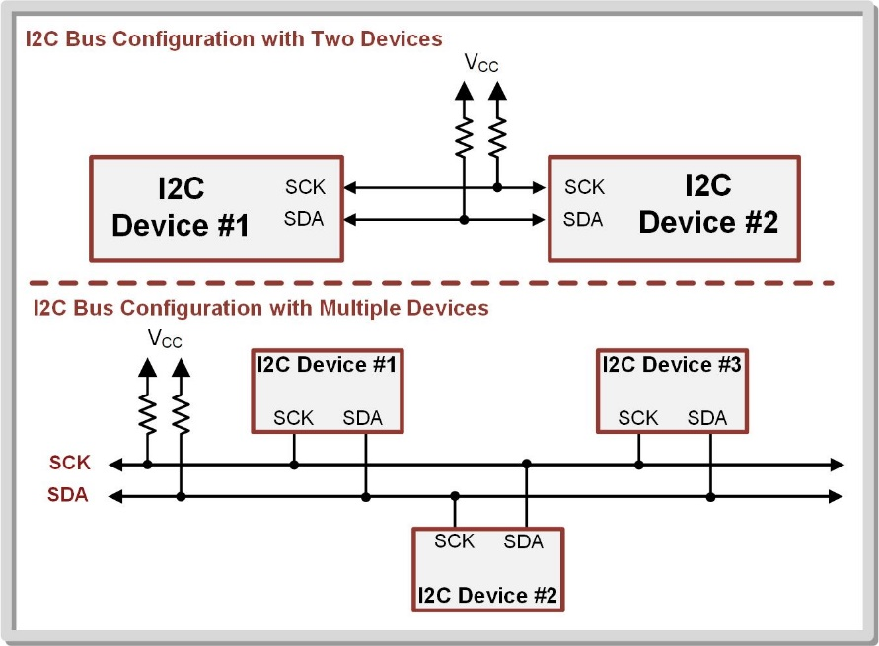
Ch. 14: Serial Communication in C
14.3.1 The I2C Protocol
An I2C bus ALWAYS needs external pull-up resistors on each of its lines.
These can’t be implemented on the MCU because the resistor function is only available when the port is configured as an INPUT.
Since I2C is bidirectional, we never know wither the pin will be an input or output.
14.3 Inter-Integrated Circuit (I2C) Bus

Slide 22
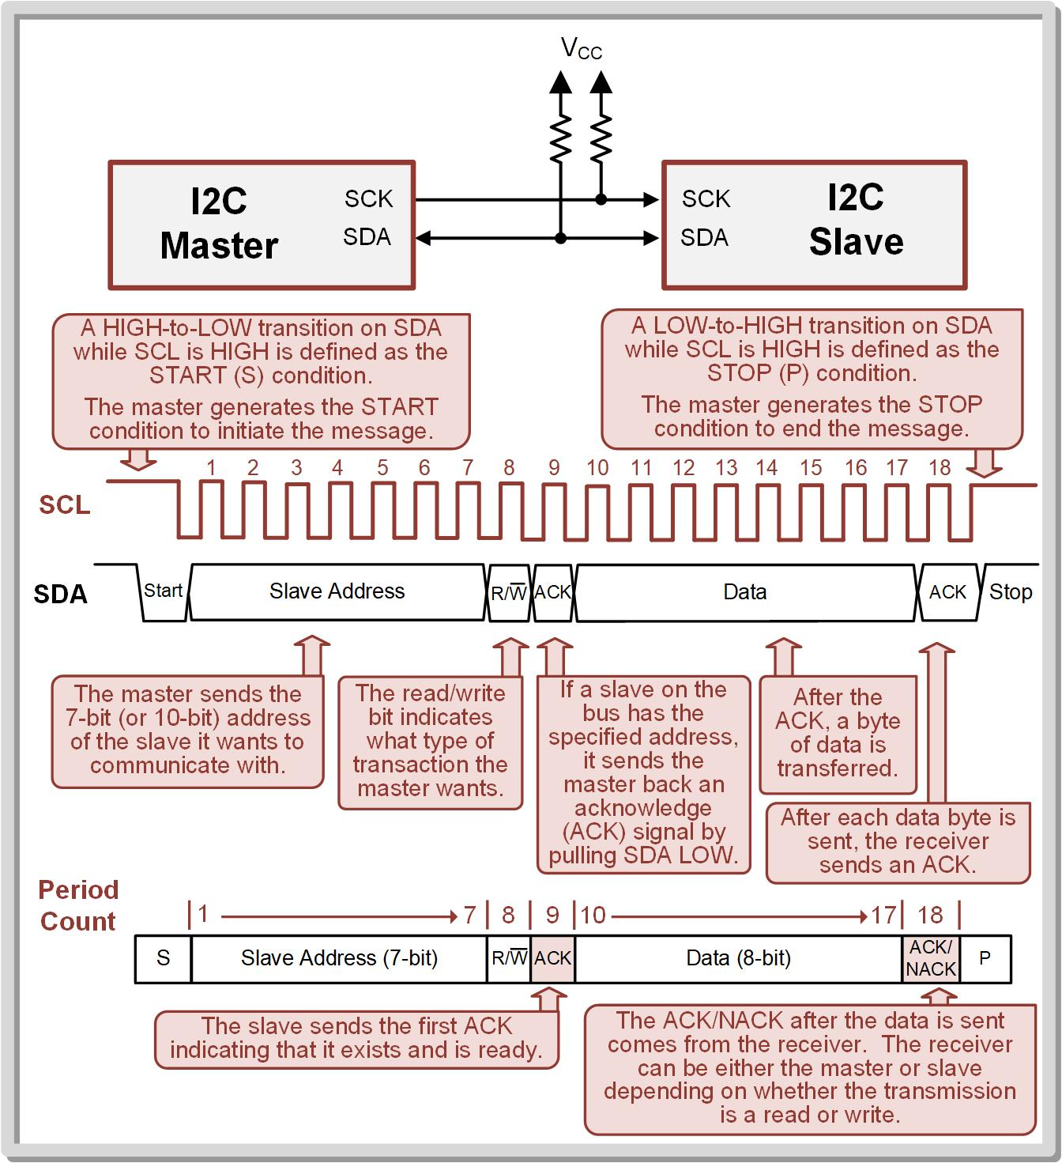
Ch. 14: Serial Communication in C
14.3.1 The I2C Protocol
Master – the device that initiates communication and controls the clock.
Multiple masters are also supported on an I2C bus.
14.3 Inter-Integrated Circuit (I2C) Bus

Slide 23
Ch. 14: Serial Communication in C
14.3.1 The I2C Protocol
Slave – a device on the bus that is read or written to, but does not initiate transmission or provide a clock.
Slave address – a unique and predetermined address for each slave on the bus.
This address is used by the master to indicate which slave it wants to communicate with.
14.3 Inter-Integrated Circuit (I2C) Bus

Slide 24
Ch. 14: Serial Communication in C
14.3.1 The I2C Protocol
Idle – when both SDA and SCL are held high by the pull-up resistors and no I2C device is attempting to communicate.
Busy – when devices are driving the bus.
Messages – how I2C information is transferred.
14.3 Inter-Integrated Circuit (I2C) Bus

Slide 25
Ch. 14: Serial Communication in C
14.3.1 The I2C Protocol
A master initiates a new message by generating a START (S) condition by pulling SDA LOW while SCL is still HIGH.
As soon as the START condition is generated, the SCL will be pulled LOW and start pulsing to provide the clock for the message.
14.3 Inter-Integrated Circuit (I2C) Bus

Slide 26
Ch. 14: Serial Communication in C
14.3.1 The I2C Protocol
The master is responsible for pulsing the clock.
14.3 Inter-Integrated Circuit (I2C) Bus

Slide 27
Ch. 14: Serial Communication in C
14.3.1 The I2C Protocol
Each clock pulse within the I2C message is numbered by periods.
Both the master and the slaves count the number of periods that have occurred since the message started in order to know when certain frames and signals should be present.
14.3 Inter-Integrated Circuit (I2C) Bus

Slide 28
Ch. 14: Serial Communication in C
14.3.1 The I2C Protocol
After the master generates the START condition, it first sends the slave address that it wishes to communicate with.
I2C slave addresses can either be 7-bit (default) or 10-bit.
14.3 Inter-Integrated Circuit (I2C) Bus

Slide 29
Ch. 14: Serial Communication in C
14.3.1 The I2C Protocol
The slave address is followed by the read/write signal indicating which type of transaction is being requested in the message.
The START condition, slave address, and read/write signal constitute periods 1 → 8.
14.3 Inter-Integrated Circuit (I2C) Bus

Slide 30
Ch. 14: Serial Communication in C
14.3.1 The I2C Protocol
Period 9 of the message is reserved for the slave acknowledge (ACK) or no-acknowledge (NACK) signal.
After the slave address and read/write signal are sent by the master, each slave on the bus checks whether it is being addressed.
14.3 Inter-Integrated Circuit (I2C) Bus

Slide 31
Ch. 14: Serial Communication in C
14.3.1 The I2C Protocol
If a slave exists with the specified slave address, it will send an ACK signal back to the master by pulling SDA LOW.
If no device exists with the specified slave address, no device will pull down SDA. This will result in period 9 remaining HIGH and will be interpreted as a NACK.
14.3 Inter-Integrated Circuit (I2C) Bus

Slide 32
Ch. 14: Serial Communication in C
14.3.1 The I2C Protocol
If the master sees the ACK signal, it knows a slave exists with the specified address and proceeds with the message.
14.3 Inter-Integrated Circuit (I2C) Bus

Slide 33
Ch. 14: Serial Communication in C
14.3.1 The I2C Protocol
After each byte is sent, the receiving device sends an ACK signal indicating that it successfully received the data.
14.3 Inter-Integrated Circuit (I2C) Bus

Slide 34
Ch. 14: Serial Communication in C
14.3.1 The I2C Protocol
A STOP condition occurs when there is a LOW-to-HIGH transition on SDA while SCL is HIGH.
Once, SDA goes HIGH, SCL also remains HIGH indicating that the bus is idle again.
14.3 Inter-Integrated Circuit (I2C) Bus

Slide 35
Ch. 14: Serial Communication in C
14.3.1 The I2C Protocol
A NACK in period 9 tells the master that no slave exists with the specified address.
The master then generates a STOP condition and ends the message.
NACK
14.3 Inter-Integrated Circuit (I2C) Bus

Slide 36
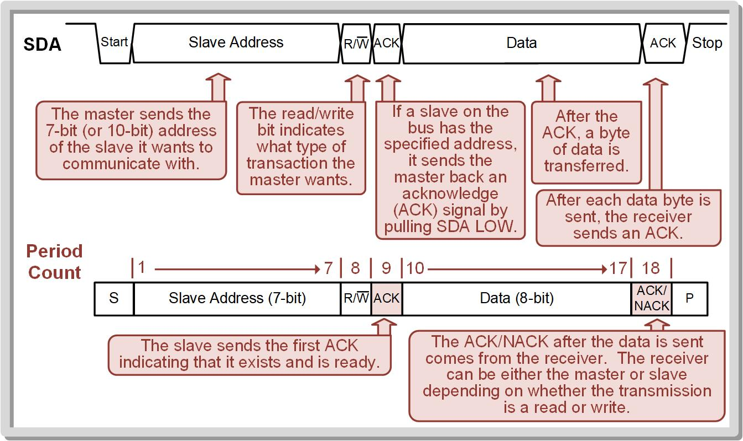
Ch. 14: Serial Communication in C
14.3.1 The I2C Protocol
14.3 Inter-Integrated Circuit (I2C) Bus

Slide 37
Ch. 14: Serial Communication in C
14.3.1 The I2C Protocol
When the master is writing to a slave, the master sends the 8-bits of data and the slave produces the ACK/NACK signal.
When the master is reading from a slave, the slave sends the 8-bits of data and the master produces the ACK/NACK signal.
After the data has been sent and acknowledged, the master can end the message by generating the STOP condition anytime.
Image Courtesy of
Recording Connection of Canada
Image Courtesy of
Recording Connection of Canada
Image Courtesy of
Recording Connection of Canada
Image Courtesy of
Recording Connection of Canada
Image Courtesy of
Recording Connection of Canada
Image Courtesy of
Recording Connection of Canada
Image Courtesy of
Recording Connection of Canada
14.3 Inter-Integrated Circuit (I2C) Bus

Slide 38
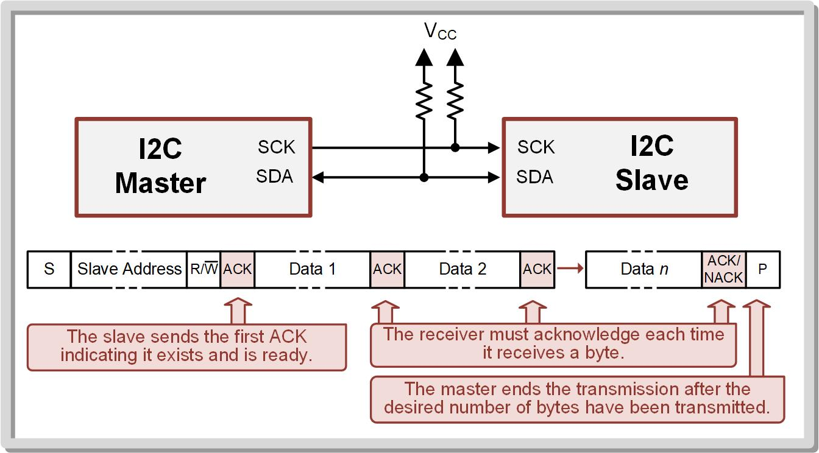
Ch. 14: Serial Communication in C
14.3.1 The I2C Protocol
The Master can send multiple data bytes in a single message.
14.3 Inter-Integrated Circuit (I2C) Bus

Slide 39
Ch. 14: Serial Communication in C
14.3.1 The I2C Protocol
Review of the Basic I2C Message Structure
14.3 Inter-Integrated Circuit (I2C) Bus

Slide 40
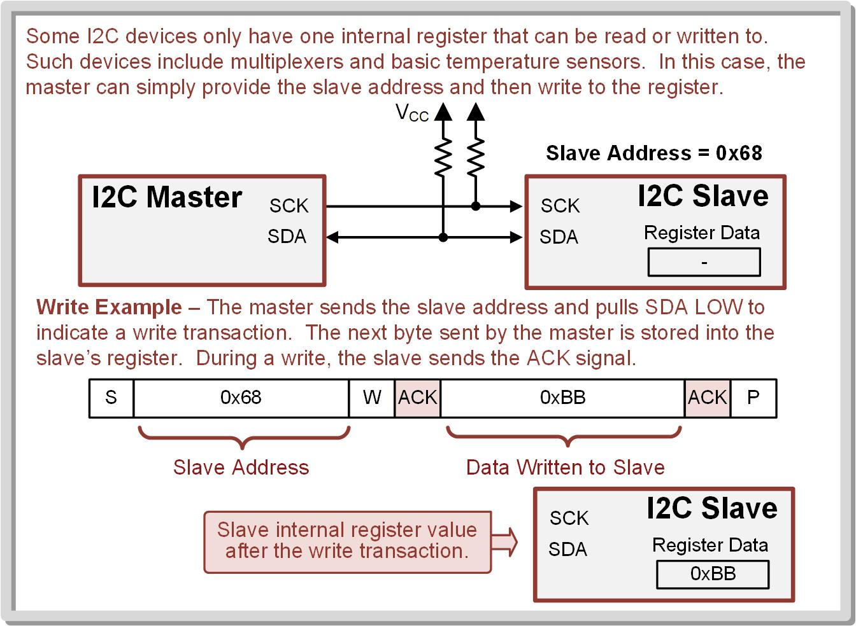
Ch. 14: Serial Communication in C
14.3.1 The I2C Protocol
I2C devices contain individual registers that hold their information.
In the simplest case, an I2C device contains only a single register.
14.3 Inter-Integrated Circuit (I2C) Bus

Slide 41
Ch. 14: Serial Communication in C
14.3.1 The I2C Protocol
Writing to a slave with a single register.
The master initiates the message by sending the S bit.
The master provides the slave address and a WRITE signal.
The slave ACKs to indicate it is ready.
The master writes the data.
The slave sends an ACK that it got the data.
The master ends the message by sending the P bit.
No register address is needed.
14.3 Inter-Integrated Circuit (I2C) Bus

Slide 42
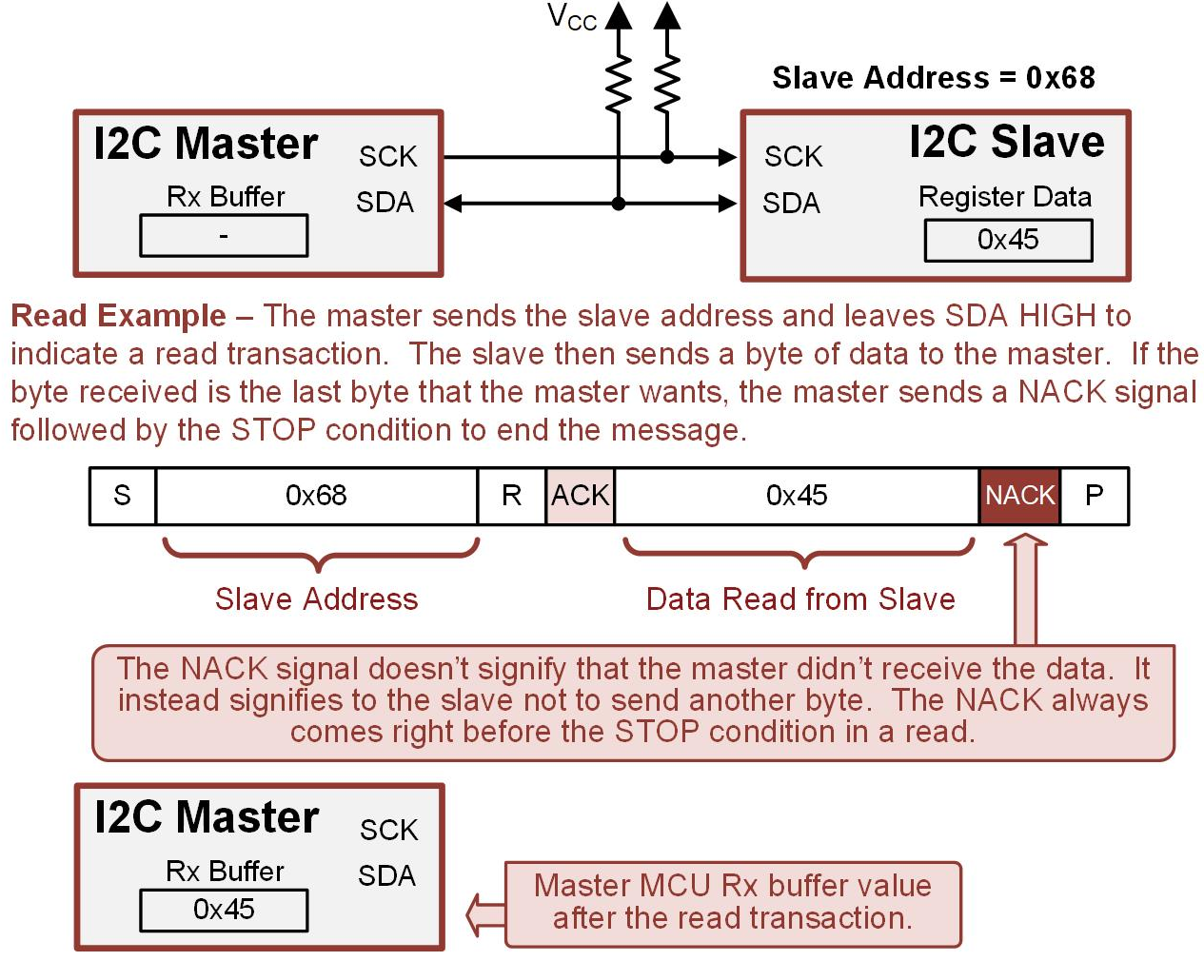
Ch. 14: Serial Communication in C
14.3.1 The I2C Protocol
No register address is needed.
Reading from a slave with a single register.
The master initiates the message by sending the S bit.
The master provides the slave address and a WRITE signal.
The slave ACKs to indicate it is ready.
The slave sends the data.
The master sends a NACK to stop the slave from sending more data.
The master ends the message by sending the P bit.
14.3 Inter-Integrated Circuit (I2C) Bus

Slide 43
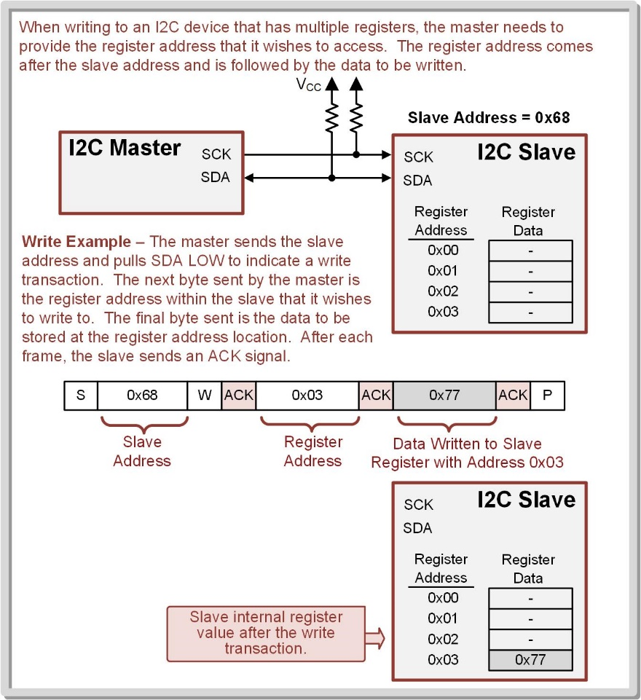
Ch. 14: Serial Communication in C
14.3.1 The I2C Protocol
When an I2C device has multiple registers, each is assigned a register address.
To access a specific register in the slave, the master needs to provide the register address in the message.
14.3 Inter-Integrated Circuit (I2C) Bus

Slide 44
Ch. 14: Serial Communication in C
14.3.1 The I2C Protocol
For a write transaction, the master generates an I2C message that first provides the slave address, then provides the register address to access, then provides the data to be written.
After each frame, the slave sends an ACK signal.
14.3 Inter-Integrated Circuit (I2C) Bus

Slide 45
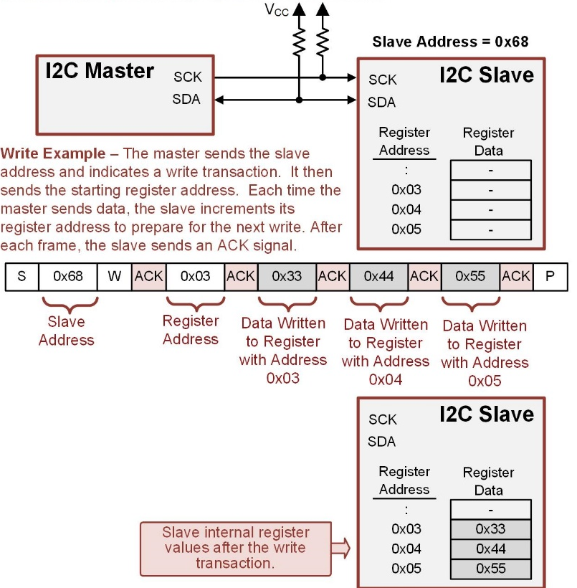
Ch. 14: Serial Communication in C
14.3.1 The I2C Protocol
The master can also write a block of data to registers.
The slave automatically increments the starting address after each byte of data is written.
The master still sends the slave address, the write signal, and the starting register address.
The next byte of data that is sent goes into the first register address location.
14.3 Inter-Integrated Circuit (I2C) Bus

Slide 46
Ch. 14: Serial Communication in C
14.3.1 The I2C Protocol
Check the slave’s datasheet for details!!!
The slave will continue to increment its register address until it sees the STOP condition generated by the master.
14.3 Inter-Integrated Circuit (I2C) Bus

Slide 47
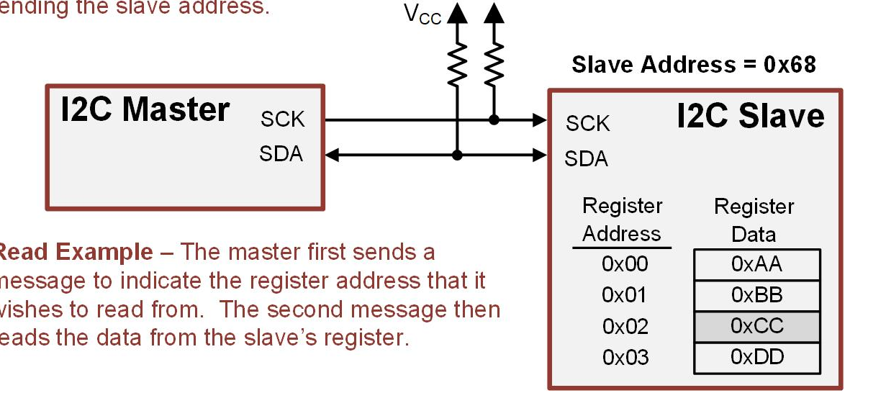
Ch. 14: Serial Communication in C
14.3.1 The I2C Protocol
When reading from a device that contains multiple registers, two message are needed.
14.3 Inter-Integrated Circuit (I2C) Bus

Slide 48
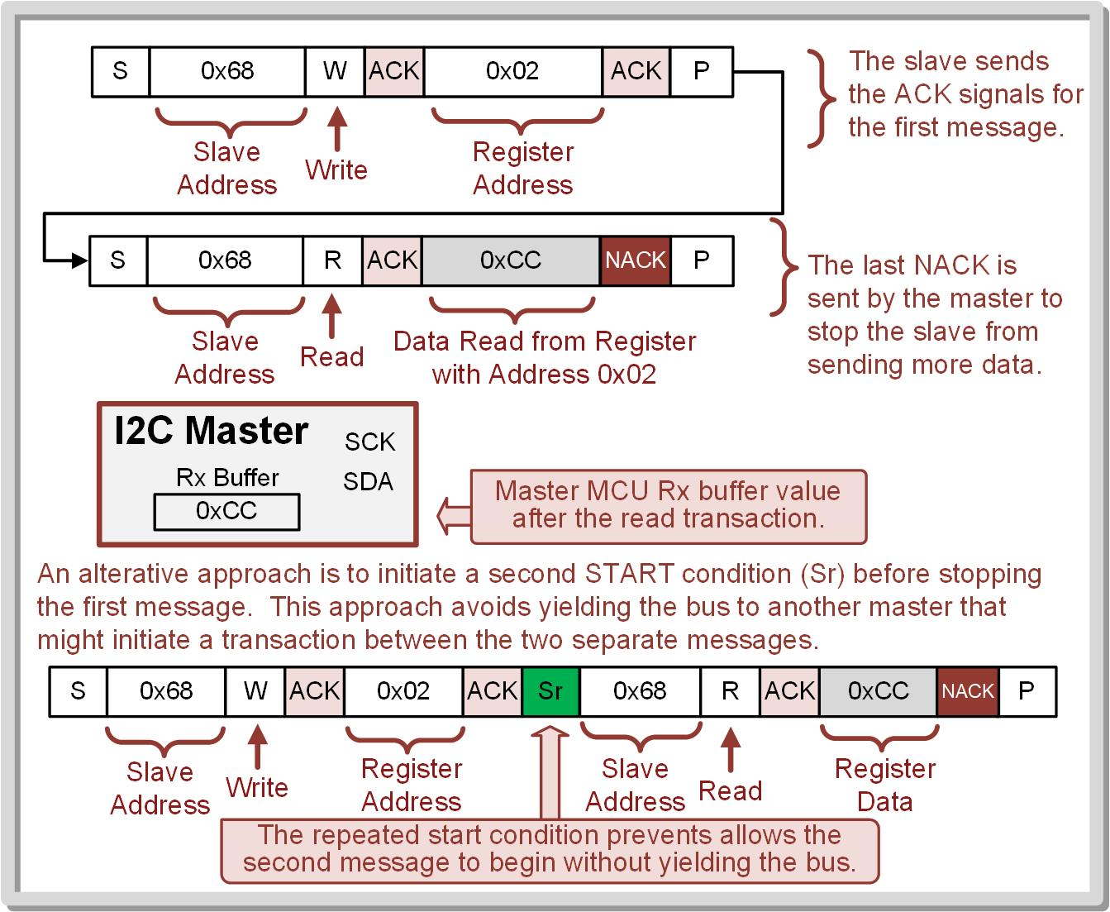
Ch. 14: Serial Communication in C
14.3.1 The I2C Protocol
When reading from a device that contains multiple registers, two message are needed.
The first message sets the register address within the slave that will be read from using a write transaction.
The first message puts the slave into a mode where it’s expecting a second message that will read data from the register address that was just sent.
14.3 Inter-Integrated Circuit (I2C) Bus

Slide 49
Ch. 14: Serial Communication in C
14.3.1 The I2C Protocol
The second message performs a read transaction that retrieves the data from the register address sent in the first message.
14.3 Inter-Integrated Circuit (I2C) Bus

Slide 50
Ch. 14: Serial Communication in C
14.3.1 The I2C Protocol
An alternative approach can also be used where a second START (Sr) condition is generated before the STOP condition of the first message.
This initiates the second read transaction immediately without giving up control of the bus.
14.3 Inter-Integrated Circuit (I2C) Bus

Slide 51
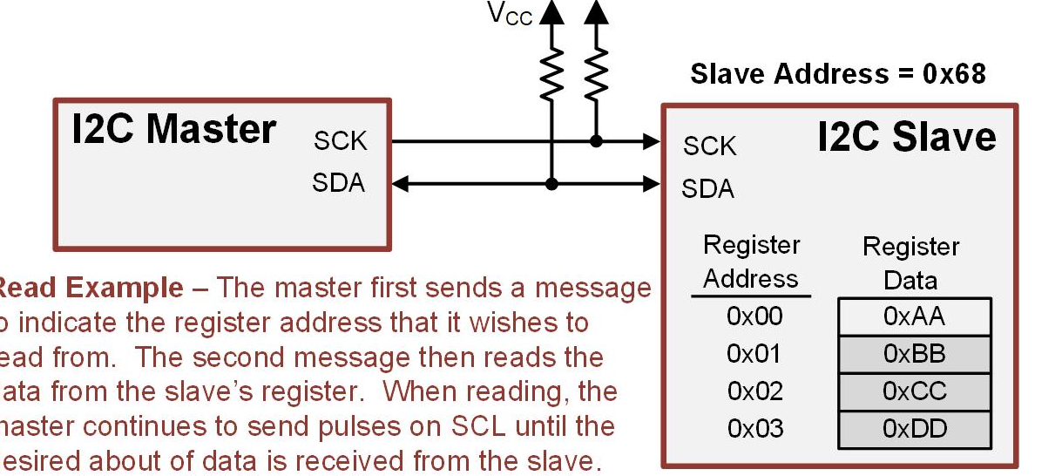
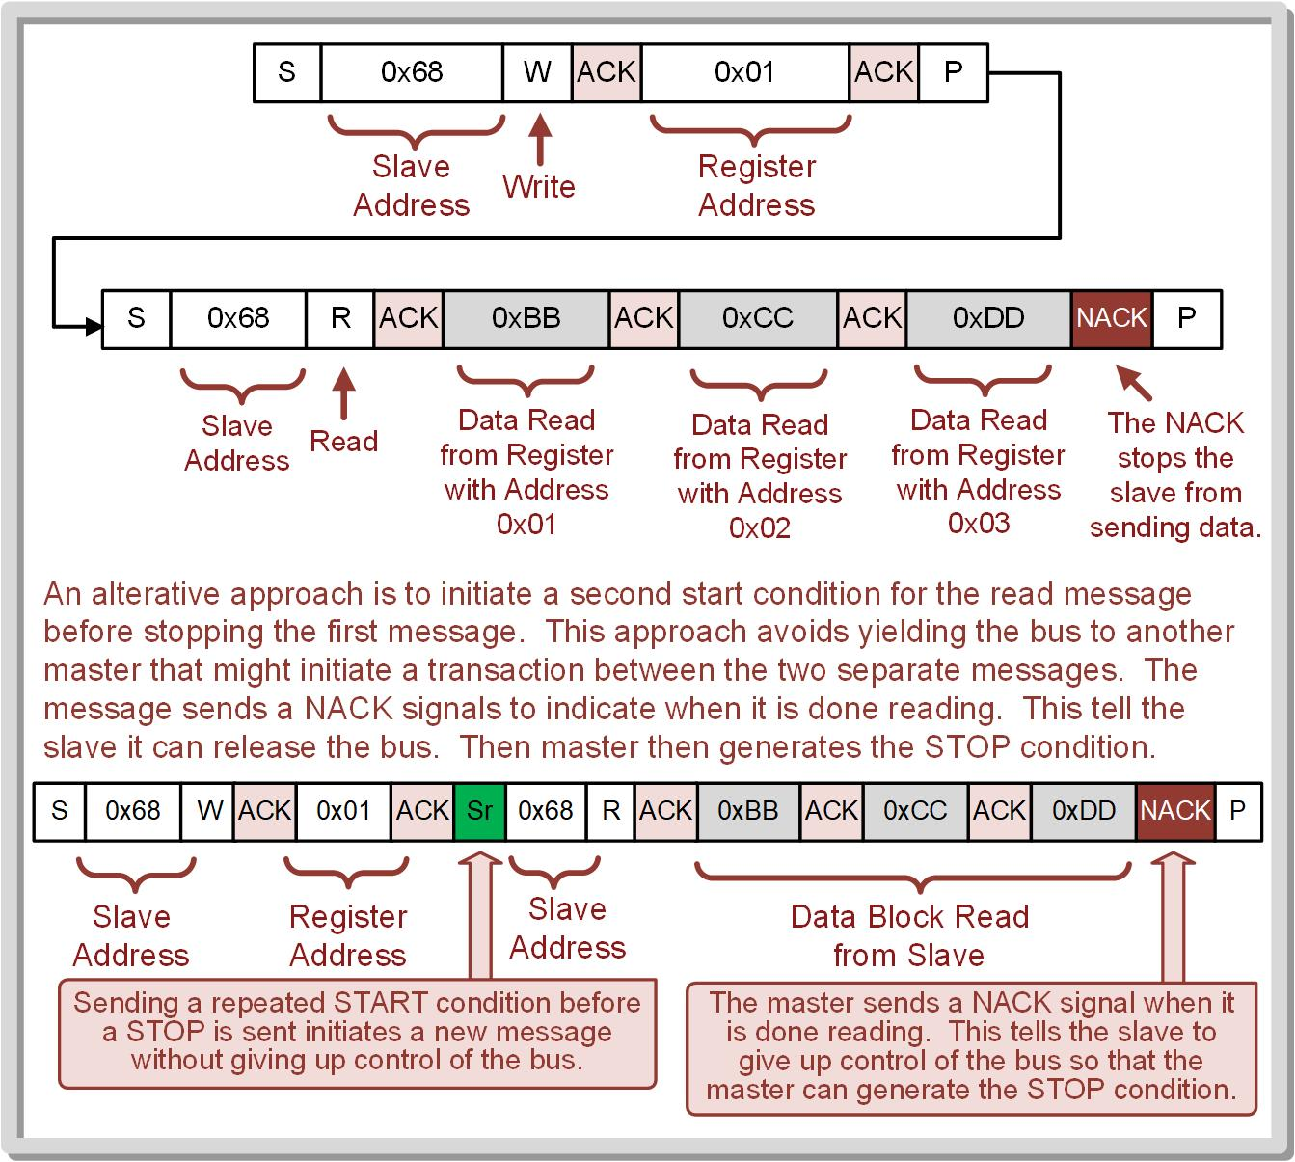
Ch. 14: Serial Communication in C
14.3.1 The I2C Protocol
The master can also read blocks of data from a slave.
In this situation, the master still sends two messages, the first setting the register address and the second retrieving the data.
In the second message, the master continually sends SCL pulses to read as many bytes as it wants prior to generating the STOP condition.
14.3 Inter-Integrated Circuit (I2C) Bus

Slide 52
Ch. 14: Serial Communication in C
14.3.1 The I2C Protocol
A repeated Start bit (Sr) can also be used to read blocks of information.
14.3 Inter-Integrated Circuit (I2C) Bus

