Slide 1


SHRI SANT GAJANAN MAHARAJ COLLEGE OF ENGINEERING, SHEGAON
DEPARTMENT OF INFORMATION TECHNOLOGY
2018-19
INTRODUCTION TO
Guided by :
Prof. A. K. Shahade
Present by :
Falgun Atara (45)

Slide 2


INTRODUCTION
TensorFlow is an open-source library for Deep Learning developed by the Google Brain team
in November 2015.
2. Originally created for tasks with heavy numerical computations, run either on CPU’s or GPU’s
3. Library for numerical computation using Data Flow Graphs (having nodes and edges)
4. C / C++ Backend

Slide 3
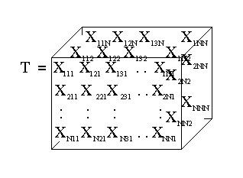
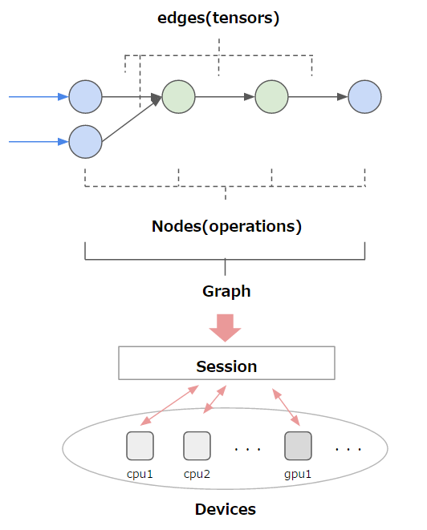
What is Tensor?
Simply put: Tensors can be viewed as a multidimensional array of numbers.
This means that:
A scalar is a tensor,
A vector is a tensor,
A matrix is a tensor
...
Data Flow (computational) Graph
Nodes (Vertices) – operations
Edges (tensors) – data flow between nodes

Slide 4
LITERATURE SURVEY
Ref. No. | Title / Author | Findings | Limitations / Remarks
[1] | C. Szegedy, et al., “Inception-v4, Inception-ResNet and the Impact of Residual Connections on Learning,” in 2016. | First noteworthy mention of TensorFlow TensorFlow is used to improve on the Inception model. | The authors report a 3.08% top-5 error on the ImageNet Classification test set.
[2] | Fatih Ertam, et al. ,“Data classification with Deep Learning using TensorFlow”, in 2016. | TensorFlow is used to classify MNIST dataset. We have studied and compared the effects of multiple activation functions on classification results. | The most accurate classification rate is found using the ReLu activation function

Slide 5
Ref. No. | Title / Author | Findings | Limitations / Remarks
[8] | Kithmi Ashangani ,et al., “ Semantic Video Search by Automatic Video Annotation using TensorFlow”, in 2016 | Here shots in each video are identified using image duplication techniques, and model is trained to extract features of frame. Semantic searching is done using NLP, allows receiving an efficient result | The benefits of leveling large scale video datasets for automated annotation presents fresh challenges and requires methods specialized for scalability and efficiency.
[6] | Sejoon Lim , et al., “Driver state estimation by convolutional neural network using multimodal sensor data” in 2017 | Driver state detection algorithm is developed to estimate the states of driver drowsiness, visual distraction, based on sensory data collected from a driving simulator. It is used to implement CNN model helps to get data in real time. | More accurate than previous research using a dynamic Bayesian network model.

Slide 6
Ref. No. | Title / Author | Findings | Limitations / Remarks
[4] | Wilton W.T. Fok, “Prediction model for students' future development by deep learning and TensorFlow artificial intelligence engine” in 2018 | Classification and prediction of students’ performance in examination are the typical challenges for educators. Here Model is trained using tensorflow & the number of hidden layers and number of nodes are adjusted for comparing the best performance configuration. | By adapting different calculation factor and element, such as hidden nodes, hidden layer and learning rate and so on, accuracy up to 90% was achieved. The prediction result provides appropriate recommendations for students, their teachers and parents.

Slide 7
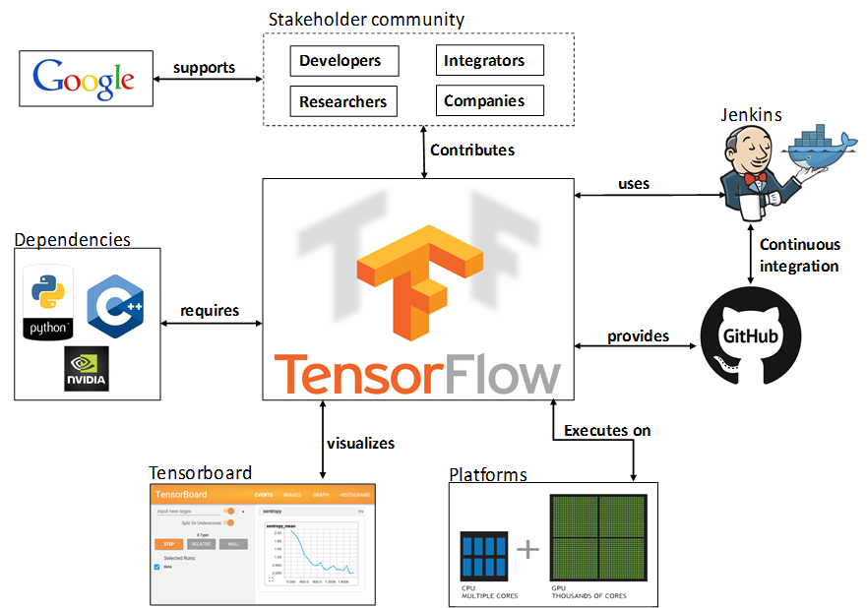
METHODOLOGY
TensorFlow separates definition of computation from executation.

Slide 8
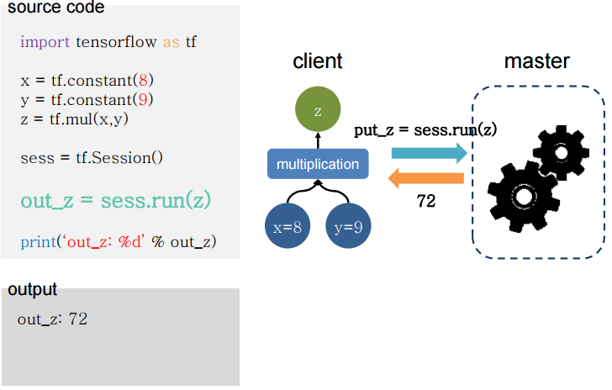
Let’s take a simple example.

Slide 9
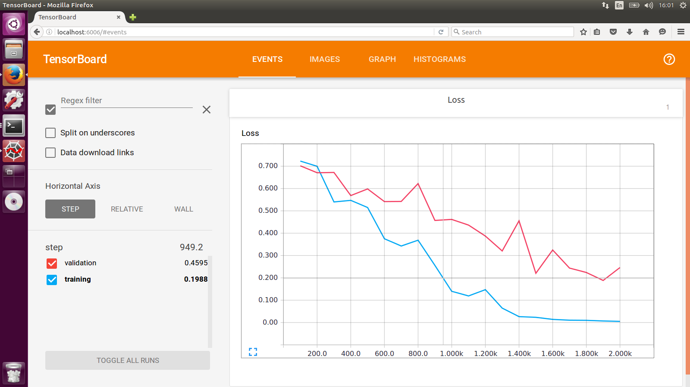
TensorBoard
It contains summary data that you can generate when running TensorFlow.
To run TensorBoard, use the following command in python
python -m tensorboard.main
.

Slide 10


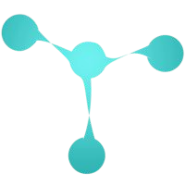


Why TensorFlow ?
COMPARATIVE STUDY AND ANALYSIS
There are lot of alternatives:
Scikit-learn
Caffe
Theano (Keras, Lasagne)
CuDNN
Mxnet
DSSTNE
DL4J
DIANNE
Etc.
19

Slide 11
Frameworks | Pros. | Cons.
Theano Released in 2008 | Python Frontend Fast | Poor visualization tool No support for distributing the execution of computational graph.
Torch Released in 2012 | Lua as its main frontend. | Lua’s limited API and library ecosystem can make industrial deployment harder Model is quite different from TensorFlow
Caffe Released in 2013 | Python interface is pretty useful. Well suited for development CNN and image recognition tasks. | No support for distributed execution. Probably dying; slow development

Slide 12
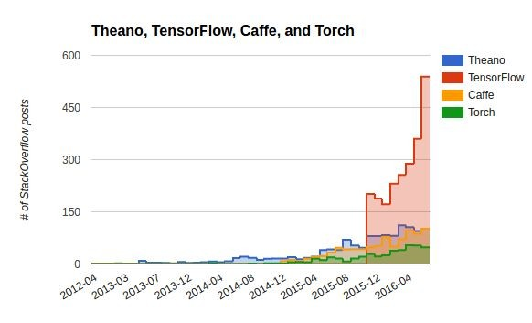
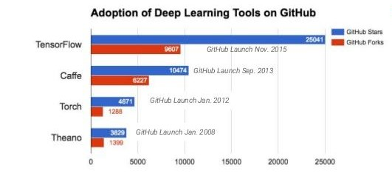
TensorFlow has the largest community
20

Slide 13
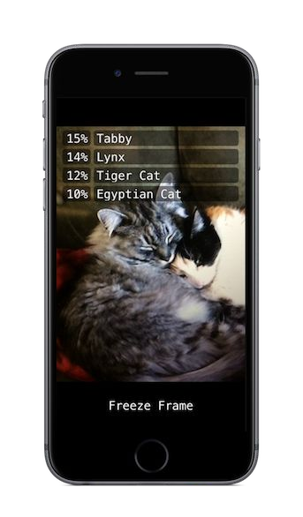
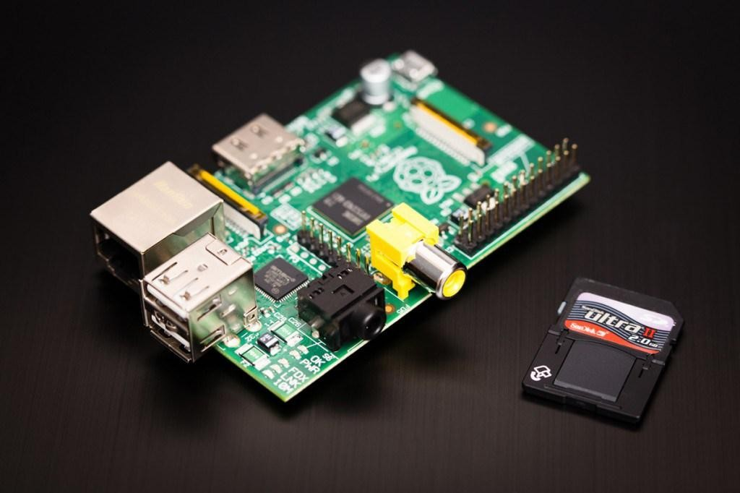
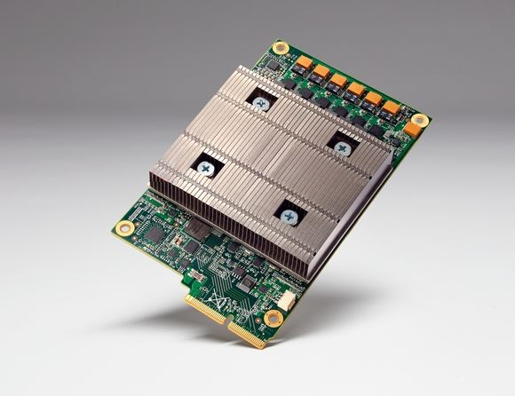
IMPLICATIONS
TensorFlow Mobile | TensorFlow Lite
Runs on CPUs, GPUs, TPUs over one or more machines, but also on phones(android+iOS) and raspberry pi’s...
TensorFlow Lite is the lightweight version provides machine learning solution to mobile with low latency and small binary size.
In TensorFlow Lite Architecture, The trained TensorFlow model on the disk will convert into TensorFlow Lite file format (.tflite) using the TensorFlow Lite converter. Then we can use that converted file in the mobile application
Introduction to TensorFlow

Slide 14

Next ??
World is massively booming towards World Wide Web.
We can Develop ML with JavaScript, run existing models and retrain existing models.
It is useful as privacy preserving application.
There are two main ways to get TensorFlow.js in your JavaScript project:
via script tag :
<script src= "https://cdn.jsdelivr.net/npm/@tensorflow/tfjs@0.13.0"> </script>
or by installing it from NPM and using a build tool like Parcel, WebPack, or Rollup.

Slide 15
LIMITATIONS
1. No Native Support for Windows.
2. No GPU support other than NVDIA and only language support.

Slide 16
CONCLUSION
TensorFlow has -
1. Python API
2. Portability
3. Flexibility: from Raspberry Pi, Android, Windows, iOS, Linux to server farms
4. Large community (> 10,000 commits and > 3000 TF-related repos in 1 year)
5. Visualization (TensorBoard)
TensorFlow has gained great popularity and strong support in the open-source community with many third-party contributions, making Google’s move a sensible decision already.

Slide 17












CONCLUSION
Companies uses TensorFlow :
And many more…

Slide 18
REFERENCES
[1] C. Szegedy, S. Ioffe, and V. Vanhoucke, “Inception-v4, Inception-ResNet and the Impact of Residual Connections
on Learning,” ArXiv e-prints, Feb. 2016.
[2] Fatih Ertam, Galip Aydm, “Data classification with Deep Learning using TensorFlow”, in International
Conference on Computer Science Engineering (UBMK), 2017.
[3] Peter Goldsborough, “A Tour of TensorFlow”, From Cornell University Library At
https://arxiv.org/pdf/1610.01178
[4] Wilton W.T. Fok, “Prediction model for students' future development by deep learning and TensorFlow artificial
intelligence engine” Pre. In 2018 4th International Conference on Information Management (ICIM)
[5] Laurie Butgereit, Laura Martinus,“Assisting Tourism in Underserved Areas with TensorFlow”,
Pre. In 2018 IST-Africa Week Conference (IST-Africa)
[6] Sejoon Lim , Ji Hyun Yang , “Driver state estimation by convolutional neural network using multimodal sensor
data”, in Electronics Letters in 2017

Slide 19
[7] Davide Mulfari, Antonino Longo Minnolo, “Building TensorFlow Applications in Smart City Scenarios”, in 2017 IEEE
International Conference on Smart Computing (SMARTCOMP)
[8] Kithmi Ashangani , Wickramasinghe K.U, De Silva D.W.N, “ Semantic Video Search by Automatic Video
Annotation using Tensorflow”, in Proceedings of the 1st Manufacturing & IE Symposium 2016, Sri Lanka
[9] Cecilio Blanco,Luciano Sanchez, “Battery diagnosis for electrical vehicles through semi-physical fuzzy models”
in 2016 IEEE International Conference on Fuzzy systems (FUZZ).
[10] Liping Yuan, Zhiyi Qu, “A Convolutional Neural Network based on TensorFlow for Face Recognition”
[11] Gittin Goyal , Sakshi Dhingra , “ Hybrid TensorFlow Based Portable Document Formatted Recommender
System” in International conference on I-SMAC (IoT in Social, Mobile, Analytics and Cloud) (I-SMAC 2017)
[12] Google Rsearch blog, acssed at –
http://www.seo-companies.co.in/blog/google-already-uses-algorithm-searches- rankbrain
[13] Google Research Blog, accessed at –
https://ai.googleblog.com/2015/11/computer-respond-to-this-email.html
[14] Jia Shijie, Jia Peiyi, “Automatic Detection of Tomato Diseases and Pests Base on Leaf Images”, in 2017
Chinese Automation Congress (CAC)

Slide 20
[15] Chi Zao, “Text Labelling applied in shopping assistant Robot using Long Short term memory”, in
International Conference on Intelligent Transportation, Big Data & Smart City 2018.
[16] Matthew Velazquez, Yugyung Lee, “QA Diagnostics with Visual Recognition Tracking for Accurate
Trending of Alzheimer’s Disease” in 2017 IEEE International Conference on Bioinformatics and
Biomedicine (BIBM)
[17] TensorFlow on AWS - https:// aws.amazon.com/TensorFlow
[18] More about Tesnorflow.js accessed at –
https://medium.com/tensorflow/introducing-tensorflow-js-machine-learning-in-javascript- bf3eab376db
[19] Introducing TensorFlow Mobile – https://data-flair.training/blogs/tensorflow-mobile/
[20] Google TensorFlow API - www.tensorflow.org/

