Slide 1

Data Preprocessing for Machine Learning
Data preprocessing is critical for machine learning. Raw data is often messy and unstructured. Preprocessing cleans, transforms, and structures data. This ensures reliable model building and better insights.
By Falguni Bhavsar
Roll No - 07

Slide 2




Data Cleaning Techniques
Handling Missing Values
Removing Duplicates
Identify and remove duplicate rows. This ensures data integrity.
Remove rows/columns or impute missing values. Use mean, median, or mode.
Handling Outliers
Remove or cap extreme values. Prevent distortion of model predictions.

Slide 3
Example: Handling Missing House Prices
Imputation Methods
Addressing Outliers
Suppose house prices are missing.
Correct or remove unusually high prices. This prevents distorted results.
Fill with the mean price.
Use advanced imputation methods.

Slide 4




Data Transformation
Normalization/Scaling
Rescale numerical features to a common range.
Standardization
Set mean to 0 and standard deviation to 1.
Encoding Categorical Data
Convert categorical variables into numerical values.

Slide 5
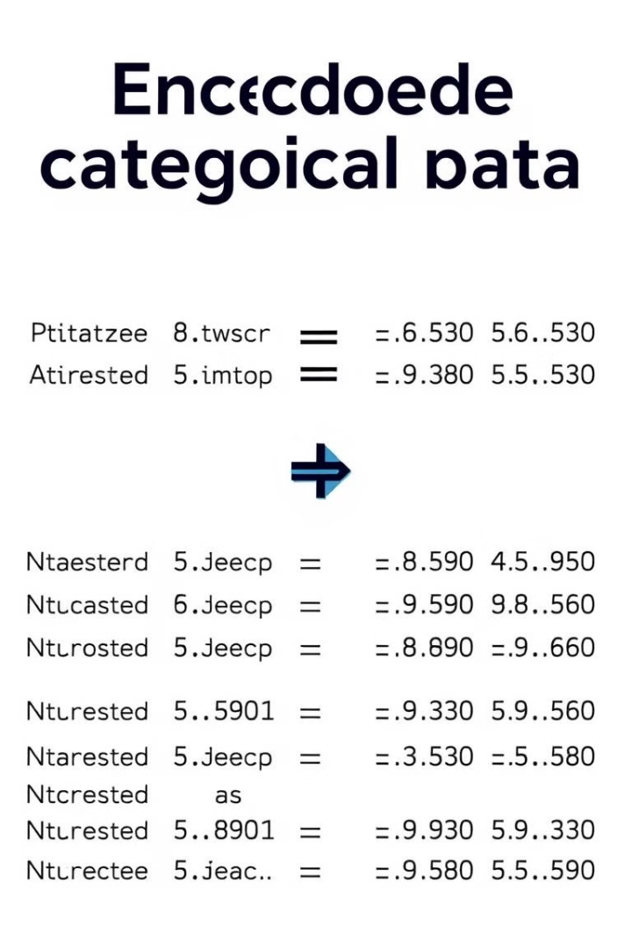
Encoding Categorical Data
Label Encoding
Assign a unique number to each category. Easy for binary or ordinal data.
One-Hot Encoding
Create binary columns for each category. Suitable for
nominal data.

Slide 6
Thank You

