Slide 1

POWER BI PROJECT REPORT
Food Delivery Time
Analysis
Understanding what drives delivery times — weather, traffic, vehicle type and distance.
SUBMITTED BY: FALHA P

Slide 2

01 · INTRODUCTION
Introduction
On-demand food delivery has become one of the most competitive corners of the gig economy. Apps like Zomato, Swiggy, Uber Eats and DoorDash compete heavily on one metric customers feel instantly: delivery time.
This project analyzes a food-delivery order dataset:-order time, weather, traffic conditions, vehicle type, distance and pickup/dropoff zone . To understand what actually slows deliveries down, and turns those patterns into an interactive Power BI dashboard.
Notes:
Food delivery apps like Zomato and Swiggy compete on one thing customers feel straight away, which is delivery time. I analyzed order data to find what causes delays ..which are order time, , weather, traffic conditions, vehicle type, distance and pickup/dropoff zone ..and put the results into an interactive dashboard.

Slide 3
02 · OBJECTIVE
Objective
01
Identify delay drivers
02
Track order volume
Measure how weather, traffic level and vehicle type each affect average delivery time.
Understand how orders are distributed across hours of the day and weekends vs. weekdays.
03
Surface problem routes
04
Support decisions
Pinpoint the slowest pickup → dropoff zone pairs so operations can act on them.
Turn the findings into a live, filterable dashboard stakeholders can explore themselves.
Notes:
4 goals

Slide 4
03 · DATASET
Dataset Used
Food_Delivery_Time_Prediction
A single flat table of individual food-delivery orders loaded into Power BI and used to build visual on the dashboard.
Order_Hour
Weather
Traffic_Level
Vehicle_Type
Is_Weekend
Delivery_Distance_Category
Pickup_Zone
Dropoff_Zone
ENTRY COUNT:
Total rows: 50,000

Slide 5
04 · KEY DETAILS
Column Reference
COLUMN | DESCRIPTION
Order_Hour | Hour of day the order was placed (0–23).
Weather | Weather condition at order time. Eg: Clear, Rainy, Stormy.
Traffic_Level | Congestion level on the route - Low / Medium / High.
Vehicle_Type | Delivery vehicle used. Eg: Bike, Scooter, Car.
Is_Weekend | Flags whether the order fell on a weekend.
Delivery_Distance_Category | Distance band for the trip . Eg: Short/Medium/Long
Pickup_Zone / Dropoff_Zone | Restaurant pickup area and customer drop-off area.

Slide 6
05 · DATA MODEL
Connections
Food_Delivery_Time_Prediction
Single fact table
Unlike a multi-table star schema, this dashboard runs on a single, already-flattened table : order details, weather, traffic and location fields all live on one row per order, so no relationships were needed between tables.
Notes:
everything sits in one flat table, I didn't need relationships between tables.

Slide 7
06 · DAX MEASURES
Measures Created
Total Orders
Avg Delivery Time
Avg Rider Rating
Avg Distance
COUNTROWS( Food_Delivery_Time_Prediction)
AVERAGE( Food_Delivery_Time_Prediction[Delivery_Time])
AVERAGE( Food_Delivery_Time_Prediction[Rider_Rating])
AVERAGE( Food_Delivery_Time_Prediction [Road_distance_km])
These four measures power the KPI cards at the top of the dashboard, giving stakeholders an at-a-glance summary before they drill into any chart.

Slide 8
07 · CRITERIA USED
Visuals Used
VISUAL | FIELDS | PURPOSE
Line Chart | Total Orders by Order_Hour | Shows order volume trending across the hours of the day.
Card | Avg Delivery Time, Avg Rider Rating, Total Orders, Avg Distance | Headline KPIs for an at-a-glance summary.
Clustered Bar Chart | Weather vs. Avg Delivery Time | Compares how each weather condition affects delivery speed.
Funnel | Traffic_Level vs. Avg Delivery Time | Ranks traffic levels by their impact on delivery time.
Clustered Column Chart | Delivery_Distance_Category vs. Avg Delivery Time | Compares delivery time across distance bands.
Table | Pickup_Zone → Dropoff_Zone, Avg Delivery Time | Surfaces the slowest routes for operational follow-up.
Slicers (x4) | Weather , Vehicle_Type , Traffic_Level , Is_Weekend | Let viewers filter the whole page interactively.
Notes:
A line chart shows orders by hour. Bar, funnel and column charts compare delivery time by weather, traffic and distance. A table lists the slowest routes, and four slicers let you filter the whole page."

Slide 9
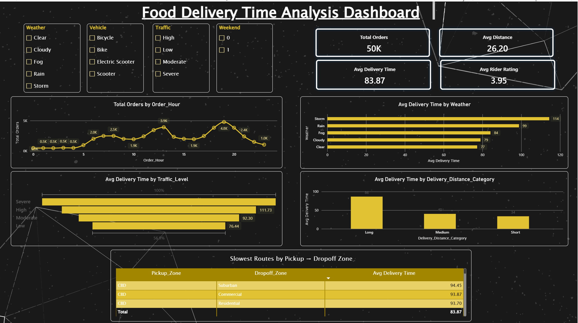

08 · THE RESULT
Dashboard

Slide 10
09 · CONCLUSION
Key Insights
Traffic is a leading delay factor
Distance has big impact
Severe traffic pushes average delivery time to 134.40 minutes, versus 76.44 minutes in low traffic. That is nearly 58 minutes (about 76%) longer.
Long-distance orders average 86 minutes, compared to 34 minutes for short ones. That is 52 minutes longer, about 2.5 times the delivery time.
Weather slows deliveries down
A few routes need attention
Storm conditions have the highest average delivery time at 114 minutes, compared to 77 minutes in clear weather. That is 37 minutes (about 48%) longer.
CBD → Suburban (94.45) and CBD → Commercial (93.87) are the slowest routes.
Industrial → CBD is the fastest at 77.15, a spread of about 17 minutes across routes.
Notes:
"Traffic has the biggest effect. Severe traffic averages 134 minutes against 76 in low traffic, about 76% longer.
Distance is next: long trips average 86 minutes and short ones 34, roughly 2.5 times longer.
Weather matters too. Storms average 114 minutes against 77 in clear weather, about 48% longer.
For routes, CBD to Suburban and CBD to Commercial are slowest at about 94 minutes. The gap between routes is only about 17 minutes, so route matters less than traffic or distance."

Slide 11


10 · REFERENCES
References
DATASET
Kaggle — https://www.kaggle.com/datasets/dharmendrapandit12/food-delivery-time-prediction-dataset
VISUALIZATION
Microsoft Power BI Desktop
FOOD DELIVERY TIME ANALYSIS · POWER BI PROJECT REPORT

Slide 12
Thank You
Food Delivery Time Analysis Dashboard

