Slide 1




I Can tell! Maybe Not
Fatimah Alhamadeh

Slide 2

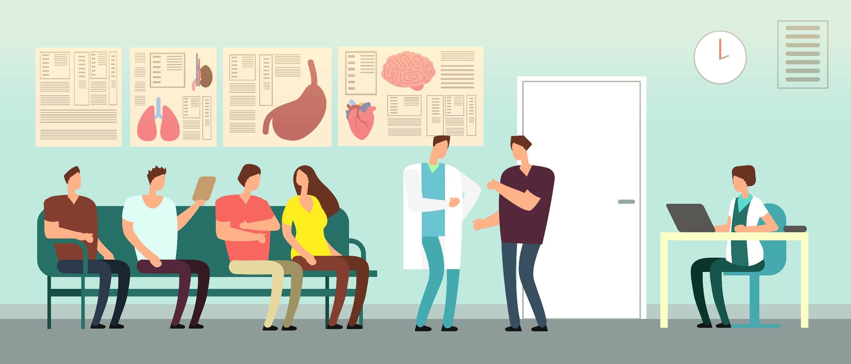
Need an Appointment?

Slide 3

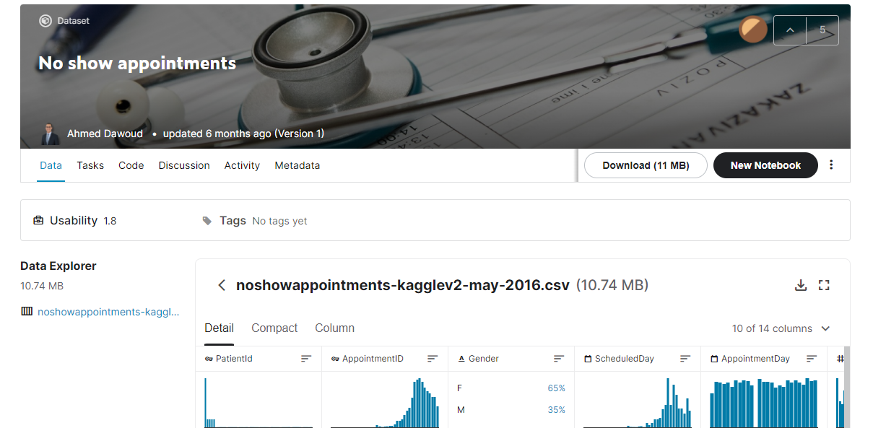
Source
100K appointments dataset from Kaggle
Notes:
100K records with patients’ health conditions and appointment details
14 Features, most are binary
For Categorical ones: get_dummy used, mapping to binary Age & Handicap

Slide 4

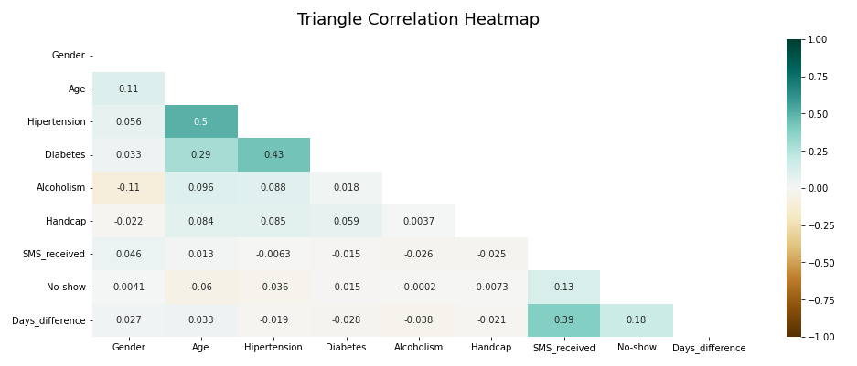
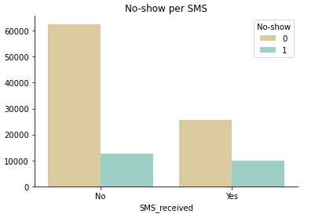
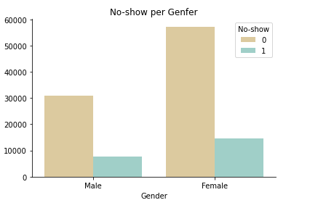
Look What I found!
20%
25%
38%
~25%
Notes:
1- Correlation is weak
2- Even Females group is bigger than Males, their no-show rate is the same
3- SMS also, didn’t say much, whether a patient received it or not didn’t affect their show/noshow status

Slide 5

Keep Learning
Feature Selection
Train & Test
Evaluate
Model Tuning
Different subsets
Construct new ones
PCA
Treat imbalanced data
Data split 80/20
train & test
Cross Validation
Different Models
Precision
Recall
F1

Slide 6

Evaluate
The model did well with majority class
Even though, imbalance was dealt with, it performed poorly with minority class!
 | Precision | Recall | F1
0 | 0.64 | 0.96 | 0.77
1 | 0.55 | 0.08 | 0.14

Slide 7

What a Ride!
It seemed like straight forward problem but it wasn’t!
More feature engineering is needed, composing new ones, deep-look into the data & correlations
I went through all stages and that’s what really matters, I learned a lot through this experience
Notes:
1- it seemed like straight forward problem but it wasn’t!
2- more feature engineering is needed, compose new ones, deep-look into the data & correlations
3- I went through all stages and that’s what really matters, I learned a lot through this experience

Slide 8
Thank you

