Slide 1




I Can tell! Maybe Not ☹
Fatimah Alhamadeh

Slide 2


Need an Appointment?

Slide 3

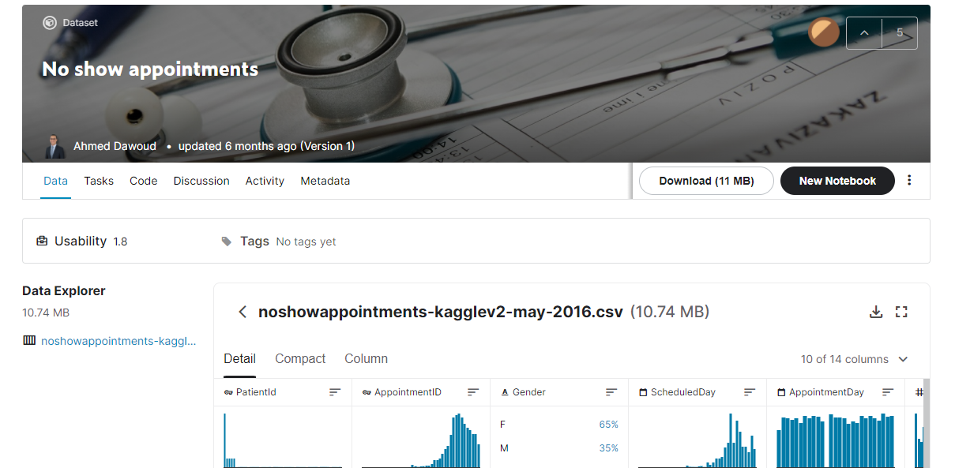
Source
100K appointments dataset from Kaggle

Slide 4

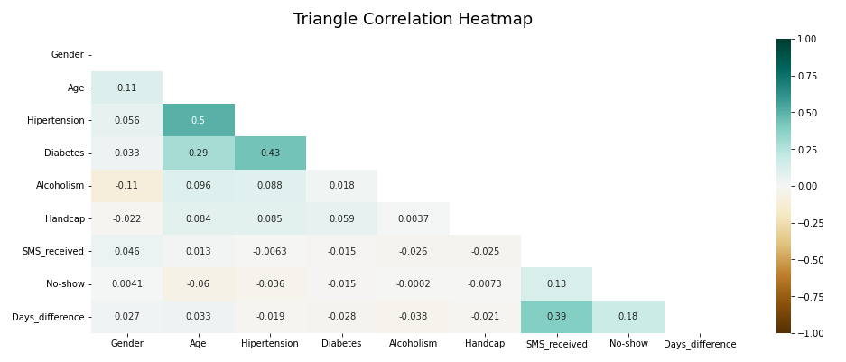
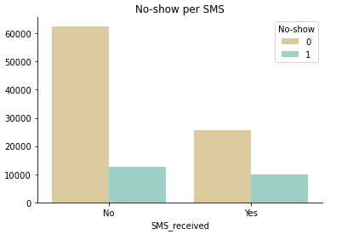
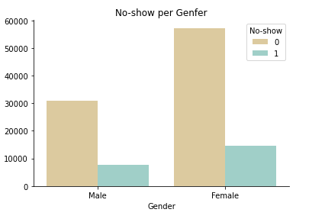
Look What I found!
20%
25%
38%
~25%

Slide 5

Keep Learning
Feature Selection
Train
Test
Evaluate
Model Tuning
 | Precision | Recall | F1
0 | 0.64 | 0.96 | 0.77
1 | 0.55 | 0.08 | 0.14

Slide 6

Conclusion
Life is tough!
60% is better than 50%, right?
It needs more time!
In-depth analysis
Feature engineering

Slide 7
Thank you ☺
Notes:
You can use this slide as your opening or closing slide. Should you choose to use it as a closing, make sure you review the main points of your presentation. One creative way to do that is by adding animations to the various graphics on a slide. This slide has 4 different graphics, and, when you view the slideshow, you will see that you can click to reveal the next graphic. Similarly, as you review the main topics in your presentation, you may want each point to show up when you are addressing that topic.
Add animation to images and graphics:
Select your image or graphic.
Click on the Animations tab.
Choose from the options. The animation for this slide is “Split”. The drop-down menu in the Animation section gives even more animations you can use.
If you have multiple graphics or images, you will see a number appear next to it that notes the order of the animations.
Note: You will want to choose the animations carefully. You do not want to make your audience dizzy from your presentation.

