Slide 1

EPILEPTIC SIEZURE DETECTION AND PREDICTION USING EEG ANALYSIS
Guide
Dr. SATHIDEVI P S
ALEX JOHN
ALEX JOSEPH
BIBIN BABY
DEEPAK M
FELIX GEORGE
TONNY JOHN

Slide 2
INTRODUCTION
Epilepsy is a neurological disorder in which the affected person experiences abnormal brain activity for a brief period.
Around 50 million affected people worldwide(WHO).
High risk of premature death mainly due to loss of control over current activity.
Warning of an oncoming seizure can greatly reduce this risk.
This project aims at detecting and predicting an oncoming seizure using EEG data.

Slide 3
EEG
Electrical activity emanating from the brain is displayed in the form of brainwaves.
There brainwaves are classified into categories namely - Alpha, Beta, Gamma, Delta, Theta.
Beta waves are of relatively low amplitude and are the fastest of the four different brainwaves.
Theta brainwaves, is of even higher amplitude and slower frequency.
Alpha brainwaves are slower, and higher in amplitude.
Delta brainwaves are of the greatest amplitude and slowest frequency
Gamma waves are a more recent discovery in the field of neuroscience. Thus the understanding of how they function is continually evolving.

Slide 4
DATASETS
Time Domain EEG signal Dataset is used for the Random Forest Classifier and Outlier Detection.
Image Dataset is used for CNN.
Frequency Domain EEG signal Dataset is used for the frequency domain analysis.

Slide 5
IMPLEMENTATION

Slide 6
OUR APPROACH
Started off with the random forest with an amplitude domain dataset.
good performance with high accuracy but with a poor F1 score.
Applied SMOTE to overcome problem due to imbalanced dataset.
increased F1 score and still maintaining the accuracy
Outlier Detection was used to predict seizure points.
failed to construct boundaries in the amplitude domain.
CNN was applied on an image dataset
average performance with a good F1 score.
Frequency domain analysis
Fourier transform
Wavelet transform

Slide 7
OUR APPROACH
Random Forest is an ensemble method which takes the best result from many average models.
Random forest trains such that the features of EEG at a time instant are matched with the marking of that time.
EEG is classified into 3 classes :
0 -post-ictal
1- pre-ictal
2- ictal
Dataset is used without any modification
It predicted seizures in post-ictal regions and also predicted pre-ictal periods when there were none in the data.
good performance with high accuracy but with a poor F1 score of 40.
RANDOM FOREST CLASSFIER

Slide 8
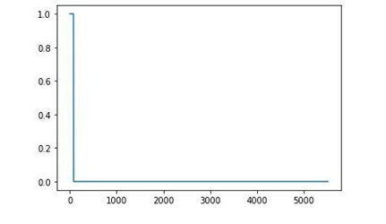
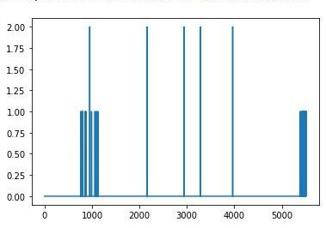

Actual Markings
Initial Predictions using Random Forest
Confusion Matrix
The rows represent actual values and the columns represent the predicted values.

Slide 9
OUR APPROACH
Oversampling method to increase the number of samples in the under sampled classes.
To maintain the balance between the number of samples in the seizure and non seizure regions.
This increased the F1 score of the model significantly to 72 than the previous 40.
Synthetic Minority Oversampling Technique

Slide 10
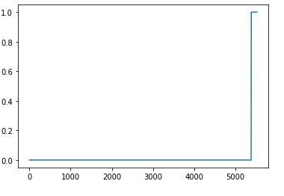
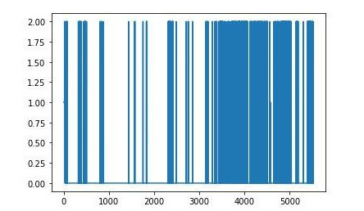

Actual Markings
Confusion Matrix. The rows represent actual values, and the columns represent the predicted values.
Output after Balancing the dataset

Slide 11
OUR APPROACH
Outlier detection is an unsupervised learning technique to remove the data separated above a few standard deviations.
Applied multivariate outlier detection since there are 23 channels.
Applied isolation forest algorithm which predicts a sample as an outlier or not an outlier by using an outlier score.
The results of this algorithm were similar to that of simple random forest implementation of the model with an accuracy of 70.
OUTLIER DETECTION

Slide 12
OUR APPROACH
CNN takes in input as 2D arrays (Images)
Created the required dataset by continually plotting the EDF data and capturing it as images.
Converted the images into binary plots to extract required features
EEG plot captured every 40ms.
Accuracy of 67% on validation set
Applying CNN on EEG images

Slide 13
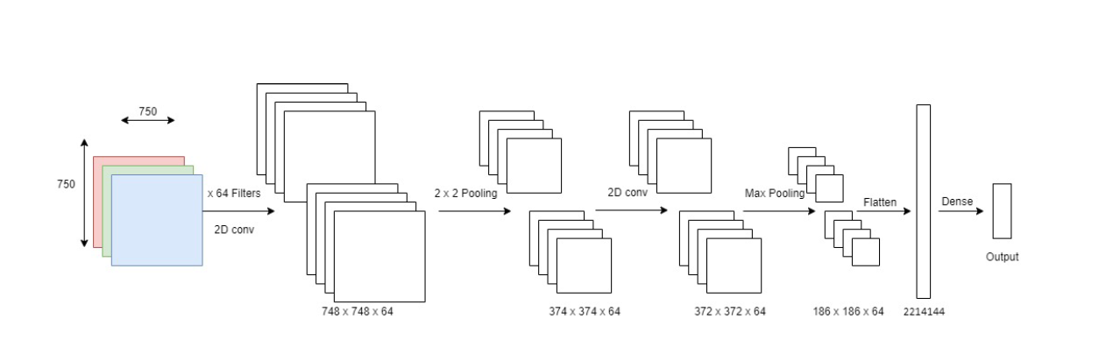
Used CNN Architecture

Slide 14
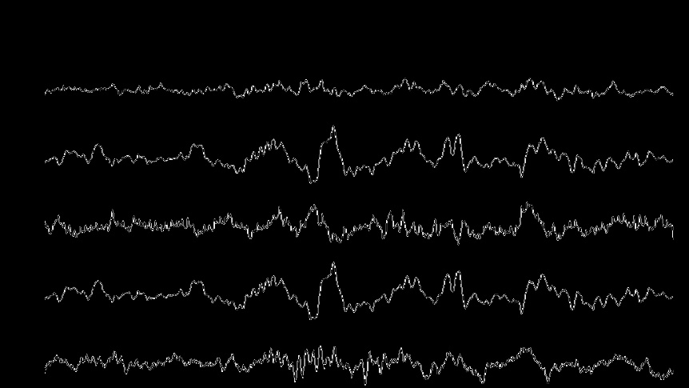
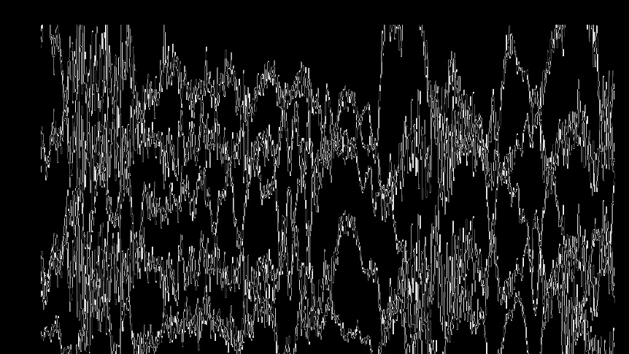
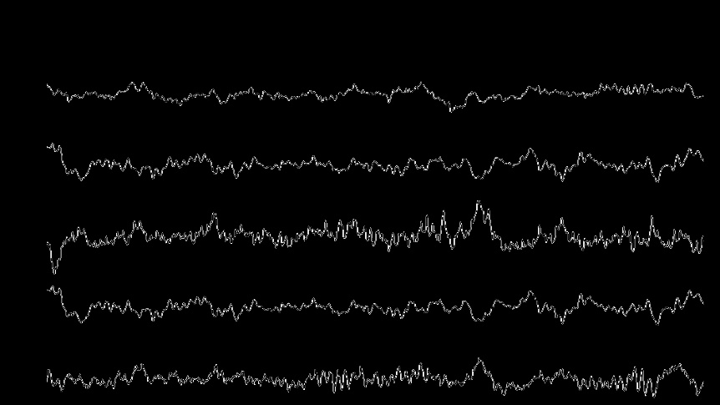
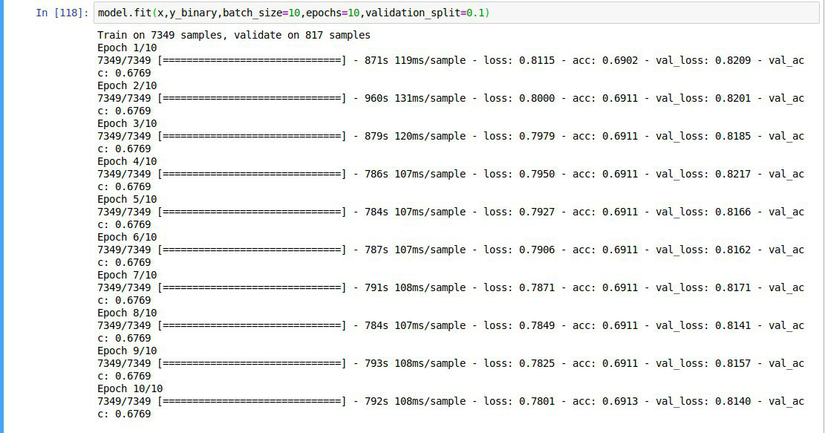
Capture of post ictal region
Capture of ictal region
Capture of pre ictal region
Training and validation of the CNN

Slide 15
OUR APPROACH
The present dataset has been sampled too close resulting in large overlap of information in the samples.
Improved dataset is being created to reduce sampling rate and include longer duration and more channels of EEG signal.
Keep the increased sampling rate in the seizure region to maintain the dataset balance.
Applying CNN on EEG images

Slide 16
OUR APPROACH
Power Spectral Density of the channels were plotted.
Observed that most of the power is concentrated on the low-frequency components:
Delta, Theta, and Alpha waves
Separated the higher frequency components using a highpass filter
Continued filtering of different passbands showed that all frequency components constituted the characteristic peak/spike in almost equal proportions.
Frequency selective analysis might not be the approach to best results
FREQUENCY DOMAIN ANALYSIS (FOURIER)

Slide 17
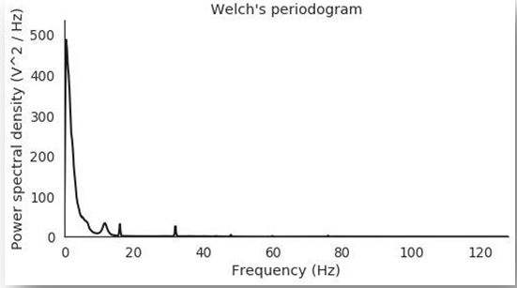
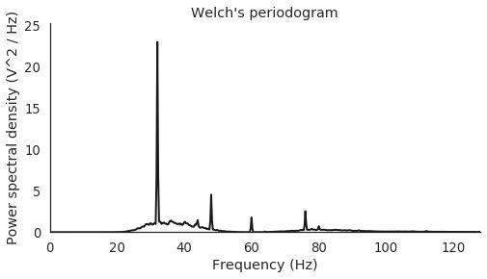
Power Spectral Density of one of the channels - channel 16
Power Spectral Density after high pass filtering

Slide 18
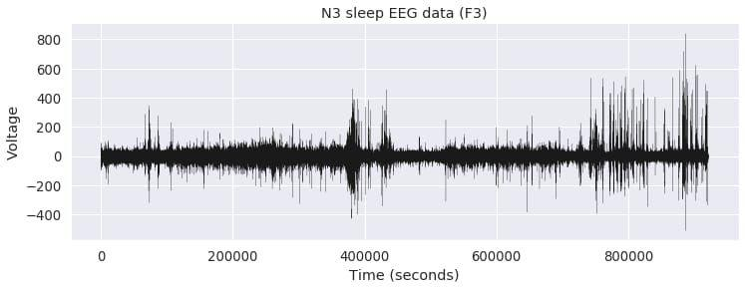
Time Domain EEG signal (1 hour)

Slide 19
OUR APPROACH
Continuous Wavelet Transform using Morse wavelets was used to see if any distinguishable features can be identified.
In most of the channels, the region of the seizure is projected up with maximum amplitude.
In some channels, there are areas of similar magnitude in other time locations also.
In all cases, the frequency (scale) of interest lies in the region of nearly 1 2.5Hz.
Region of increasing density of higher magnitudes in narrow horizontal band between 1Hz and 2.5Hz from 40 to 20 minutes before the seizure.
This is followed by followed by a region of decreased (normal) density of higher magnitudes.
FREQUENCY DOMAIN ANALYSIS (WAVELET)

Slide 20
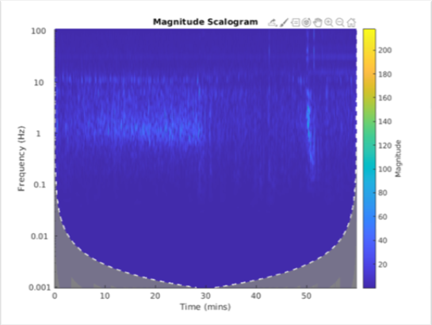
CHANNEL 1 CWT
seizure region can be identified by two characteristic peaks at 50 minutes and 25 seconds at about 1.41Hz and 2.45Hz.

Slide 21
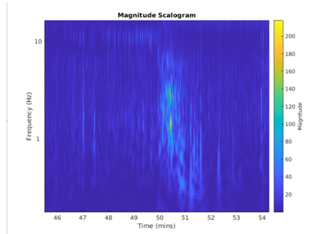
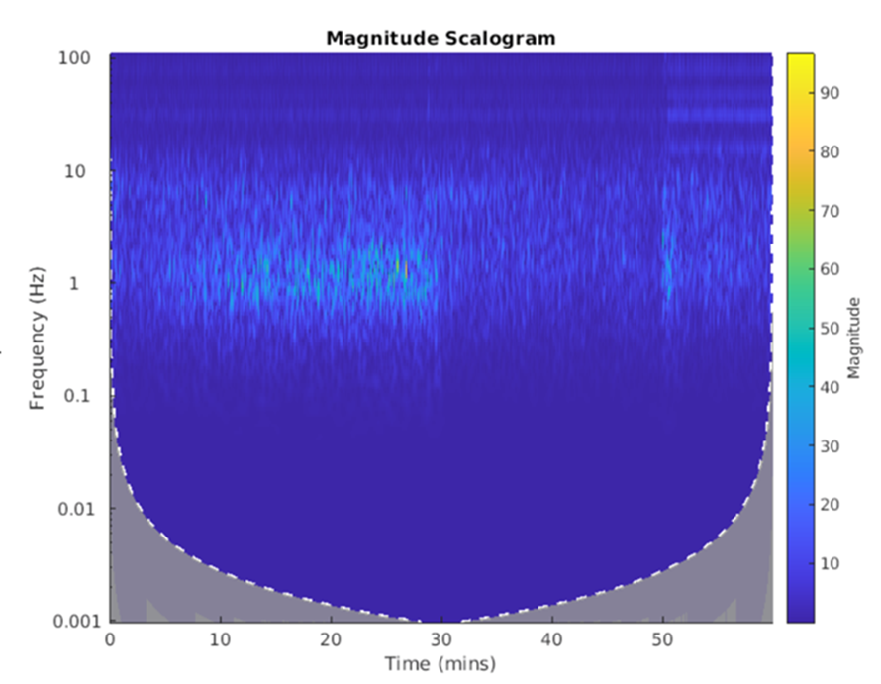
CHANNEL 1 CWT - zoomed-in view of the seizure region
CHANNEL 4 CWT

