Slide 1
LOGISTIC REGRESSION

Slide 2
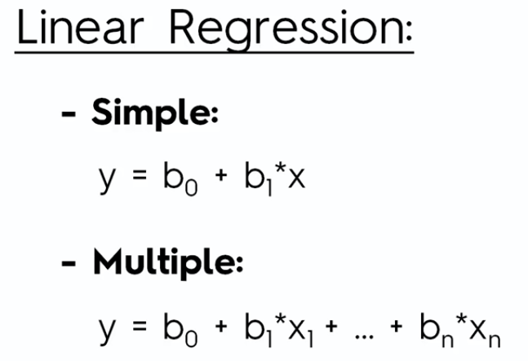

Slide 3
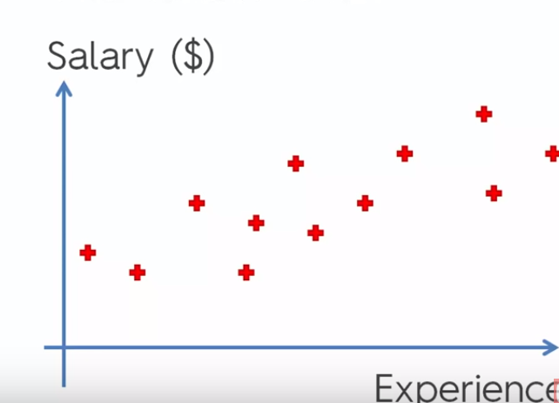

Slide 4
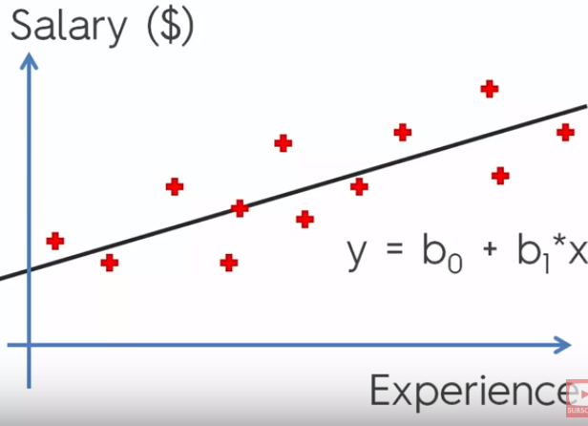

Slide 5
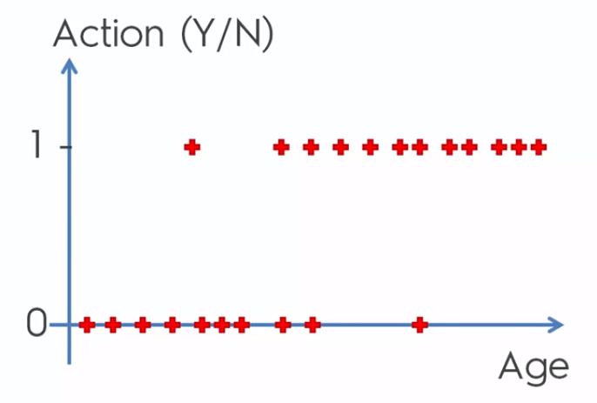

Slide 6
We can see a correlation..between age and reponse

Slide 7
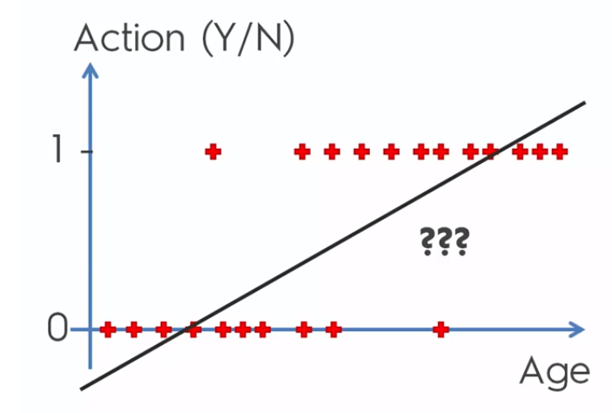

Slide 8
We want to predict whether a person will
(based on age) will take up the offer or not
Better to predict the probability (likelihood) of that person taking up the offer.

Slide 9
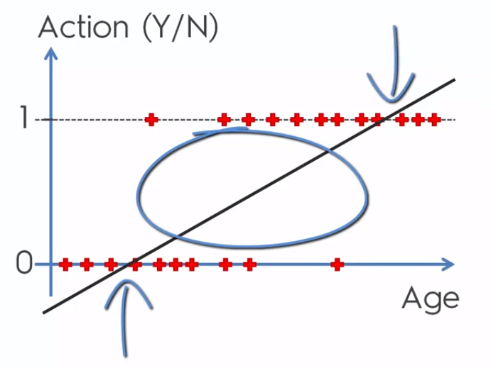
People between say (35 and 55)are marked with arrows

Slide 10
For those people ,there is a probability that they might take up the offer and the probability increases with age .

Slide 11
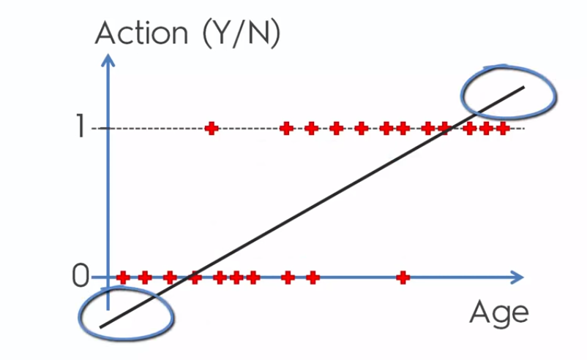
Probability makes no sense outside of 0 and 1

Slide 12
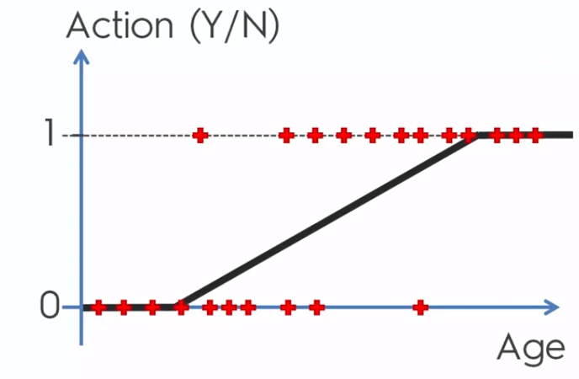

Slide 13
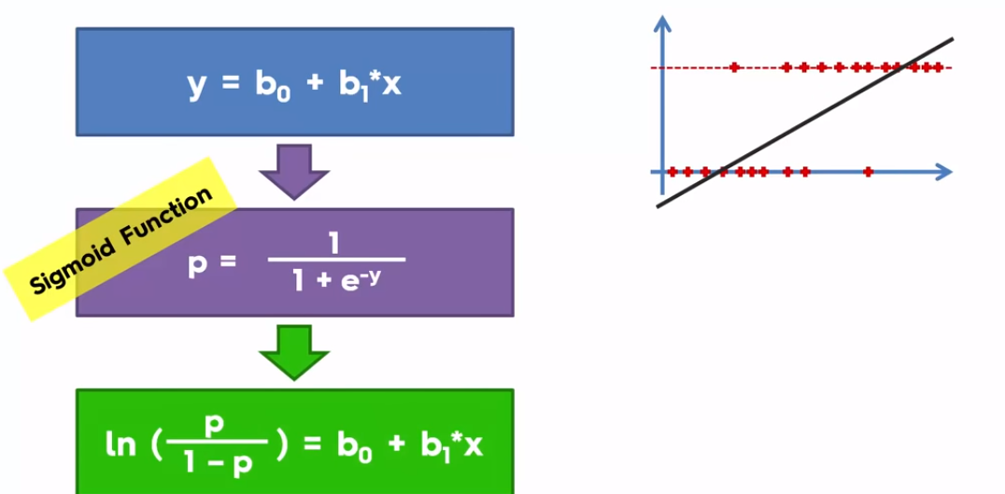
Apply a sigmoid function to linear regression

Slide 14
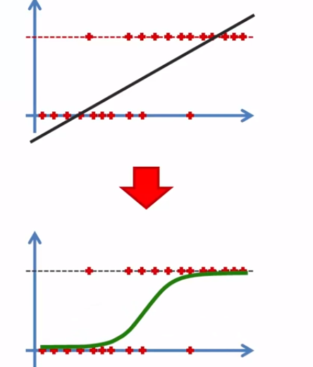
Apply the logistic function and we get..

Slide 15
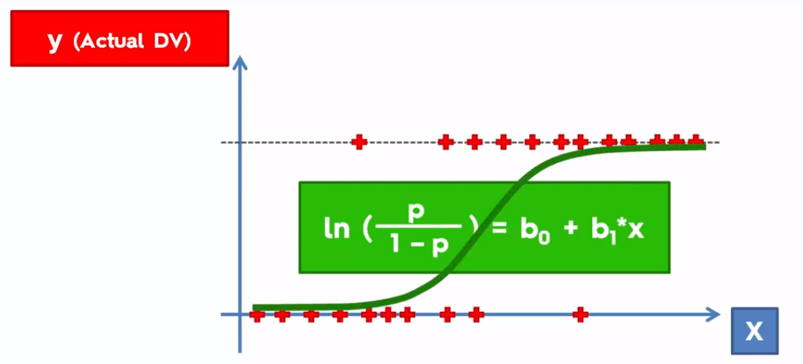
The line is a ‘trend’ line for logistic regression-we get the best fitting line for the data

Slide 16
There can be many such lines ,but the idea of logistic regression is to get the best fitting line.
We can use this line to get the probabilities of an event happening .(p^ -predicted value of the probability)

Slide 17
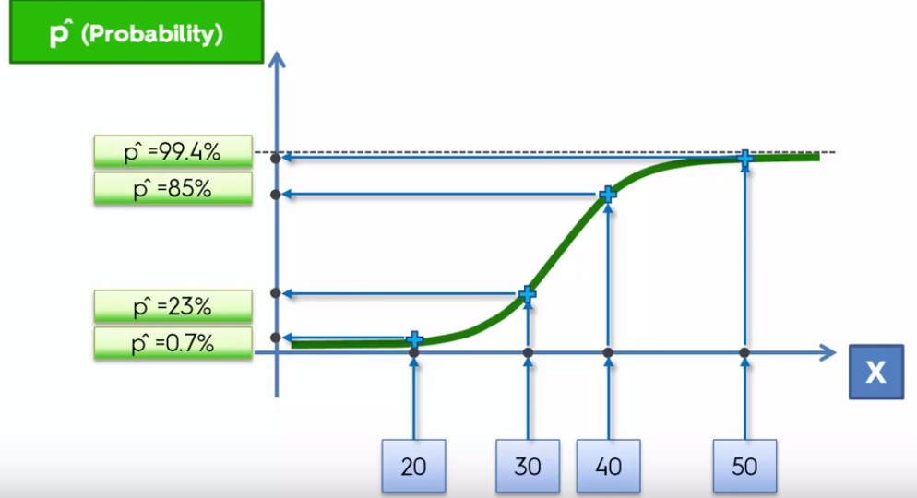
Showing the fitted values of probabilities

Slide 18
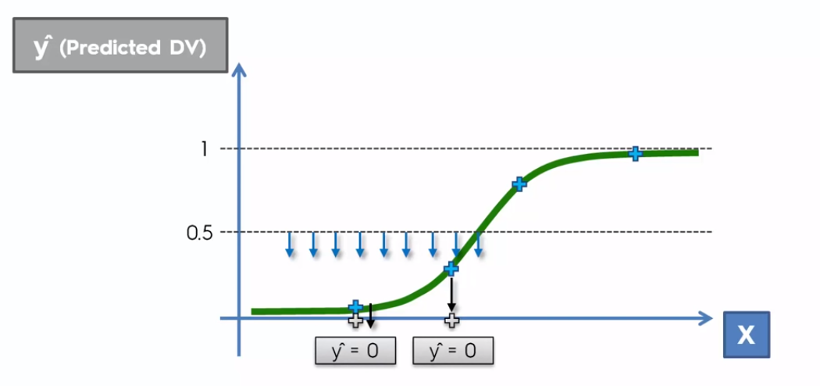
If we want a prediction of Y/N take

Slide 19
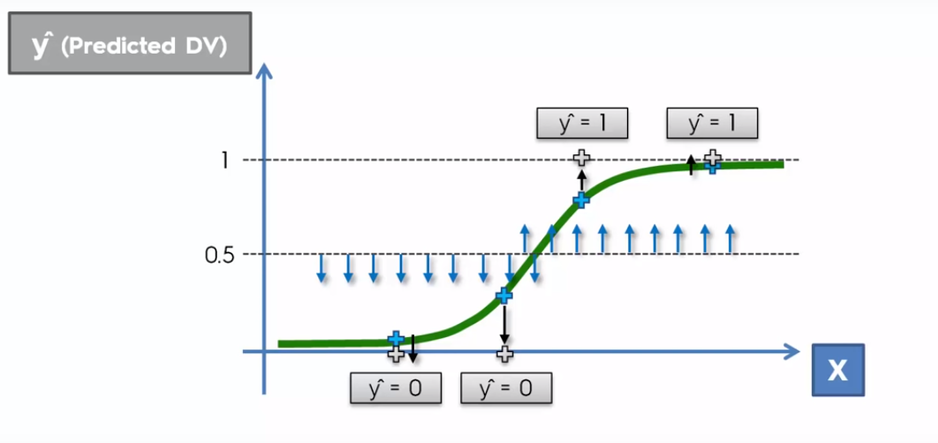

Slide 20
What is a logistic function?
The logistic function is a function that models the exponential growth of a population.
So a logistic function puts a limit on growth.

Slide 21

is the log of the odds..
‘ Odds’ means the probability of an
event occurring / not occurring

Slide 22

Logit function
All that means is when y is categorical, we use the logit of y as the response in our regression equation instead of just y

Slide 23
The inverse of the logit function is the sigmoid function.
That is, if you have a probability p, sigmoid(logit(p)) = p.
The sigmoid function maps arbitrary real values back to the range [0, 1].
The larger the value, the closer to 1 you’ll get.

Slide 24
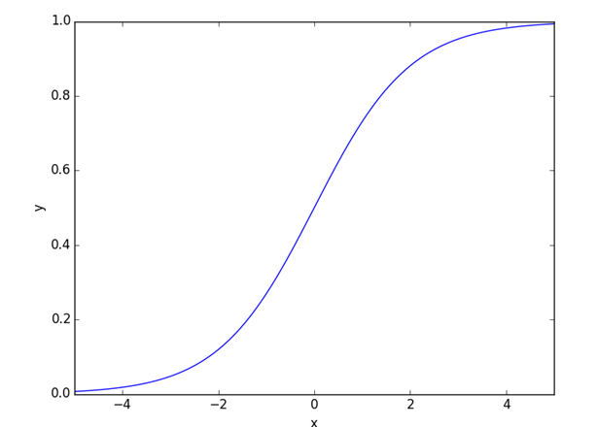

Slide 25
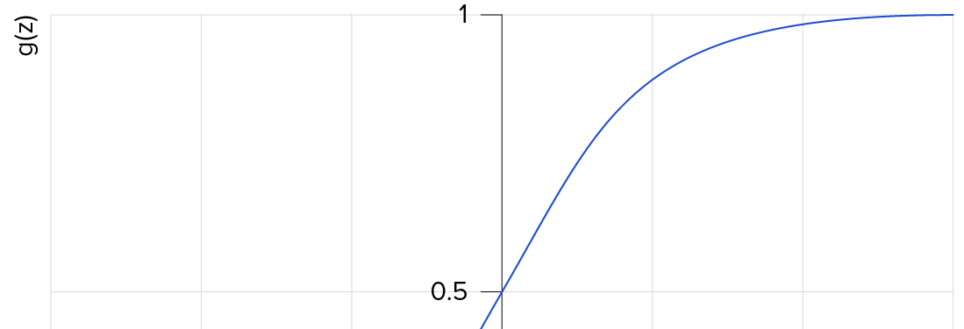
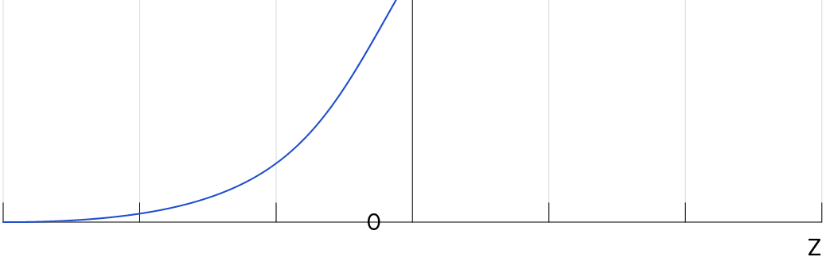

Slide 26
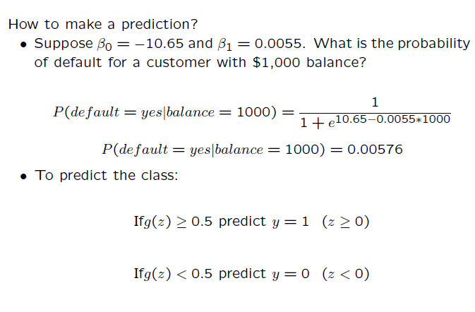

Slide 27
The sigmoid might be useful if you want to transform a real valued variable into something that represents a probability.
This sometimes happens at the end of a classification process.

Slide 28
Classification vs Regression
Classification predictive modeling problems are different from regression predictive modeling problems.
Classification is the task of predicting a discrete class label.
Regression is the task of predicting a continuous quantity.

Slide 29
There is some overlap between the algorithms for classification and regression; for example:
A classification algorithm may predict a continuous value, but the continuous value is in the form of a probability for a class label.

Slide 30
Some algorithms can be used for both classification and regression with small modifications, such as decision trees and artificial neural networks.
Some algorithms cannot, or cannot easily be used for both problem types, such as linear regression for regression predictive modeling and logistic regression for classification predictive modeling.

Slide 31
Importantly, the way that we evaluate classification and regression predictions varies and does not overlap, for example:
Classification predictions can be evaluated using accuracy, whereas regression predictions cannot.
Regression predictions can be evaluated using root mean squared error, whereas classification predictions cannot.

