Slide 1
PertaAcoustic
Desain hardware

Slide 2
Skema data logger
Signal coditioning
RTC
Analog Filter
Sensor
Op amp
ADC
MCU
SD Card
Power Management

Slide 3
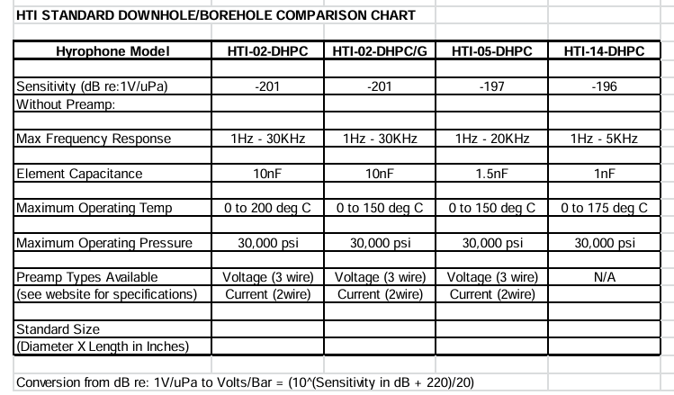
Sensor

Slide 4
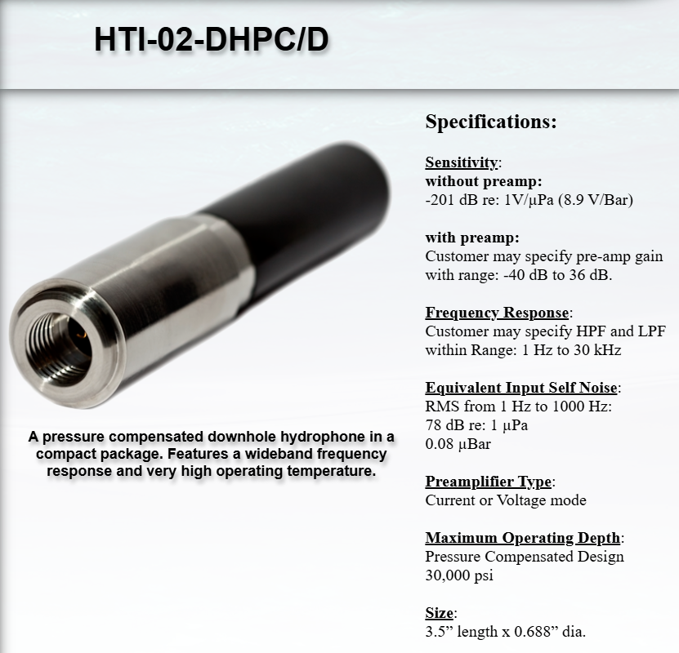
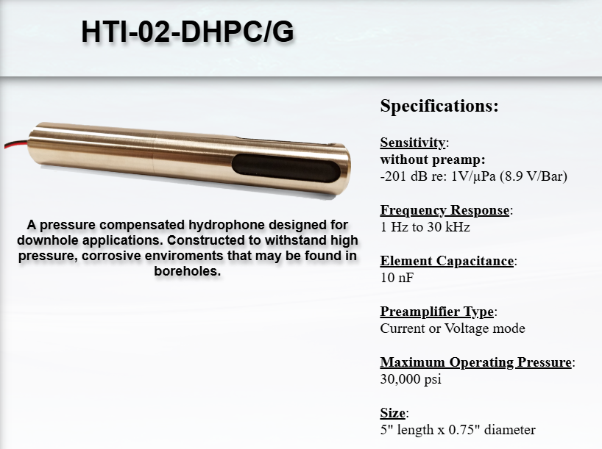
Sensor

Slide 5
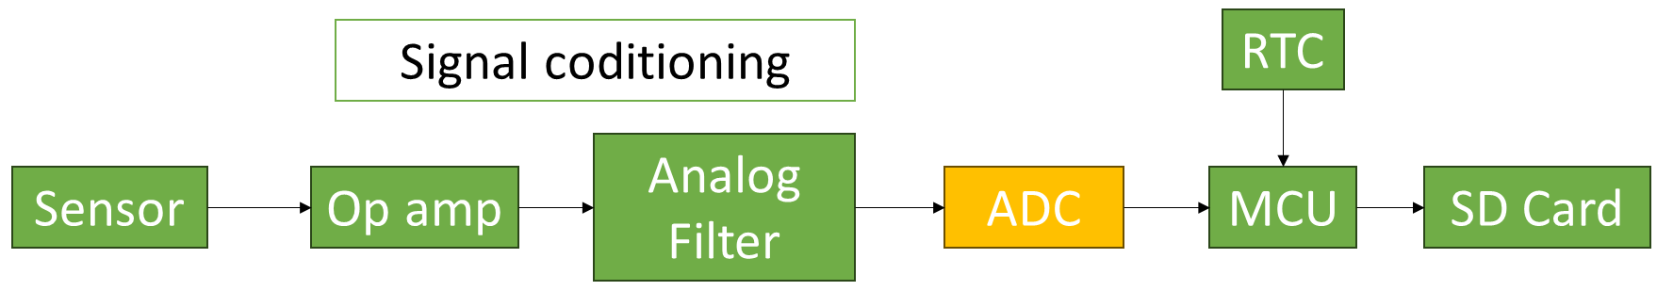
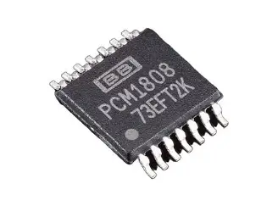
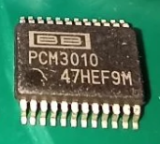
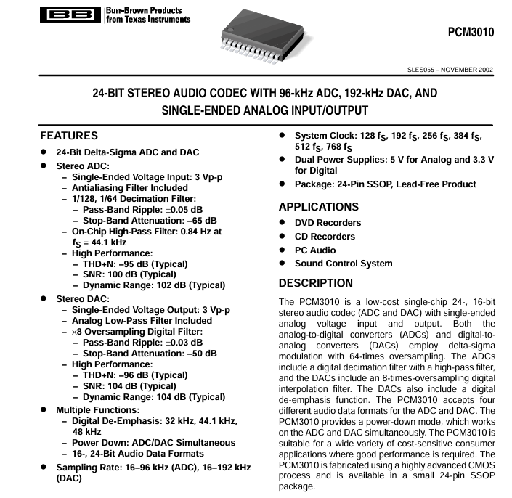
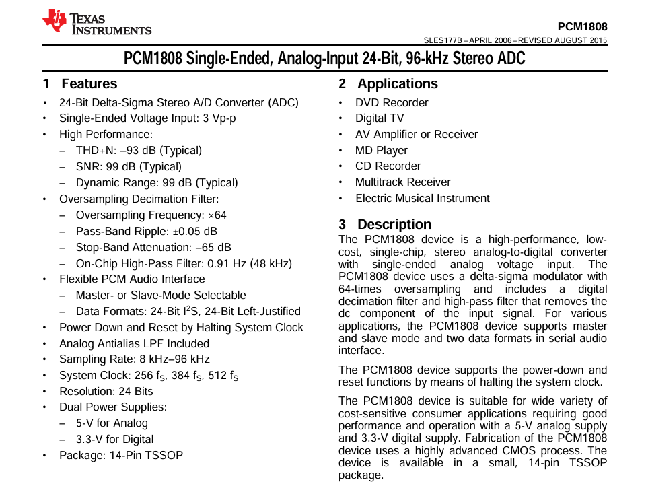
ADC
–25°C to 85°C
–25°C to 85°C

Slide 6
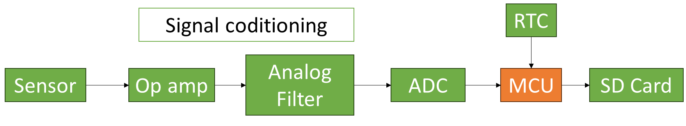
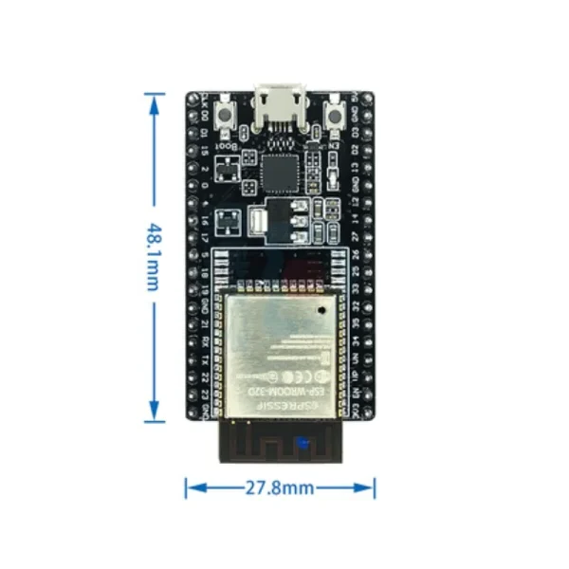
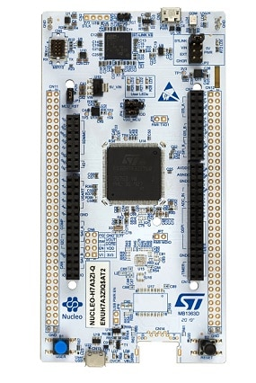
MCU
Arsitektur 32 bit
Support : I2S communication
SPI communication
STM32
ESP32
Spesifikasi:
Dimensi:
Frekuensi clock:
IC ESP32
Maximum Temperature: +125°C
IC STM32
extended ambient temperature range up to 125 °C with junction temperature range up to 140°C.

Slide 7
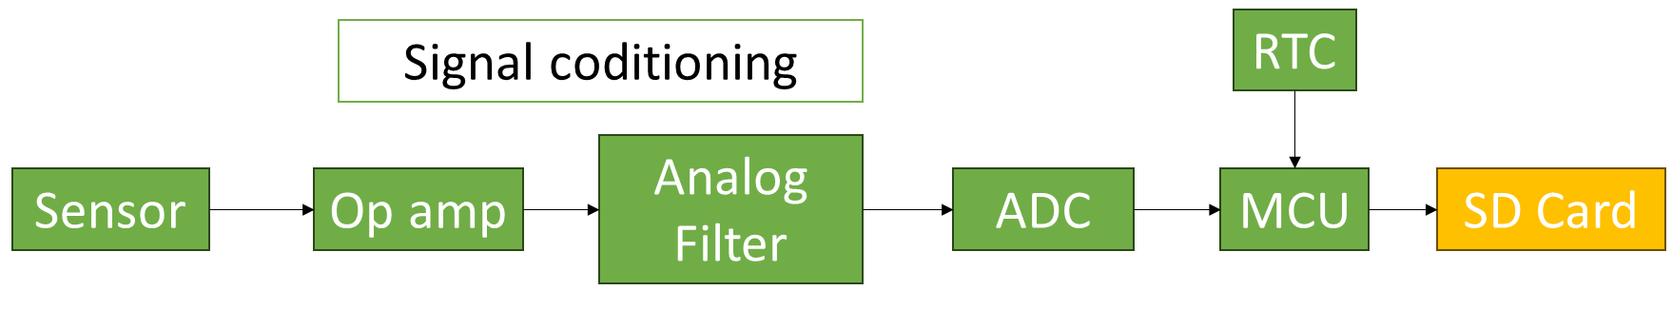
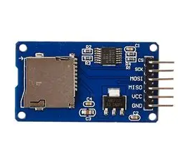
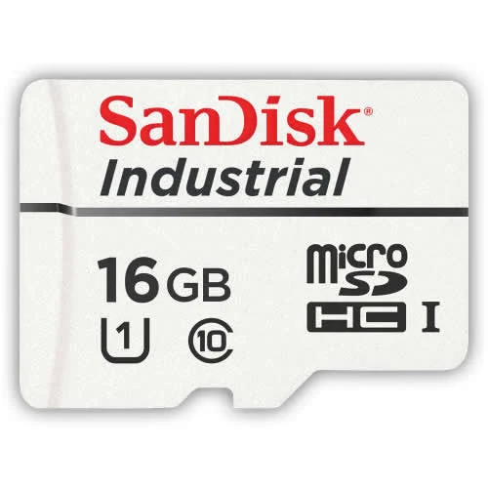
Suhu kerja
-40°C hingga +85°C

Slide 8
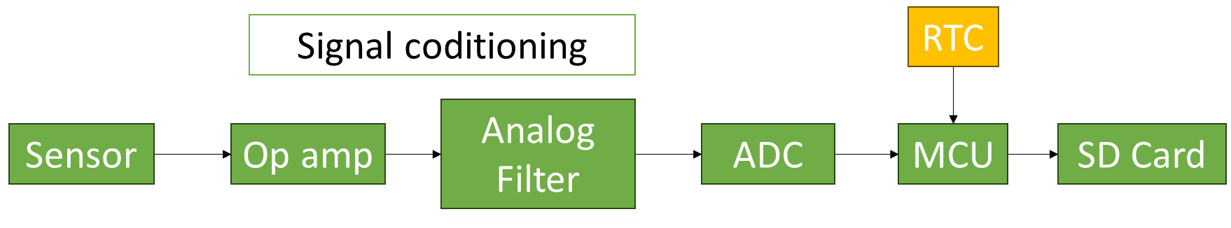
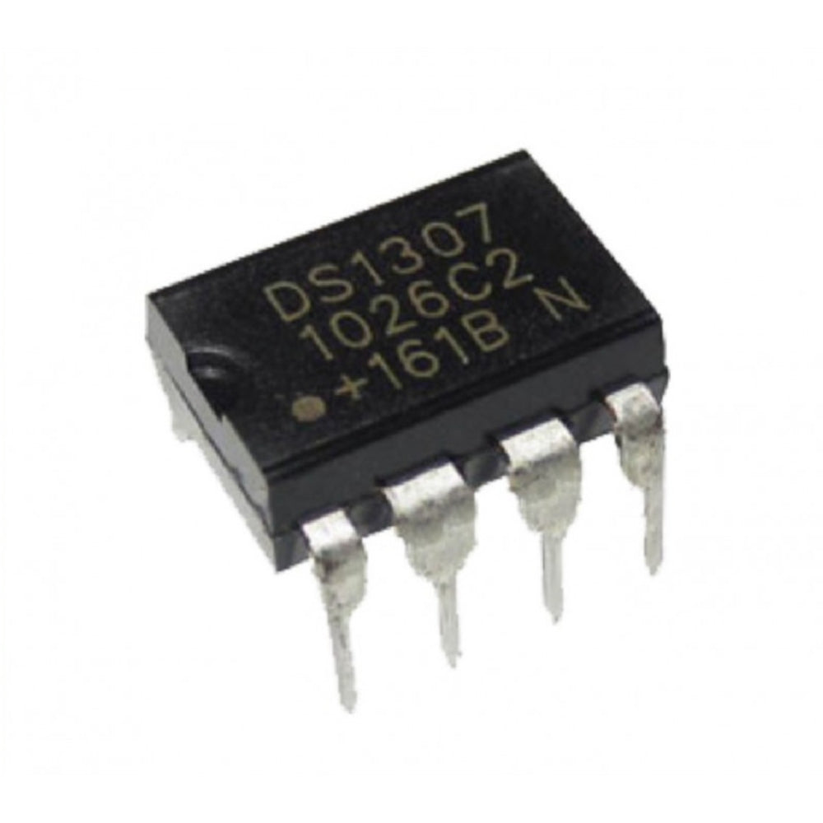
0°C to +70°C

Slide 9
Batere
Lithium Thionyl Chloride (Li-SOCl₂)
Lithium-titanate battery
Lithium-polymer LiFePO₄
Tabel perbandingan
BMS

Slide 10
PCB
Standard FR-4: Maximum continuous safe operating temperature is ≈ 90 °C - 110 °C.
High-Tg Materials: Materials like ISOLA IS410, ITEQ IT-180A, or Arlon 85N feature a temperature ~150 °C
Ceramic & Metal Core: For temperatures up to 300 °C, direct copper bonding on ceramic avoids the degradation of organic resins.
Flexible PCBs: Liquid Crystal Polymer (LCP) can withstand up to 250 °C, whereas standard flexible adhesives (like those on Kapton) fail around 230 °C.

Slide 11
ENCLOSURE
Harus mampu menahan suhu maksimum < 70 C selama operasi kerja ~ 4 jam

