Slide 1
OWASP
TOP 10
falk-m.de
2024

Slide 2

OWASP
- Open Worldwide Application Security
Project (OWASP)
- Non profit organization, aiming to increase security in www
- Top 10 list of most critical security risks to
web applications
- https://owasp.org/Top10/

Slide 3
A01: Broken Access Control

Slide 4
A01: Broken Access Control
- view or modification of data, performing functions
- out of users permissions or limits
- missing or wrong user authentication
A01

Slide 5
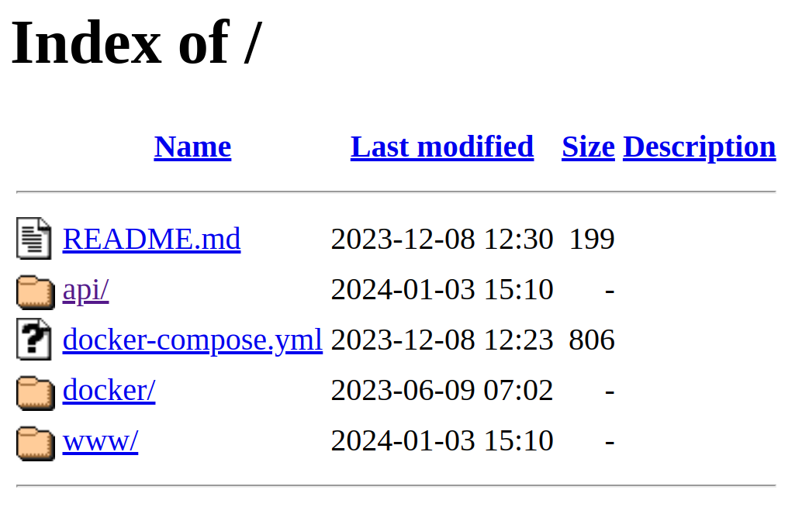
web server directory listing
A01

Slide 6
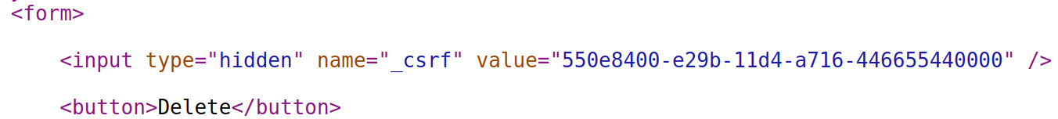
Cross-Site Request Forgery (CSRF)
interaction with user authentication, e.g., permits requests and uses the session cookie
- session based anti-csrf-token must be permitted for action
- reauthentication for high risk actions
A01

Slide 7
Cross-Origin Resource Sharing (CORS)
- Policy to use resources in Browser
- Host: managed by 'Access-Control-*' headers
- Resource: ‚Access-Control-Allow-Origin: *‘
- Same-Origin-Policy by default
A01

Slide 8
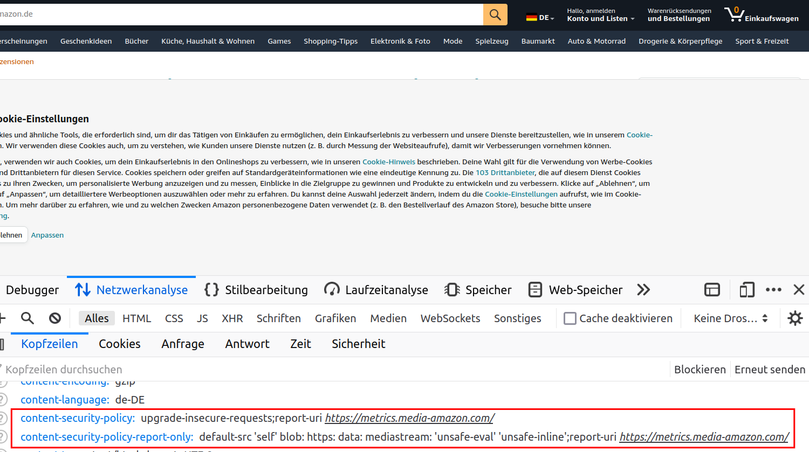

Slide 9
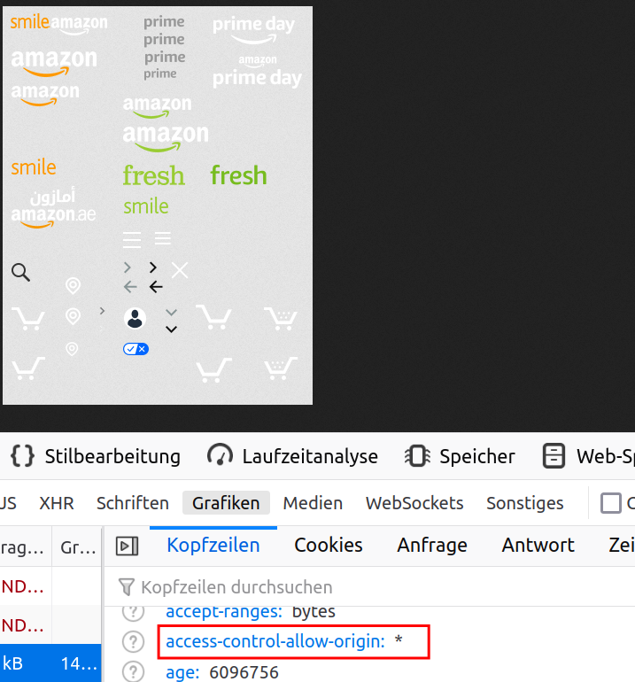
A01

Slide 10
Content-Security-Policy: default-src data: blob: 'self' https://*.fbsbx.com *.facebook.com *.fbcdn.net 'wasm-unsafe-eval';script-src *.facebook.com *.fbcdn.net *.facebook.net *.google-analytics.com *.google.com 127.0.0.1:* blob: data: 'self' connect.facebook.net 'wasm-unsafe-eval';style-src fonts.googleapis.com *.fbcdn.net data: *.facebook.com 'unsafe-inline';connect-src *.facebook.com facebook.com *.fbcdn.net *.facebook.net wss://*.facebook.com:* wss://*.whatsapp.com:* wss://*.fbcdn.net attachment.fbsbx.com ws://localhost:* blob: *.cdninstagram.com 'self' http://localhost:3103 wss://gateway.facebook.com wss://edge-chat.facebook.com wss://snaptu-d.facebook.com wss://kaios-d.facebook.com/ v.whatsapp.net *.fbsbx.com *.fb.com wss://web.whatsapp.com/ws/chat reg-e2ee.facebook.com api1.tenor.co media.tenor.co cdn.fbsbx.com https://api.mapbox.com https://*.tiles.mapbox.com;font-src data: *.gstatic.com *.facebook.com *.fbcdn.net *.fbsbx.com;img-src *.fbcdn.net *.facebook.com data: https://*.fbsbx.com *.tenor.co media.tenor.com facebook.com *.cdninstagram.com fbsbx.com fbcdn.net *.giphy.com connect.facebook.net *.carriersignal.info blob: android-webview-video-poster: googleads.g.doubleclick.net www.googleadservices.com *.whatsapp.net *.fb.com *.oculuscdn.com;media-src *.cdninstagram.com blob: *.fbcdn.net *.fbsbx.com www.facebook.com *.facebook.com https://*.giphy.com data:;frame-src *.doubleclick.net *.google.com *.facebook.com www.googleadservices.com *.fbsbx.com fbsbx.com data: www.instagram.com *.fbcdn.net https://paywithmybank.com https://sandbox.paywithmybank.com;worker-src *.facebook.com/static_resources/webworker_v1/init_script/ *.facebook.com/static_resources/webworker/init_script/ *.facebook.com/static_resources/sharedworker/init_script/ *.facebook.com/static_resources/webworker/map_libre/ *.facebook.com/static_resources/webworker/map_libre_rtl/ *.facebook.com/sw/ *.facebook.com/sw;block-all-mixed-content;upgrade-insecure-requests
A01

Slide 11
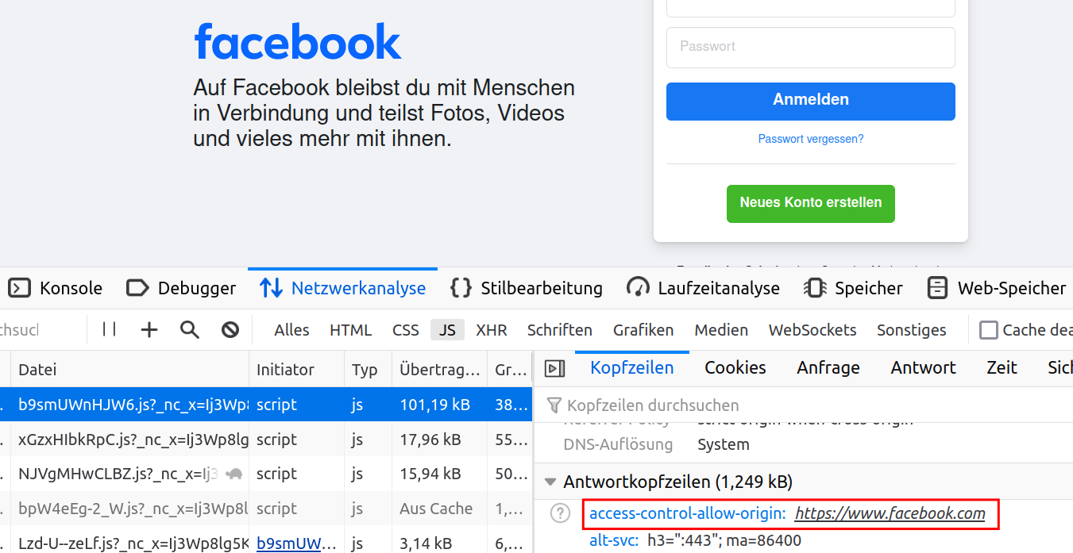

Slide 12
TODO: access control
- Implement access control mechanisms once and re-use them throughout the application
- Log access control failures, alert admins when appropriate
- Rate limit API and controller access
A01

Slide 13
TODO: File protection
- Except for public resources, deny by default
- Disable web server directory listing
- ensure file metadata (e.g., .git) and backup files are not present within web roots
A01

Slide 14
TODO: session invalidation
- Stateful session identifiers should be invalidated on the server after logout.
- Stateless JWT tokens should rather be short-lived
A01

Slide 15
A02: Cryptographic Failures
failures related to cryptography or lack of them

Slide 16
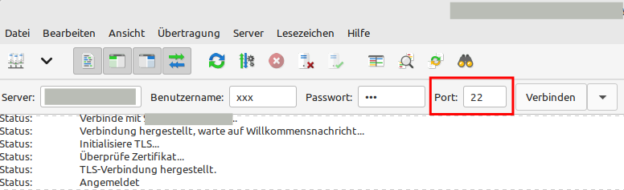
SFTP
A02

Slide 17
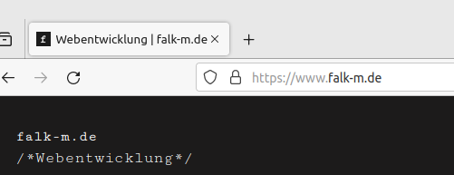
SSL
web servers, back-end systems?
A02

Slide 18
TODO: transfer encryption
- Encrypt all data in transit with secure protocols such as TLS
- Do not use legacy protocols such as FTP
- Verify all internal traffic, e.g., between load balancers, web servers, or back-end systems
A02

Slide 19
TODO: data encryption
- Don't store sensitive data unnecessarily. Data that is not retained cannot be stolen.
- Ensure up-to-date and strong standard algorithms, protocols, and keys
- Disable caching for response that contain sensitive data.
A02

Slide 20
TODO: password encryption
- Store passwords using strong adaptive and salted hashing functions with a work factor
- unsalted hashes can be exposed with a rainbow table
- Avoid deprecated cryptographic functions and padding schemes, such as MD5, SHA1
A02

Slide 21
A03: Injection

Slide 22
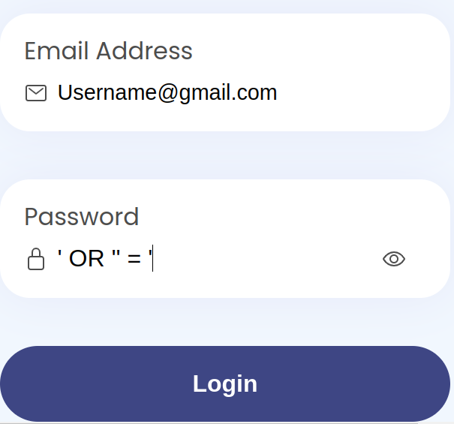
SQL Injection
WHERE Password =‘‘ OR ‘‘ = ‘‘
A03

Slide 23
TODO: use parameterized interface
Security Issue: Dynamic queries or non-parameterized calls without context-aware escaping are used directly in the interpreter.
- keeping data separate from commands and queries
- using the interpreter entirely, provides a parameterized interface
- or use escape functions
A03

Slide 24
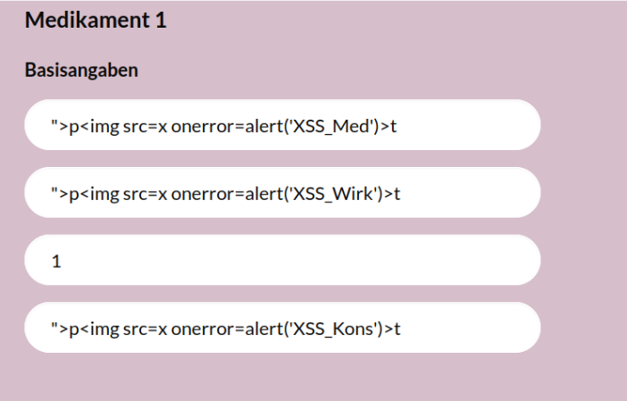
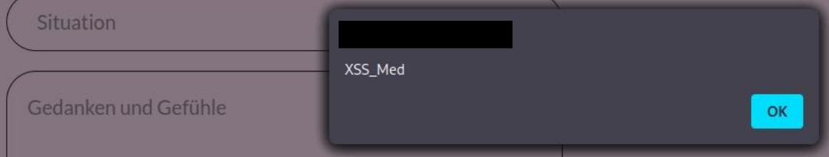
Cross-Site-Scripting
A03

Slide 25
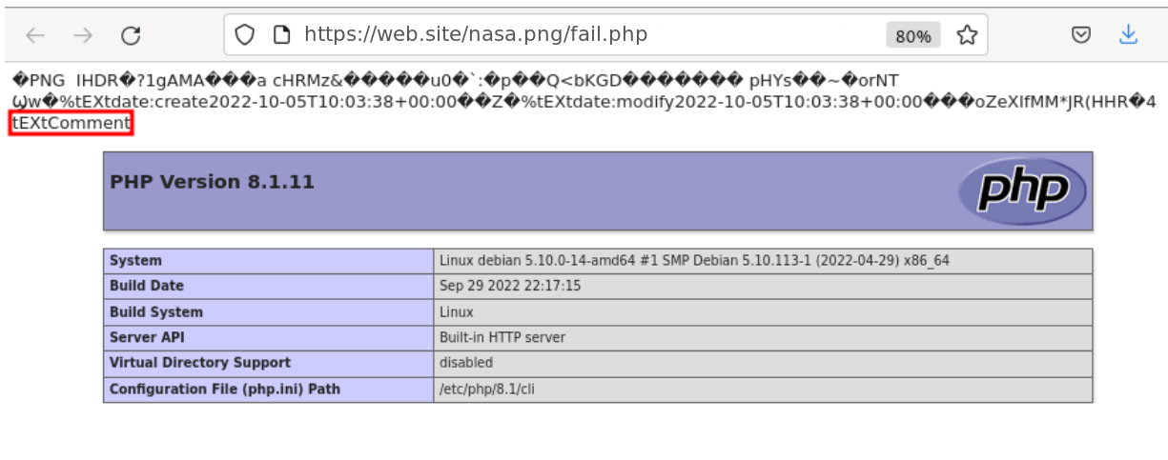
php code injection
https://www.synacktiv.com/publications/persistent-php-payloads-in-pngs-how-to-inject-php-code-in-an-image-and-keep-it-there.html
https://onestepcode.com/injecting-php-code-to-jpg/
A03

Slide 26
TODO: sanitize user input
Security Issue: an attack in which an attacker injects malicious executable scripts into the code of a trusted website
- Automated testing of all parameters, headers, URL, cookies, JSON, SOAP, and XML data inputs is strongly encouraged
- User-supplied data is validated, filtered, or sanitized by the application.
A03

Slide 27
A04: Insecure Design

Slide 28
TODO: security by design
- look for changes in data flows and access control or other security controls
- In the user story, determine the correct flow and failure states
A04

Slide 29
TODO: plausibility checks
- Integrate plausibility checks at each tier of your application
- Limit resource consumption by user or service
A04

Slide 30
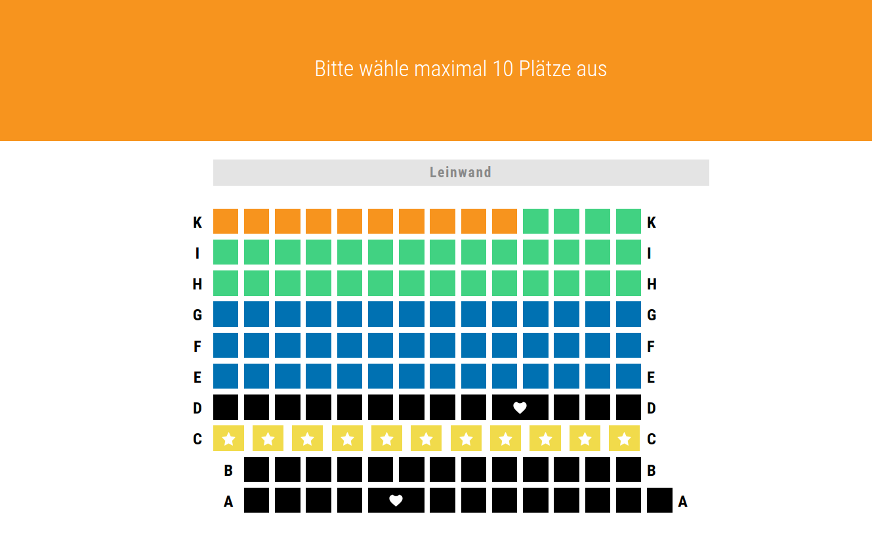

Slide 31
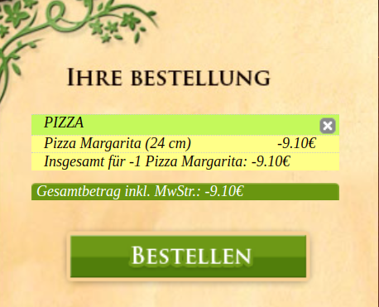

Slide 32
TODO: few informations
- A credential recovery workflow might include “questions and answers”, which is prohibited
- Error Message Containing Sensitive Information
- Unprotected Storage of Credentials
A04

Slide 33
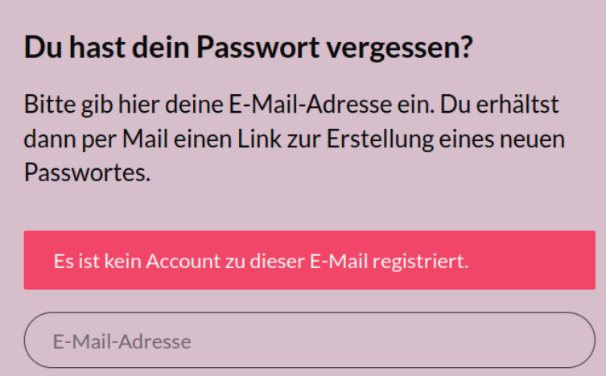
Error Message Containing Sensitive Information
„Sollte der Account existieren, senden wir die eine E-Mail zu.“
„Es gibt keinen Account zu dieser E-Mail oder das Passwort ist falsch“
A04

Slide 34
A05: Security Misconfiguration

Slide 35
TODO: check configuration
Security Issues:
- Default accounts and their passwords are still enabled and unchanged.
- Error handling reveals stack traces or other overly informative error messages to users (check debug mode or environment vars)
- the latest security features are disabled or not configured securely.
A05

Slide 36
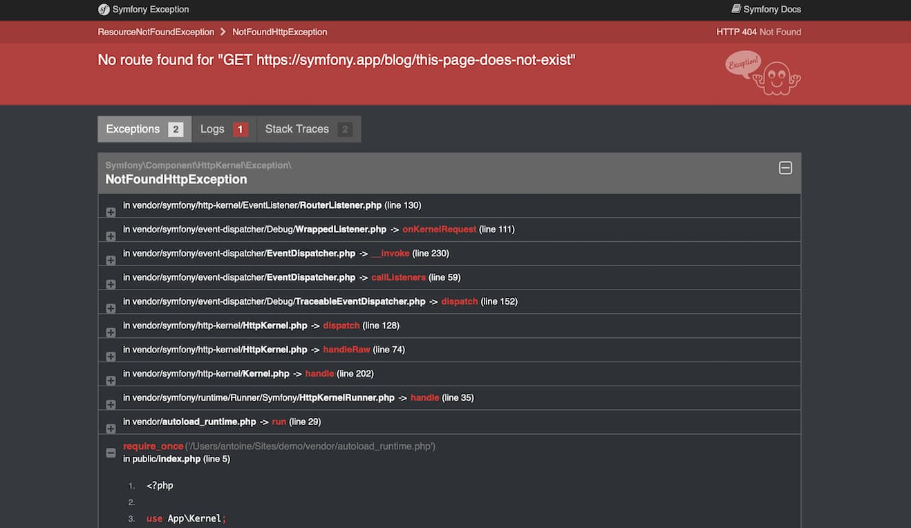

Slide 37
A06: Vulnerable and Outdated Components

Slide 38
TODO: check features
Security issue:
- Unnecessary features are enabled or installed (e.g., unnecessary ports, services, pages, accounts, or privileges)
- The software is out of date or vulnerable
Protection:
-Without a concerted, repeatable application security configuration process, systems are at a higher risk.
- Remove or do not install unused features and frameworks
A05/A06

Slide 39
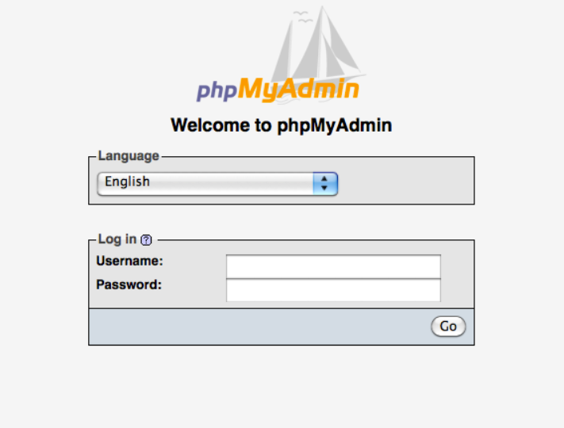
TODO: hide from web
A05/A06

Slide 40
TODO: check software
OS, web/application server, database management system (DBMS), applications, APIs and all components, runtime environments, and libraries
- Remove unused dependencies, unnecessary features, components, files, and documentation.
- Only obtain components from official sources over secure links.
A06

Slide 41
A07: Identification and Authentication Failures

Slide 42
TODO: Prevent brute Force Attacks
- Permits brute force or other automated attacks.
- Limit or increasingly delay failed login attempts
- Log all failures and alert administrators when credential stuffing, brute force, or other attacks are detected.
A07

Slide 43
TODO: Protect Sessions
- Does not expose session identifier in the URL.
- Regenerate session identifier after successful login.
- Invalidate sessions after logout or a period of inactivity.
A07

Slide 44
TODO: check user passwords
- check default, weak, or well-known passwords
- Implement weak password checks, such as testing new or changed
passwords against the top 10,000 worst passwords list
- not use weak or ineffective credential recovery and
forgot-password processes, such as "knowledge-based answers,"
- do not use plain text, encrypted, or weakly hashed passwords data stores
- password rotation and complexity requirements encourage users to use
and reuse weak passwords. Stop these practices and
use multi-factor authentication.
A07

Slide 45
A08 Software and Data Integrity Failures

Slide 46
TODO: Check components integrity
- relies upon plugins, libraries, or modules from untrusted sources,
repositories, and content delivery networks (CDNs)
- Use digital signatures or similar mechanisms to verify the software or data
is from the expected source and has not been altered.
- Ensure libraries and dependencies, such as npm or Maven, are
consuming trusted repositories.
A08

Slide 47
A09 Security Logging and Monitoring Failures

Slide 48
TODO: Logging
do not:
- Auditable events, such as logins, failed logins, and high-value transactions, are not logged.
- Warnings and errors generate no, inadequate, or unclear log messages.
do:
- Ensure all login, access control, and server-side input validation failures can be logged
- log with sufficient user context to identify suspicious or malicious accounts
- NOT Insertion of Sensitive Information into Log File.
A09

Slide 49
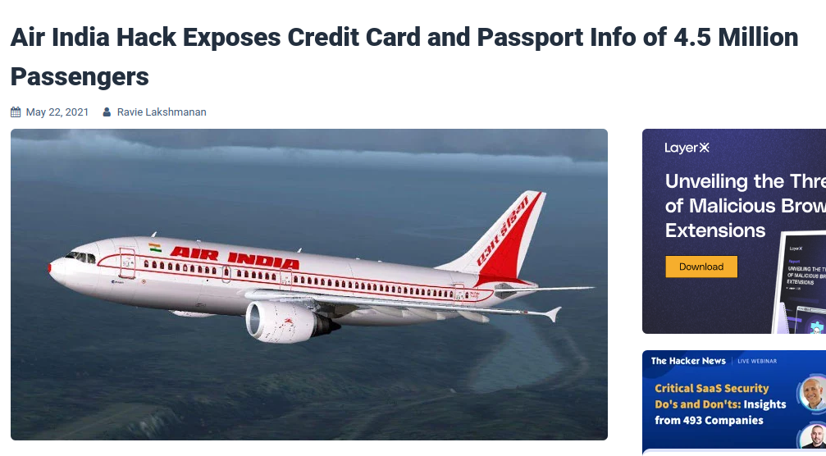

Slide 50
TODO: Escalation
do:
- Ensure that logs are generated in a format that log management solutions can easily consume.
- Ensure log data is encoded correctly to prevent injections or attacks on the logging or monitoring systems.
- use appropriate alerting thresholds, detect and alert for active attacks in real-time
- Establish or adopt an incident escalation response and recovery plan
A09

Slide 51
A10 Server-Side Request Forgery (SSRF)

Slide 52
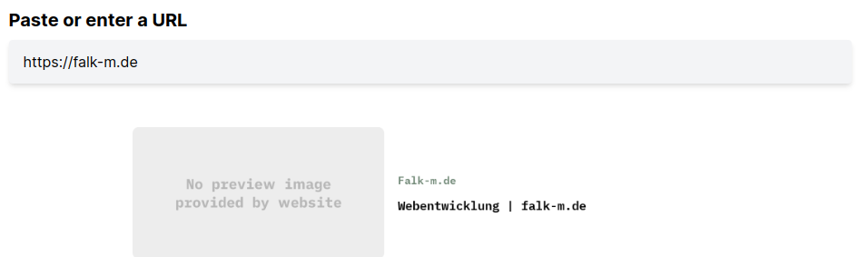
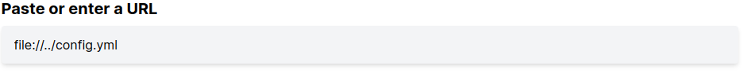
‚file://‘ protocol, internal administration sites (mongo db, ...)
A10

Slide 53
TODO: Prevent SSRF
Risk:
- a web application is fetching a remote resource without validating the user-supplied URL
- server internal requests like 'file://' or other application internal apis
Prevent:
- Sanitize and validate all client-supplied input data
- Enforce the URL scheme, port, and destination with a positive allow list
- Do not send raw responses to clients
- Disable HTTP redirections
A10

Slide 54

Thank you

