Slide 1
Making a standalone effects pedal system based on embed Linux
Creating a realtime, highly-optimized Linux audio platform
for a standalone effects pedal.
The tech stack behind the MOD Dwarf

Slide 2
Making a standalone effects pedal system
Quick self-introduction
  Who is talking – Filipe Coelho a.k.a. falkTX
  Works on the tech stack behind MOD Audio (formerly MOD Devices)
  ~8 years at it
  Also does some Linux audio related things

Slide 3
Making a standalone effects pedal system
What is the MOD Dwarf exactly
Decisions, iterations and lessons learned
Quick intro demo time

Slide 4
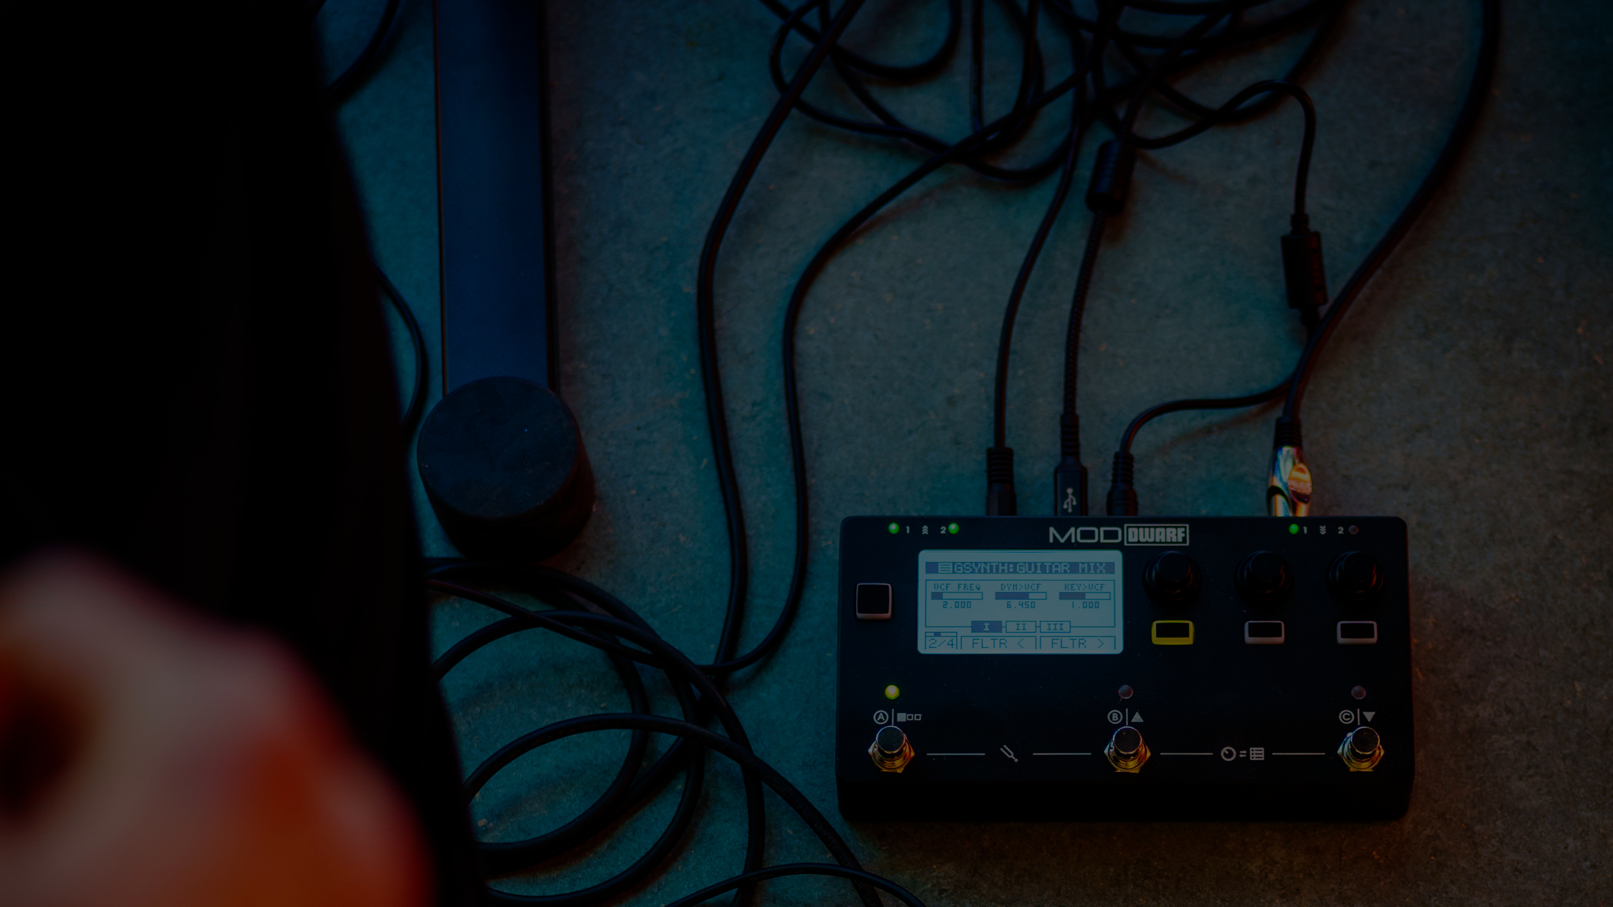
Making the MOD Dwarf
Targets to achieve
  Fully-capable portable device
    to be taken on stage
  Low-latency Audio (& MIDI) processing
  Easy to manage and use
    install new files & plugins
    firmware updates
    factory reset
    usable by non-techies

Slide 5
Making the MOD Dwarf
Choose what to build upon
  Smallest possible form factor
  ARM vs x86 vs other?
  Full boards vs SoM / SODIMM?
    Consider price, scalability and longevity
    Very custom board

Slide 6
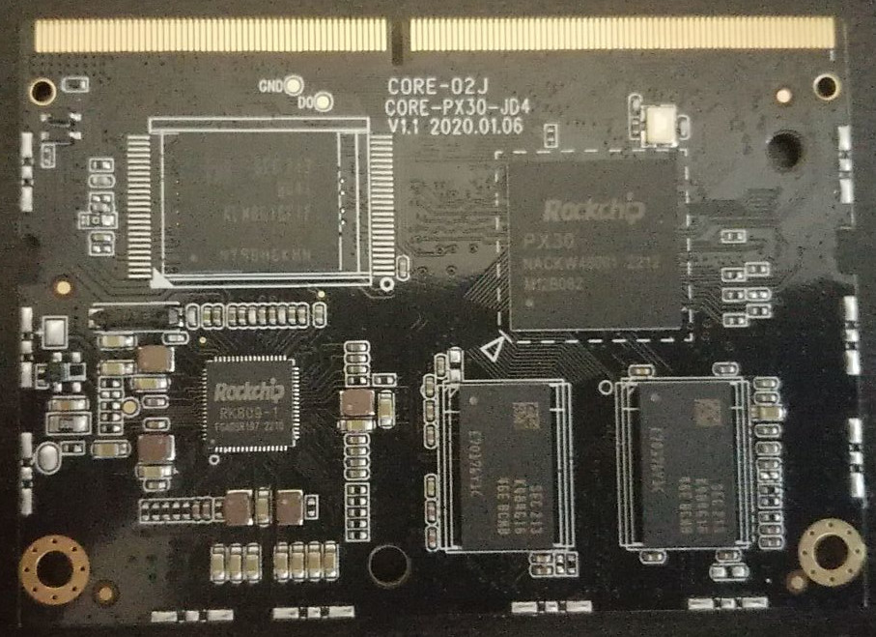
Making the MOD Dwarf
Choose what to build upon -> ARM SoM
  Cheap and capable
  Experiment with many boards (!)
Firefly PX30-JD4 “core board”
  Cortex-A35 CPU (4-Core 1.3GHz)
  I2S, UART, USB host and gadget
  Promised 10 years of availability

Slide 7
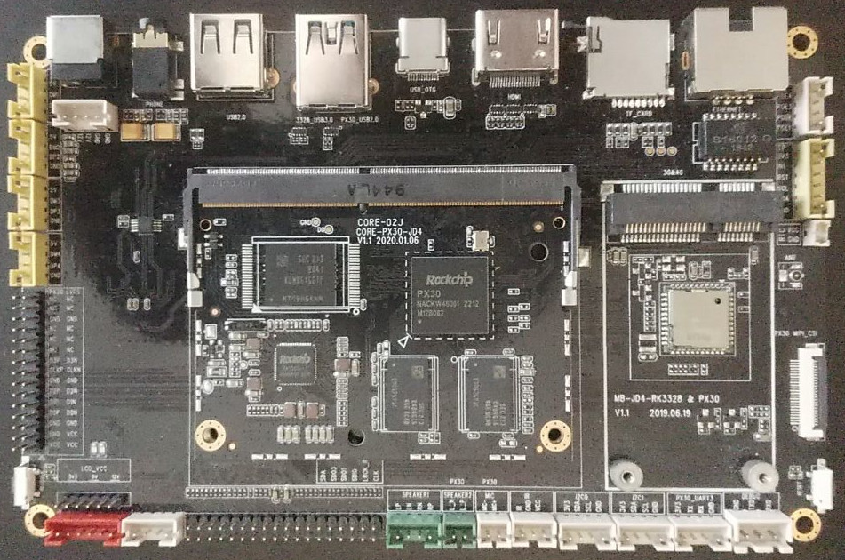
Making the MOD Dwarf
Initial bootup, check expectations
  Start with a dev board
  Use regular Linux images
    Might only be available from the vendor
  Just get it to boot something first…

Slide 8
Making the MOD Dwarf
Initial experiments and testing
  Check performance and stability (!)
  Check mainline support
  Initial tests with RT audio (preempt=full or threadedirq + PREEMPT)
  Investigate deploy methods properly (!)
Finally pick a board

Slide 9
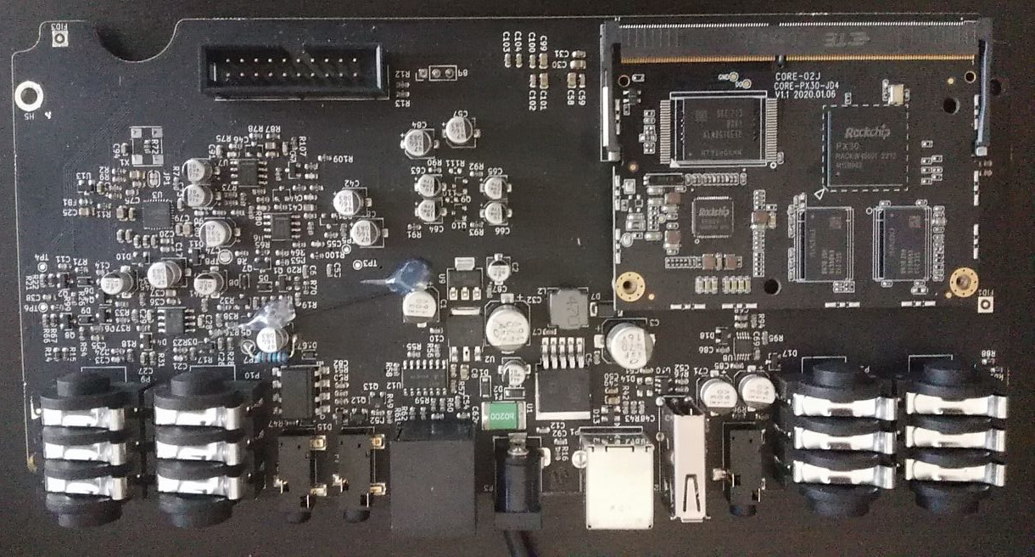
Making the MOD Dwarf
Custom board!
  Defined elsewhere ;)
Before you ask:
  Coreboard-specific
  No standard

Slide 10
Making the MOD Dwarf
Getting hands dirty..?
A few critical things to solve first
  The versioning problem (split packages vs immutable system)
  Device/CPU-specific optimizations?
  Reproducible builds? (!)
  How to deal with updates?
  Factory-reset?

Slide 11
Making the MOD Dwarf
Getting hands dirty!
  Custom builds using buildroot (chosen in 2016)
    Generates rootfs image
    Should be done inside reproducible-y container/system (!)
  Lots of extra utilities added on top [DEMO]
Disclaimer:
- The “MOD Build System” end result is not open-source
- Derivative “MOD Plugin Builder” is, can build plugins and kernel

Slide 12
Making the MOD Dwarf
Booting up: Initial steps
  Understand deploy and boot procedure
  Manual build of bootloader, partitioning, other device details
  Getting a kernel to build&run, using vendor kernel if needed
Dwarf:
  rkdevelop for flashing maskrom
  proprietary cpu/ram init bits :(
  uboot/trust.img
Oh yeah it boots!

Slide 13
Making the MOD Dwarf
Booting up: Initial steps
  Add busybox and other tools, verify RAM and eMMC
  Set up dns server, ssh server, usb network gadget (!)
  Start tweaking kernel in quick iterations [DEMO]
Dwarf:
  dnsmasqd
  g_ether kernel module
  systemd
We can validate the custom board hardware now!

Slide 14
Making the MOD Dwarf
Partitioning and restore/recovery
  Define partitions
    Dwarf uses “restore” (128Mb), “system” (512Mb) and “data”
  Create kernel variant for handling updates/restore
    Disable everything not strictly needed (RT, audio services)
  Entire restore filesystem embed in kernel image, boots to RAM
    Entire disk can be deleted if necessary

Slide 15
Making the MOD Dwarf
Handling updates
  Define install/update OS image
    Dwarf uses single tar file for each partition content [DEMO]
  Define update process
    Dwarf uses linux mass storage gadget and/or usb stick in restore mode
    Formats partition and extracts tar, feedback through LEDs [DEMO]
  Generate the entire thing in 1 go
  Have a way to do initial flash (with only restore mode)
    Needs device-specific image format (!)
Hurray, a deployable device!

Slide 16
Making the MOD Dwarf
Audio setup (aka what this device is supposed to do)
  JACK2 audio server on top of ALSA
    Dwarf uses Cirrus-Logic 4265 I2S device
  Setup mod-host and mod-ui
    mod-host as plugin host
    mod-ui as webserver on port 80
    mod-ui tells mod-host what to do
  Everything over systemd :D

Slide 17
Making the MOD Dwarf
Audio setup (part 2)
  All but mod-ui as internal JACK clients
    Everything audio related runs “in process”
  jackd (…) -C /etc/jack-internal-session.conf (…)
    Loads all audio tools in one go
    Signals when ready (systemd Type=Notify)
  mod-host with 1 plugin = 1 JACK client
    Free SMP!
  mod-ui holds session state, not mod-host
    Allows for audio/host/plugin crash recovery [DEMO]

Slide 18
Making the MOD Dwarf
Introduce (read: develop) any other needed tools
  mod-midi-merger for combining MIDI streams
    aka “aggregated” device mode
  mod-peakmeter for audio peak metering on I2C bus
  mod-spi2jack for handling CV ports (through ADC/DAC hardware)
  mod-ttymidi as ttymidi fork to get serial MIDI into JACK
  audio-bridge: custom alsa-to-jack handling
    for future USB Audio mode (WIP)
  Many, many LV2 plugins

Slide 19
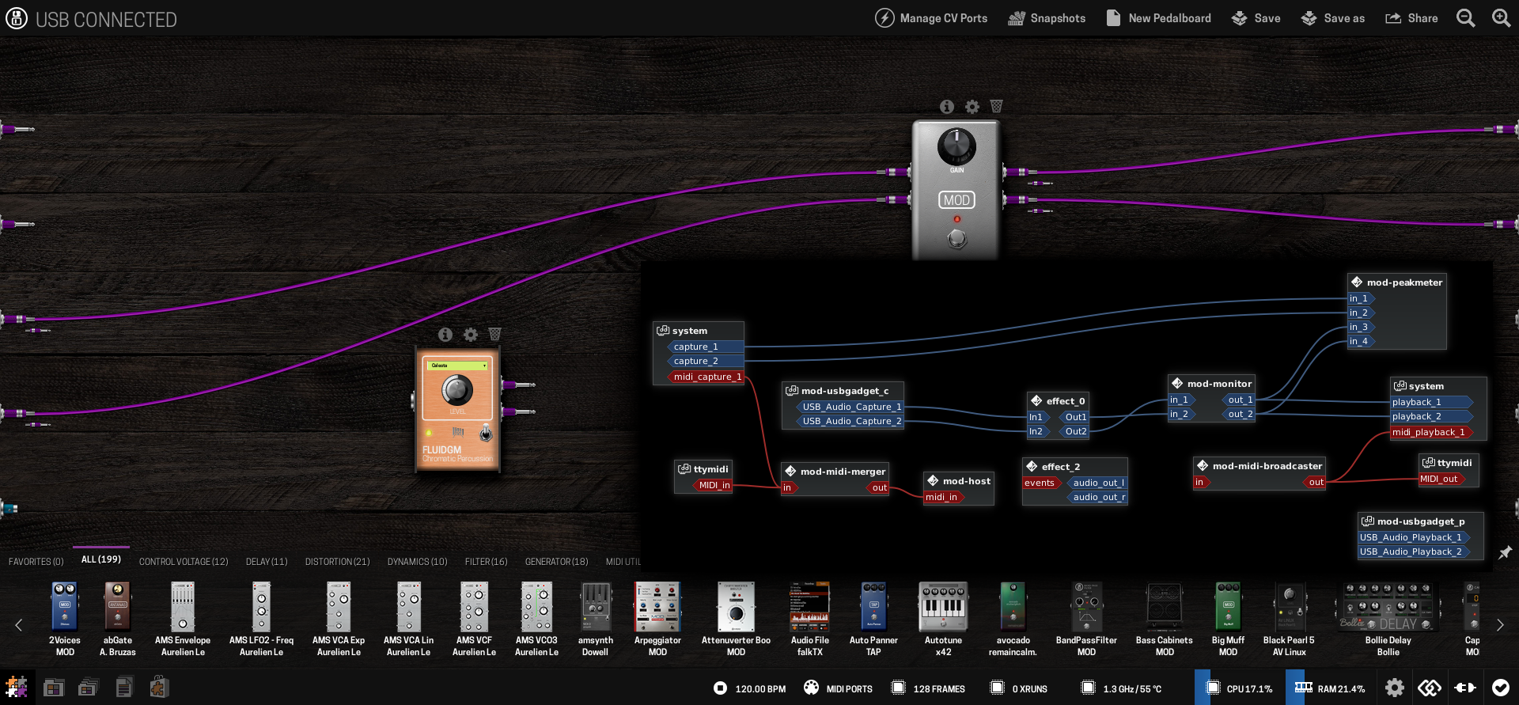
Making the MOD Dwarf

Slide 20
Making the MOD Dwarf
Human-Machine Interface (aka what the user controls)
  Top-board and bottom-board
    Communication through serial lines
  Define protocol for communication (!)
    Both mod-host and mod-ui have access
  HMI → System uart access
    Can run custom commands!
    Hooks into bootloader too, can enter restore mode [DEMO?]
Disclaimer:
- The “mod-controller-proto” project is open-source
- The “mod-controller” project (HMI) is not

Slide 21
Making the MOD Dwarf
Device authentication
  Tag each unit with a unique serial number
  Using “UID” dedicated hardware chip
    guaranteed to contain globally unique ID
    read-only
  Store per-device GPG key in EEPROM
    remains even after factory reset
  Create LV2 plugin API around it [DEMO]
    Used to validate licenses
We have commercial plugins now!

Slide 22
Making the MOD Dwarf
Hardware tests and QC (introducing self-test mode)
  Test that all hardware features work
    Audio, MIDI and USB loopback
    Manual press of all buttons, one by one
  Units must pass self-test before being usable
  Give direct feedback on device screen [DEMO]

Slide 23
Making the MOD Dwarf
System tweaks and fine-tuning (aka optimization)
  IRQ tuning (DMA #1, audio services #2)
  JACK with internal clients and private futexes
  Split main system vs plugin-deps build
    Audio-specific libraries built with extra optimizations
Bonus:
  Nightmares of hardware quirks [DEMO]
  Throwing CPU at the noise problem

Slide 24
Making the MOD Dwarf
Buildroot target split
  restore (self-contained with everything: kernel, init and utils)
  kernel (can be multiple per platform)
  rootfs (all required user-space tools and their deps)
  plugins-dep (heavily optimized extra libs, to be used by plugins)
1 kernel per device
Combined system image
  kernel(s) + roofs + plugins-dep

Slide 25
Making the MOD Dwarf
The internet side of things
  Automated cloud builds [DEMO]
  Cloud side for OS updates [DEMO]
  Plugin store [DEMO]
  Pedalboard sharing [DEMO]
Disclaimer:
- MOD Cloud stuff is not open-source, restricted to MOD units
- Soon to expand access into generic desktop builds [DEMO]

Slide 26
Making the MOD Dwarf
Little extra cloud things
  Cloud plugin builder [DEMO]
Disclaimer:
- mod-cloud-builder project is open-source

Slide 27
Conclusion
Lots of work, but we end up with:
  Deployment and usage as easy as possible
  Consistent OS/release versions
  Device-specific tuning for the best performance possible
  Automated builds and updates*
    (*assuming integration with cloud side)

