Slide 1

Product overview
Tournament check-in, schedule visibility, referee coaching, and ratings.
Current web platform

Slide 2
Current platform functions
CHECK-IN
COACHING + RATINGS
Check-in methods
Assign referee coaches by game, site, date, or time.
Account-based QR check-in, external check-in without an account, and manual staff check-in.
Attendance records
Basic Eval and Skills Eval forms support visibility controls, rating history, filters, and spreadsheet exports.
Displays expected officials, check-in status, check-in time, and check-in method.
Event access
Responsive rosters, schedule views, filters, and printable daily QR sheets.
Access is controlled by group, event, and user role.

Slide 3
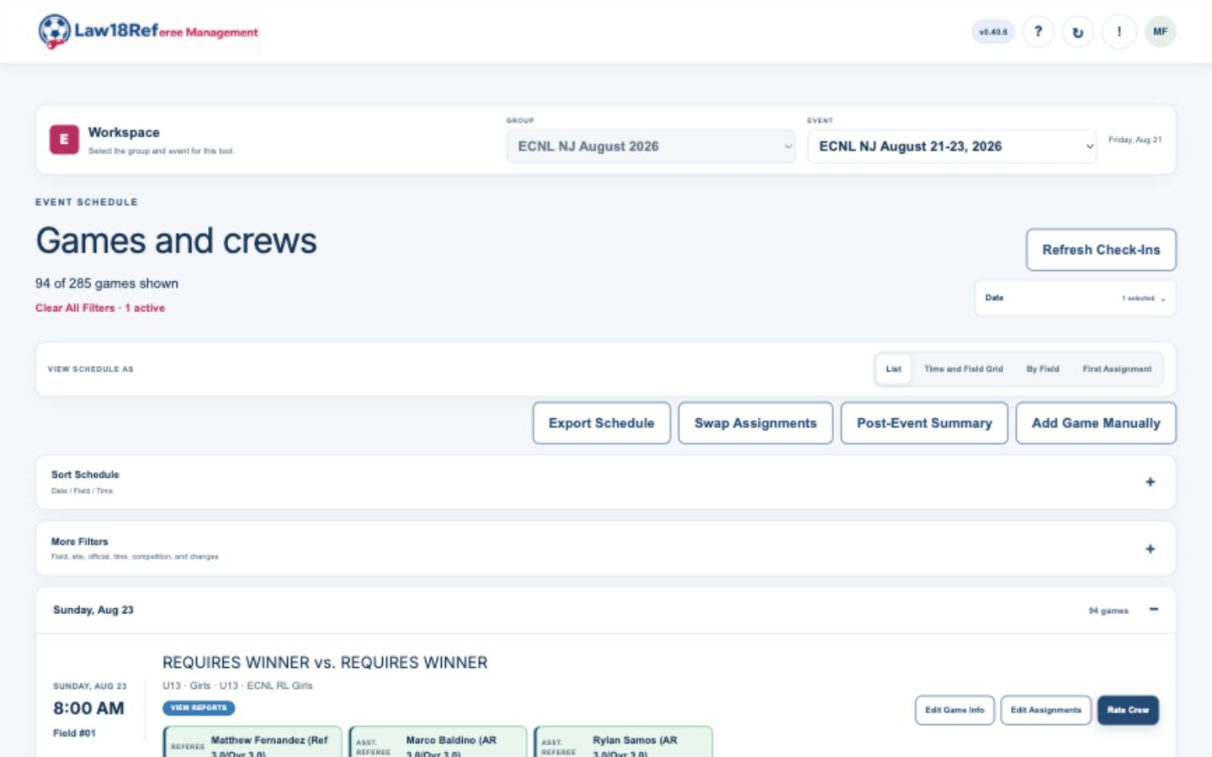
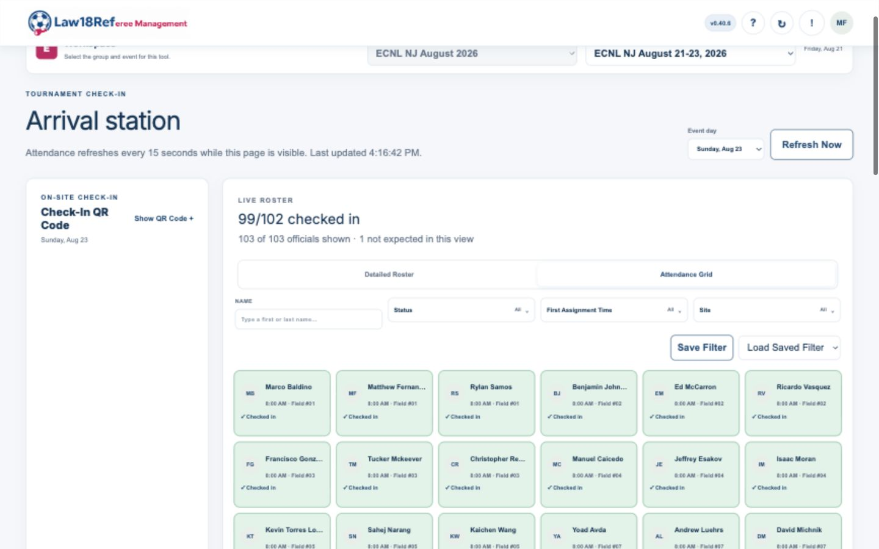
Schedule and check-in screens
SCHEDULE AND CREW VIEW
CHECK-IN ATTENDANCE GRID
The schedule displays games and assigned crews. The check-in screen displays attendance status for expected officials.

Slide 4
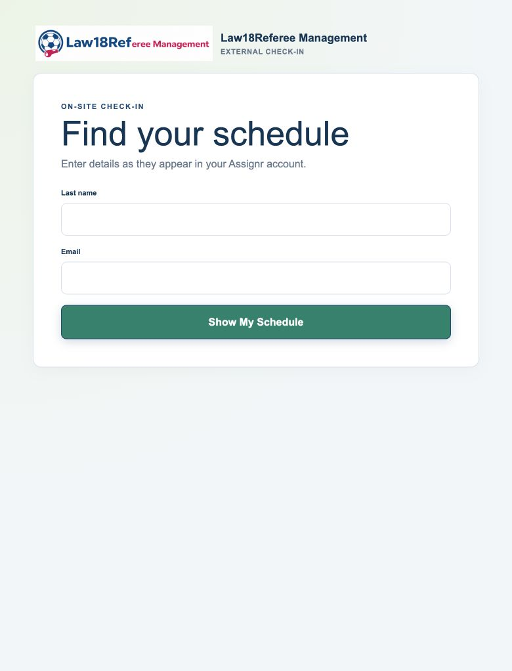
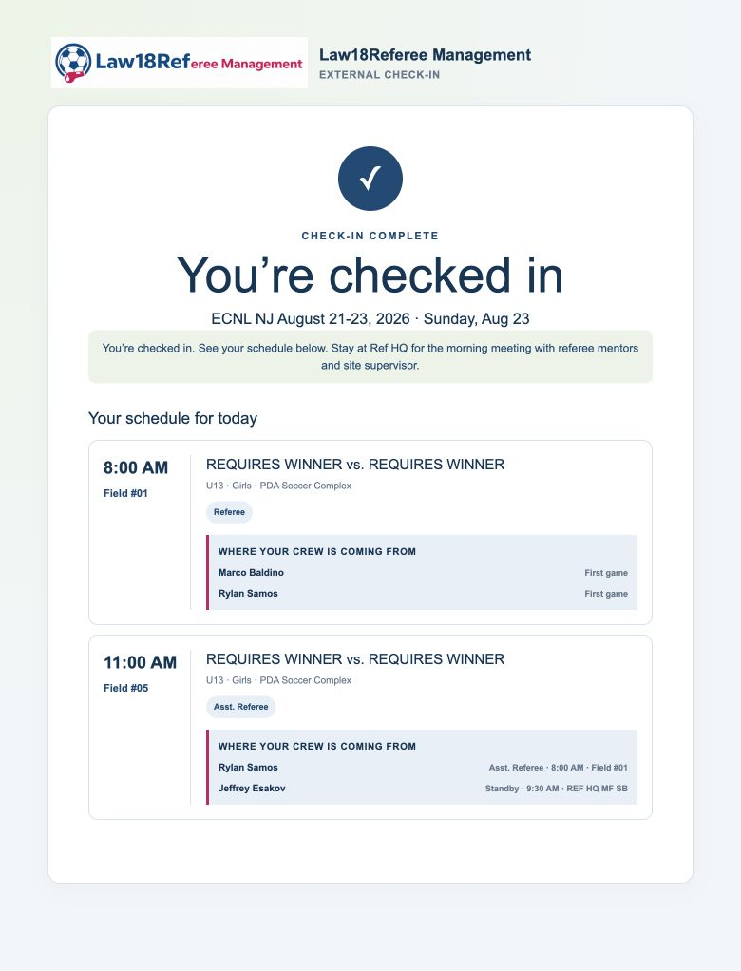
External check-in screens
Officials enter required information. A successful match displays confirmation and the official's daily assignments.
1 FIND THE IMPORTED SCHEDULE
2 SEE THE CONFIRMATION + ASSIGNMENTS

Slide 5
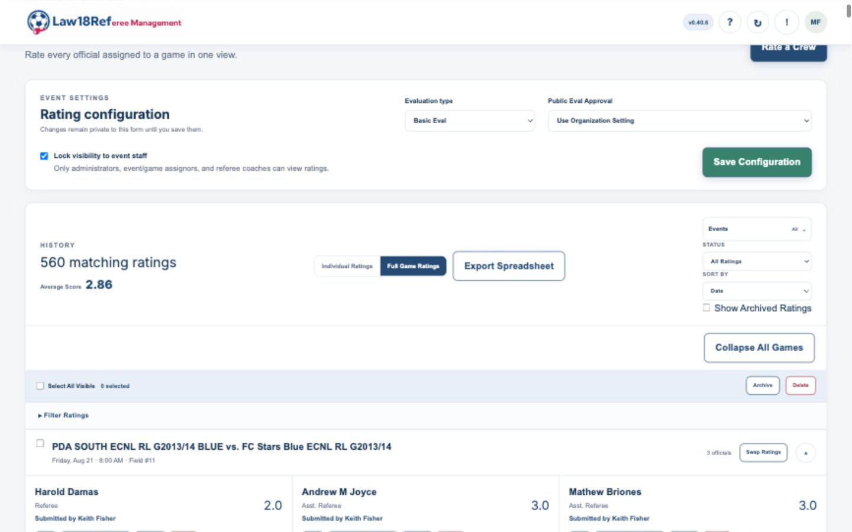
Ratings database screen
The full-game view displays all submitted ratings for a game, rating scores, submitters, filters, and export controls.

Slide 6
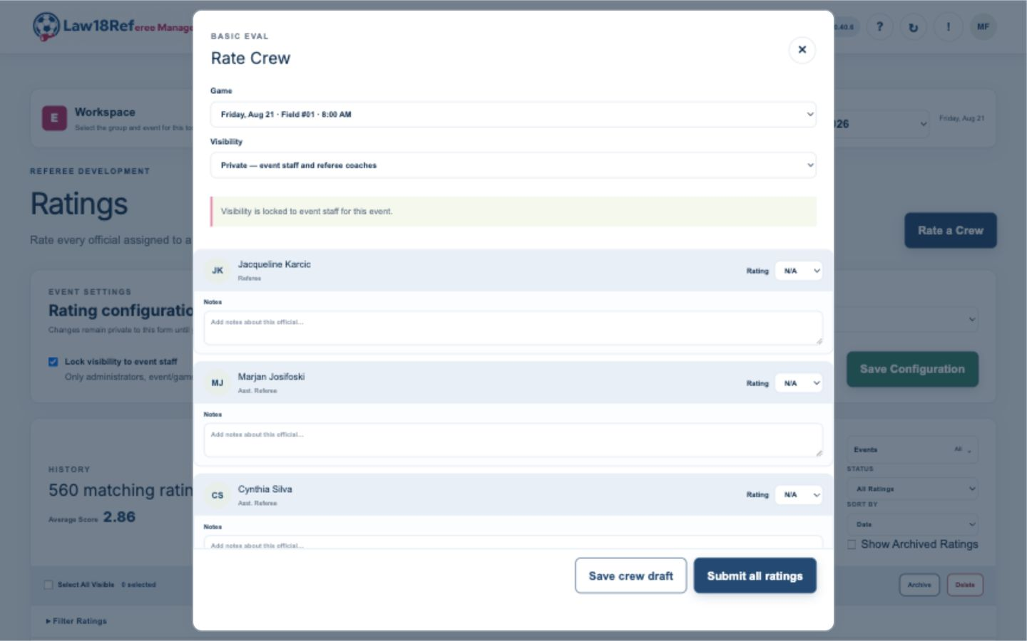
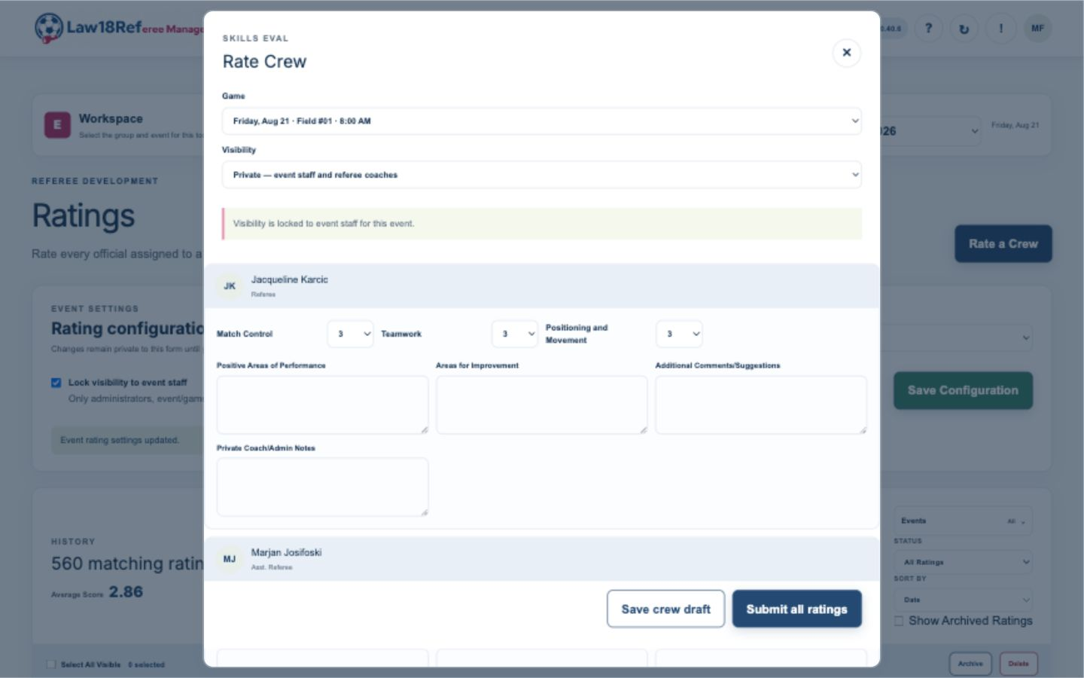
Evaluation form screens
BASIC EVAL
SKILLS EVAL
One 1-5 rating and notes for each official
Position-specific categories and written fields
Custom evaluation formats can be made available for a group's workflow.

Slide 7
Current and potential functions
Functions available in the current tournament pilot:
Import schedules and officials
Potential future functions
Run check-in and attendance
Messaging and full assignment tools are potential future additions being explored - not committed product promises.
Coordinate coaches and ratings
Law18Referee Management

