Slide 1

Tournament operations,
simplified.
Check in officials. Coordinate referee coaches. Build a useful ratings history.
Pilot-ready web platform

Slide 2
Two jobs. One clear event-day view.
CHECK-IN
COACHING + RATINGS
Flexible arrival workflows
Assign coaches across selected games, sites, dates, and times.
Account-based or external QR check-in, plus manual staff controls.
Live attendance visibility
Capture Basic or Skills evaluations, control visibility, review history, and export results for analysis.
See who is expected, checked in, or still missing - with time and method recorded.
Built for tournament day
Mobile rosters, schedule access, filters, and printable QR sheets.
Private by default. Share only what each role may see.

Slide 3
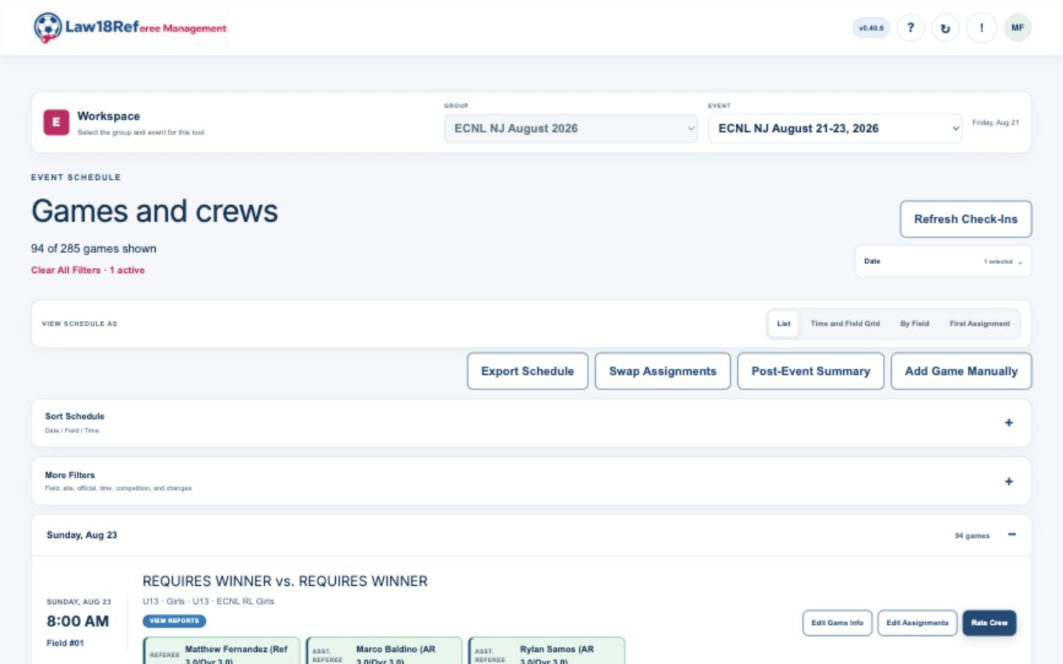
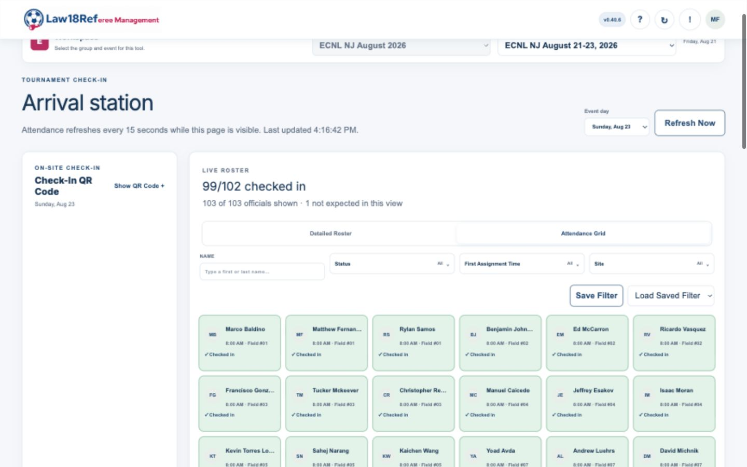
The event-day picture stays visible.
Schedule and crew detail
Arrival status at a glance
Staff can move from the posted schedule to live attendance without rebuilding the event in a second tool.

Slide 4
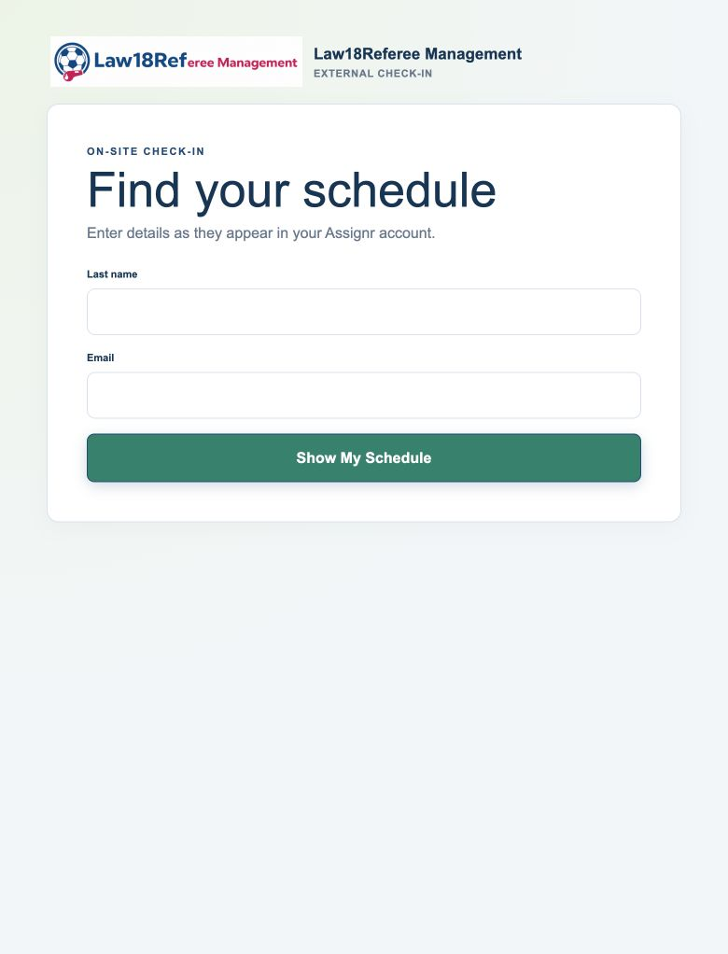
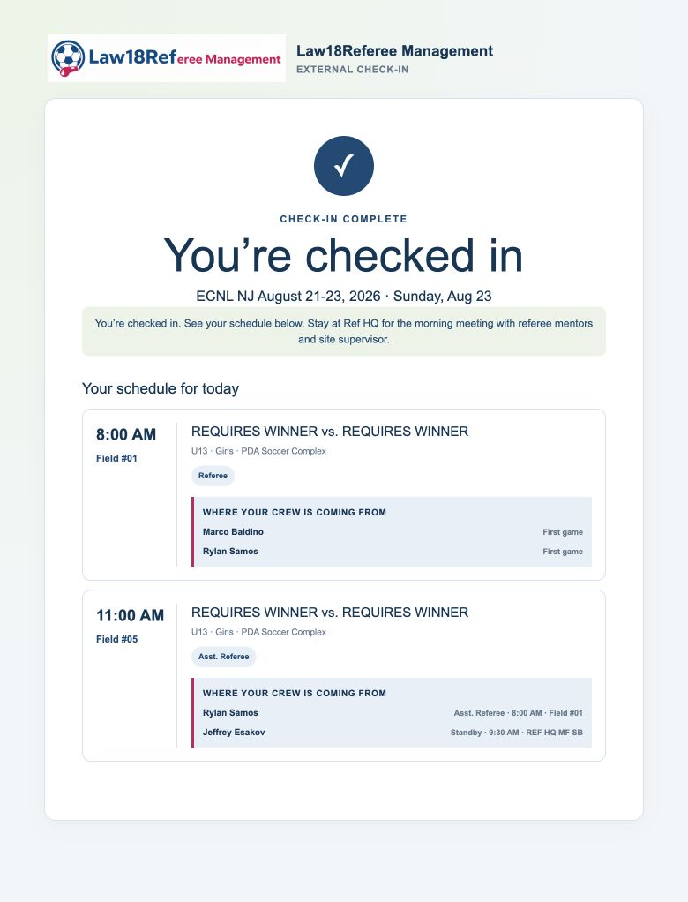
External check-in is a simple phone flow.
Scan, identify, confirm - with the referee's schedule shown immediately.
1 FIND THE IMPORTED SCHEDULE
2 SEE THE CONFIRMATION + ASSIGNMENTS

Slide 5
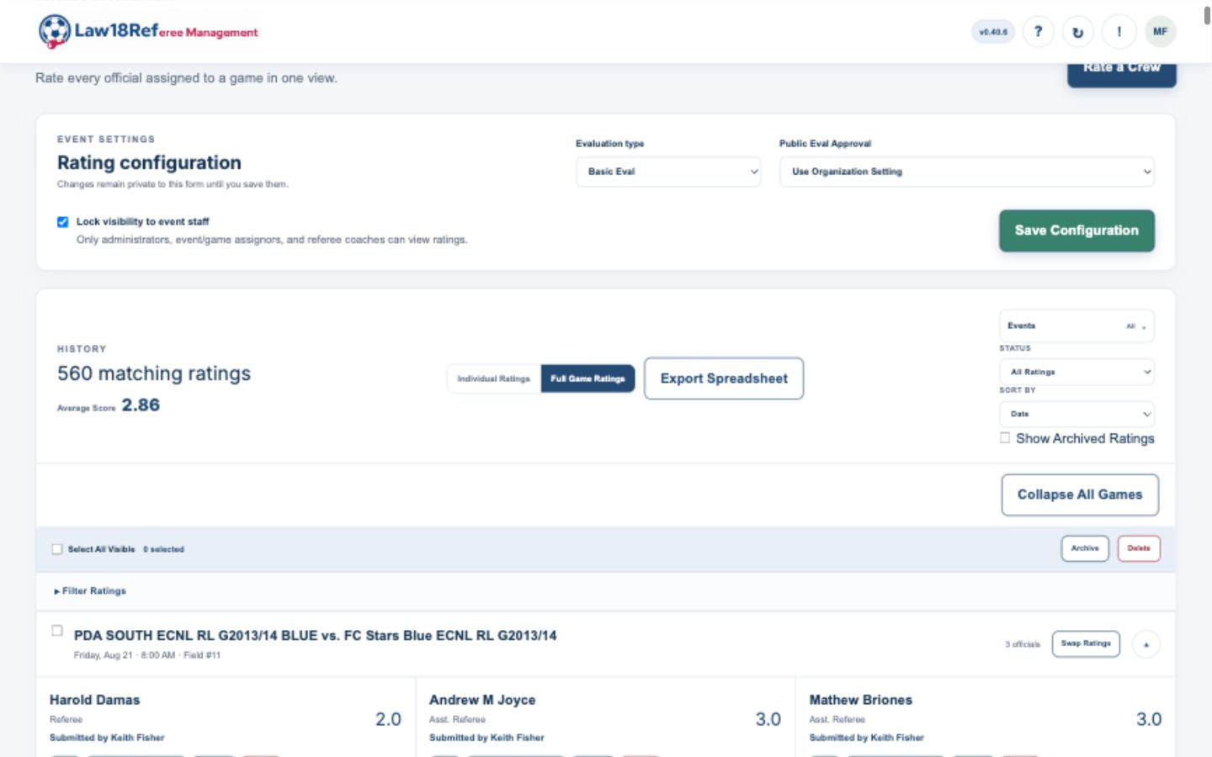
Ratings become a usable development record.
Review a full crew together, control access, filter results, and export the history.

Slide 6
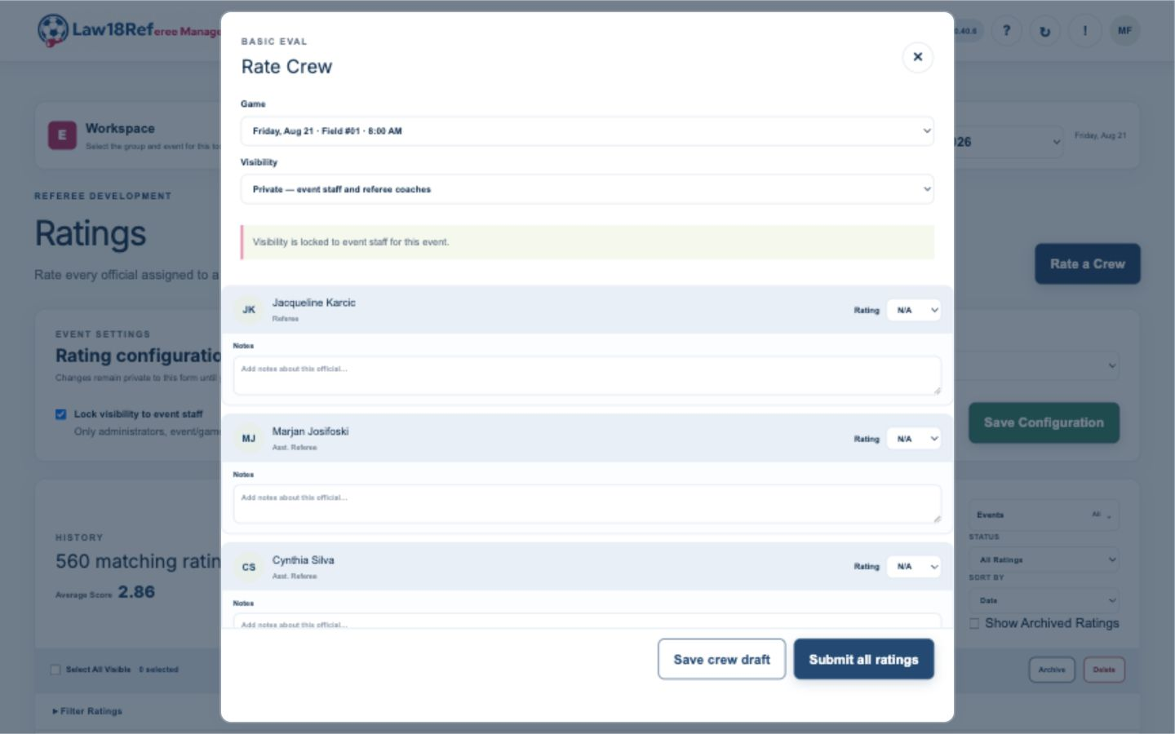
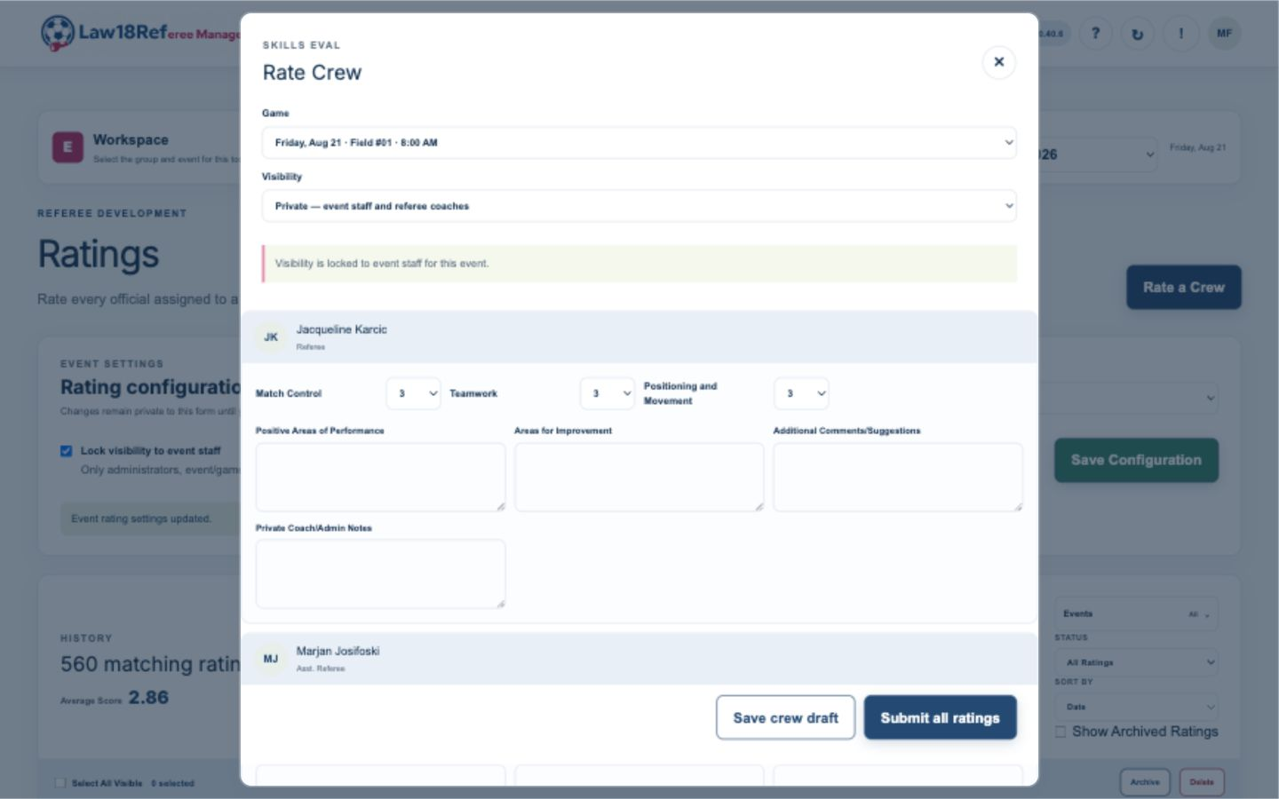
Choose the right depth for each event.
BASIC EVAL
SKILLS EVAL
Fast 1-5 rating plus notes
Role-specific scoring and written feedback
Custom evaluation formats can be made available for a group's workflow.

Slide 7
Start small. Prove the workflow.
Law18Ref supports a focused tournament pilot today.
Import schedules and officials
Exploring what comes next
Run check-in and attendance
Messaging and full assignment tools are potential future additions being explored - not committed product promises.
Coordinate coaches and ratings
Law18Referee Management

