Slide 1
Chapter 2
Competitiveness, Strategy, and Productivity

Slide 2
Chapter 2: Learning Objectives
You should be able to:
LO 2.1 List several ways that business organizations compete
LO 2.2 Name several reasons that business organizations fail
LO 2.3 Define the terms mission and strategy and explain why they are important
LO 2.4 Discuss and compare organization strategy and operations strategy and explain why it is important to link the two
LO 2.5 Describe and give examples of time-based strategies
LO 2.6 Define the term productivity and explain why it is important to organizations and to countries
LO 2.7 Describe several factors that affect productivity
2-2

Slide 3
A Cold Hard Fact
Better quality, higher productivity, lower costs, and the ability to respond quickly to customer needs are more important than ever, and…
the bar is getting higher
Copyright ©2021 McGraw-Hill Education. All rights reserved. No reproduction or distribution without the prior written consent of McGraw-Hill Education.
2-3

Slide 4
Chapter Focus
This chapter focuses on three separate but related ideas that are vitally important to business organizations
Competitiveness
Strategy
Productivity
2-4

Slide 5
Competitiveness
Competitiveness:
How effectively an organization meets the wants and needs of customers relative to others that offer similar goods or services
Organizations compete through some combination of their marketing and operations functions
What do customers want?
How can these customer needs best be satisfied?
LO 2.1
Copyright ©2021 McGraw-Hill Education. All rights reserved. No reproduction or distribution without the prior written consent of McGraw-Hill Education.
2-5

Slide 6
Marketing’s Influence
Identifying consumer wants and/or needs
Pricing and quality
Advertising and promotion
LO 2.1
2-6

Slide 7
Businesses Compete Using Operations
Product and service design
Cost
Location
Quality
Quick response
Flexibility
Inventory management
Supply chain management
Service
Managers and workers
LO 2.1
2-7

Slide 8
Why Some Organizations Fail
Neglecting operations strategy
Failing to take advantage of strengths and opportunities and/or failing to recognize competitive threats
Too much emphasis on short-term financial performance at the expense of R&D
Too much emphasis on product and service design and not enough on process design and improvement
Neglecting investments in capital and human resources
Failing to establish good internal communications and cooperation
Failing to consider customer wants and needs
LO 2.2
2-8

Slide 9
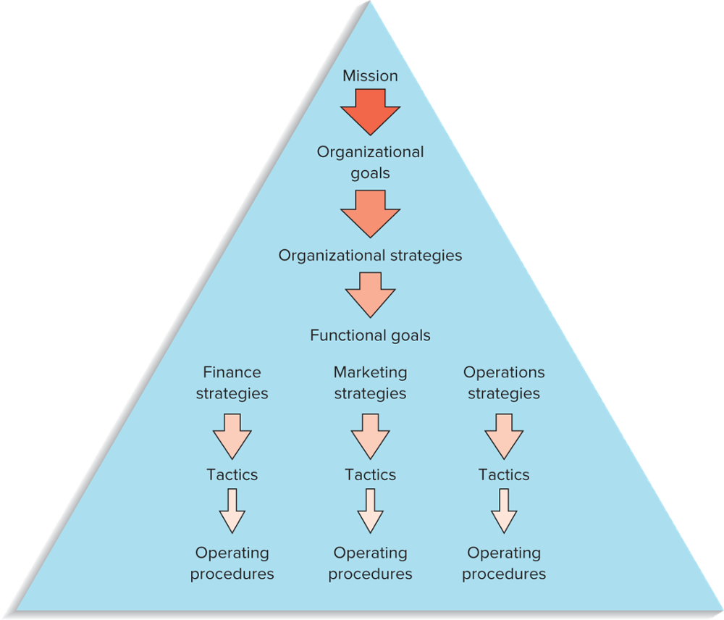
Hierarchical Planning
Mission
Goals
Organizational strategies
Functional strategies
Tactics
FIGURE 2.1
Planning and decision making are hierarchical in organizations
LO 2.3
2-9

Slide 10
Mission
Mission
The reason for an organization’s existence
Mission statement
States the purpose of the organization
The mission statement should answer the question of “What business are we in?”
LO 2.3
Copyright ©2021 McGraw-Hill Education. All rights reserved. No reproduction or distribution without the prior written consent of McGraw-Hill Education.
2-10

Slide 11
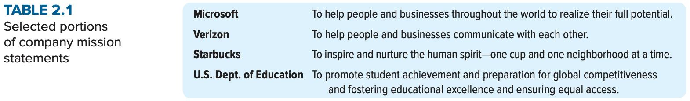
Mission Statement
LO 2.3
Copyright ©2021 McGraw-Hill Education. All rights reserved. No reproduction or distribution without the prior written consent of McGraw-Hill Education.
2-11

Slide 12
Goals
The mission statement serves as the basis for organizational goals
Goals
Provide detail and the scope of the mission
Goals can be viewed as organizational destinations
Goals serve as the basis for organizational strategies
LO 2.3
Copyright ©2021 McGraw-Hill Education. All rights reserved. No reproduction or distribution without the prior written consent of McGraw-Hill Education.
2-12

Slide 13
Strategies
Strategy
A plan for achieving organizational goals
Serves as a roadmap for reaching the organizational destinations
Organizations have
Organizational strategies
Overall strategies that relate to the entire organization
Support the achievement of organizational goals and mission
Functional level strategies
Strategies that relate to each of the functional areas and that support achievement of the organizational strategy
LO 2.3
Copyright ©2021 McGraw-Hill Education. All rights reserved. No reproduction or distribution without the prior written consent of McGraw-Hill Education.
2-13

Slide 14
Tactics and Operations
Tactics
The methods and actions taken to accomplish strategies
The “how to” part of the process
Operations
The actual “doing” part of the process
LO 2.3
Copyright ©2021 McGraw-Hill Education. All rights reserved. No reproduction or distribution without the prior written consent of McGraw-Hill Education.
2-14

Slide 15
Core Competencies
Core competencies
The special attributes or abilities that give an
organization a competitive edge
To be effective, core competencies and strategies need to be aligned
LO 2.3
Copyright ©2021 McGraw-Hill Education. All rights reserved. No reproduction or distribution without the prior written consent of McGraw-Hill Education.
2-15

Slide 16
Sample Operations Strategies
Organizational Strategy | Operations Strategy | Examples of Companies or Services
Low Price | Low cost | U.S. first-class postage Wal-Mart
Responsiveness | Short processing times On-time delivery | McDonald’s restaurants FedEx
Differentiation: High Quality | High performance design and/or high quality processing Consistent quality | Sony TV Coca-Cola
Differentiation: Newness | Innovation | 3M, Apple
Differentiation: Variety | Flexibility Volume | Burger King (Have it your way”) McDonald’s (“Buses Welcome”)
Differentiation: Service | Superior customer service | Disneyland IBM
Differentiation: Location | Convenience | Supermarkets; mall stores
LO 2.4
2-16

Slide 17
Strategy Formulation
Effective strategy formulation requires taking into account:
Core competencies
Environmental scanning
SWOT: Strengths, Weaknesses, Opportunities, and Threats
Successful strategy formulation also requires taking into account:
Order qualifiers
Order winners
LO 2.4
2-17

Slide 18
Strategy Formulation (cont.)
Order qualifiers
Characteristics that customers perceive as minimum standards of acceptability for a product or service to be considered as a potential for purchase
Order winners
Characteristics of an organization’s goods or services that cause it to be perceived as better than the competition
LO 2.4
2-18

Slide 19
Environmental Scanning
Environmental scanning is necessary to identify
Internal factors
Strengths and weaknesses
External factors
Opportunities and threats
LO 2.4
2-19

Slide 20
Key External Factors
Economic conditions
Political conditions
Legal environment
Technology
Competition
Customers
Suppliers
Markets
LO 2.4
2-20

Slide 21
Key Internal Factors
Human resources
Facilities and equipment
Financial resources
Customers
Products and services
Technology
Other
LO 2.4
2-21

Slide 22
Operations Strategy
Operations strategy
The approach, consistent with organization strategy, that is used to guide the operations function
LO 2.4
Copyright ©2021 McGraw-Hill Education. All rights reserved. No reproduction or distribution without the prior written consent of McGraw-Hill Education.
2-22

Slide 23
Strategic OM Decision Areas
Decision Area | What the Decisions Affect
Product and service design | Costs, quality, liability, and environmental issues
Capacity | Cost, structure, flexibility
Process selection and layout | Costs, flexibility, skill level needed, capacity
Work design | Quality of work life, employee safety, productivity
Location | Costs, visibility
Quality | Ability to meet or exceed customer expectations
Inventory | Costs, shortages
Maintenance | Costs, equipment reliability, productivity
Scheduling | Flexibility, efficiency
Supply chains | Costs, quality, agility, shortages, vendor relations
Projects | Costs, new products, services, or operating systems
LO 2.4
Copyright ©2021 McGraw-Hill Education. All rights reserved. No reproduction or distribution without the prior written consent of McGraw-Hill Education.
2-23

Slide 24
Quality-Based Strategies
Quality-based strategy
Strategy that focuses on quality in all phases of an organization
Pursuit of such a strategy is rooted in a number of factors:
Trying to overcome a poor quality reputation
Desire to maintain a quality image
A desire to catch up with the competition
A part of a cost reduction strategy
LO 2.4
2-24

Slide 25
Time-Based Strategies
Time-based strategies
Strategies that focus on the reduction of time needed to accomplish tasks
It is believed that by reducing time, costs are lower, quality is higher, productivity is higher, time-to-market is faster, and customer service is improved
LO 2.5
2-25

Slide 26
Time-Based Strategies (cont.)
Areas where organizations have achieved time reductions:
Planning time
Product/service design time
Processing time
Changeover time
Delivery time
Response time for complaints
LO 2.5
2-26

Slide 27
The Balanced Scorecard Approach
A top-down management system that organizations can use to clarify their vision and strategy and transform them into action
Develop objectives
Develop metrics and targets for each objective
Develop initiatives to achieve objectives
Identify links among the various perspectives
Finance
Customer
Internal business processes
Learning and growth
Monitor results
LO 2.5
Copyright ©2021 McGraw-Hill Education. All rights reserved. No reproduction or distribution without the prior written consent of McGraw-Hill Education.
2-27

Slide 28
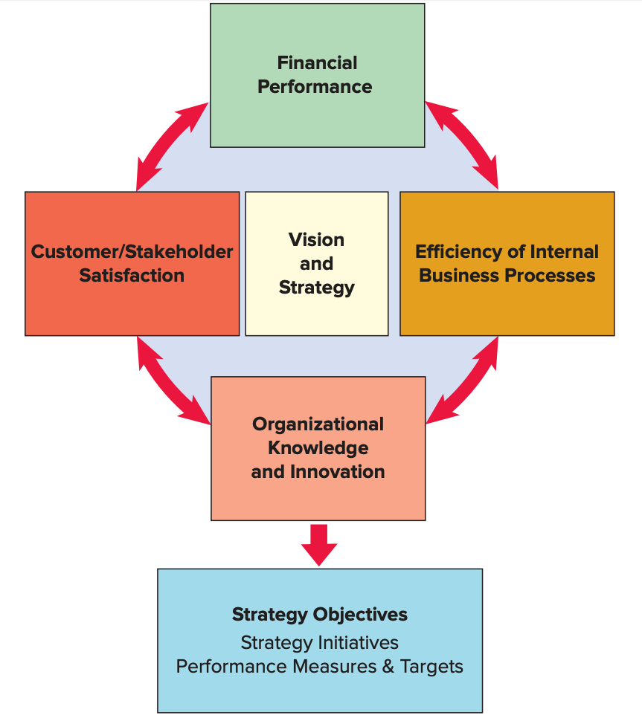
The Balanced Scorecard
FIGURE 2.2
The Balanced Scorecard
Source: Adapted from Robert S. Kaplan and David P. Norton, “Using the Balanced Scorecard as a Strategic Management System,” Harvard Business Review (January-Febrary 1996): 76.
LO 2.5
2-28

Slide 29
Productivity
Productivity
A measure of the effective use of resources, usually expressed as the ratio of output to input
Productivity measures are useful for
Tracking an operating unit’s performance over time
Judging the performance of an entire industry or country
LO 2.6
Copyright ©2021 McGraw-Hill Education. All rights reserved. No reproduction or distribution without the prior written consent of McGraw-Hill Education.
2-29

Slide 30
Productivity Measures
LO 2.6
Copyright ©2021 McGraw-Hill Education. All rights reserved. No reproduction or distribution without the prior written consent of McGraw-Hill Education.
2-30

Slide 31
Productivity Calculation Example
Units produced: 5,000
Standard price: $30/unit
Labor input: 500 hours
Cost of labor: $25/hour
Cost of materials: $5,000
Cost of overhead: 2× labor cost
What is the
multifactor productivity?
LO 2.4
Copyright ©2021 McGraw-Hill Education. All rights reserved. No reproduction or distribution without the prior written consent of McGraw-Hill Education.
2-31

Slide 32
Solution
What is the implication of an unitless measure of productivity?
LO 2.6
Copyright ©2021 McGraw-Hill Education. All rights reserved. No reproduction or distribution without the prior written consent of McGraw-Hill Education.
2-32

Slide 33
Productivity Growth
Example: Labor productivity on the ABC assembly line was 25 units per hour in 2014. In 2015, labor productivity was 23 units per hour. What was the productivity growth from 2014 to 2015?
LO 2.6
2-33

