Slide 1
CHILDREN Fifteenth Edition
JOHN W. SANTROCK
JENNIFER E. LANSFORD
KIRBY DEATER-DECKARD
Copyright 2022 © McGraw Hill LLC. All rights reserved. No reproduction or distribution without the prior written consent of McGraw Hill LLC.

Slide 2
Chapter 2
Biological Beginnings
Copyright 2022 © McGraw Hill LLC. All rights reserved. No reproduction or distribution without the prior written consent of McGraw Hill LLC.

Slide 3
Learning Goals
Discuss the evolutionary perspective on development.
Describe what genes are and how they influence human development.
Identify some important reproductive challenges and choices.
Characterize some of the ways that heredity and environment interact to produce individual differences in development.

Slide 4
What Is the Evolutionary Perspective?
Natural selection and adaptive behavior:
Natural selection is the evolutionary process by which those individuals of a species that are best adapted are the ones that survive and reproduce.
Charles Darwin, in On the Origin of Species, observed survivors are better adapted to their world.
All organisms must adapt to particular places, climates, food sources, and ways of life.

Slide 5
Evolutionary Psychology
Evolutionary psychology emphasizes the importance of adaptation, reproduction, and “survival of the fittest” in shaping behavior.
“Fit” refers to the ability to bear offspring that survive long enough to bear offspring of their own.
Natural selection favors behaviors that increase reproductive success.

Slide 6
Evolutionary Developmental Psychology
There is growing interest in using evolutionary psychology to understand human development.
Possibility that our extended childhood evolved to allow larger the human brain time to grow.
Many evolved psychological mechanisms are domain-specific.
Evolved mechanisms are not always adaptive in contemporary society.

Slide 7
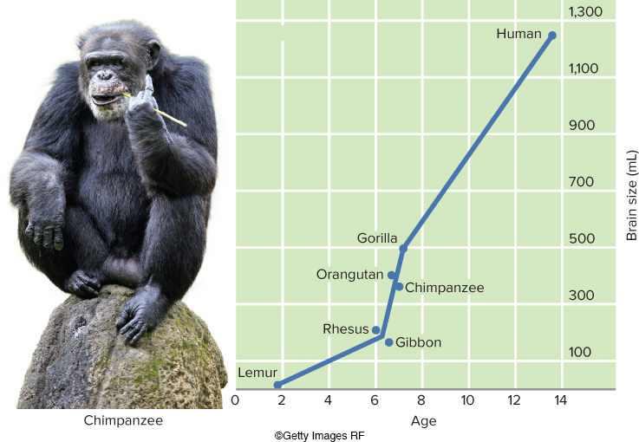
Figure 1 The Brain Sizes of Various Primates and Humans in Relation to the Length of the Childhood Period
Compared with other primates, humans have both a larger brain and a longer childhood period.
Access the text alternative to slide image
Source: Bonner, J., “Brain Sizes of Various Primates and Humans,” in The Evolution of Culture in Animals, Princeton, NJ: Princeton University Press, 1983. Tier Und Naturfotografie J und C Sohns/Getty Images

Slide 8
Evaluating Evolutionary Psychology
Evolutionary psychology remains just one theoretical approach among many.
Evolution gives us bodily structures and biological potentialities but does not dictate behavior.

Slide 9
What Are the Genetic Foundations of Development?
Nucleus of each human cell contains chromosomes.
Chromosomes: threadlike structures made up of deoxyribonucleic acid, or DNA.
DNA: a complex molecule with a double helix shape that contains genetic information.
Genes: units of hereditary information composed of DNA that help cells to reproduce themselves and manufacture the proteins that maintain life.

Slide 10
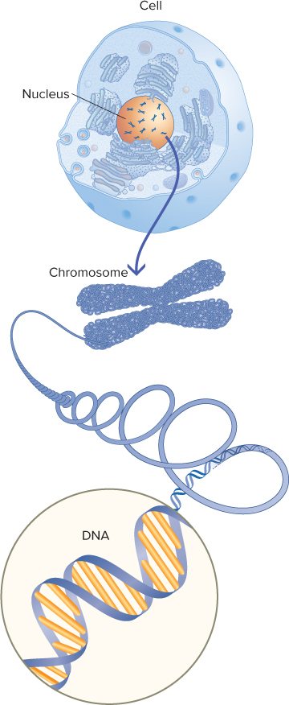
Figure 2 Cells, Chromosomes, DNA, and Genes
(Top) The body contains trillions of cells. Each cell contains a central structure, the nucleus. (Middle) Chromosomes are threadlike structures located in the nucleus of the cell. Chromosomes are composed of DNA. (Bottom) DNA has the structure of a spiral staircase. A gene is a segment of DNA.

Slide 11
The Collaborative Gene
Major approaches to gene identification and discovery:
Genome-wide association method, used in the Human Genome Project.
Linkage analysis.
Next-generation sequencing.
Thousand Genomes Project.
Human genome consists of many genes that collaborate with each other and with nongenetic factors inside and outside the body.

Slide 12
Genes and Chromosomes 1
How do genes get passed from generation to generation?
Mitosis: cellular reproduction in which the cell’s nucleus duplicates itself, with two new cells being formed.
Each contains the same DNA as the parent cell, arranged in the same 23 pairs of chromosomes.
Meiosis: a specialized form of cell division that occurs to form eggs and sperm (or gametes).

Slide 13
Genes and Chromosomes 2
Fertilization: a stage in reproduction whereby an egg and a sperm fuse to create a single cell, called a zygote.
Zygote: a single cell formed through fertilization.
23 pairs of chromosomes.
One chromosome for each pair comes from the mother’s egg and the other from the father’s sperm.

Slide 14
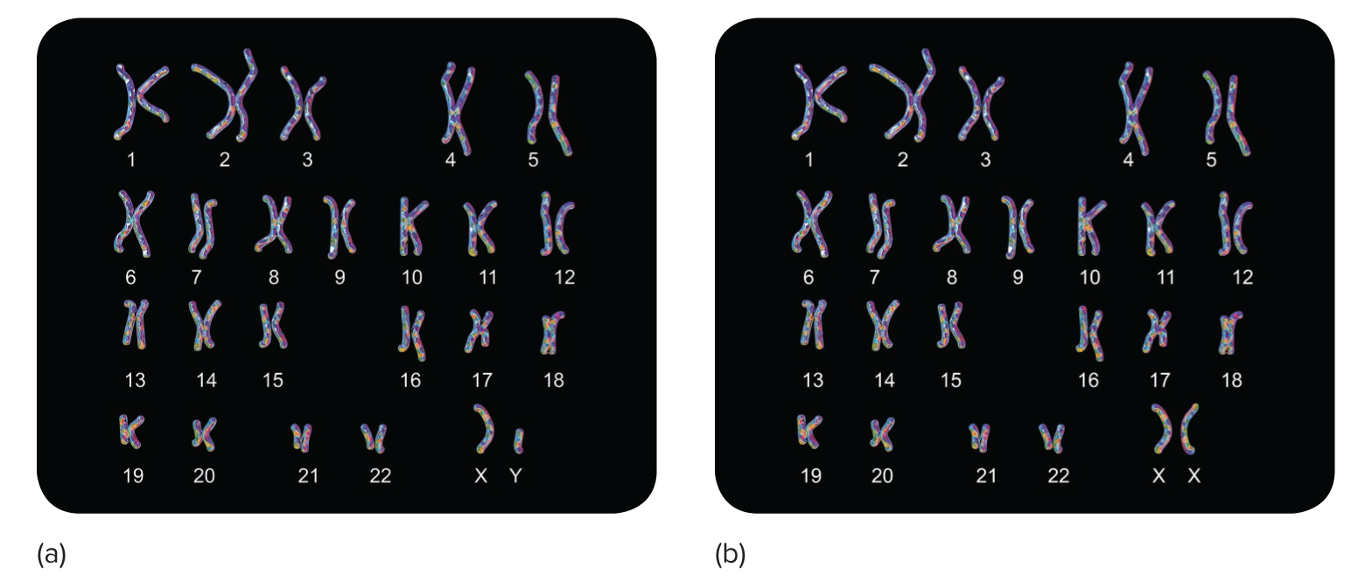
Figure 4 The Genetic Difference Between Males and Females
Set (a) shows the chromosome structure of a male, and set (b) shows the chromosome structure of a female. The last pair of 23 pairs of chromosomes is in the bottom right box of each set. Notice that the Y chromosome of the male is smaller than the X chromosome of the female. To obtain this kind of chromosomal picture, a cell is removed from a person’s body, usually from the inside of the mouth. The chromosomes are stained by chemical treatment, magnified extensively, and then photographed.
Kateryna Kon/Shutterstock

Slide 15
Sources of Variability 1
Chromosomes in the zygote are not exact copies of those in the mother’s ovaries and the father’s testes.
Monozygotic (identical) twins develop from a single zygote, while fraternal (dizygotic) twins develop when two eggs are each fertilized by a different sperm.
Chance, a mistake by cellular machinery, or damage from an environmental agent may produce a mutated gene, which is a permanently altered segment of DNA.

Slide 16
Sources of Variability 2
For each genotype, a range of phenotypes can be expressed.
Genotype: a person’s genetic heritage; the actual genetic material.
Phenotype: the way an individual’s genotype is expressed in observed and measurable characteristics.
Examples: height, weight, hair color.

Slide 17
Genetic Principles 1
Dominant-recessive genes principle: a recessive gene is influential only if the two genes of a pair are both recessive.
Dominant genes: brown hair, farsightedness, and dimples.
Recessive genes: blond hair, nearsightedness, and freckles.
Sex-linked genes: when a mutated gene is carried on the X chromosome, the result is called X-linked inheritance.
Implications for males may be very different from those for females.

Slide 18
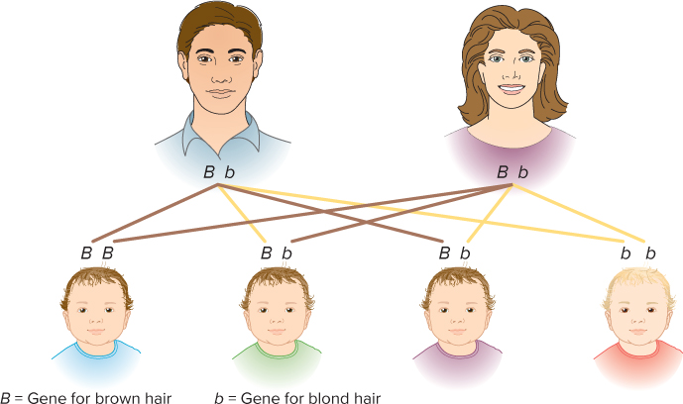
Figure 5 How Brown-Haired Parents Can Have a Blond-Haired Child
In this example, both parents have brown hair, but each parent carries the recessive gene for blond hair. The odds of their child having blond hair is one in four—the probability the child will receive a recessive gene (b) from each parent.
Access the text alternative to slide image

Slide 19
Genetic Principles 2
Genetic imprinting occurs when genes have differing effects depending on whether they are inherited from the mother or the father.
Polygenic inheritance occurs when most characteristics are determined by the interaction of many different genes.
Gene-gene interaction describes studies that focus on the interdependence of two or more genes.

Slide 20
Chromosomal and Gene-Linked Abnormalities
Some abnormalities occur when whole chromosomes do not separate properly during meiosis.
Other abnormalities are produced by harmful genes.

Slide 21
Figure 6 Some Chromosomal Abnormalities
Name | Description | Treatment | Incidence
Down syndrome | An extra chromosome causes mild to severe intellectual disability and physical abnormalities. | Surgery, early intervention, infant stimulation, and special learning programs | 1 in 1,900 births at age 20. 1 in 300 births at age 35. 1 in 30 births at age 45.
Klinefelter syndrome (XXY) | An extra X chromosome causes physical abnormalities. | Hormone therapy can be effective | 1 in 1000 male births.
Fragile X syndrome | An abnormality in the X chromosome can cause intellectual disability, learning disabilities, or short attention span. | Special education, speech and language therapy | More common in males than in females
Turner syndrome (XO) | A missing X chromosome in females can cause intellectual disability and sexual underdevelopment. | Hormone therapy in childhood and puberty | 1 in 2,500 female births.
XYY syndrome | An extra Y chromosome can cause above-average height. | No special treatment required | 1 in 1,000 male births
Table divided into four columns summarizes five chromosomal abnormalities. The column headers are marked from left to right as: Name, description, treatment, and incidence.
The treatments for these abnormalities do not necessarily erase the problem but may improve the individual’s adaptive behavior and quality of life.

Slide 22
Figure 7 Some Gene-Linked Abnormalities
Name | Description | Treatment | Incidence
Cystic fibrosis | Glandular dysfunction that interferes with mucus production; breathing and digestion are hampered, resulting in a shortened life span | Physical and oxygen therapy, synthetic enzymes, and antibiotics; most individuals live to middle age | 1 in 2,000 births
Diabetes | Body does not produce enough insulin, which causes abnormal metabolism of sugar | Early onset can be fatal unless treated with insulin | 1 in 2,500 births
Hemophilia | Delayed blood clotting causes internal and external bleeding | Blood transfusions/injections can reduce or prevent damage due to internal bleeding | 1 in 10,000 males
Huntington’s disease | Central nervous system deteriorates, producing problems in muscle coordination and mental deterioration | Does not usually appear until age 35 or older; death likely 10 to 20 years after symptoms appear | 1 in 20,000 births
Phenylketonuria (PKU) | Metabolic disorder that, left untreated, causes intellectual disability | Special diet can result in average intelligence and normal life span | 1 in 10,000 to 1 in 20,000 births
Sickle-cell anemia | Blood disorder that limits the body’s oxygen supply; it can cause joint swelling, as well as heart and kidney failure | Penicillin, medication for pain, antibiotics, and blood transfusions | 1 in 400 African American children (lower among other groups)
Spina bifida | Neural tube disorder that causes brain and spine abnormalities | Corrective surgery at birth, orthopedic devices, and physical/medical therapy | 2 in 1,000 births
Tay-Sachs disease | Deceleration of mental and physical development caused by an accumulation of lipids in the nervous system | Medication and special diet are used, but death is likely by 5 years of age | 1 in 30 American Jews is a carrier
Table divided into four columns summarizes eight gene-linked abnormalities. The column headers are marked from left to right as: Name, description, treatment, and incidence.

Slide 23
Prenatal Diagnostic Tests 1
Ultrasound sonography is a prenatal medical procedure in which high frequency sound waves are directed into the pregnant woman’s abdomen.
A fetal MRI uses a powerful magnet and radio images to generate detailed images of the body’s organ and structures.

Slide 24
Prenatal Diagnostic Tests 2
Chorionic villus sampling is a prenatal medical procedure in which a small sample of the placenta is removed.
Between 9.5 and 12.5 weeks of pregnancy.
Amniocentesis is a prenatal medical procedure in which a sample of amniotic fluid is withdrawn by syringe and tested for chromosomal or metabolic disorders.
Between the 14th and 20th weeks of pregnancy.

Slide 25
Prenatal Diagnostic Tests 3
Maternal blood screening identifies pregnancies that have an elevated risk for birth defects such as spina bifida and Down syndrome.
During the 16th to 18th weeks of pregnancy.
Current test is the triple screen, measuring three substances in the blood.
Fetal sex determination:
Noninvasive techniques have been able to determine the sex of the fetus at an earlier point by assessing cell-free DNA in maternal plasma.

Slide 26
Infertility and Reproductive Technology
Infertility is defined as the inability to conceive after 12 months of regular intercourse without contraception.
Cause can rest with the woman or with the man.
More than 2 million couples seek help each year in the United States.
Treatments range from surgery to hormone-based drugs.
In vitro fertilization (IVF): eggs and sperm are combined in a laboratory dish and transferred into the women’s uterus.
One result of treatment is an increased likelihood of multiple births.

Slide 27
Adoption
Adoption is the social and legal process by which a parent-child relationship is established between persons unrelated at birth.
Internationally adopted adolescents are at a higher risk for mental health problems than their non-adopted counterparts; however, they fare much better than those in long term foster care or in an institutional environment.

Slide 28
How Do Heredity and Environment Interact?
Behavior genetics is the field that seeks to discover the influence of heredity and environment on individual differences in human traits and development.
Key research question: to what extent do people differ because of differences in genes, environment, or a combination of these?

Slide 29
Behavior Genetics
Twin study: a study in which the behavioral similarity of identical twins is compared with the behavioral similarity of fraternal twins.
Adoption study: a study in which investigators seek to discover whether, in behavior and psychological characteristics, adopted children are more like their adoptive parents or more like their biological parents.
Can also compare adopted and biological siblings.

Slide 30
Heredity-Environment Correlations
In heredity-environment correlations, individuals’ genes may be systematically related to the types of environments to which they are exposed.
Passive genotype-environment correlations.
Evocative genotype-environment correlations.
Active (niche-picking) genotype-environment correlations.

Slide 31
Figure 11 Exploring Heredity-Environment Correlations
Heredity-Environment Correlation | Description | Examples
Passive | Children inherit genetic tendencies from their parents, and parents also provide an environment that matches their own genetic tendencies. | Musically inclined parents usually have musically inclined children and they are likely to provide an environment rich in music for their children.
Evocative | The child’s genetic tendencies elicit stimulation from the environment that supports a particular trait. Thus genes evoke environmental support. | A happy, outgoing child elicits smiles and friendly responses from others.
Active (niche-picking) | Children actively seek out “niches” in their environment that reflect their own interests and talents and are thus in accord with their genotype. | Libraries, sports fields, and a store with musical instruments are examples of environmental niches children might seek out if they have intellectual interests in books, talent in sports, or musical talents, respectively.
Table divided into three columns summarizes three types of heredity-environment correlations. The column headers are marked from left to right as: Heredity-environment correlation, description, and examples.

Slide 32
The Epigenetic View and Gene × Environment (G × E) Interaction
Epigenetic view: emphasizes that development is the result of an ongoing, bidirectional interchange between heredity and environment.
Gene × Environment (G × E) interaction: the interaction of a specific measured variation in the DNA and a specific measured aspect of the environment.
Actual molecular modification of the DNA strand as a result of environmental inputs.

Slide 33
Conclusions About Heredity-Environment Interaction
Relative contributions of heredity and environment are not additive.
There are no specific percentages.
Complex behaviors are influenced by genes in a way that gives people a propensity for a particular developmental trajectory.

Slide 34
Review
Discuss the evolutionary perspective on development.
Describe what genes are and how they influence human development.
Identify some important reproductive challenges and choices.
Characterize some of the ways that heredity and environment interact to produce individual differences in development.

Slide 35
End of Main Content
Copyright 2022 © McGraw Hill LLC. All rights reserved. No reproduction or distribution without the prior written consent of McGraw Hill LLC.

Slide 36
Accessibility Content: Text Alternatives for Images

Slide 37
Figure 1 The Brain Sizes of Various Primates and Humans in Relation to the Length of the Childhood Period – Text Alternative
Return to parent-slide containing image
A line graph shows the age at which each species is reproductively mature and the approximate brain size.
Lemurs: at 2 years old, with a brain size of less than 50 mL.
Rhesus monkeys: at about 6 years old, with a brain size of about 200 mL.
Gibbons: at 6 to 7 years old, with a brain size of under 200 mL.
Orangutans: at 6 to 7 years old, with a brain size of about 400 mL.
Chimpanzees: at about 7 years old, with a brain size of about 350 mL.
Gorillas: at about 7 years old, with a brain size of about 500 mL.
Humans: at close to 14 years, with a brain size of about 1,250 mL.
Return to parent-slide containing image

Slide 38
Figure 5 How Brown-Haired Parents Can Have a Blond-Haired Child – Text Alternative
Return to parent-slide containing image
Two brown-haired adults are pictured with three brown-haired children and one blond-haired child.
One brown-haired child has received the dominant gene for brown hair (capital B, capital B) from both parents.
One brown-haired child has received the dominant gene for brown hair (capital B) from the mother and the recessive gene for blond hair (lowercase b) from the father.
One brown-haired child has received the dominant gene for brown hair (capital B) from the father and the recessive gene for bond hair (lowercase b) from the mother.
The blond-haired child has received the recessive gene for blond hair (lowercase b, lowercase b) from both parents.
Return to parent-slide containing image

