Slide 1


Parallelization and Distribution of a Python
Machine Learning Pipeline with
Luigi and Kubernetes

Slide 2
Parallelization and Distribution of a Python
Machine Learning Pipeline with
Luigi and Kubernetes

Slide 3
Content
Goal
Used Technology
Use Case
Luigi
Kubernetes
Live Demo
Lessons Learned

Slide 4
Project Goal
Combine Kubernetes and Luigi
Parallelized Pipeline
Faster Preprocessing and Training

Slide 5
Used Technology
Python
Luigi
Docker
Kubernetes
Notes:
*"This dataset contains 1302 labeled sound recordings. Each recording is labeled with the start and end times of sound events from 10 classes: air_conditioner, car_horn, children_playing, dog_bark, drilling, enginge_idling, gun_shot, jackhammer, siren, and street_music. Each recording may contain multiple sound events, but for each file only events from a single class are labeled."* [Urban Sound Dataset](https://urbansounddataset.weebly.com/urbansound.html)

Slide 6
Use Case
Classify Sounds
Dataset¹
Amount Features 1302
Amount Classes: 10
Include Labels (air_conditioner, children_playing, dog_bark, …)
Notes:
*"This dataset contains 1302 labeled sound recordings. Each recording is labeled with the start and end times of sound events from 10 classes: air_conditioner, car_horn, children_playing, dog_bark, drilling, enginge_idling, gun_shot, jackhammer, siren, and street_music. Each recording may contain multiple sound events, but for each file only events from a single class are labeled."* [Urban Sound Dataset](https://urbansounddataset.weebly.com/urbansound.html)

Slide 7
Luigi

Slide 8
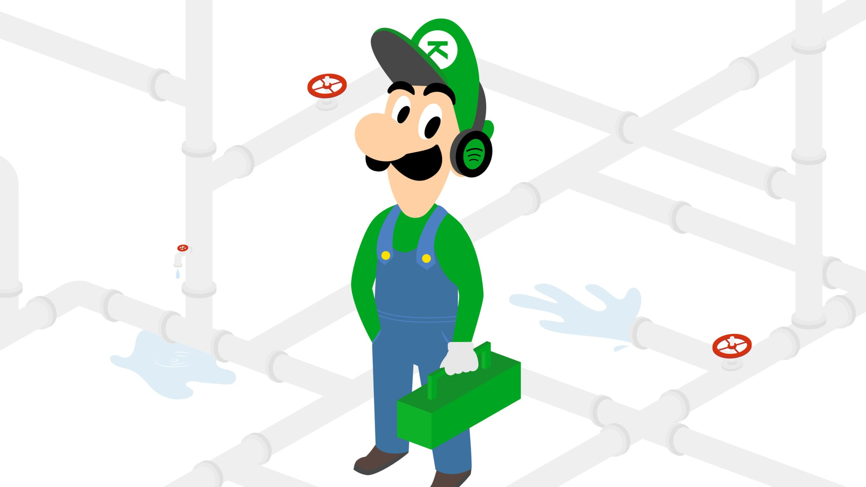
What is Luigi
Pipeline Library completely in Python
Solve pipeline problems associated with long-running batch process
Handles dependency resolution, workflow management and visualization, …¹
Stich many Tasks together
Hadoop support build in¹
Designed by Spotify
Notes:
1: https://github.com/spotify/luigi

Slide 9
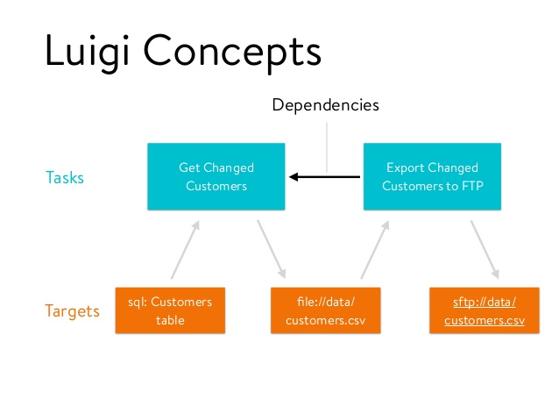
Structure
Tasks and Targets (main Building Blocks)

Slide 10
Elements of Luigi
Targets
Tasks (Nodes)
Parameters

Slide 11
Targets
File usually outputted by a Task
Examples:
LocalTarget → Build in class for reading/writing from/to local filesystem
HdsfTarget → They map on a file on the local drive or a file in HDFS
Luigi.contib.s3.S3Target, luigi.contrib.mysqldb.MySqlTarget
Notes:
LocalTarget … Build in class that makes it easy to read/write from/to the local filesystem.
It also makes all file operations atomic, which is nice in case your script crashes for any reason.

Slide 12
Tasks
Performs computations and consumes Targets, which are generated by other Tasks.
Elements:
Requires() …Calls an other Luigi Task, to define dependencies between Tasks.
Run() … Methods to be executed should be written here.
Output() … Returns one or more Taget objects (CSV file, …)

Slide 13
Task cont
A Task could be:
Machine Learning Algorithms
Hive query
Hadoop job in Java
Spark job in Scala or Python
…

Slide 14
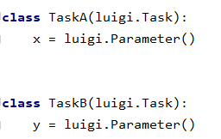
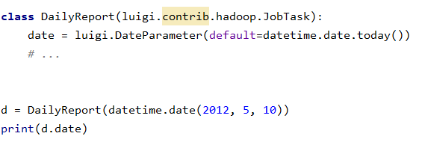
Parameter
Can be seen as a constructor for each Task.
Types:
KubernetesJobTask - Kubernetes Job wrapper for Luigi.
Subclasses: DateParameter, DateIntervalParameter, etc.
Not necessary to specify the type - if you don`t care you can simple use the base class Parameter
Notes:
The Task class corresponds to some type of job that is run, but in general you want to allow some form of parameterization of it. For instance, if your Task class runs a Hadoop job to create a report every night, you probably want to make the date a parameter of the class. See Parameters for more info.
KubernetesJobTask Kubernetes Job wrapper for Luigi.

Slide 15
Execution of Tasks

Slide 16
Execution of Tasks
Process of workflow is backword
First the last task will be executed, then they will be executed in the correct order
Why? → To avoid to re-run a task which is already satisfied

Slide 17
Execution of Tasks cont
Start
Task C
Task B
Task A
Task B
Task C
End
No Error

Slide 18
Execution of Tasks cont
Start
Task C
Task B
Task A
(done)
Task B
(error)
Task C
End (error)
Run 1
Start
Task C
Task B
Task C
End
Run 2
error but no need to run Task A entirely

Slide 19
Luigi at Spotify
What they use it for

Slide 20
What do Spotify use Luigi for?
Music Recommendations
A/B Testing
Top Lists
Label Reporting
Dashboards

Slide 21
Live Demo
Kubernetes
Notes:
@Dominik!!

Slide 22
Lessons Learned
Notes:
@Dominik!!

Slide 23
Lessons Learned
Docker aufsetzten
Notes:
Docker aufsetzten (Surface)

Slide 24

Any
Questions?

Slide 25
Additional Information
Visualizer Page
Dependency Graph Example
Example Aritist
Notes:
@dominik: Lass das mal drinnen falls wir das noch brauchen

Slide 26
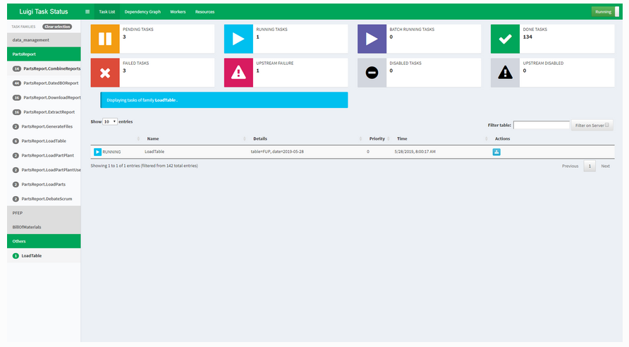
Visualiser Page

Slide 27
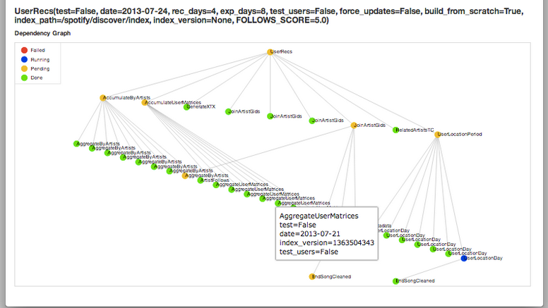
Dependency Graph Example

Slide 28

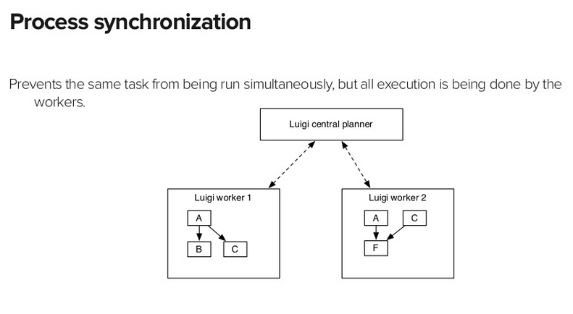
Process Synchronization
Notes:
https://www.slideshare.net/erikbern/luigi-presentation-nyc-data-science

Slide 29
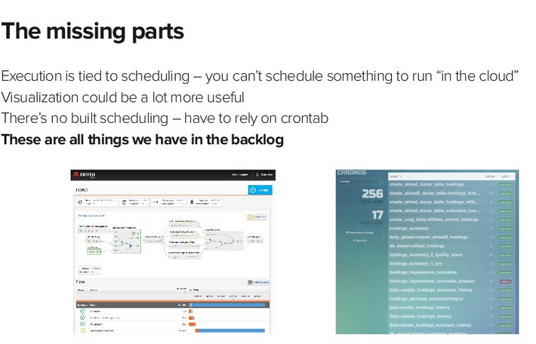
Missing Parts of Luigi
2014
Run Luigi in the Cloud
Backlog
Notes:
https://www.slideshare.net/erikbern/luigi-presentation-nyc-data-science
Slide 63

