Slide 1
Hi!
Find your team number, and sit close to the sign! If you don’t find your name, talk to us!
TTM4115 — Design of Communicating Systems
Table 1
8 | Aarekol | Anna
8 | Aase | Eirik Vale
2 | Aspdal | Sissel-Johanne
13 | Berbom | Sigmund
4 | Berg | Kristina Hovland
8 | Berg | Silje
12 | Bjørnhaug | Sigmund
4 | Bøe | Andreas Skjong
6 | Brandal | Håvard Pedersen
7 | Brandhaug | Martin
1 | Buene | Knut Formo
3 | Christ | Frédéric Tobias
10 | Edvardsen | Kristian Zunder
13 | Eltayeb | Mathani
3 | Espedal | Sjur
7 | Færøy | Fartein
12 | Fredheim | Lars Jørgen
5 | Fredriksen | Mari
4 | Frenje | Marcus
10 | Gnanasekaran | Vahiny
5 | Grimsgaard | Stian Tornholm
3 | Grujic | Luka
4 | Gundersen | Irina
Table 1-1
4 | Gusev | Alexey
9 | Hatlen | Herborg
10 | Henriksen | Ingvild Sørum
3 | Huus | Andrea
2 | in't Veld | Kristian
5 | Janzso | Dennis
12 | Johansen | Filip
1 | Karadan | Farsana
2 | Karlstrøm | Martin Langmo
12 | Kierulf | Alva Herdis
1 | Kohmann | Marius
8 | Kronborg | Henrik
10 | Langdal | Håvard
11 | Larsen | Tuva
1 | Lavre | Helene
11 | Luong | Nhu
6 | Markussen | Thomas
9 | Medakovic | Damir
6 | Medhus | Endre Braut
8 | Molland | Torstein
8 | Myrekrok | Haavard Borgen
13 | Nes | Hanne Æsøy
3 | Ødegaard | Ole Håkon
10 | Olsen | Aleksander
11 | Opheim | Håvard
Table 1-2
7 | Paulsen | Rikke
12 | Plesner | Cornelia Vedeld
9 | Qaq | Hasan
9 | Ramos | Jose
7 | Rey Gallo-Alcántara | Ignacio
6 | Rossow | Christian
7 | Sandberg | Daniel
5 | Sandnes | Miriam Helene
2 | Shan | Zhengyu
5 | Skarnes | Aleksander
6 | Sønsterud | Linn Marie
3 | Sridhar | Sahana
5 | Standal | Anders Grytten
7 | Standeren | Andrea
4 | Stensli | Stian
11 | Styrmoe | Aleksander
2 | Tenold Fridtun | Helga
9 | Thorvik | Tilde
13 | Tjomsland | Håkon
2 | Torgersen | Simen
11 | Vad | Lasse
6 | Vågsdal | Nora
13 | Vang | Trygve
1 | Varhaugvik | Sigurd
9 | Warsame | Mohammed
1 | Weber | Caroline-Milena

Slide 2
Individual RAT
Mobile in flight mode, in your bag.
All bags in front.
No talking.

Slide 3

Individual RAT
A friendly reminder:
Mobile in flight mode, in your bag.
All bags in front.
No talking.

Slide 4
Team RAT
A friendly reminder:
Mobile in flight mode, in your bag.
All bags in front.
No talking across teams.
Break: Once your team delivered, you can take a break outside. Return by 13:15

Slide 5
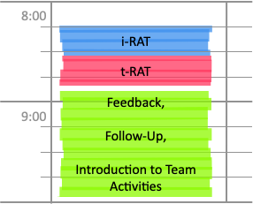

Slide 6



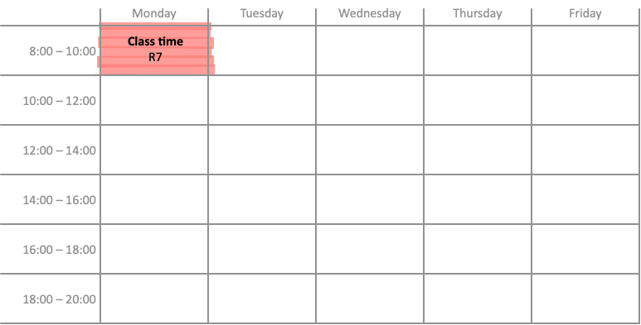
Delivery on BB

Slide 7

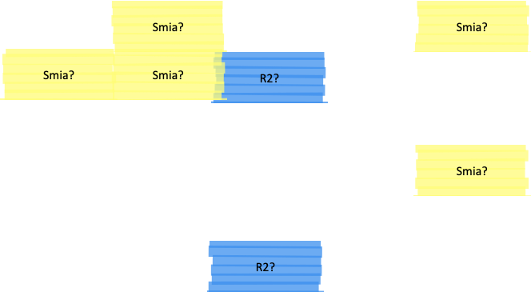
Delivery on BB

