Slide 1
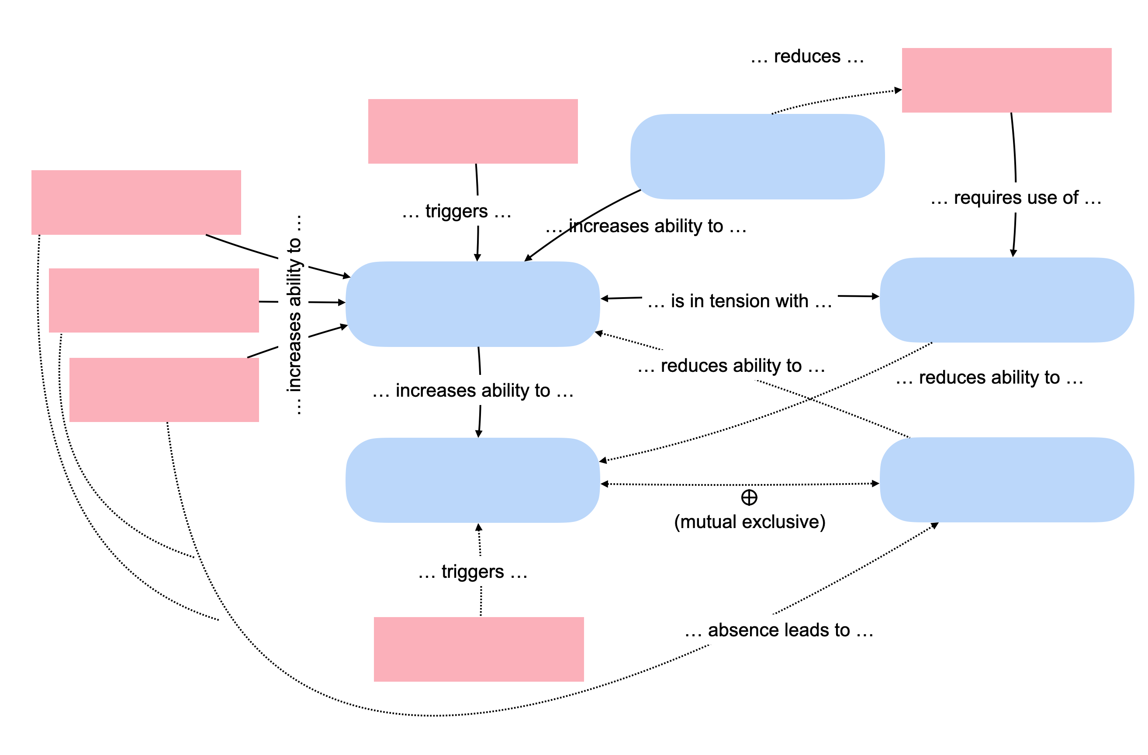
S1: respond to change
S2: address risk
S3: emergent architecture
S4: big design up-front
S5: frameworks and template architectures
F1: requirements instability
F2: technical risk
F3: early value
F4: team culture
F5: customer agility
F6: experience

