Slide 1
Moffat Bay Lodge
Created by, Isaac, Patrice, Jose, and Cannon

Slide 2
Table Of Contents
Team Introduction Slide 3
Project Overview Slide 4
ERD Slide 5
Prototypes Slide 6 - 16
Tests Slide 17 - 18
Demo Slide 19
Unique Code Slide 20 –
Lessons Learned As a Team
What Went Well
What Went Wrong
Conclusion

Slide 3
Team Introduction

Slide 4
Project Overview

Slide 5
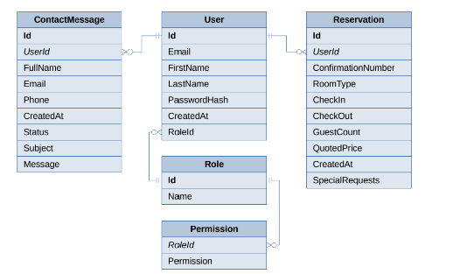
ERD

Slide 6
Prototypes

Slide 7
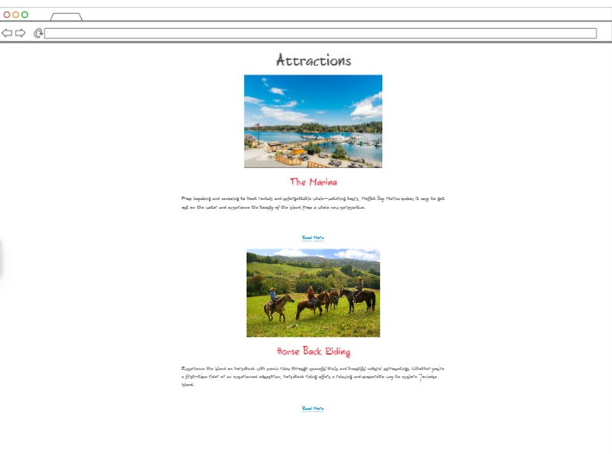

Slide 8
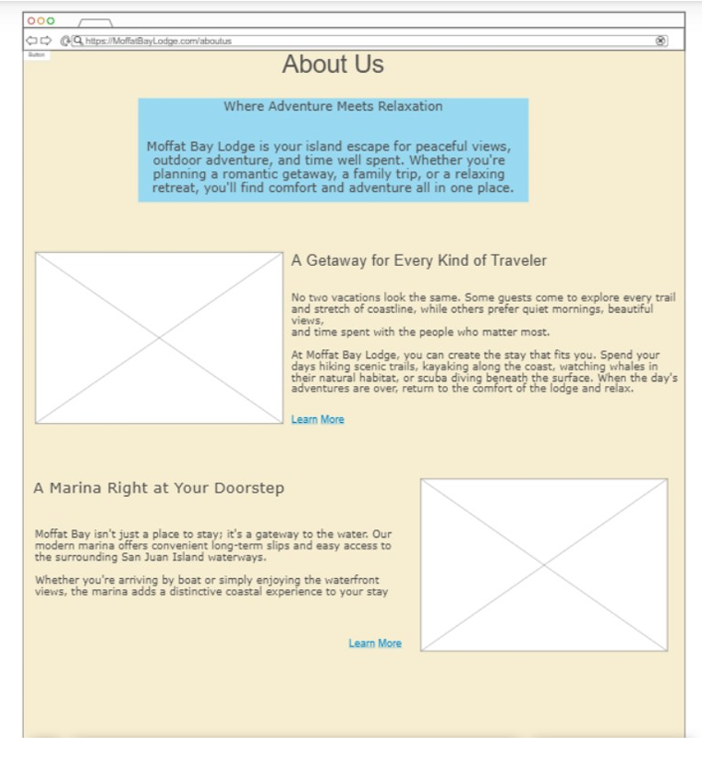

Slide 9
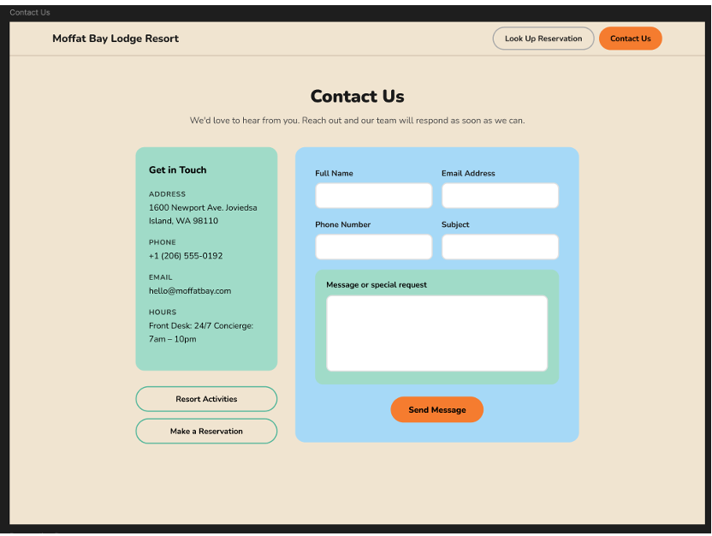

Slide 10
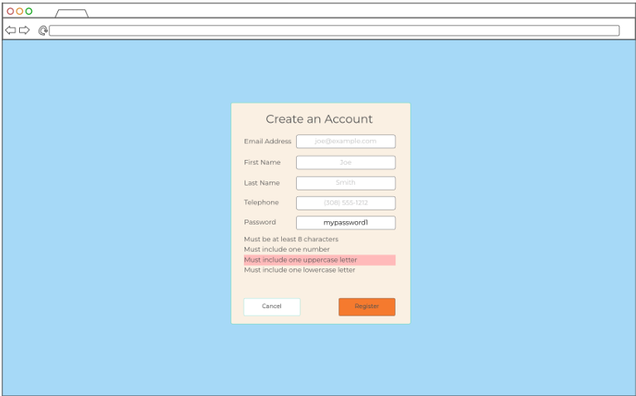

Slide 11
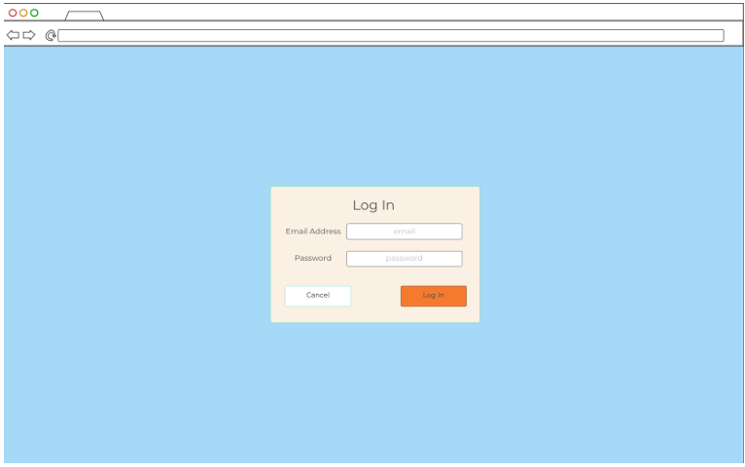

Slide 12
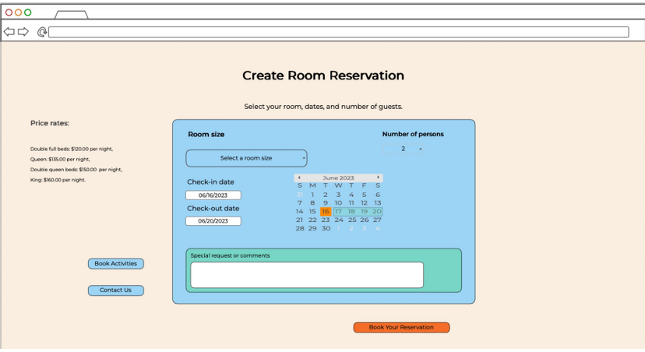

Slide 13
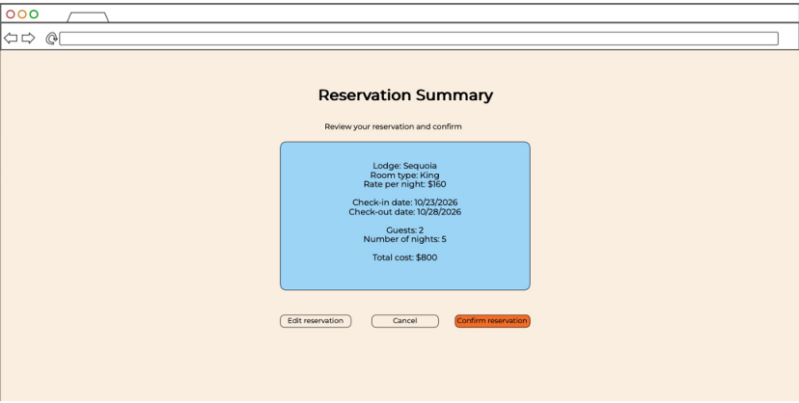

Slide 14
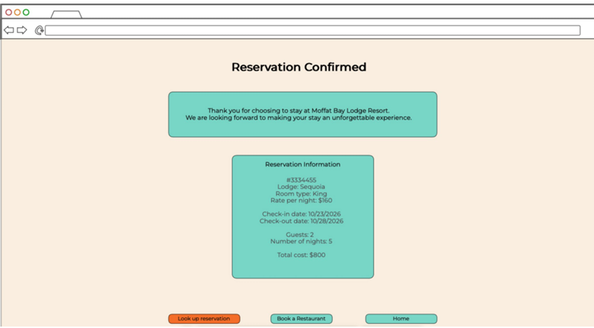

Slide 15
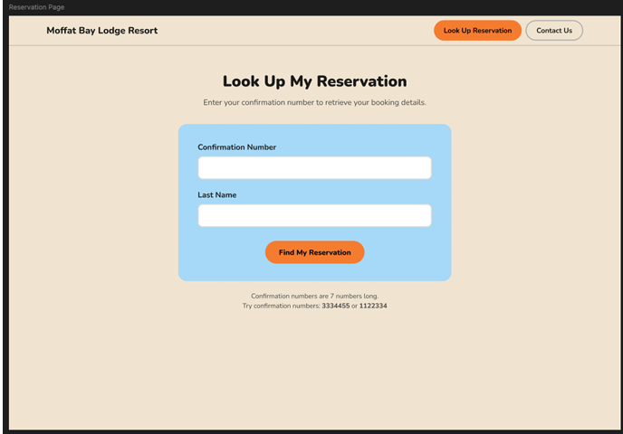

Slide 16
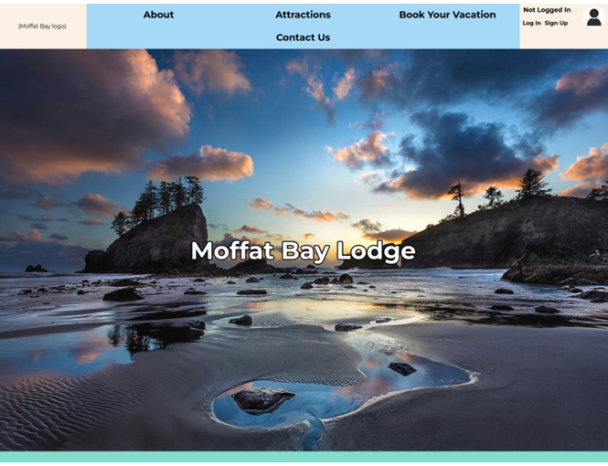

Slide 17
Tests
We created test cases for every page we created for this project.
Here are 5 of the most important tests:
Input Options and Validation
Appropriate Redirection If Not logged In
Contact Us Input and Validation
Reservation Summary and Details
And Reservation Editing and Confirmation
Notes:
All Tests Can be Accessed Here: MoffatBay/tests at main · falkreon/MoffatBay

Slide 18
About These Tests
Notes:
All Tests Can be Accessed Here: MoffatBay/tests at main · falkreon/MoffatBay

Slide 19
Demo
The demo will be hosted locally using Moffat Bay GitHub main data.
Link:

