Slide 1
Moffat Bay Lodge
Created by, Isaac, Patrice, Jose, and Cannon

Slide 2
The Team - Jose
I worked on the Login Page, the Lookup Reservation Page, and an error and confirmation page for the Contact Us Page. Additionally, I helped with the test plans and created the outline for our video.

Slide 3
The Team - Patrice
Hello, this is my first development project as a student.
I participated in the technical design document. I helped create the user personas, user stories, and we all “played” a planning poker session to determine the work tasks.
I then built the reservation, the reservation summary, and the reservation confirmation page mockups
I did some updates to the ERD concerning the RBAC tables.
I then built the 3 reservation pages as mockups with Isaac’s help on the JavaScript parts. I found a new passion for CSS and had a blast through trial and error, especially because it appears on the screen immediately and can be corrected and improved.
I also participated in page testing by creating a test plan and conducting a peer test on another page.
I finally integrated the last-minute client logo on the landing page and performed a beta test with a user.

Slide 4
The Team - Isaac
I wrote the database capability, the user registration page, and the user info widget at the top right corner. I’ve been a security advocate in the team, chasing down anything that smells like a CORS vulnerability or leaky reservation id’s.

Slide 5
Project Overview
The required pages are:
A landing page for marketing the lodge.
An About Us page.
A Contact Us page.
An Attractions page that includes hiking, kayaking, whale watching, and scuba diving.
A Registration page.
A Login page.
A Reservation/Book Your Vacation page.
A Reservation Summary page.
A Reservation Lookup page.

Slide 6
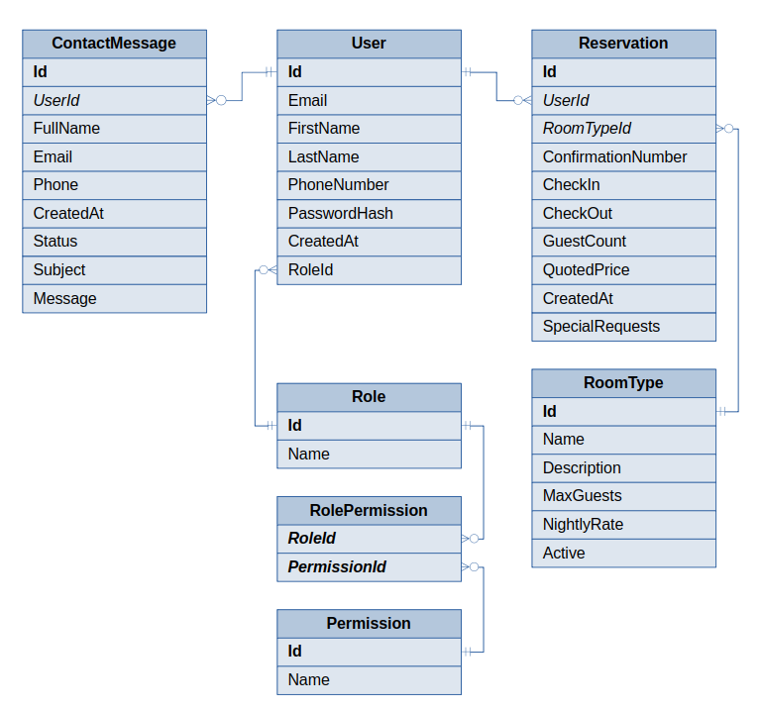
ERD
Contact Messages can be created from users and nonusers.
Reservations require Users to login before being created.
Roles create a way to give access to employees and admins to guests info/reservations for changes or upgrades.

Slide 7
Prototypes

Slide 8
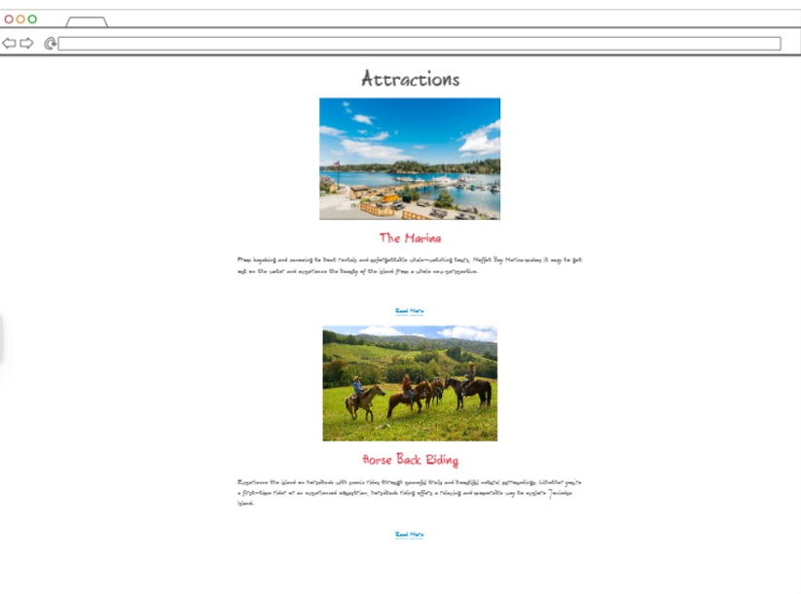

Slide 9
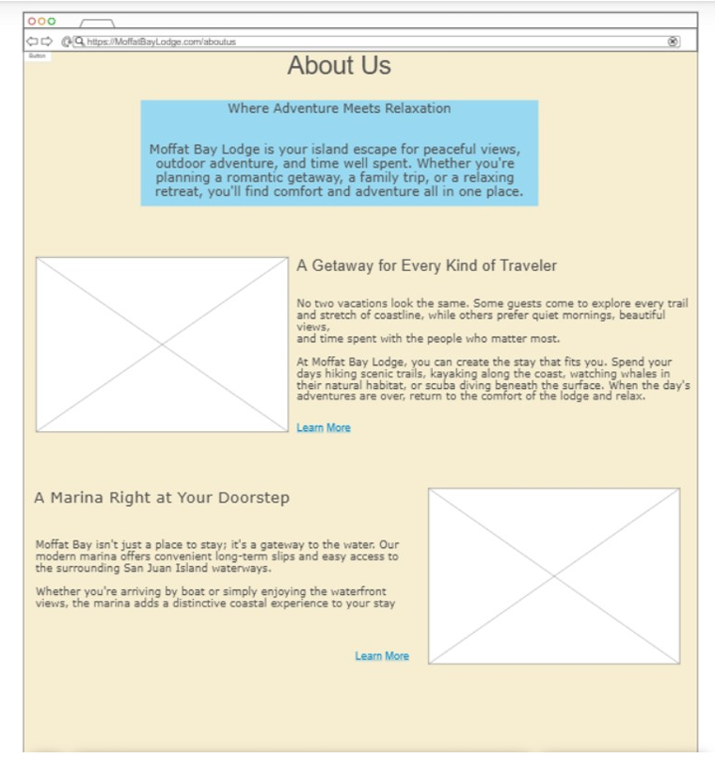

Slide 10
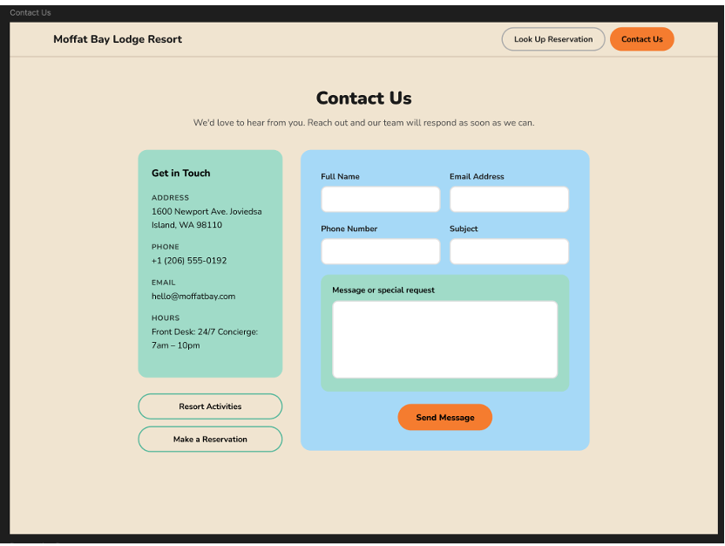

Slide 11
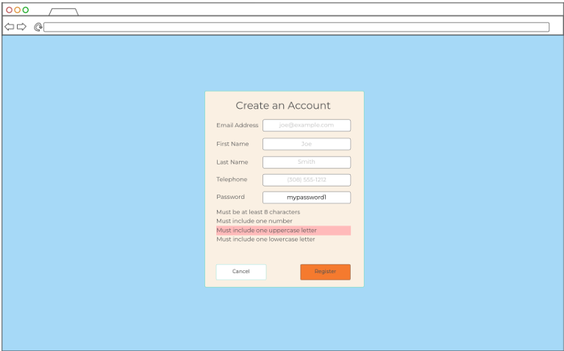

Slide 12
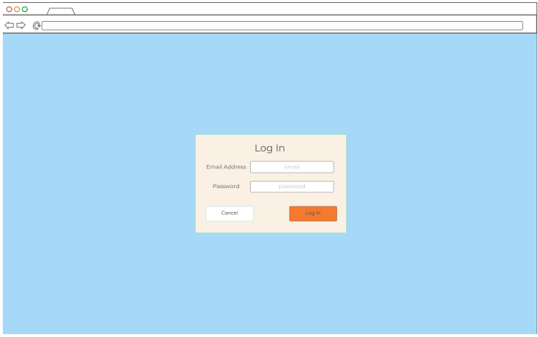

Slide 13
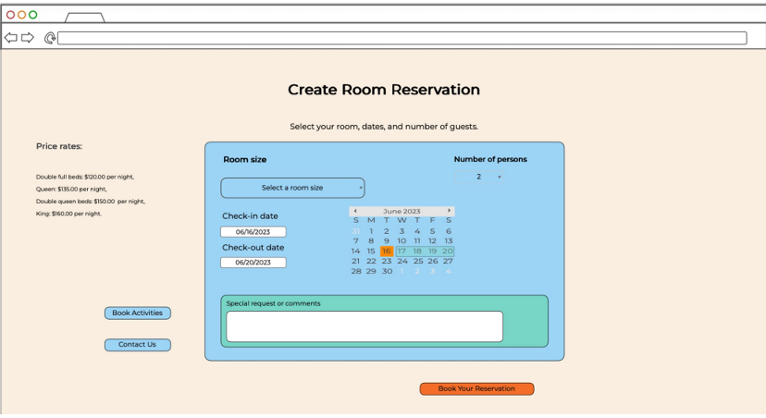

Slide 14
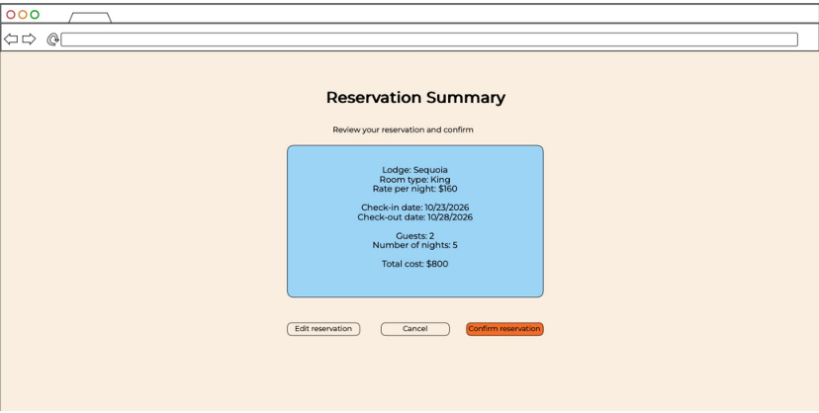

Slide 15
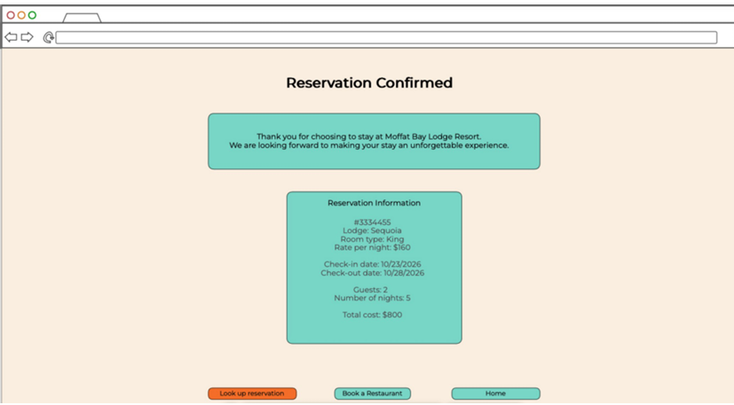

Slide 16
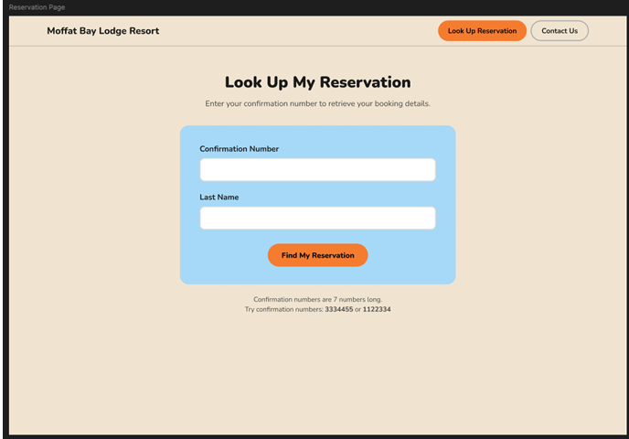

Slide 17
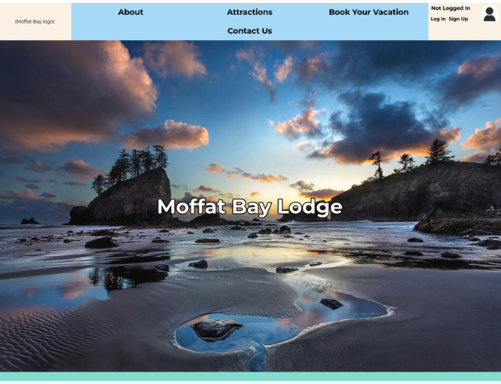

Slide 18
Tests
Test: Verify that all text and images load properly on the Attractions Page
Test passed. Tester noted concerns about reactivity. Page later confirmed to display well on mobile devices.
Notes:
All Tests Can be Accessed Here: MoffatBay/tests at main · falkreon/MoffatBay

Slide 19
Tests
Test: Verify that the Contact Us form correctly validates required information, rejects invalid entries, and successfully submits valid contact information.
Test failed. Page rejected invalid information and accepted valid information. Contact messages appeared in the database. However, no redirect happened, so the user arrived at a blank page.
Notes:
All Tests Can be Accessed Here: MoffatBay/tests at main · falkreon/MoffatBay

Slide 20
Tests
Test: Ensure user is able to input data for registration, and data is saved to database when submit is clicked.
Test passed. Tester noted that page did a good job of giving validation feedback, and the form was easy to understand.
Notes:
All Tests Can be Accessed Here: MoffatBay/tests at main · falkreon/MoffatBay

Slide 21
Tests
Test: Ensure that using an MBR number on the Reservation Look-Up page brings up reservation details associated with it.
Test passed. Not only was MBR able to be loaded without error, but invalid entry showed an error directly on the lookup page.
Notes:
All Tests Can be Accessed Here: MoffatBay/tests at main · falkreon/MoffatBay

Slide 22
Demo
You should have received a demo video in the previous post.

Slide 23
What Went Right
We maintained strong communication and consistently stayed in touch throughout the project.
We used GitHub effectively and followed a well-organized, structured branching system.
We worked hard to meet the client’s expectations and quickly implemented any changes or feedback they requested.
We divided the workload fairly and consistently completed our assigned tasks on schedule.

Slide 24
Lessons Learned As A Team
Isaac-
I think Trunk Based Development worked out really well for us, and I'd recommend it to similar groups in the future. It gave us a really tight loop with a lot of review opportunities in it.,
Testing was a real surprise - both peer tests and QA gave us a lot of valuable insight. I often don't have access to as many testers as I'd like, and this really showed what kind of quality improvements you can get from them.

Slide 25
Lessons Learned As A Team
Patrice-
This was my first project so i learned during the whole process and i put a "face" on everything we learned during the year. even if we had assignments it's very different to do it in a project and a team setting. I learned to listen and take everyone point of view. Still have work to do on that part though.

Slide 26
Lessons Learned As A Team
Jose-
I learned many things during this project, but the biggest was collaborating on a coding project with multiple people. I had never done anything like that, so it was great to see how each person worked on their part before we all merged everything.
I learned many new techniques from my peers. We all write code slightly differently, so it was nice to pick up some new ideas. It was interesting to see how we all worked as individuals, but then came together to make edits and see the project through to the end.
Additionally, I learned how to use GitHub. I have not had many projects using the site and all of its features. The site guided us through this process. I will continue to use it for future projects and learn more.

Slide 27
Thank You!
Please leave us some feedback in the replies!

