Slide 1
WezTerm
Conceptual Architecture Overview
CISC 322 • Assignment 1
Group 17: We can fly
https://youtu.be/BeAer5_p0Yg
October 6, 2026
01
Notes:
中文讲解：大家好，我们是第17组 We can fly，今天介绍 WezTerm 的概念架构。
Source: CISC 322 Assignment 1 Report(1).pdf

Slide 2
Group Members
Lingwei Huang: Control & Data Flow, Concurrency, Non-Functional Requirements
Kylin Jin: User Case & Sequence Diagram 1 / Presenter
Bei Lin: User Case & Sequence Diagram 2 / Presenter
Krystal Sun: Conceptual Architecture
Yun Zhang: Abstract, Introduction, Data Dictionary and Naming Conventions, Conclusion and Lesson Learnt, AI Collaboration Report / Group Leader
Hongtian Zhao: WezTerm Overview

Slide 3
Project Scope
Cross-platform terminal emulator and multiplexer, primarily written in Rust
Documentation-based recovery of major responsibilities and interactions
Six conceptual subsystems, with the multiplexer as the coordination point
A foundation for comparing the conceptual model with source code in A2
02
Notes:
中文讲解：我们根据文档恢复概念架构，研究主要职责与交互。具体类、函数、线程与同步实现留到A2验证。
Source: CISC 322 Assignment 1 Report(1).pdf

Slide 4
System Functionality
Main functions
Key capabilities
Terminal Emulation
GPU-accelerated rendering
Ligatures and color emoji
True color and hyperlinks
Searchable scrollback
Terminal graphics
Terminal Multiplexing
Remote Access
Serial Communication
Configuration & Customization
03
Notes:
中文讲解：五个主要功能是终端模拟、多会话管理、远程访问、串口通信和配置。显示能力包括GPU加速、连字、彩色表情、真彩色、超链接、历史搜索与终端图形。
Source: CISC322A1Slides.pdf, p. 1

Slide 5
Target Users and Platforms
Users
Platforms
Workflows
Developers
System administrators
DevOps engineers
Linux and macOS
Windows
FreeBSD and NetBSD
Local command-line work
SSH to remote systems
Serial device communication
Lua customization
04
Notes:
中文讲解：面向开发者、系统管理员和DevOps。支持Linux、macOS、Windows、FreeBSD与NetBSD。SSH适合远程工作，串口适合嵌入式设备，Lua支持自定义与自动化。
Source: CISC 322 Assignment 1 Report(1).pdf

Slide 6
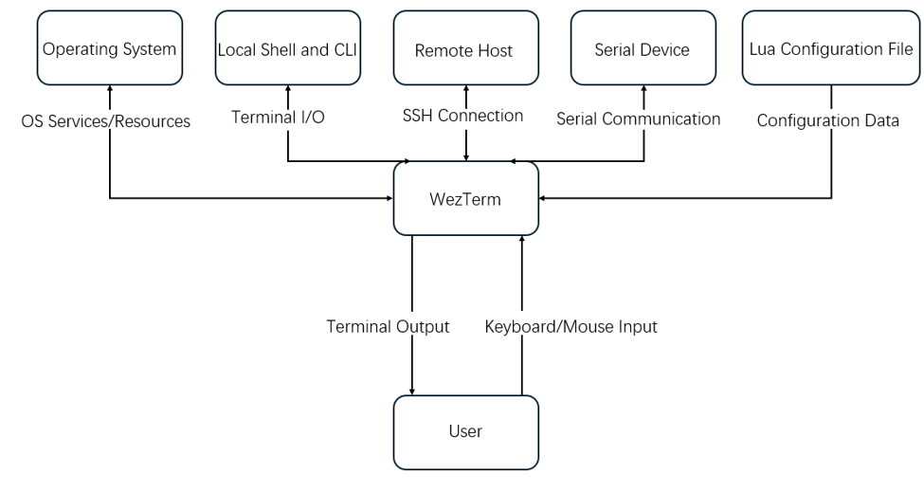
System Boundary and External Interfaces
User
Operating system
Local shells and CLI
Remote hosts
Serial devices
Lua configuration file
05
Notes:
中文讲解：系统外部包括用户、操作系统、本地Shell与CLI、远程主机、串口设备与Lua配置文件。图中显示系统服务、终端输入输出、SSH、串口和配置接口。
Source: CISC322A1Slides.pdf, pp. 2–3

Slide 7
System Evolution and Developer Responsibilities
Evolution
Development
Late-2019 additions included tabs, hot reloading, SSH and remote multiplexing, serial support, inline images, and software-rendering fallback.
Later work refined configuration, rendering, SSH behavior, and platform integration.
Created by Wez Furlong with contributions from the open-source community.
Responsibilities include core functionality, testing and bug fixes, cross-platform support, and documentation.
06
Notes:
中文讲解：2019年末加入标签页、热重载、SSH与远程复用、串口、内联图像、软件渲染回退等能力。Wez Furlong与开源社区负责核心维护、测试、修复、跨平台支持与文档。
Source: CISC 322 Assignment 1 Report(1).pdf

Slide 8
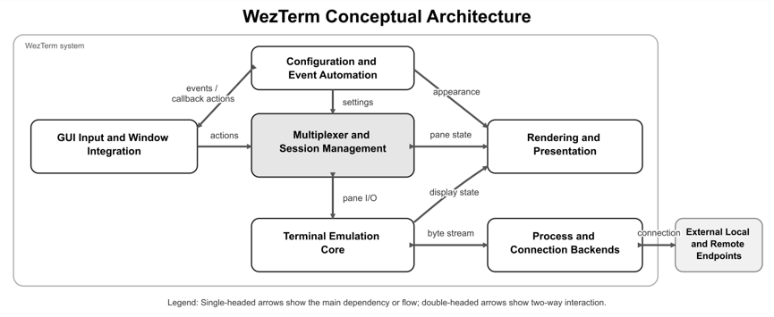
Conceptual Architecture
07
Notes:
中文讲解：六个子系统围绕多路复用器进行协调。会话状态与图形界面概念上分离，支持本地与远程会话。
Source: CISC 322 Assignment 1 Report(1).pdf

Slide 9
Subsystem Responsibilities and Interfaces 1
Subsystem | Responsibility | Main interfaces
Configuration and Event Automation | Loads Lua settings and runs registered callbacks | Configuration table, event API, reload
GUI Input and Window Integration | Represents native windows and user interaction | Keyboard and mouse events, GUI objects, mux actions
Multiplexer and Session Management | Maintains domains, workspaces, windows, tabs, and panes | Mux API, domain connections, pane and window IDs
08
Notes:
中文讲解：本页对应原A1Slides职责与接口表，列出子系统、主要职责和接口。
Source: CISC322A1Slides.pdf, p. 4

Slide 10
Subsystem Responsibilities and Interfaces 2
Subsystem | Responsibility | Main interfaces
Terminal Emulation Core | Parses UTF-8 and control sequences and updates terminal state | Byte stream, terminal cells, pane I/O
Rendering and Presentation | Converts terminal state into visible frames | Display state, OpenGL, WebGPU, software renderer
Process and Connection Backends | Connects panes to local or remote endpoints | PTY, SSH, serial ports, Unix sockets, TLS
09
Notes:
中文讲解：本页对应原A1Slides职责与接口表，列出子系统、主要职责和接口。
Source: CISC322A1Slides.pdf, p. 4

Slide 11
Component Interaction
Configuration
User input
Program output
Evaluates the Lua file and distributes settings.
Can reload configuration or run event handlers.
The GUI checks key assignments.
Configured actions use the mux. Other input becomes bytes sent to the active pane’s PTY.
The terminal core reads the endpoint stream and updates cells.
The renderer draws the next frame.
10
Notes:
中文讲解：启动时处理Lua配置，分发设置，可热重载与执行回调。GUI先检查快捷键，普通输入编码为字节送入活动pane的PTY。输出由终端核心解释、更新cells并由renderer显示。
Source: CISC322A1Slides.pdf, p. 5

Slide 12
Architectural Styles
Loosely layered
Client-server
Implicit invocation
User actions pass through the GUI and mux.
Output passes through the terminal core and renderer.
Direct GUI and Lua access makes the layers less strict.
The GUI acts as the client. The multiplexer manages sessions.
Communication can use SSH, Unix sockets, or TLS.
The Lua event API calls registered callbacks in order.
A callback can stop the callbacks that follow it.
11
Notes:
中文讲解：松散分层允许GUI与Lua跨层访问。客户端服务器模式由GUI连接管理会话的mux，通过SSH、Unix socket或TLS通信。隐式调用由事件触发回调，按顺序调用，某个回调可停止后续回调。
Source: CISC322A1Slides.pdf, p. 6

Slide 13
Architecture Evaluation
Strengths
Limitations
Platform boundaries
GUI, rendering, PTY, and connection details stay near the system boundary.
Separation
The terminal model and mux remain separate from native window operations.
Flexibility
One model supports different platforms and remote sessions.
Additional coupling
Direct GUI access and Lua callbacks weaken layered boundaries.
Central coordination
The multiplexer keeps pane state consistent across several kinds of input. A problem here may affect several features.
12
Notes:
中文讲解：优点是平台边界、职责分离与灵活性。限制是直接GUI访问与Lua回调增加耦合，mux集中协调，故障可能影响多个功能。
Source: CISC322A1Slides.pdf, pp. 7–8

Slide 14
Control Flow and Data Flow
Local input
User → GUI Input Handling → Active Pane → PTY → Shell / Application
Application output
Application → PTY → Pane / Terminal Emulation → GUI / Renderer → Screen
Pane splits and tab switching use mux actions. Remote multiplexing connects the GUI to a remote mux, which manages process I/O at the remote endpoint.
13
Notes:
中文讲解：普通本地输入依次经过用户、GUI、活动pane、PTY和Shell。应用输出通过PTY返回，终端核心更新状态，GUI与渲染器显示。分屏切换标签属于mux操作。远程mux在远端连接进程。
Source: CISC 322 Assignment 1 Report(1).pdf

Slide 15
Concurrency
Concurrent activities
Communication
Architectural impact
Independent programs in multiple panes
User input, terminal output, session management, network communication, and display updates
Local sessions use PTYs.
Remote multiplexing can use Unix-domain sockets, SSH, or TLS.
Synchronization keeps states consistent.
Separate terminal and process state for each pane
Responsiveness, latency, and failure coordination
Exact threading and scheduling require source analysis.
14
Notes:
中文讲解：多个pane同时运行独立程序，用户输入、输出处理、会话管理、网络通信与显示更新可以并发。同步维持状态一致，具体线程和调度机制需A2源代码验证。
Source: CISC 322 Assignment 1 Report(1).pdf

Slide 16
Non-Functional Requirements
Performance: responsive input, efficient output processing, GPU or software rendering
Portability: common terminal model with platform-specific PTY / ConPTY facilities
Modifiability: Lua configuration, custom key bindings, and hot reloading
Testability: separate responsibilities create unit and integration testing boundaries
Reliability and security: persistent remote sessions depend on mode and configuration, with SSH or TLS protecting remote communication
Architectural concerns inferred from documentation, rather than a formal requirements specification
15
Notes:
中文讲解：这些NFR是从文档推导出的架构关注点，不是官方正式需求规格。性能、可移植性、可修改性、可测试性、可靠性与安全性。
Source: CISC 322 Assignment 1 Report(1).pdf

Slide 17
UC-01: Execute a Command in a Local Terminal
Actor and preconditions
Main flow
Alternative and outcome
Actor: user
WezTerm is running with an active local pane, connected PTY, and shell.
Trigger: enter a command.
GUI forwards input to the pane.
PTY delivers it to the shell.
Output returns, terminal state updates, and the GUI displays the result.
An invalid command produces a shell error message.
Output or error follows the same return path.
The session remains active.
16
Notes:
中文讲解：用户输入命令，GUI传入pane，经过PTY到Shell。Shell执行后返回输出或错误，终端模拟器更新状态，显示结果，会话继续运行。
Source: CISC 322 Assignment 1 Report(1).pdf

Slide 18
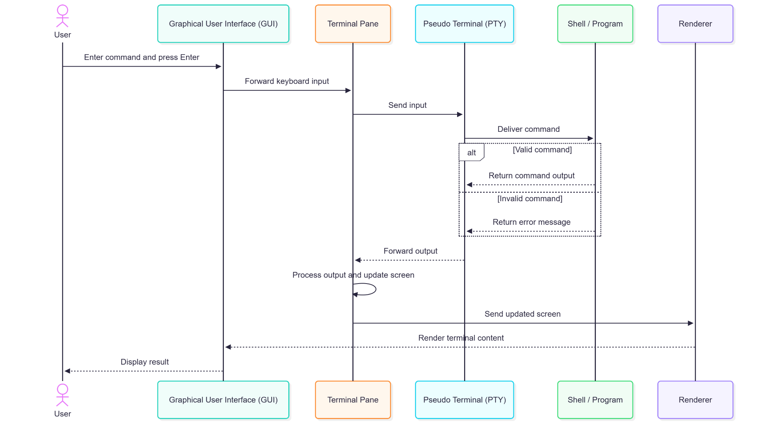
UC-01: Original Sequence Diagram
17
Notes:
中文讲解：沿原图讲解用户、GUI、pane、PTY、Shell与renderer的交互。有效命令与无效命令在Shell分支后通过相同路径返回。
Source: CISC 322 Assignment 1 Report(1).pdf

Slide 19
UC-02: Terminal Input and Output Processing
Trigger and input
Output processing
Presentation and alternatives
An active pane receives I/O.
Pane forwards input to the mux.
Mux writes it to the PTY and shell or program.
Program output returns through the PTY.
Parser interprets bytes and terminal actions.
Screen model updates terminal state.
Mux notifies the renderer.
Errors and escape sequences use the same path.
A closed PTY stops further process output.
18
Notes:
中文讲解：该用例关注内部处理。pane传输入至mux，mux写PTY，程序输出经PTY返回，parser解释字节，screen model更新，mux通知renderer。PTY关闭后不再接收输出。
Source: CISC 322 Assignment 1 Report(1).pdf

Slide 20
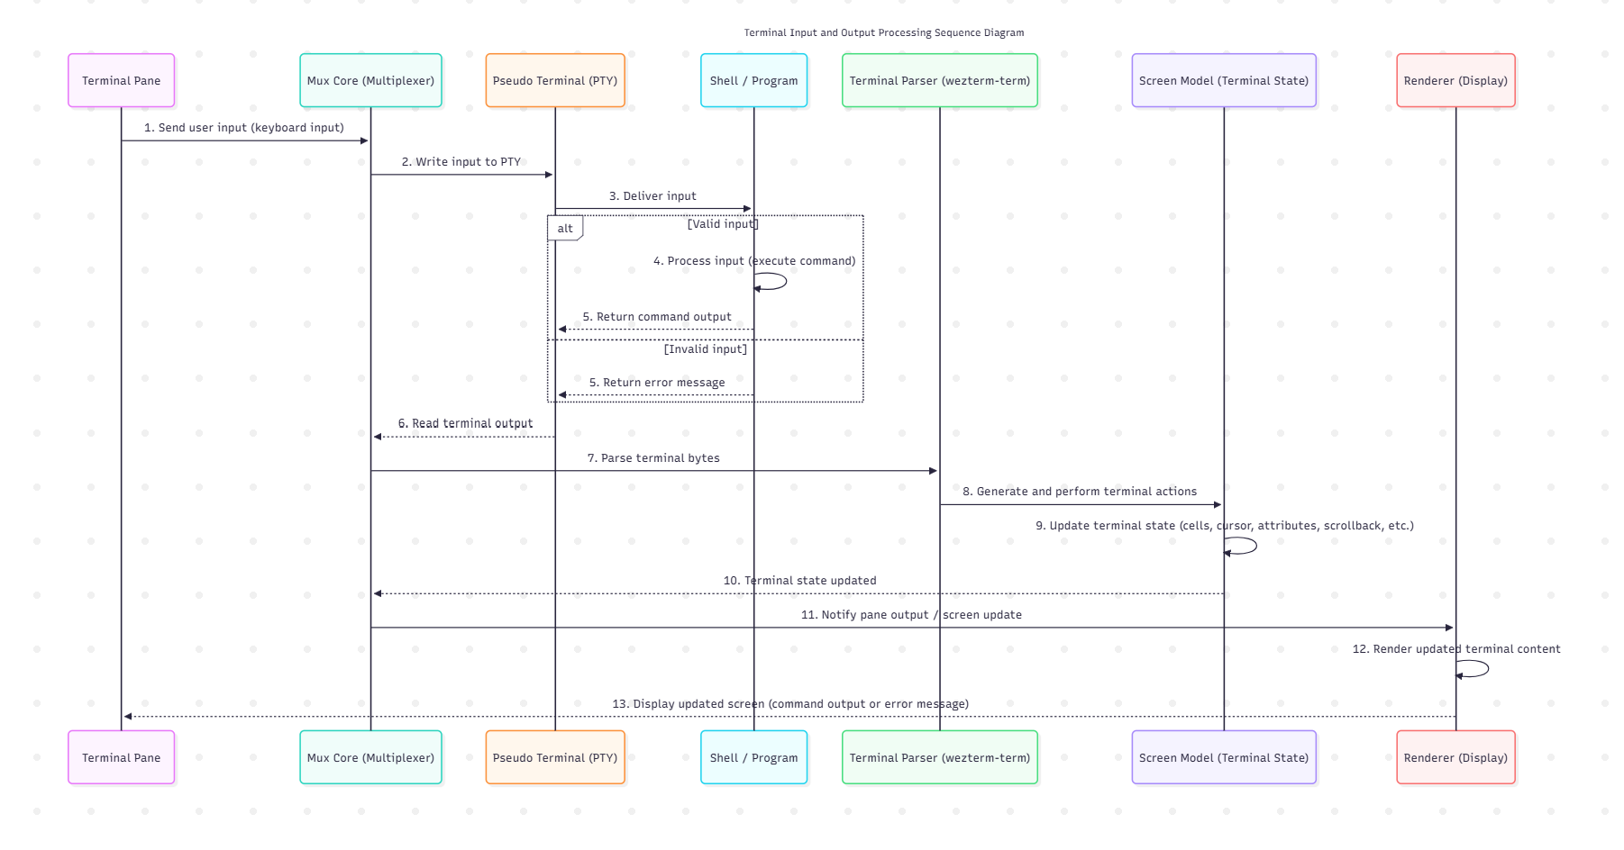
UC-02: Original Sequence Diagram
19
Notes:
中文讲解：使用上传的Kernel Processing原图，讲解13步流程。parser执行控制序列，screen model保存cells、cursor、attributes与scrollback，renderer显示内容。
Source: image(20261005-190012).png; CISC 322 Assignment 1 Report(1).pdf, UC-02

Slide 21
Conclusion and Lessons Learned
Six subsystems separate session management, interaction, terminal processing, rendering, configuration, and connections
The multiplexer coordinates local and remote sessions independently of presentation
Architecture recovery groups documented features into meaningful responsibilities
Shared terminology and subsystem boundaries help integrate team contributions
A2 will verify implementation details and compare concrete architecture with this model
20
Notes:
中文讲解：六个子系统分离会话、输入、模拟、渲染、配置与连接职责。mux协调本地远程工作。概念恢复需要归纳职责并统一术语，避免把不确定实现当成事实。A2将比较源代码实现。
Source: CISC 322 Assignment 1 Report(1).pdf

Slide 22
References
WezTerm Features and Configuration
wezterm.org/features.html • wezterm.org/config/files.html
Multiplexing, SSH, and Serial Ports
wezterm.org/multiplexing.html • wezterm.org/ssh.html
wezterm.org/config/lua/config/serial_ports.html
Mux API and Lua Events
wezterm.org/config/lua/wezterm.mux/index.html
wezterm.org/config/lua/wezterm/on.html
Rendering, Keyboard Encoding, and Change Log
wezterm.org/config/lua/config/front_end.html
wezterm.org/config/key-encoding.html • wezterm.org/changelog.html
21
Notes:
References reproduced from the supplied group report. Also: https://wezterm.org/install/source.html; https://wezterm.org/config/lua/pane/; https://wezterm.org/what-is-a-terminal.html; https://github.com/wez; https://mynixos.com/nixpkgs/package/wezterm; Angela (2026, May 14), https://wezterm.com/2026/05/14/what-is-wezterm-used-for/. Official documentation retrieved October 3–4, 2026 as stated in the report.

