Slide 1
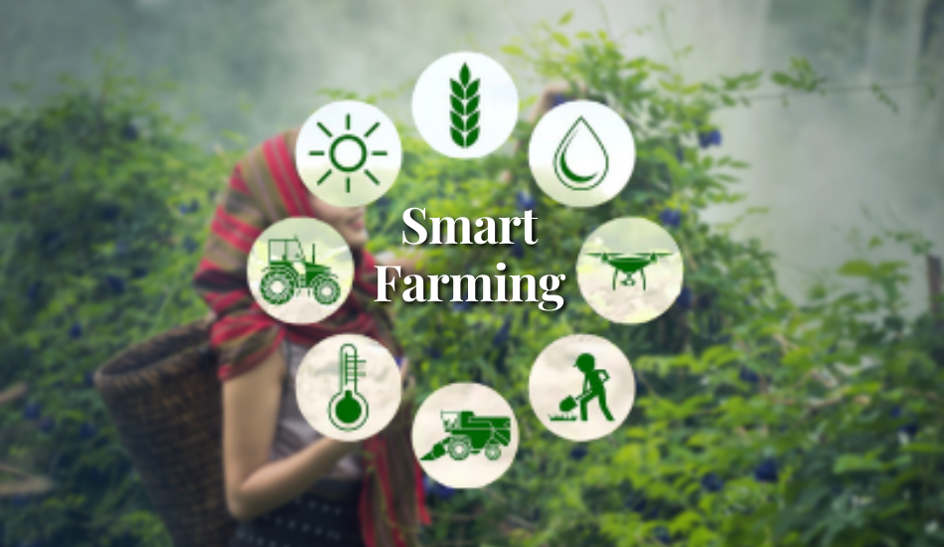

Slide 2
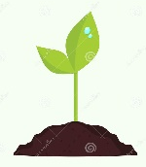
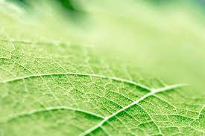
About Team
Our Product Name Is Avand
Optimization Of Farming method
Group Farm Iran Team

Slide 3






Problem
According to the way of maintaining the greenhouses as you can see in the figure below,
it leads to an excessive increase in water consumption and damage to the greenhouses.
water shortage
Improper storage
Damage to plants

Slide 4
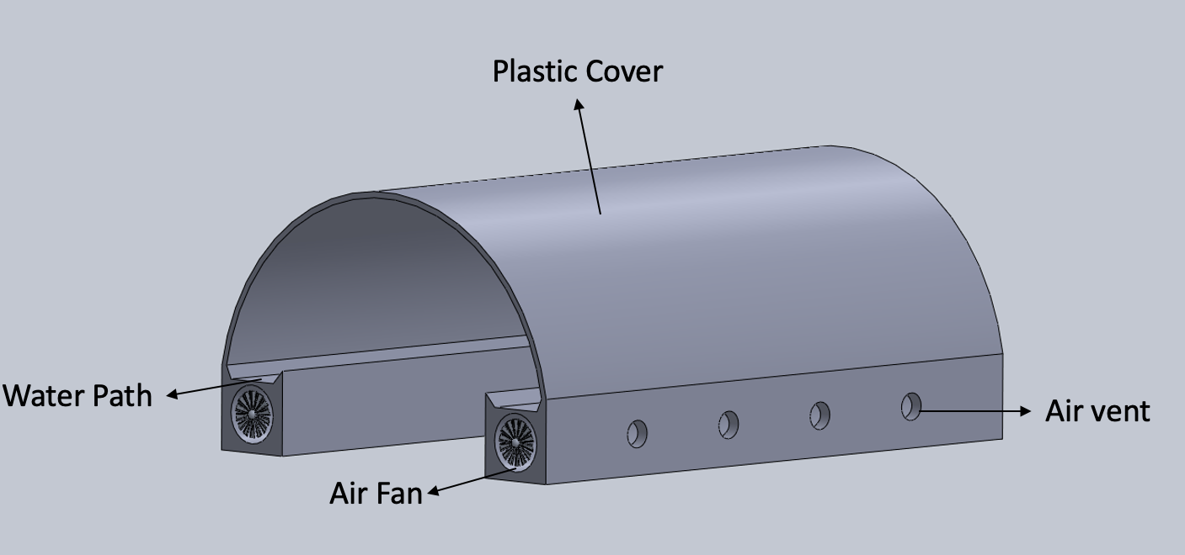

solution
Structure And Mechanical

Slide 5
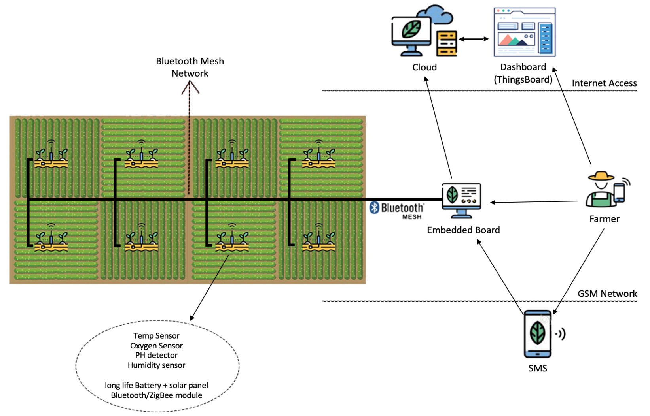
solution
Data and IOT
Our infrastructure contains four different parts:
Sensor Nodes : packed sensors together associated with a Bluetooth or ZigBee module and a long-life battery
Network : Bluetooth mesh network
Edge Node
Accessibility Options : Cloud and GSM network

Slide 6

Market
The primary requirement of our product is drip irrigation and a smartphone, which according to the
following comprehensive information includes a great purpose.
1.3 million hectares of agricultural land are available for planting syfijat
(according to the report of the Agricultural Jihad Organization)
2) It had 4.4 million hectares of irrigated land, of which approximately 77% was used by traditional
methods and the remaining 23% was under irrigation (according to the (FAO) report in 2019).
3) Hormozgan, 70% of its agricultural lands benefit from drip irrigation (according to the report
of the Deputy Minister of Water and Soil, Ministry of Agricultural Jihad, 2023).
4) The number of active mobile phone subscribers in Iran is about 102 million people, which represents
a penetration rate of 123.2% of the population (according to the report of the Iranian Statistics Center
in 2020).

Slide 7
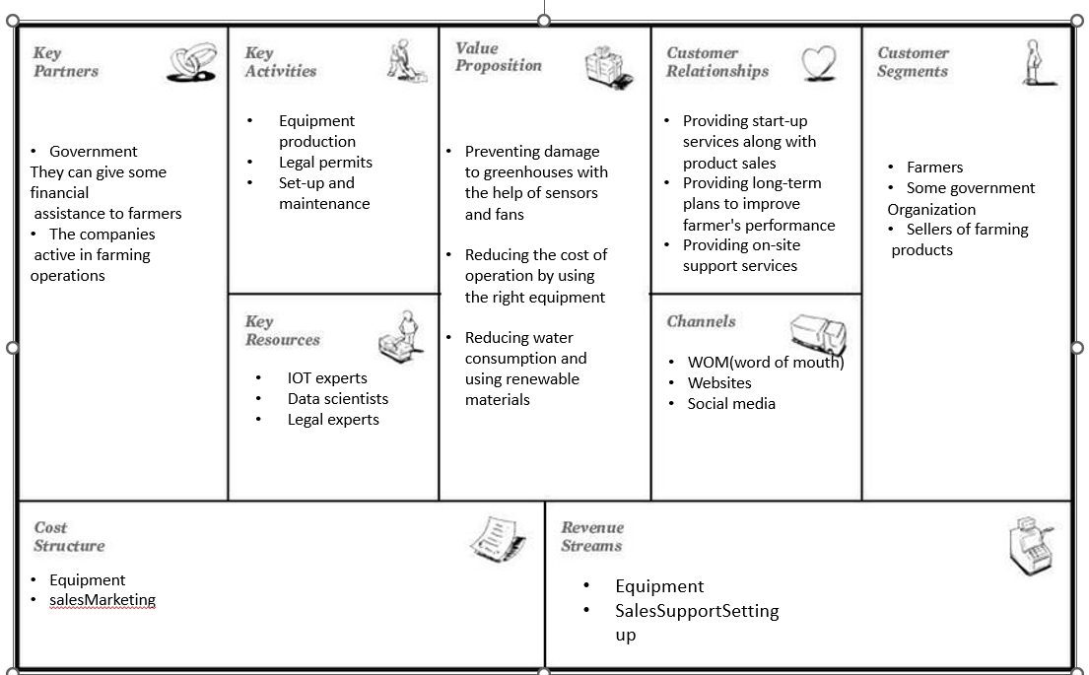
Business plan

Slide 8
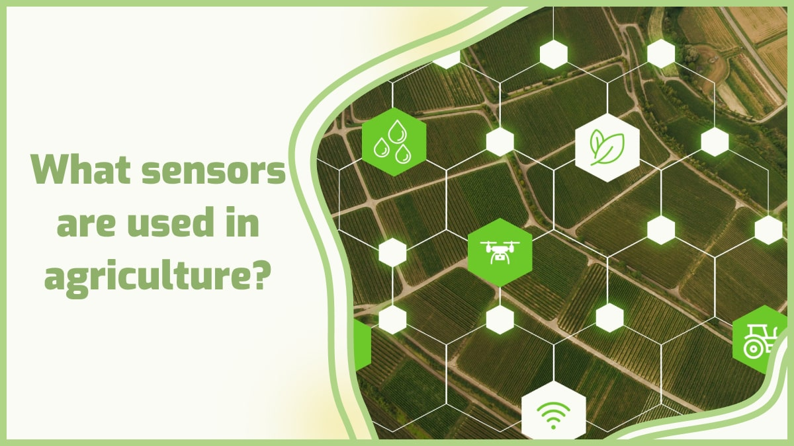
Product Feature
Controls temperature and heat with IOT sensors
By using the stored data, a more appropriate solution can be found to produce more and
more healthy products in the future Intelligent
Air circulation setup
Scalable : Can work different sensor with different price and setup simply
Long lifetime and Low maintenance cost
Low maintenance cost

Slide 9
Next Step
We tried our product to cover all aspects of technology and to be simple,
accessible and low-cost for farmers
We can use image processing to analyze the health of the product to take preventive measures when it is rotting
improving the condition of plants and crops with the help of collected data
Production of sensors with long life and high resistance
Trying to build a highly scalable product
Construction of a resistant and renewable protection chamber

Slide 10
Team Member
Our team are expertised in the field of data, IOT, software, law and business
Legal field : Erafan Feiz
Business field : Mohammad Hossein Marzdar
Data : Farzaneh Fallahpour and Ghazale keyvani
IOT : Rasoul Bousaeedi , Mahdi Vafaei and Sepehr Voroodi
Electricity : Elnaz Tavakkoli and Hossein Miyar

Slide 11

Save Earth
Save Life

