Slide 1
Probability Calibration
for Reliable Deep Learning
Hae Beom Lee

Slide 2
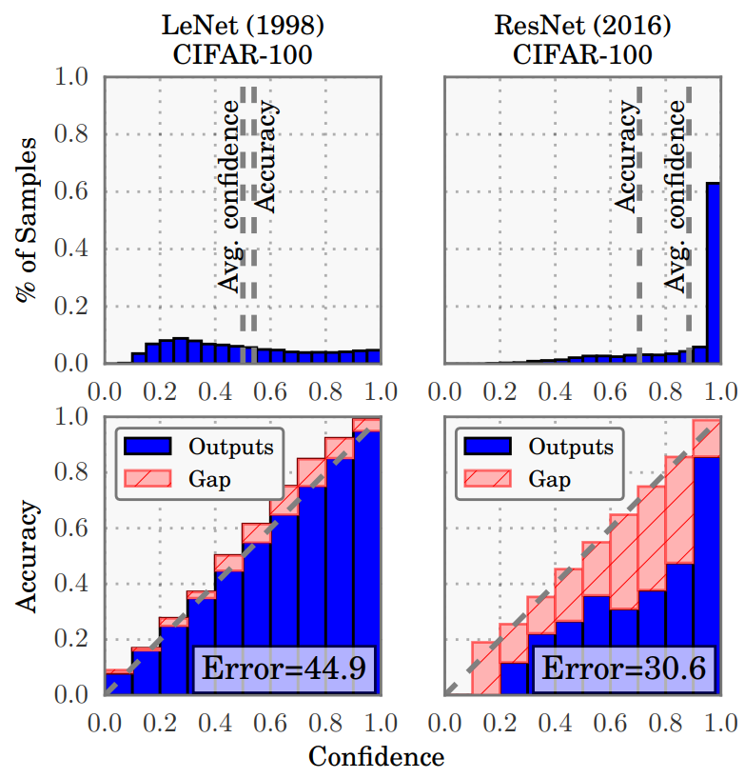
Calibration
Model confidence should be equal to actual accuracy, but it’s not for modern NN.
Guo et al., On Calibration of Modern Neural Networks, ICML 2017
https://arxiv.org/pdf/1706.04599.pdf

Slide 3
Calibration
Why important?
→ 인간이 model prediction 을 해석할 때 얼만큼 믿을 것인지 알 수 있다.
Guo et al., On Calibration of Modern Neural Networks, ICML 2017
https://arxiv.org/pdf/1706.04599.pdf

Slide 4
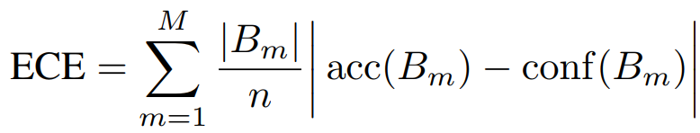
Expected Calibration Error
Expected gap between accuracy and model confidence.
Total M bins
Each bin‘s average
accuracy
Each bin‘s average
confidence
Each bin’s weight
Guo et al., On Calibration of Modern Neural Networks, ICML 2017
https://arxiv.org/pdf/1706.04599.pdf

Slide 5
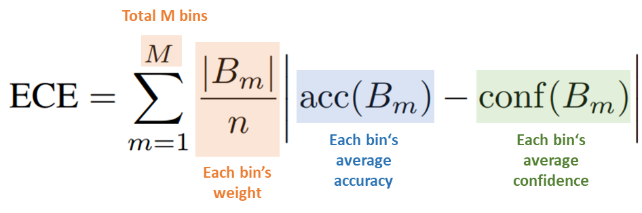
ECE (binary)
답이 1 이라고 예측할
Model output
0.9 | 0.4 | 0.3 | 0.2 | 1.0 | 0.7 | 0.8 | 0.1 | 0.3 | 0.6
Label
1 | 0 | 1 | 1 | 1 | 0 | 1 | 1 | 1 | 1
Predicted class
1 | 0 | 0 | 0 | 1 | 1 | 1 | 0 | 0 | 1
Confidence
0.9 | 0.6 | 0.7 | 0.8 | 1 | 0.7 | 0.8 | 0.9 | 0.7 | 0.6
Correctness (0/1)
1 | 1 | 0 | 0 | 1 | 0 | 1 | 0 | 0 | 1

Slide 6
ECE (binary)
Predicted label
1 | 0 | 0 | 0 | 1 | 1 | 1 | 0 | 0 | 1
Confidence
0.9 | 0.6 | 0.7 | 0.8 | 1 | 0.7 | 0.8 | 0.9 | 0.7 | 0.6
Correctness (0/1)
1 | 1 | 0 | 0 | 1 | 0 | 1 | 0 | 0 | 1
accuracy
0.5
0~0.25
0.25~0.5
0.5~0.75
0.75~1.0
confidence

Slide 7



ECE (binary)
Predicted label
1 | 0 | 0 | 0 | 1 | 1 | 1 | 0 | 0 | 1
Confidence
0.9 | 0.6 | 0.7 | 0.8 | 1 | 0.7 | 0.8 | 0.9 | 0.7 | 0.6
Correctness (0/1)
1 | 1 | 0 | 0 | 1 | 0 | 1 | 0 | 0 | 1
$$acc\left(B_{1}\right)=0.4$$
accuracy
Gap: 0.26
$$conf\left(B_{1}\right)=0.66$$
0.5
Acc: 0.4
$$gap\left(B_{1}\right)=\left|0.4−0.66\right|=0.26$$
0~0.25
0.25~0.5
0.5~0.75
0.75~1.0
confidence

Slide 8



ECE (binary)
Predicted label
1 | 0 | 0 | 0 | 1 | 1 | 1 | 0 | 0 | 1
Confidence
0.9 | 0.6 | 0.7 | 0.8 | 1 | 0.7 | 0.8 | 0.9 | 0.7 | 0.6
Correctness (0/1)
1 | 1 | 0 | 0 | 1 | 0 | 1 | 0 | 0 | 1
$$acc\left(B_{1}\right)=0.6$$
Gap: 0.28
accuracy
Gap: 0.26
$$conf\left(B_{1}\right)=0.88$$
0.5
Acc: 0.6
$$gap\left(B_{1}\right)=\left|0.6−0.88\right|=0.28$$
Acc: 0.4
0~0.25
0.25~0.5
0.5~0.75
0.75~1.0
confidence

Slide 9
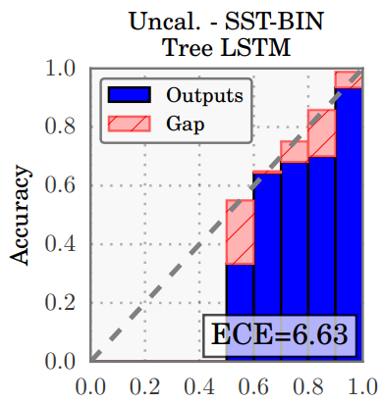
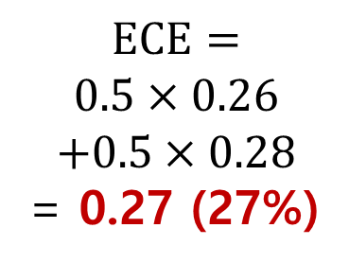
ECE (binary)
$$ECE=$$
$$0.5×0.26$$
$$+0.5×0.28$$
= 0.27 (27%)
Gap: 0.28
accuracy
Gap: 0.26
0.5
Acc: 0.6
Acc: 0.4
0~0.25
0.25~0.5
0.5~0.75
0.75~1.0
confidence

Slide 10






Total M bins
ECE (Multi-class)
Each bin‘s average
accuracy
Each bin‘s average
confidence
Each bin’s weight
Binary case 와 같이 Maximum confidence 인 class 에 대해서 ECE 계산.
Model output
$$k=1$$
0.8 | 0.2 | 0.3
$$k=2$$
0.1 | 0.1 | 0.3
Predicted class
1
3
3
$$k=3$$
0.1 | 0.7 | 0.4
confidence
0.8 | 0.7 | 0.4
label
$$k=1$$
1 | 0 | 0
Correctness (0/1)
1 | 1 | 0
$$k=2$$
0 | 0 | 1
$$k=3$$
0 | 1 | 0
나머지는 binary 와 동일

Slide 11
Total M bins
실습
Each bin‘s average
accuracy
Each bin‘s average
confidence
Each bin’s weight
주어진 numpy array 를 가지고 ECE 계산.
git clone github.com/haebeom-lee/ece_samsung

Slide 12
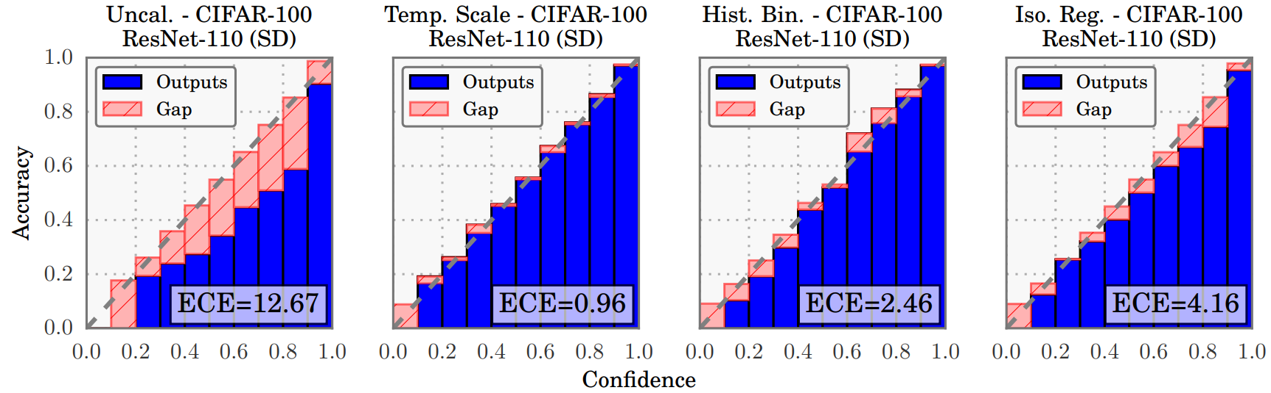

Temperature Scaling
Most simple, efficient and effective method for calibration.
$$p\left(y | x;T\right)←softmax(z(x)/T)$$
Validation set 을 이용해서 $T 를$ validation loss 에 fitting 시킴.
즉, temperature scaling 으로 너무 overconfident 한 예측을 바로잡는다.
(Training set 만으로는 불가능(?)함.)

Slide 13
Assignment: Temperature Scaling
LeNet 을 MNIST-1000 에 학습시킨 후 ECE 계산
100개 example 로 이루어진 validation set 으로 temperature scaling 한 후 ECE 비교.

