Slide 1
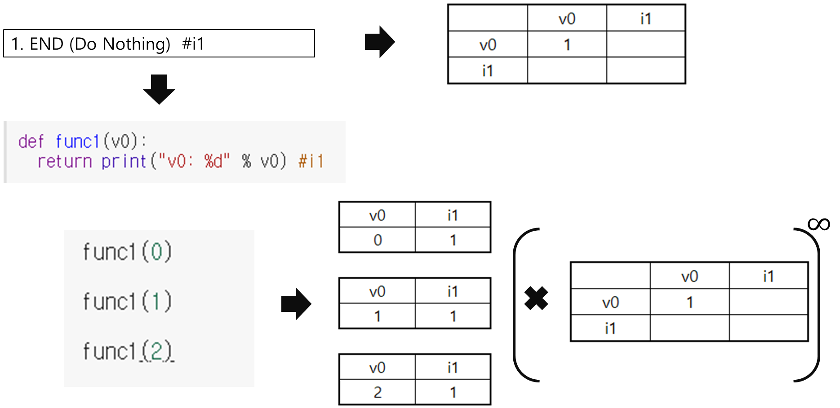
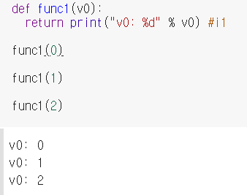

Slide 2
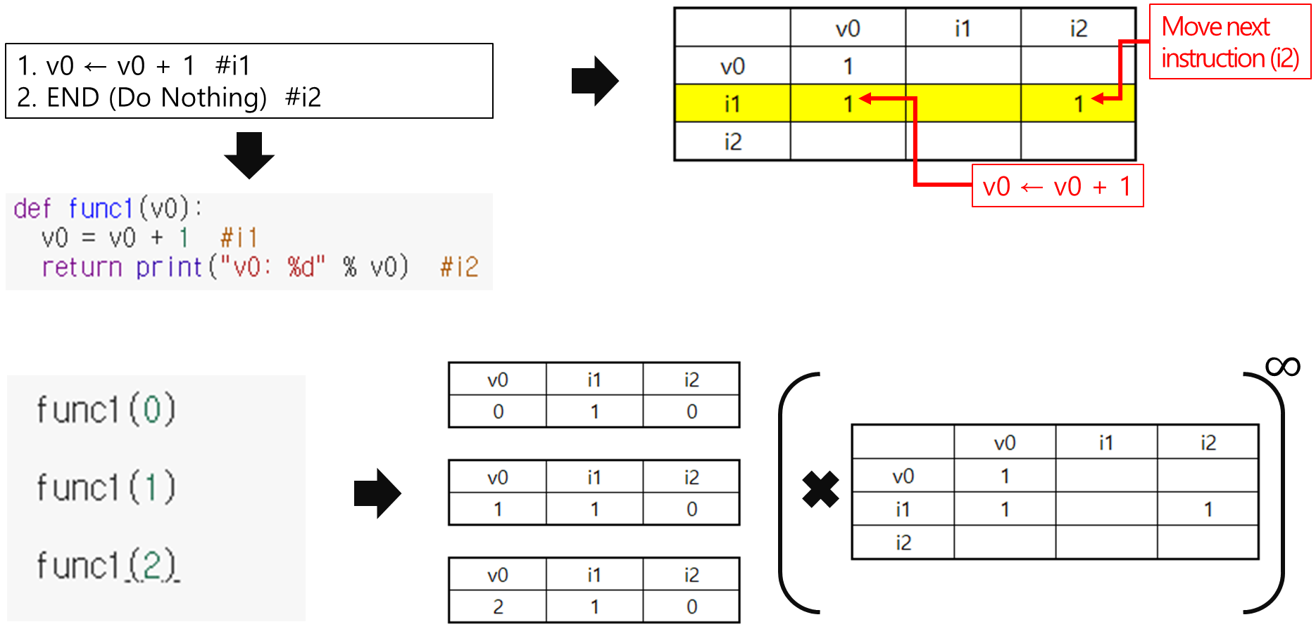
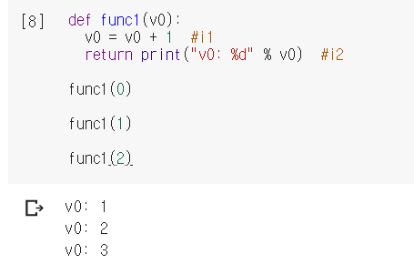

Slide 3
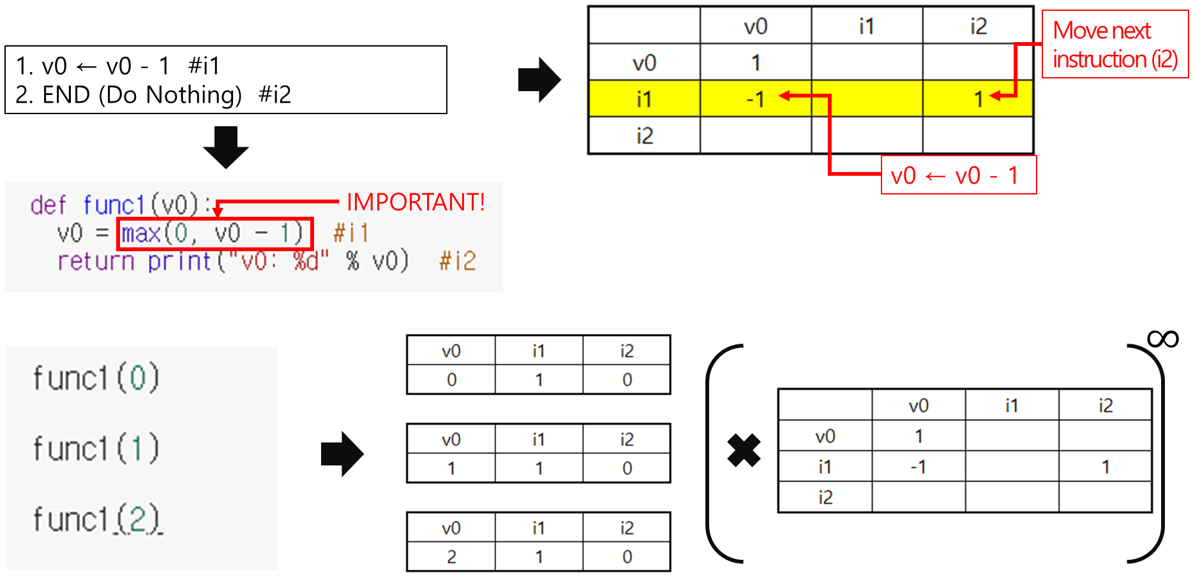
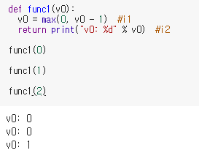

Slide 4
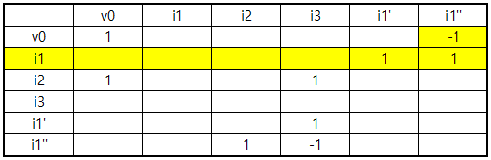
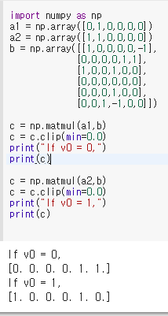

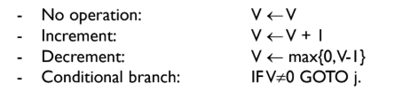
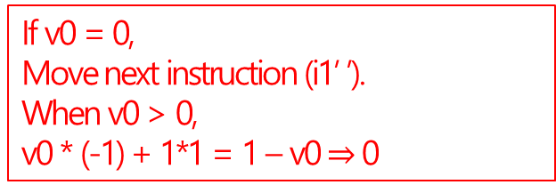
1. IF v0 ≠ 0 GOTO 3 #i1
2. v0 ← v0 + 1 #i2
3. END (Do Nothing) #i3
Move next instruction (i1’)
If v0 = 0,
Move next instruction (i1’ ’).
When v0 > 0,
v0 * (-1) + 1*1 = 1 – v0 $⇒$ 0

Slide 5
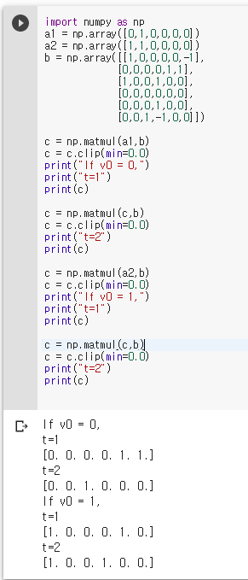
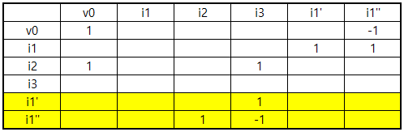
If v0 = 0,
Move next instruction (i2)
If v0 ≠ 0,
Move next instruction (i3)

Slide 6
