Slide 1
DataScience.com
Take Home Assessment Analysis
By Brian Porter

Slide 2
Question #1
Is coupon usage increasing or decreasing on Status Indicator products? In addition to any visualizations you choose to provide, please quantify your results in numerical terms.

Slide 3
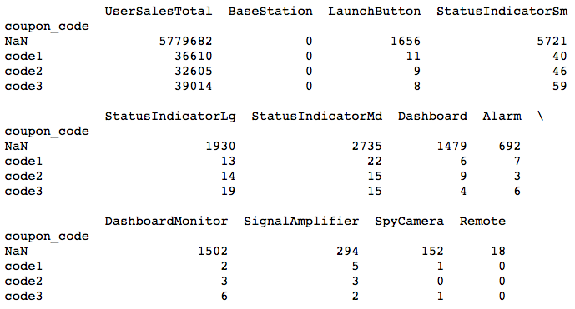
Coupon Distribution
- Despite the Status Indicators getting the bulk of the coupon uses, we will see that sales do not seem to be heavily effected

Slide 4
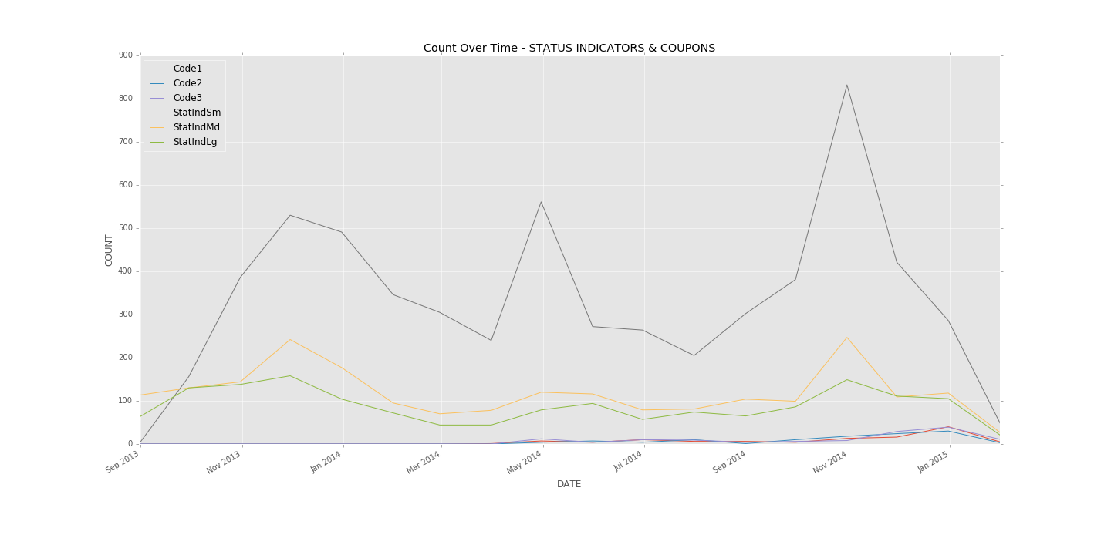
Chronological Graph of Status Indicator Sales and Coupon Uses
Looking at the graph there does not seem to be a solid correlation between coupon uses and Status Indicator sales.
Despite a large increase from the first to second holiday season, the rise of coupon offerings does not seem to directly affect sales. If anything the coupons seem to reduce demand for status indicators towards the end of the dataset.

Slide 5
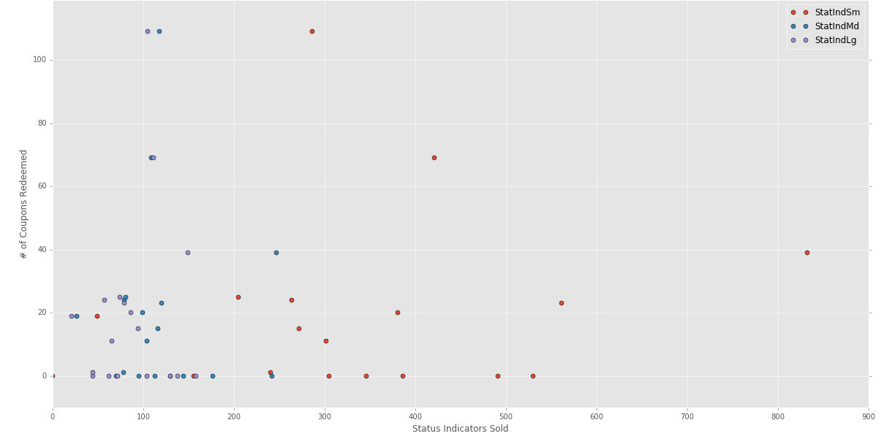
Relational Graph – Status Indicators vs. Coupons
-As the Status Indicators sold increases, the coupons redeemed do not seem to do the same
-There is no apparent correlation between the two
Each dot indicates one month X-axis: Status Indicators Sold Y-axis: Coupons Redeemed

Slide 6
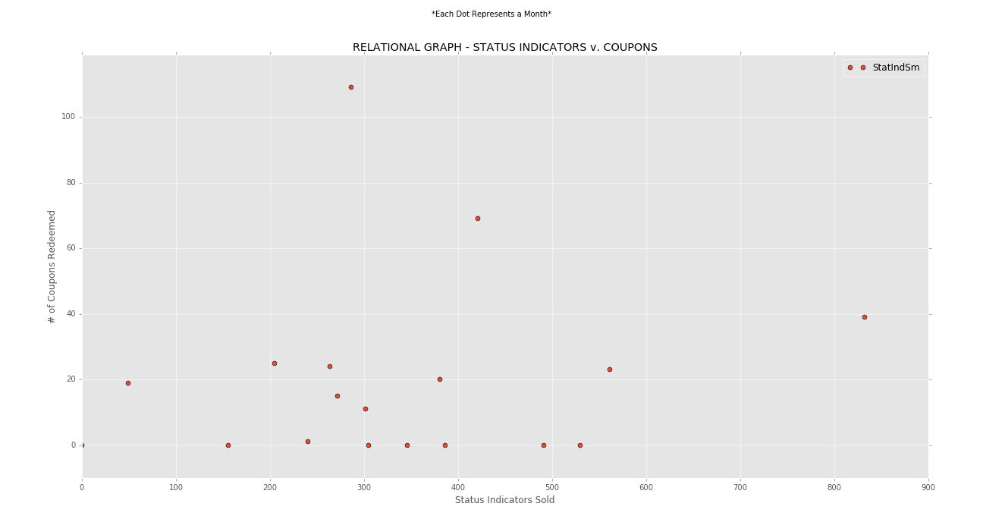
Relational Graph – Small Status Indicators vs. Coupons
-Looking at just Small Status Indicators, there are almost as many months that are sold without coupons as with (7 vs. 10)
-Even when coupons are redeemed that does not have any link to increased sales volume

Slide 7
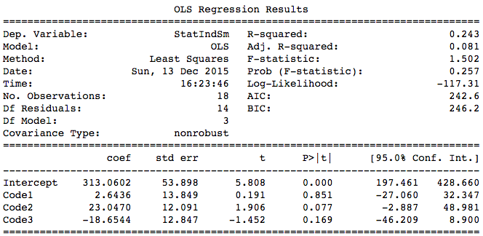
Linear Regression – Small SI’s Sold vs.. Coupons Used
The R-Squared is low, indicating the predictive model does not fit the data very closely
The P-Values are all above .05 which also indicate that the coupons do not have a great effect on sales

Slide 8
Answer #1
Looking at the data both visually and numerically, there does not seem to be a strong correlation between coupon use and increased sales for Status Indicators.
The Status Indicators received a strong boost during the holiday season in comparison to last year however, this does not seem to be a result of the coupons despite the Small Status Indicator receiving the bulk of the coupon usages.

Slide 9
Question #2
FutureHome is looking to increase repeat customers. Are there products that appear to encourage further sales?

Slide 10
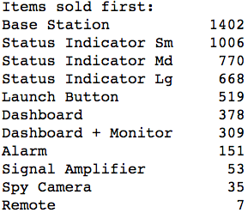
SubQ1: Which items are sold first?
The Base Station is the most likely to be sold first purchase for users that buy 2 or more items.
Users that purchase of two or more items make up 63.19% of total purchases and 63.65% of total revenue.

Slide 11
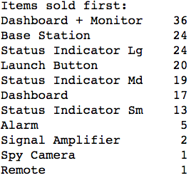
SubQ2: Which item is most prominent in high purchase counts?
Item distribution for individuals who made nine or more purchases
These purchases make up 3.35% of total purchases and 3.98% of revenue.
Dashboard + Monitor becomes the most common item for users with high item purchase counts.

Slide 12
Answer #2
The Base Station is the product most associated with customer purchases of two or more.
The Dashboard + Monitor is most associated with power users with 9 or more purchases.

Slide 13
Question #3
What is the most valuable customer segment between Best Buy, Status Indicator Sm, and Holiday shoppers?

Slide 14
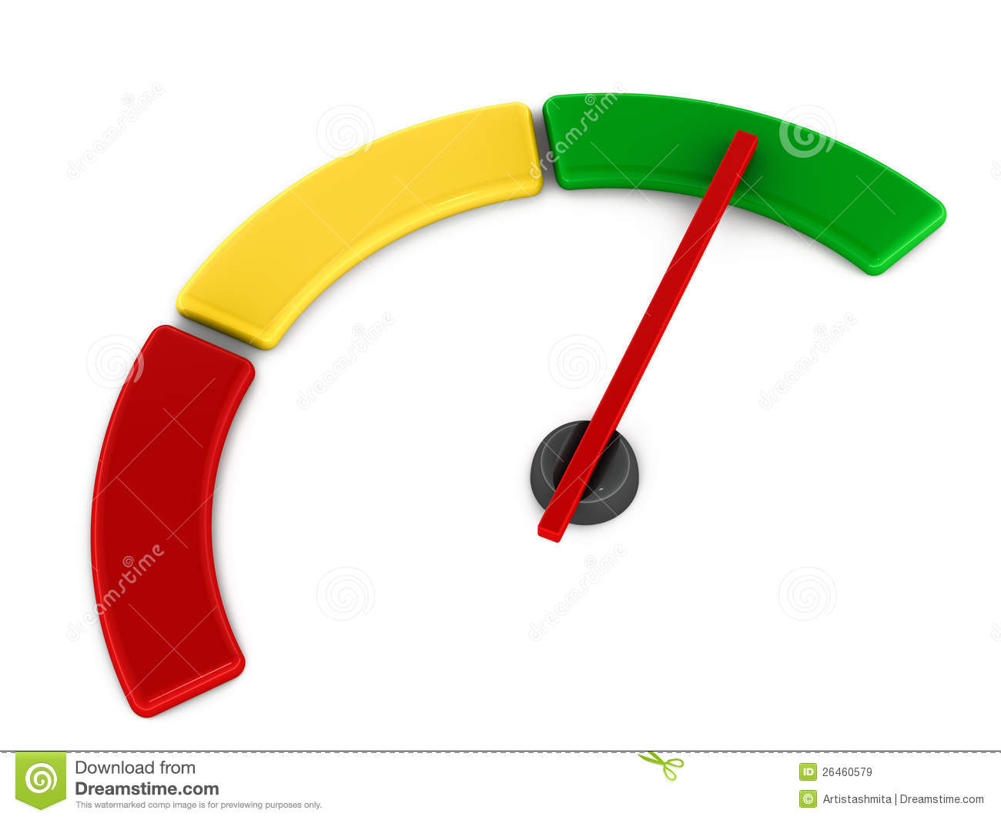
Small SI Customer Segment (third place)
Segment Total Value = $1,190,798
Total Transactions = 5,866
Unique User Purchases = 3,688
Average Spend/User = $323
Coupon Utilization/Customer = 3.93%

Slide 15

Best Buy Customer Segment (second place)
Segment Total Value = $390,611
Total Transactions = 1,286
Unique User Purchases = 695
Average Spend/User = $562
Coupon Utilization/Customer = 0%

Slide 16

Holiday Customer Segment (first place!)
Segment Total Value = $2,116,635
Total Transactions = 6,476
Unique User Purchases = 3,706
Average Spend/User = $571
Coupon Utilization/Customer = 5.4%

Slide 17
Answer #3
The most valuable customer segment is the holiday shopper with an average spend of $571/user.
This shopper segment also has the highest rate of coupon utilization suggesting that customers would appreciate coupons as a reward for brand loyalty more so than the other segments.

Slide 18
Question #4
What is the ideal coupon?

Slide 19
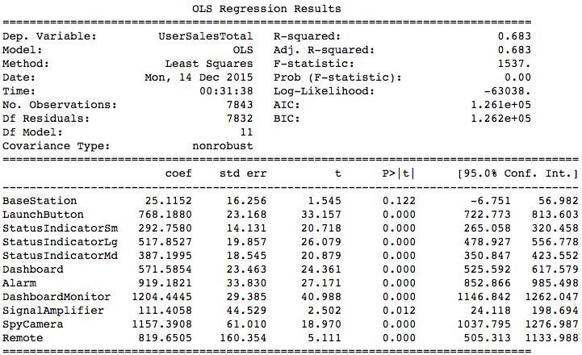
Linear Regression – Lucrative User Item Commonalities
-Using linear regression, we are able to distinguish a trend between Dashboard + Monitor purchases and the most lucrative user.
-The predictive model fits the data rather well by looking at the R-Squared, P-Value, and the Confidence Intervals
- The Coefficient notes that if an user buys a Dashboard Monitor their worth raises by $1,228, more than any other item.

Slide 20
Answer #4
Considering the first go of coupons did not seem to have a beneficial impact on sales growth it would seem best to withhold the offerings of coupons unless to reward and encourage customer loyalty.
If FutureHome is set on offering coupons it would seem the best use would be for items most closely correlated with multiple sales and lucrative users:
The best coupon to offer would be for the Dashboard + Monitor. The customer of this item is associated with both repeat business and being the most valuable so incentivizing sales for this item could drive up sales for others.
The second best would be for the Base Station. Given that it seems to be the best entry item for users who purchase between 2 and 8 items, this could be a cheap way to encourage sales of other products.

Slide 21
The End
Thank you for the opportunity to work on this assessment!
It has been a lot of fun ☺

