Slide 1
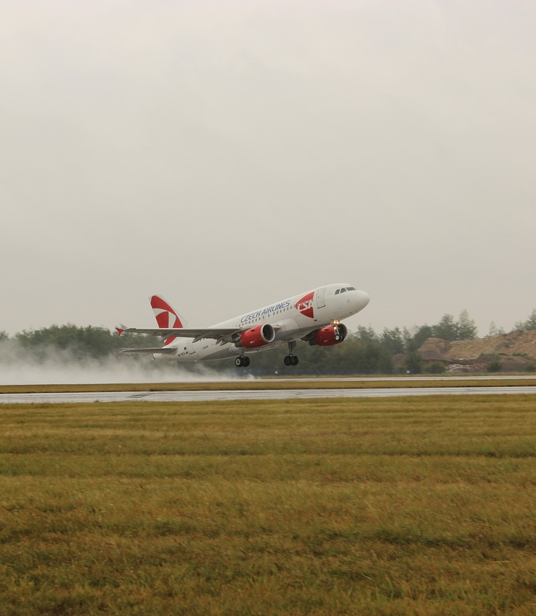
Avionics Safety Report
WHITLEE PEARSON
JAY IRAJ
RIGAT ASHEBIR

Slide 2
Outline
Problem Statement
Values
Data Understanding
Result
Conclusion

Slide 3
Problem Statement
Our team was asked to provide recommendations based on avionics safety data so that our company can establish a profitable and safe avionics department

Slide 4
values
Post avionics department setup, our responsibility shifts to lives or goods, impacting future fiscal outcomes.

Slide 5
Data Understanding
Injury severity rating
Minor | 1
Serious | 2
Fatal | 3
Location based analysis

Slide 6
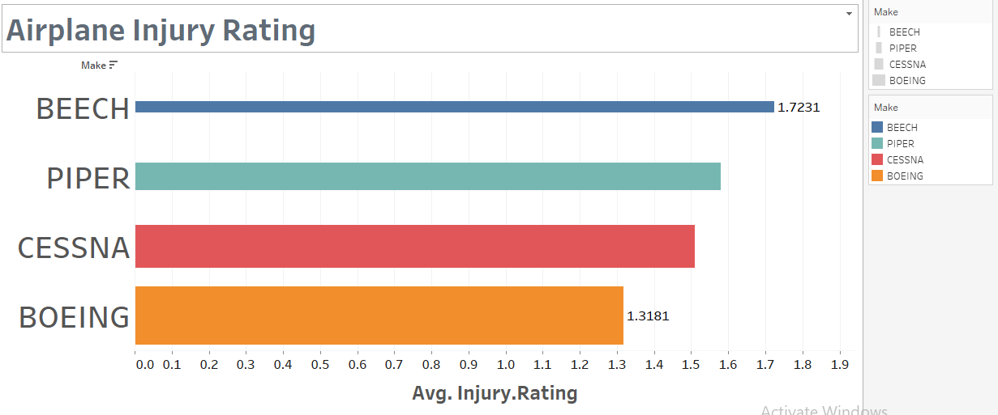
Result

Slide 7
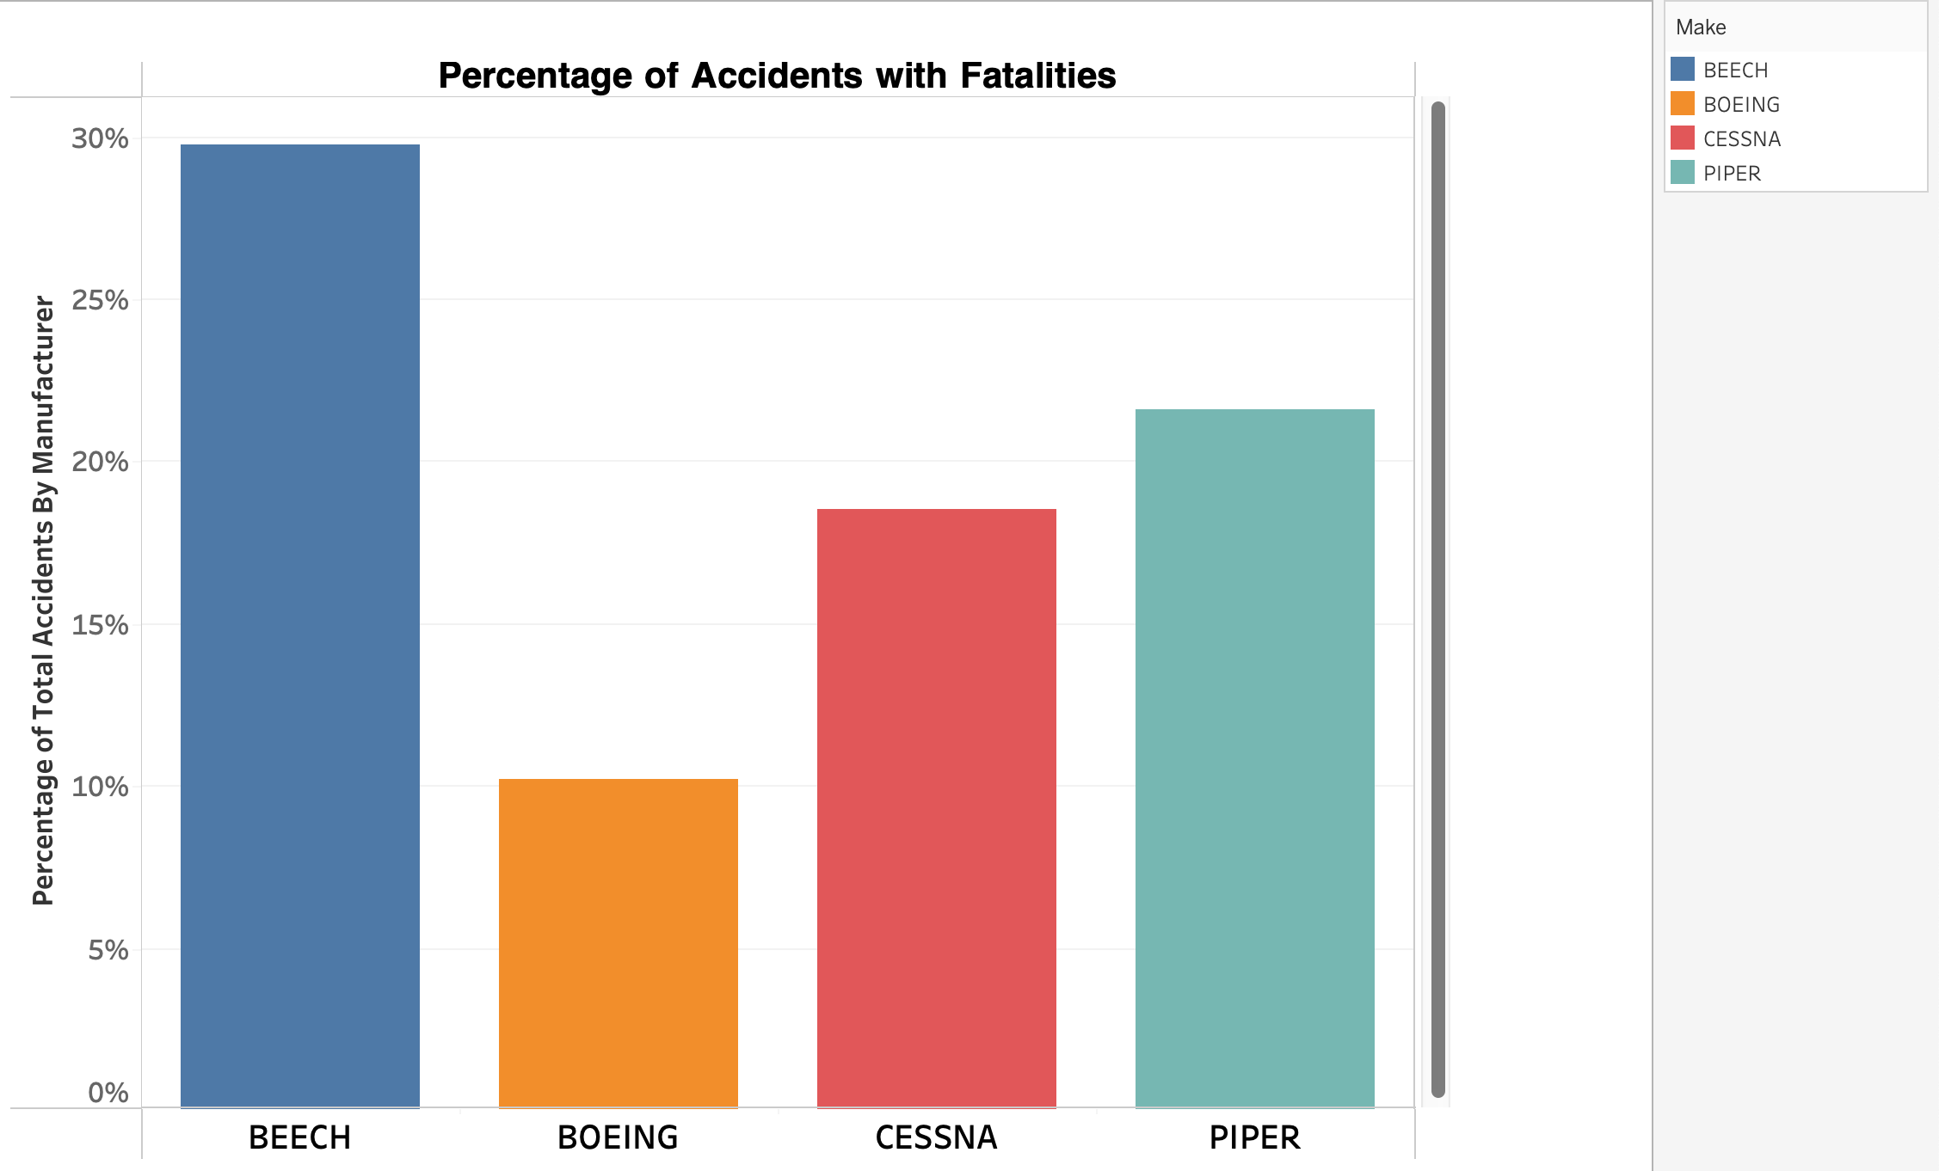
Result

Slide 8
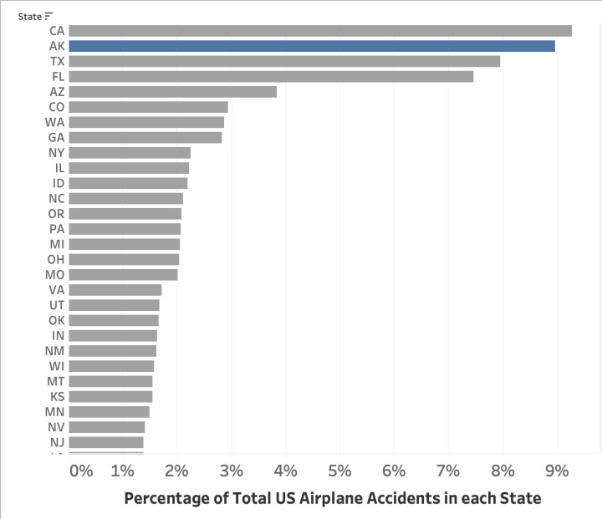
Result

Slide 9

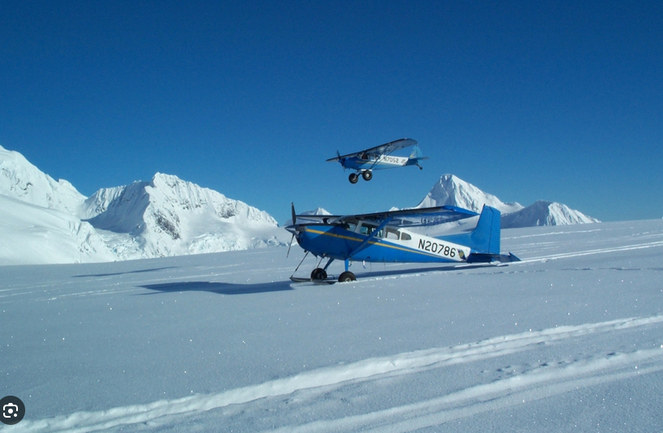
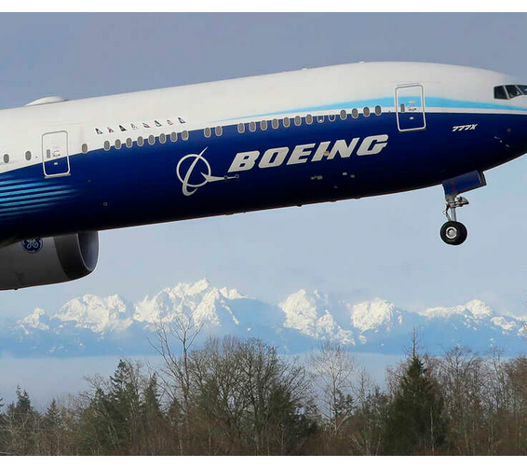
Conclusion
Beech has the least favorable safety record
we recommend avoiding operations in that state of Alaska where possible.
Boeing stands out as the most robust safety record

Slide 10

Thank you

